Slide 1

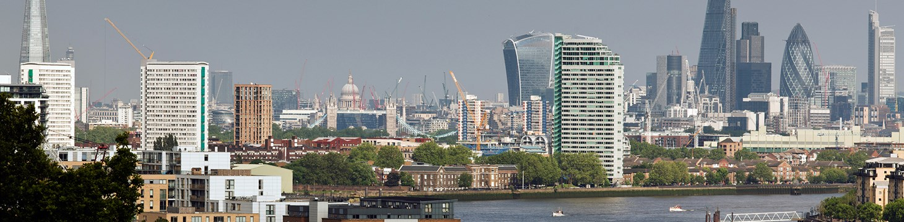
Development Pressures in urban World Heritage Sites
Perspective from Historic England
Duncan Wilson
Chief Executive

Slide 2
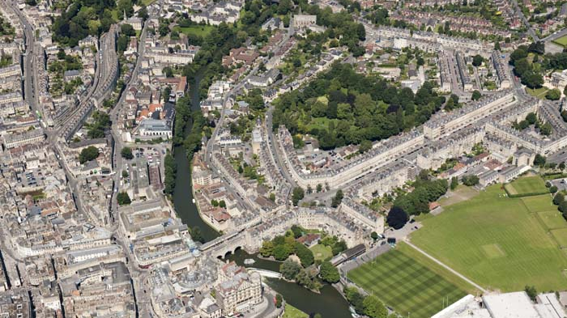

Slide 3
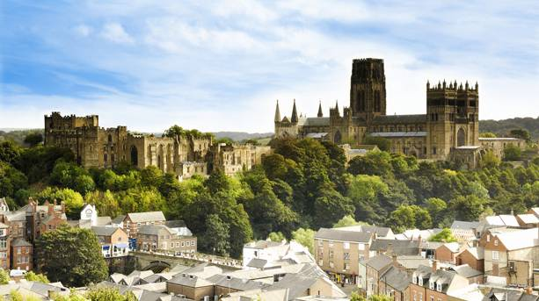

Slide 4
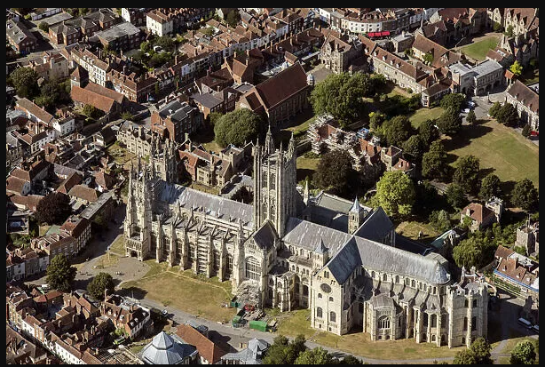

Slide 5
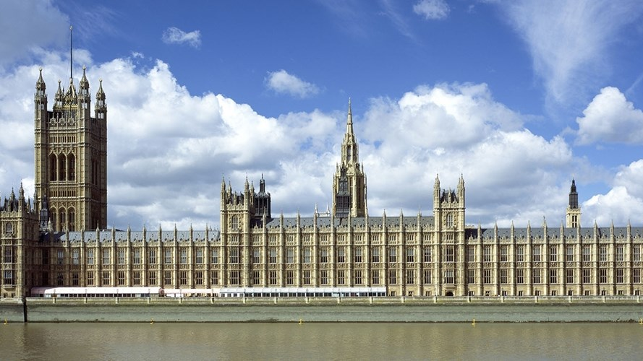

Slide 6
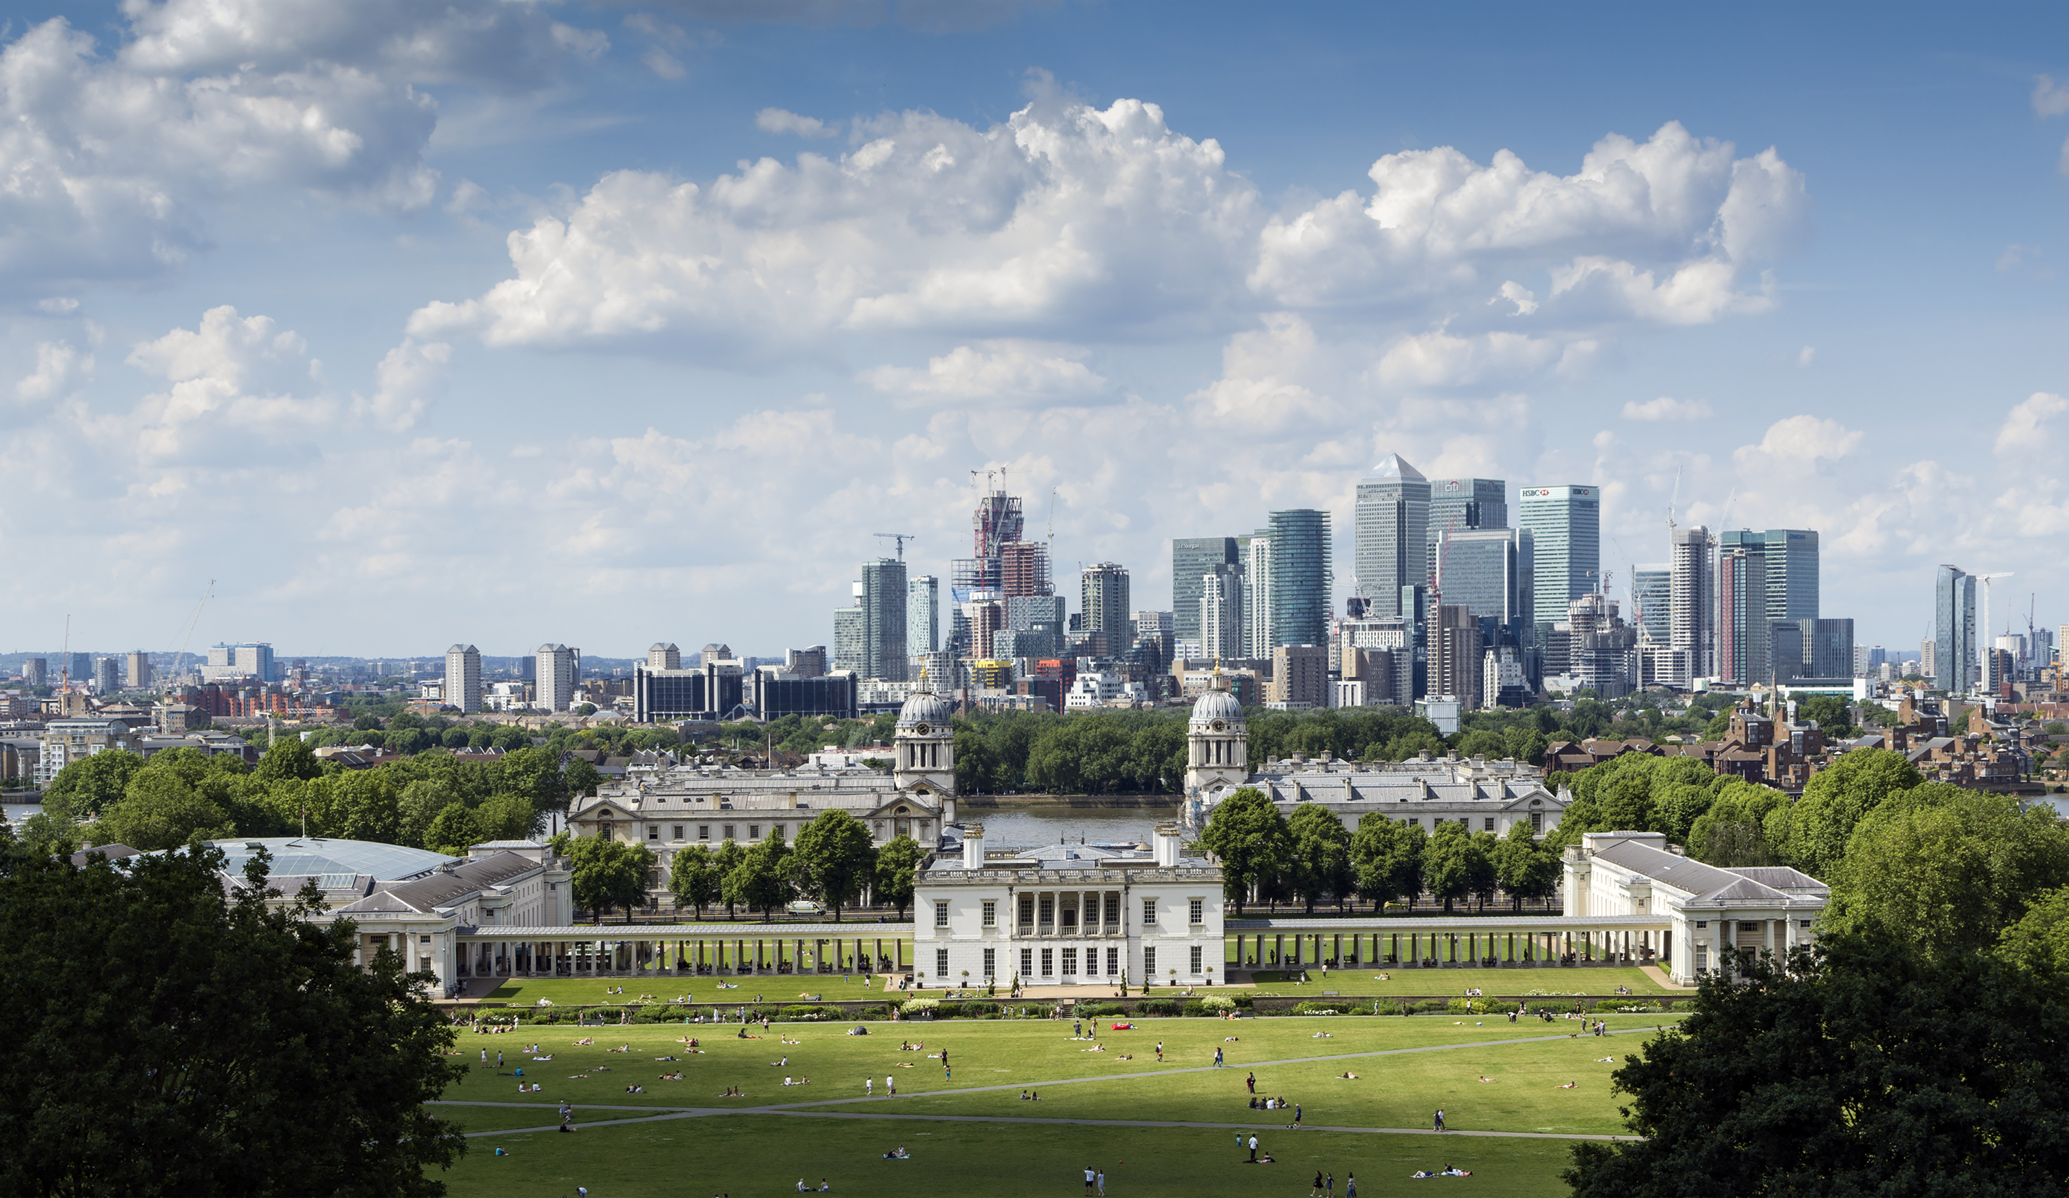

Slide 8
https://historicengland.org.uk/international

