Slide 1
Who, how, why do we remember?
This PowerPoint relates to this Teaching Activity: https://historicengland.org.uk/services-skills/education/teaching-activities/who-how-why-do-we-remember

Slide 2
Who, how, why do we remember?
Key Stage 3: History
Learning Aims and Outcomes (Overall)
To encourage students to investigate the reasons why monuments and memorials are put up and to think about their purpose
To develop students’ critical thinking skills, helping them reflect on the reasons decisions were made by people in the past, by exploring the background to those decisions
To help students to understand, contemplate and develop their own emotional responses to statues, monuments and memorials
To enable students to use a range of sources to learn about their past, help them understand the present and reach decisions for themselves
This PowerPoint relates to this Teaching Activity: https://historicengland.org.uk/services-skills/education/teaching-activities/who-how-why-do-we-remember
Notes:
Although this PPT is written as a teacher-led classroom presentation, it is designed so that all the activities and research tasks within it could be done by students as part of their home learning.

Slide 3
Who, how, why do we remember?
Key Stage 3: History
Note to teachers:
The following resources all relate to public statues and memorials. They have been divided into a series of ‘themes’ (listed below) which can be looked at consecutively or as a ‘pick & mix’ of stand alone, or combined, activities.
The themes covered are:
Introduction: ‘Immortalised’
The ‘Great and Good’
Difficult Histories
Everyday People
LGBTQI (Lesbian, Gay, Bisexual, Transgender, Queer and Intersex)
Ethnic Diversity
Women
Disability Representation
This PowerPoint relates to this Teaching Activity: https://historicengland.org.uk/services-skills/education/teaching-activities/who-how-why-do-we-remember
Notes:
We are aware that looking at these topics through themes or as a list is not ideal and that the best way to look at these topics would as part of a blended learning scheme of work. We hope the information in the following slides can be easily adapted/incorporated into your own schemes of work.

Slide 4
1. Introduction
This theme encourages students to address the following questions:
What do we mean by ‘immortalised’?
How and why do we remember?
What is the purpose of statues, monuments and memorials? Why do we put them up?
What are the most common types of statues, monuments and memorials?

Slide 5
1. Introduction: ‘Immortalised’
What does ‘immortalised’ mean?
Which definitions are the most appropriate for statues/memorials?
To make immortal
To give unending life to
To bestow unending fame upon
To make famous forever
Notes:
Ask students to think about what the word might mean. Encourage them to break the word down – have they heard the word ‘immortal’ in books or films? Does this help them understand ‘immortalised’? Using their own knowledge or by researching in a dictionary or online come up with a series of definitions for the word ‘immortalised’. As a class, or as part of a home learning online discussion forum, decide which you think are the most appropriate?

Slide 6
Who, how, why do we remember?
Historic England, are the public body that helps people care for, enjoy and celebrate England's spectacular historic environment. We protect, champion and save the places that define who we are and where we've come from as a nation. We are interested in how, why and who England remembers in its streets, buildings and spaces.
‘People across the world create objects to remember those they have loved, admired and lost: to keep their memories alive, to immortalise them. From personal tokens to grand public monuments, such objects are symbols of grief, a celebration of lives lived, and they shape our environment.’
Notes:
Quote taken from Historic England’s Immortalised Exhibition guide: https://historicengland.org.uk/content/docs/get-involved/immortalised-exhibition-guide/

Slide 7
Why do memorials matter?
The urge to capture memory makes us human. To remember and understand our past, our loved ones, our ancestors, our collective experience, is what grounds us and gives us identity.
When we memorialise an event in stone, carve names into marble, honour people in bricks and mortar, or shape bronze into human form, it is an act of public remembrance.
England's memorials and statues can tell us what mattered to people in the past…….and what matters to them today.
Notes:
Text taken from: https://historicengland.org.uk/get-involved/help-write-history/immortalised/

Slide 8
Historic England is looking at the changing memorial landscape and how some of our once revered public figures have become symbols of difficult histories. Our ‘Immortalised’ exhibition in 2018 was our first step in addressing some of these issues.
Watch this virtual tour of the exhibition, by its curator, to find out more.

Slide 9
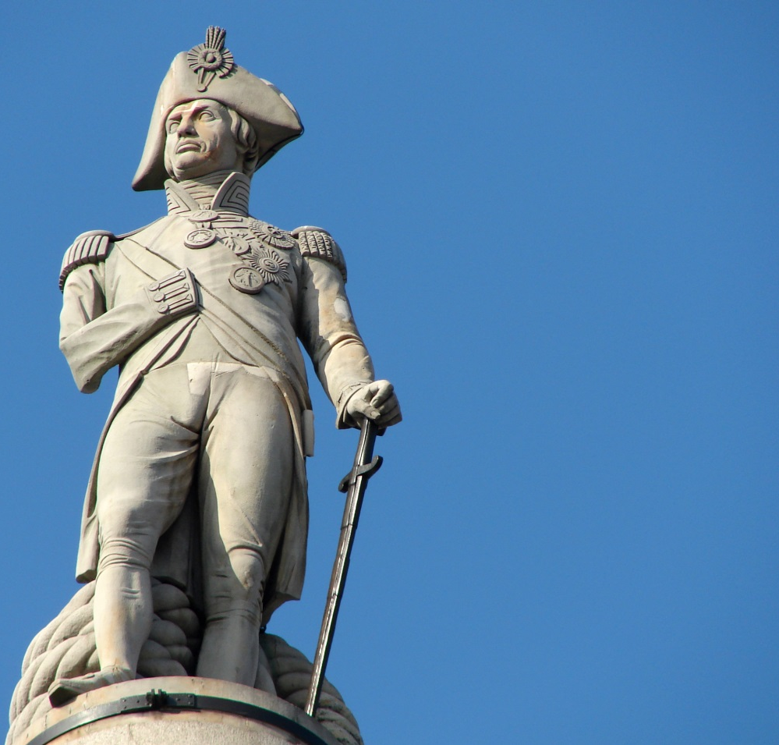
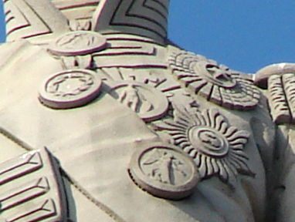
Activity
What questions do you need to ask to find out more about a statue?
E.g: Statue of Nelson on Nelson’s Column, Trafalgar Square, London
Is there the name of the artist? Who paid for it?
If it is a person? What are they like? Man/ Woman, describe them.
Is there a date? When was it made?
Is there any text/ writing? Can you see a name?
Where is it located? Look around, why do you think it’s been placed where it has?
Is it a life like representation of the person? If yes, why? If no, why not?
Notes:
How to look at and investigate monuments, memorials and statues
Here are some examples of the types of questions to prompt students to ask and the kind of things for them to look for when investigating and interrogating monuments, memorials and statues.
Image: https://en.wikipedia.org/wiki/Monuments_and_memorials_to_Horatio_Nelson,_1st_Viscount_Nelson#/media/File:Lord_Nelson,_Nelson's_Column.JPG
Image Attribution: By RedCoat - Own work, CC BY-SA 4.0, https://commons.wikimedia.org/w/index.php?curid=3084840

Slide 10
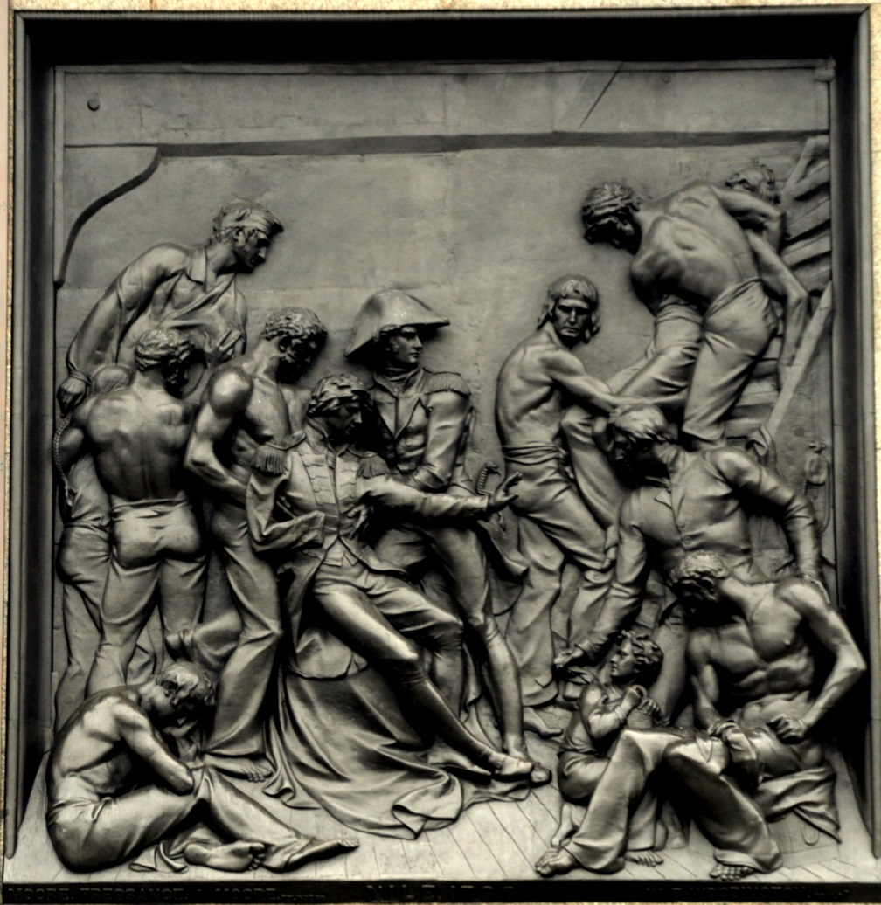
Activity
What can we tell by examining all the details on statues and monuments?
Are there any clues on the statue to tell us what the person was/ did? e.g. this plaque depicting Nelson at the Battle of the Nile
If there are people, what clothes are they wearing, can their clothing tell us about their role? E.g. a King or Queen wearing a crown, a judge in a wig, a military commander with a uniform or hat?
NB: You can use Google Street View to ‘walk’ around the monument looking for details to investigate
Notes:
How to look at and investigate monuments, memorials and statues
Here are some examples of the types of questions to prompt students to ask and the kind of things for them to look for when investigating and interrogating monuments, memorials and statues.
Image: https://commons.wikimedia.org/wiki/File:Nelson%27s_column_-_Battle_of_the_Nile_relief_(Edward_Carew,_1850).jpg
Image Attribution: Eluveitie / CC BY-SA (https://creativecommons.org/licenses/by-sa/3.0)

Slide 11
Research Task
Use the internet to answer the questions about Nelson on the previous slides, plus any others you’ve come up with. Here are some websites to get you started:
Topic | Reference
Why do memorials matter? | https://historicengland.org.uk/get-involved/help-write-history/immortalised/
Why he Nelson considered to be a national hero? | http://www.bbc.co.uk/history/historic_figures/nelson_admiral_horatio_lord.shtml
Article on everything you need to know about Lord Nelson | https://londonist.com/london/history/everything-you-need-to-know-about-nelson-s-column
Remember to cite all the websites you use and think about your sources:
Is the website credible?
Is it likely to give a one sided view / opinion?
Does it conflict with another source?
Why do you think Nelson has been ‘immortalised’?
Notes:
This task could also be done remotely by asking students to write their summary and email it to the teacher. These summaries could be shared in an online forum by the teacher to ask students to comment on each other’s summaries and discuss why Charles I was ‘immortalised’ in this way.

Slide 12
Note to teachers:
The Nelson's Column is a monument in Trafalgar Square in the City of Westminster, London, built to commemorate Admiral Horatio Nelson, who died at the Battle of Trafalgar in 1805. Nelson was a British naval commander and national hero, famous for his naval victories against the French during the Napoleonic Wars. After Nelson was shot at the Battle of Trafalgar his (is) body was brought back to England on board HMS Victory and he was buried at St Paul’s Cathedral. His funeral was one the grandest state occasions of the Georgian era and lasted over five days. As his body lay in state in the painted hall in Greenwich, more than 15,000 people came to pay their respects and many more were turned away. The monument was constructed between 1840 and 1843 to a design by William Railton at a cost of £47,000 (over £3m in today’s money). The money for the monument was raised by public subscription. It is made of granite and bronze and is 59.51 meters in height. The statue of Nelson at the top was created by the sculptor E. H Baily and was judged a true likeness by sailors who still remembered him.
Details
Location | Trafalgar Square, City of Westminster, London
Artist | Design by William Railton Statue by E. H. Baily Bas-relief panels by J. E. Carew, J. Ternouth, M. L. Watson and W. F. Woodington The lions added 1867, by Sir Edwin Landseer.
Commissioned by | In February 1838 a group of 121 peers, MPs and others formed a committee to raise a monument to Lord Nelson. It was funded by public subscription
Date unveiled | 1843

Slide 13
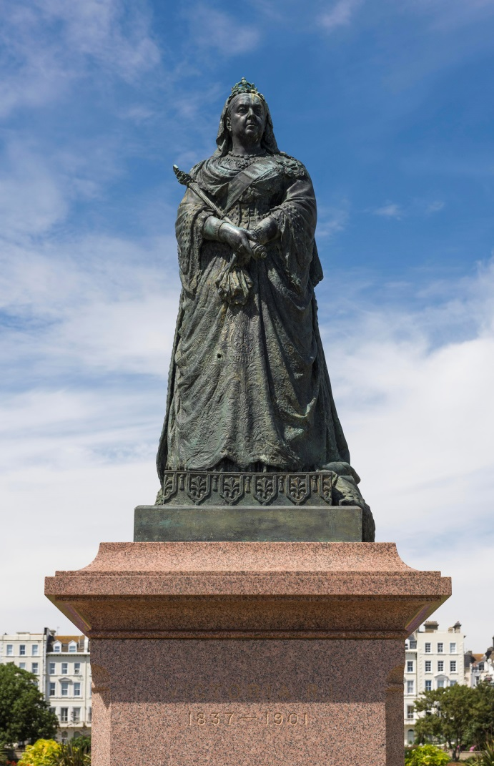
Why do we put up monuments, memorials and statues to people?
We put them up because………………
……………………………………………….
……………………………………………………
2. ……………………………………………….
……………………………………………………
3. ……………………………………………….
……………………………………………………
Criteria?
Notes:
Ask students to complete the above sentence with 3 different reasons. Then as a class, or in an online discussion forum, go through and make a list of all the different reasons students have listed. Having made your list ask students to consider – do these reasons allow us to create a list of ‘criteria’ for how monuments in the past were decided upon?
Image: https://historicengland.org.uk/images-books/photos/item/DP217961
Image Attribution: Copyright Historic England Archive dp217961

Slide 14
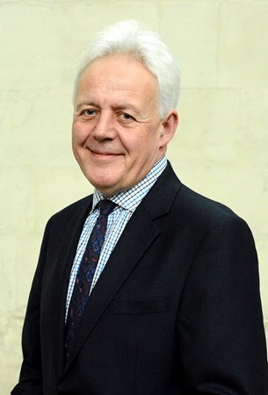
What is their purpose?
“Up and down the country, there are statues and memorials that give us clues about what people cared about in the past. Together, they make up a vast national collection of monuments, connecting us to another age.
From grand civic statues in great industrial cities to the modest war memorial in a remote village, every statue, bronze, plaque, barrow, plinth, monument and mural matters. They help us remember and mourn, connect with the past and stimulate debate.”
Duncan Wilson, Chief Executive of Historic England 2018
Discuss
Notes:
Following on from your own discussions about the reasons for monuments and the criteria used in the past to create them encourage students to write their own paragraph about the purpose of monuments. You can use this quote from Duncan Wilson either before or after you’ve asked students to write their own piece to stimulate discussion on the topic.

Slide 15
What are the most common types of monument or memorial?
“If aliens landed in London, what conclusions would they draw from our monuments?
As things stand, they might look at our memorials and conclude that we are a nation of kings and generals, we’ve mastered asexual
reproduction (there are hardly any women) and our primary transport mode is the horse.”
Justine Simons OBE
London’s Deputy Mayor for Culture and Creative Industries 2018
Notes:
Use the images on the next two slides to decide how true this statement is – also compare it to the statement from Duncan Wilson
Image: https://media-exp1.licdn.com/dms/image/C4E03AQH7gwC4pkC7xA/profile-displayphoto-shrink_200_200/0?e=1597881600&v=beta&t=RwxWFsQMgERi09EcAJm3iKOsz9i23UI4FfEZE0qADdo
Image Attribution: https://uk.linkedin.com/in/justine-simons-2b437954

Slide 16
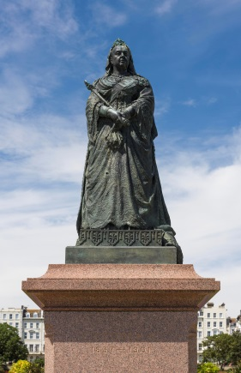
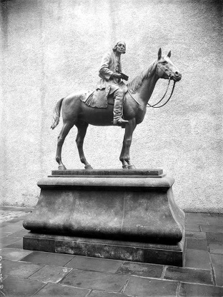
What are the most common types of monument or memorial?
Statues of famous people:
Kings & Queens
Scientists
Authors
Military ‘Heroes’
Social Reformers
Religious Reformers
Notes:
Image: https://historicengland.org.uk/images-books/photos/item/DP217961
Image Attribution: Copyright Historic England Archive dp217961
Image: https://historicengland.org.uk/services-skills/education/educational-images/statue-of-joseph-priestly-batley-5543
Image Attribution: © Mr Eric M Lee. Source Historic England Archive ref: 340939
Image: https://historicengland.org.uk/services-skills/education/educational-images/statue-of-judge-hughes-rugby-5331
Image Attribution:© Mr Brian W Sherwin. Source Historic England Archive ref: 308413
Image: https://historicengland.org.uk/services-skills/education/educational-images/duke-of-wellington-statue-round-hill-aldershot-2101
Image Attribution: © Reproduced by permission of Historic England Archive ref: CC97/01442
Image: https://historicengland.org.uk/services-skills/education/educational-images/the-fielden-statue-todmorden-5489
Image Attribution: © Mr Norman Hurst. Source Historic England Archive ref: 339059
Image: https://historicengland.org.uk/services-skills/education/educational-images/john-wesleys-statue-wesleys-new-room-chapel-broadmead-1380
Image Attribution:© Reproduced by permission of Historic England Archive ref: cc80/00466

Slide 17
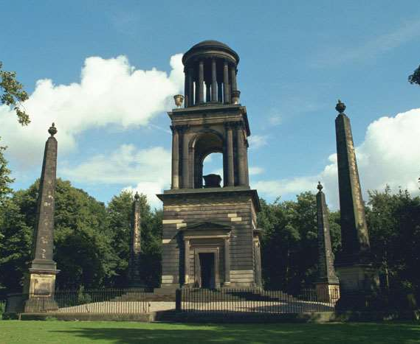
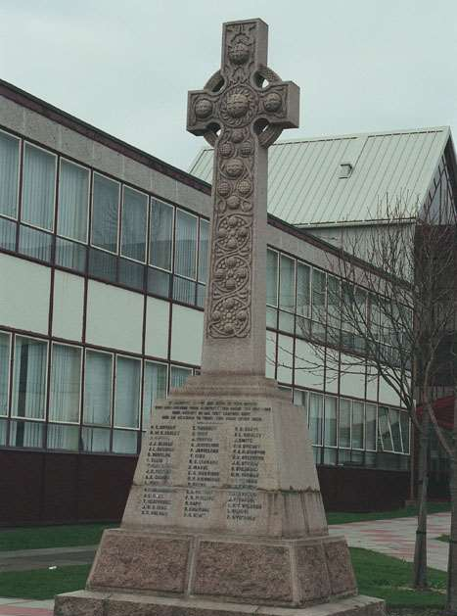
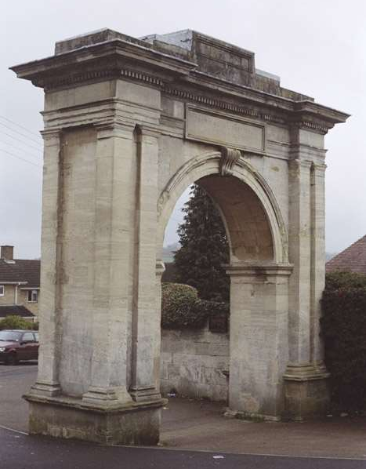
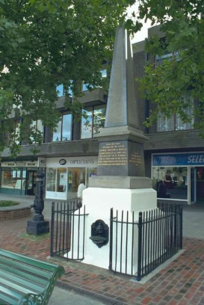
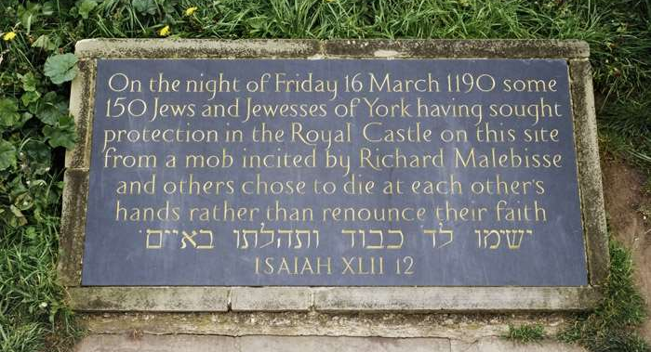
What are the most common types of monument or memorial?
Common ‘shapes/types’ of memorial:
Mausoleums
War memorials
Arches
Clock Towers
Obelisks
Plaque/Stone
Notes:
Image: https://historicengland.org.uk/services-skills/education/educational-images/rockingham-mausoleum-wentworth-6271
Image Attribution: © Ms Marilyn Shenton ARPS AMPA. Source Historic England Archive ref: 335592
Image: https://historicengland.org.uk/services-skills/education/educational-images/war-memorial-sir-william-turners-college-redcar-7712
Image Attribution: © Mr Alan Bradley LRPS. Source Historic England Archive ref: 60341
Image: https://historicengland.org.uk/services-skills/education/educational-images/memorial-to-the-abolition-of-slavery-stroud-gloucestershire-4643
Image Attribution: © Historic England Archive/Mr John Leaver ref: 415628
Image: https://historicengland.org.uk/services-skills/education/educational-images/the-clock-tower-station-approach-maidenhead-5336
Image Attribution: © Mr Chris Pooley. Source Historic England Archive ref: 40763
Image: https://historicengland.org.uk/services-skills/education/educational-images/martyrs-memorial-rayleigh-5985
Image Attribution: © Mr M W Keogh LRPS. Source Historic England Archive ref: 123030
Image: https://historicengland.org.uk/services-skills/education/educational-images/jewish-memorial-stone-cliffords-tower-york-castle-york-10786
Image Attribution: © Historic England Archive Photo Library ref: K970374

Slide 18
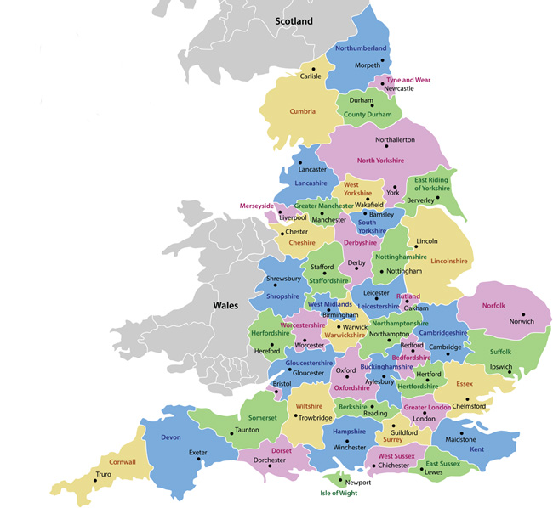
Activity
What are my local monuments?
Using the 12 types of common monuments on the previous two slides as templates, try to find your local examples for each different type of monument.
Could you find all 12 types?
Is your area typical of the rest of the country?
What other monuments did you find?
Notes:
Using the previous two slides as inspiration try to recreate them, but using local examples instead – village/town, county, region….what is local?
Ask pupils to go online and find examples of memorials near their school or home – then recreate this page using local examples that represent the national picture. If students need ‘scaffolding’ for this activity send them to: https://en.wikipedia.org/wiki/Category:Monuments_and_memorials_in_England

Slide 19
Activity
Where do we usually find memorials and monuments?
Using all the monuments you’ve looked at so far complete a table (as below) to record where the monuments you have found are located, such as; market place, cross roads, garden, churchyard etc.
What do you notice about the location of the monuments?
Are there any patterns to where monuments are built?
Are different types of monument found in certain places?
Name of monument | Location of monument
Notes:
Discuss what monuments are found where and what this tells us about the attitudes and beliefs of the people who built them.

Slide 20
2. The ‘Great and Good’
This theme encourages students to address the following questions:
What makes someone great?
Who gets to be immortalised?
What qualities do you think someone should have/ what things should they have done to get immortalised?

Slide 21
2. The ‘Great and Good’
Nelson’s column in Trafalgar Square is perhaps one of the most iconic examples of a statue or monument to a ‘Great Man’.
In the case of Admiral Lord Nelson, MP’s and members of the public wanted a statue to him because they thought he was a ‘national hero’, he had won the Battle of Trafalgar and had died serving his country. He was considered a great naval commander and military figure.
But what makes someone ‘great’………..?
Notes:
Image: https://en.wikipedia.org/wiki/Monuments_and_memorials_to_Horatio_Nelson,_1st_Viscount_Nelson#/media/File:Lord_Nelson,_Nelson's_Column.JPG
Image Attribution: By RedCoat - Own work, CC BY-SA 4.0, https://commons.wikimedia.org/w/index.php?curid=3084840

Slide 22
Activity
Look at the images and descriptions of the ‘traditional’ monuments on the following slides. You may also need to research the people remembered.
What are the qualities that the people remembered have?
As you look at the monuments start to think of some adjectives you could use to describe the people being immortalised, such as:
Brave
Talented
Wealthy
Notes:
Image: https://en.wikipedia.org/wiki/Monuments_and_memorials_to_Horatio_Nelson,_1st_Viscount_Nelson#/media/File:Lord_Nelson,_Nelson's_Column.JPG
Image Attribution: By RedCoat - Own work, CC BY-SA 4.0, https://commons.wikimedia.org/w/index.php?curid=3084840

Slide 23
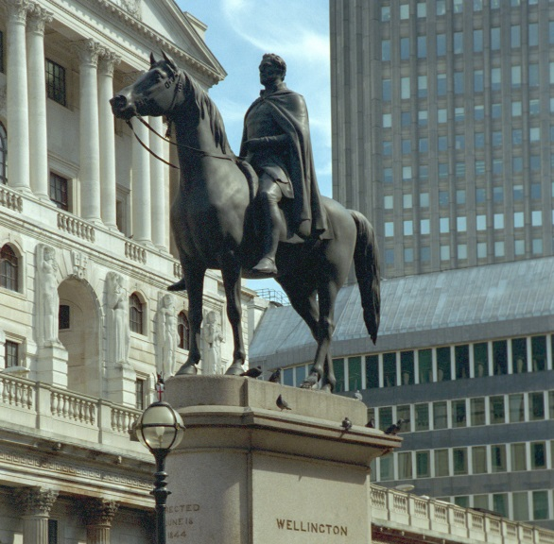
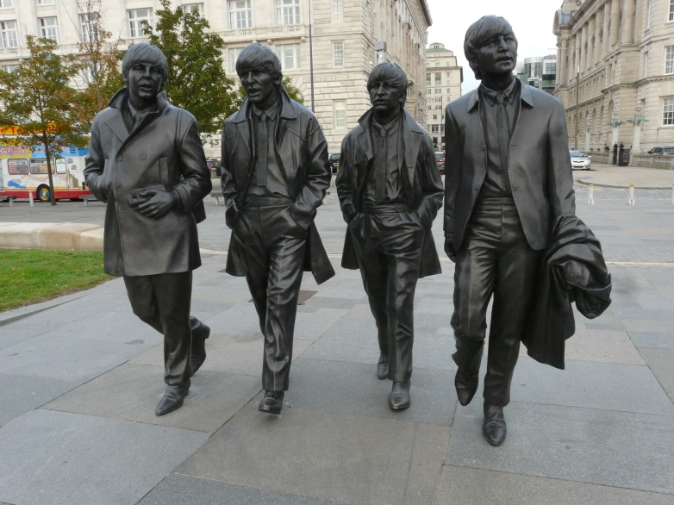
Duke of Wellington, London Arthur Wellesley, 1st Duke of Wellington was an Anglo-Irish soldier and statesman who was one of the leading military and political figures of 19th-century Britain, serving twice as Prime Minister.
The Beatles, Liverpool The Beatles were an English rock band formed in Liverpool in 1960. They are the best-selling music act of all time and hold the records for most number ones on the UK Album and Singles charts.
Notes:
Image: https://historicengland.org.uk/images-books/photos/item/IOE01/01945/01
Image Attribution: © Mrs Mary Winch. Source: Historic England Archive – IOE01/01945/01
Image: https://commons.wikimedia.org/wiki/File:The_Beatles_Statues.jpg
Image Attribution: Loz Pycock / CC BY-SA (https://creativecommons.org/licenses/by-sa/2.0)

Slide 24
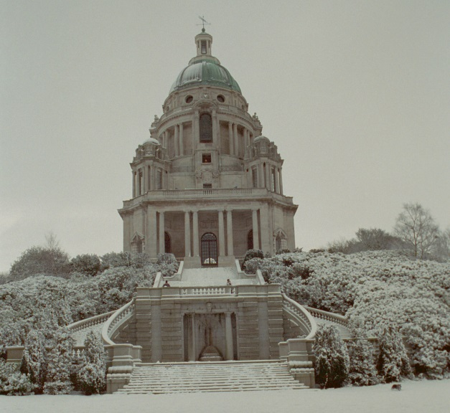
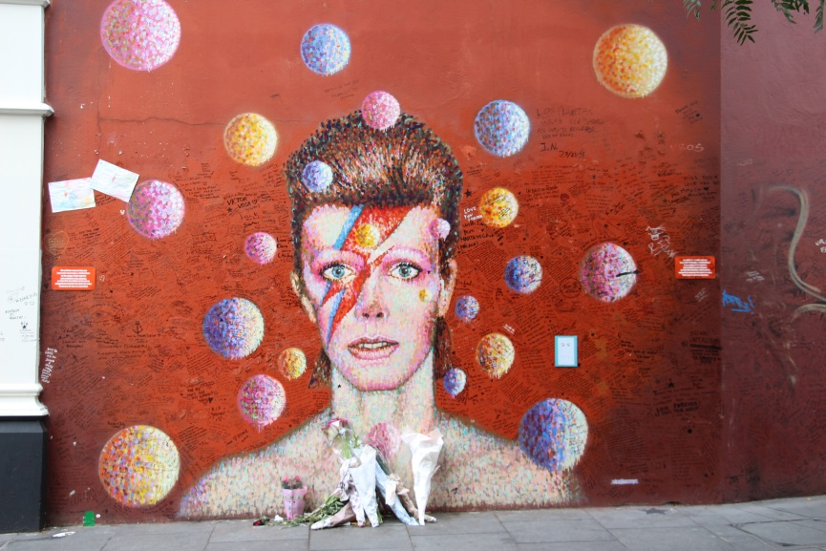
The Ashton Memorial, Lancaster The Ashton Memorial is a folly in Williamson Park, Lancaster. It was built between 1907 and 1909. It commemorates Jess, the second wife of James Williamson who was a very successful local businessman.
David Bowie, Brixton, London David Bowie was an English singer, songwriter and actor who is often considered to be one of the most influential musicians of the 20th century. When he died in 2016, fans made this mural and memorial in Brixton to him.
Notes:
Image: https://historicengland.org.uk/images-books/photos/item/IOE01/03213/09
Image Attribution: © Mr Charles Satterly. Source: Historic England Archive – IOE01/03213/09
Image: https://www.flickr.com/photos/129231073@N06/31705064380
Image Attribution: Fred Romero https://creativecommons.org/licenses/by/2.0/

Slide 25
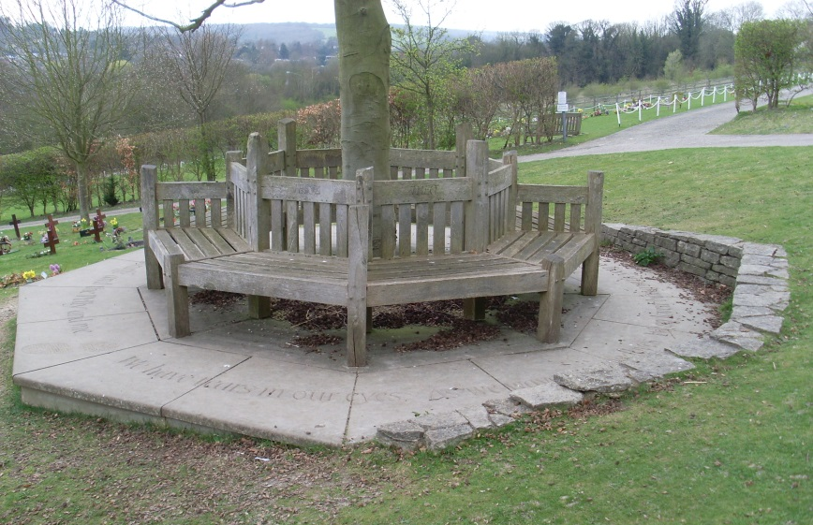
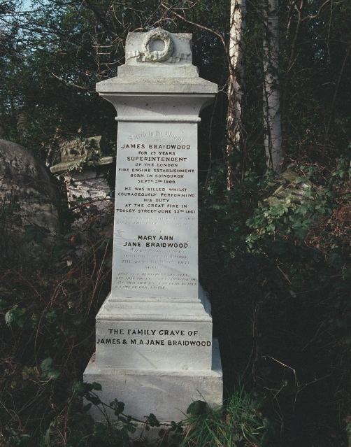
Roald Dahl's Memorial Seat, Great Missenden This memorial seat to Roald Dahl is in the churchyard in the village of Great Missenden where Roald Dahl lived. The inscription on the base is a quote from his book ‘The Giraffe and the Pelly and Me.
James Braidwood, fire fighter Stoke Newington, London James Braidwood (1800-61) was a leading fireman of his day, helping to establish the profession of fire-fighting. He lost his life in the great Tooley Street fire of 22 June 1861. He was buried here on 29 June as a national hero.
Notes:
Image: https://commons.wikimedia.org/wiki/File:Roald_Dahls_Memorial_Seat,_Great_Missenden_(geograph_2373417).jpg
Image Attribution: David Hillas / Roald Dahl&#039;s Memorial Seat, Great Missenden
Inscription on Roald Dahl Memorial Seat: "We have tears in our eyes As we wave our goodbyes We so loved being with you we three So do please now and then Come and see us again The Giraffe and the Pelly and me".
Image: https://historicengland.org.uk/images-books/photos/item/IOE01/09904/07
Image Attribution: © Ms Linda Margaret Simmonds. Source: Historic England Archive –IOE01/09904/07

Slide 26
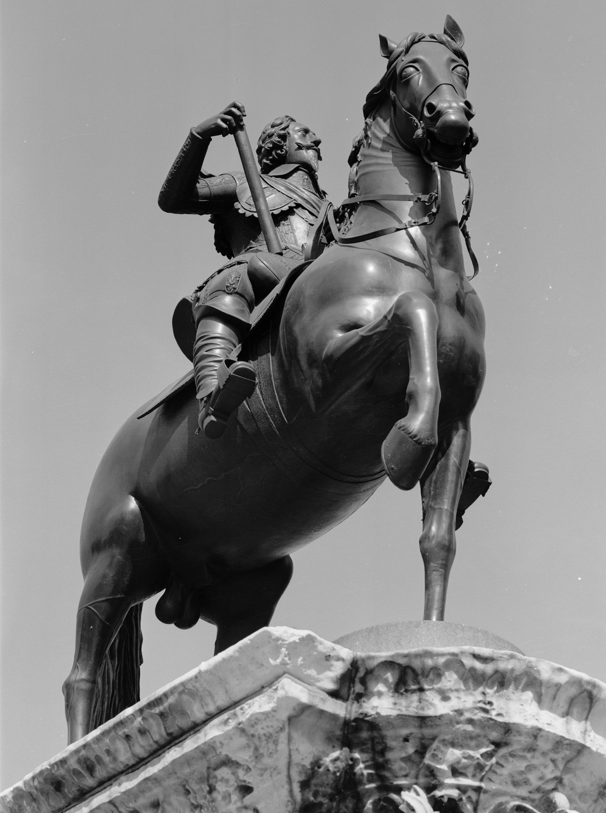
Queen Victoria, Hastings Victoria was Queen of the United Kingdom of Great Britain and Ireland from 20 June 1837 until her death on 22 January 1901. On 1 May 1876, she also adopted the additional title of Empress of India.
Charles I, Trafalgar Square, London Charles I was born on 19 November 1600 and died on 30 January 1649. He was King of England, King of Scotland, and King of Ireland from 27 March 1625 until his execution in 1649.
Notes:
Image: https://historicengland.org.uk/images-books/photos/item/DP217961
Image Attribution: © Historic England Archive – DP217961
Image: https://historicengland.org.uk/images-books/photos/item/AA98/05631
Image Attribution: © Historic England Archive – AA98/05631

Slide 27
Activity
Having looked at the evidence on the previous slides use it to try and answer the question: What makes someone great?
Try to create a set of criteria that you think could have been used to select the previous 8 monuments.
Do you agree with these criteria to decide who gets ‘immortalised’ or should they be changed?
Brave
Wealthy
Talented

Slide 28
Activity
What qualities do you think someone should have/ things should they should have done to get immortalised?
Create your own set of criteria.
Do you think anyone is missing in this category of the ‘Great and Good’?
Why do you think they’re not included?
Brave
Wealthy
Talented

Slide 29
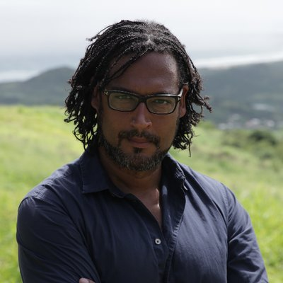
3. Difficult Histories
“These are the history wars we are having…statues have become lightning rods for a struggle we are going to have to have about our history”
David Olusoga, Historian, broadcaster and film-maker 2018
Notes:
Image:https://twitter.com/DavidOlusoga/photo
Image Attribution: https://twitter.com/davidolusoga

Slide 30
3. Difficult Histories
This theme encourages students to address the following questions:
What do we mean by difficult or contested history? Who is it difficult for, who is contesting, protesting, criticising and who is defending the stories of statues?
What makes a monument, memorial or statue’s story contested? How have opinions and values changed since the monument, memorial or statue was first erected/ put up?
Should we remove monuments, memorials and statues of people with difficult or contested histories? What should we would put in their place?
How do we tell these stories?

Slide 31
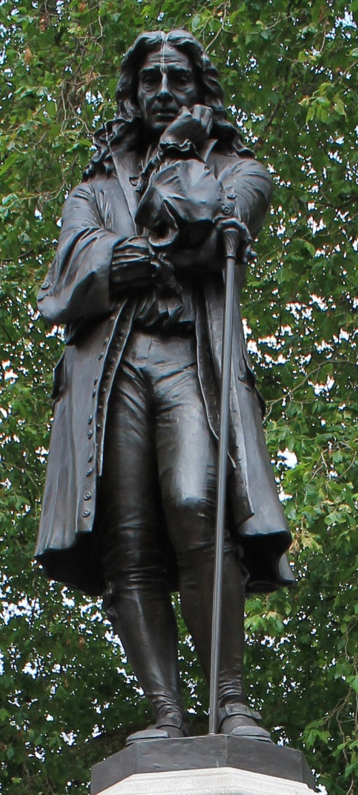
3. Difficult Histories
This is a Statue of Edward Colston. It stood on Colston Avenue in Bristol from 1895 until 2020
The inscription on the plaque at the base of the statue reads ‘erected by / citizens of Bristol / as a memorial / of one of the most / virtuous and wise sons of / their city / AD 1895'
Notes:
Image: https://commons.wikimedia.org/wiki/File:Statue_Of_Edward_Colston.jpg
Image Attribution: Simon Cobb / CC0

Slide 32
Who was Edward Colston?
Edward Colston was born in Bristol in 1636. He was the son of a prosperous Bristol merchant, who had made his money by trading textiles, fruit and wine in European ports, especially in Spain and Portugal.
By the 1650s the family had left Bristol and moved to London.
In 1654 Edward turned 18 and was apprenticed to the Worshipful Company of Mercers for 8 years.
By 1872 he had become a London merchant. Like his father he mostly exported textiles and imported oil, wine and sherry from Spain and Portugal. As his business grew it expanded to include silk from Virginia and cod from Newfoundland.
Notes:
Image: https://commons.wikimedia.org/wiki/File:Statue_Of_Edward_Colston.jpg
Image Attribution: Simon Cobb / CC0

Slide 33
In 1680 Edward became a member of the Royal African Company which at the time dominated the slave trade.
By 1689 he had risen to become its deputy governor. Between 1672 and 1689, his ships are believed to have transported about 80,000 men, women and children from Africa to the Americas as slaves.
Those men, women and children worked as forced labour on plantations in the Americas producing sugar and other high profit commodities. The profits from this exploitation went back into the pockets of rich merchants back in England such as Edward Colston.
When he died in 1721 he left money to charities and foundations in Bristol, mostly schools, alms houses and churches. His legacy can still be seen in the streets, memorials and buildings named after him.
Notes:
Image: https://commons.wikimedia.org/wiki/File:Statue_Of_Edward_Colston.jpg
Image Attribution: Simon Cobb / CC0

Slide 34
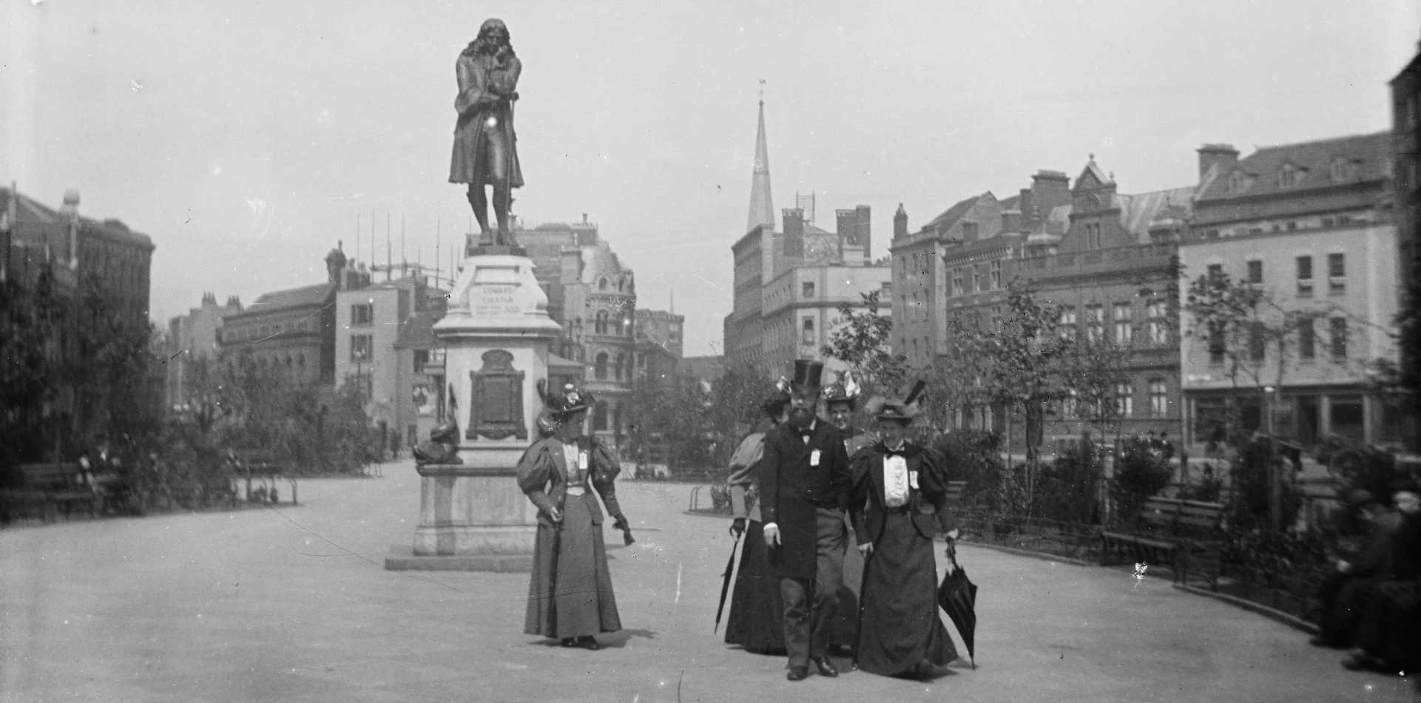
Activity
3. Difficult Histories
His statue which was built in 1895, around 170 years after his death. It describes him as ‘virtuous and wise’. Do you think that he was?
Why did the people of Bristol want to commemorate him at the end of the 19th century?
What were people’s attitudes to empire and the slave-trade at that time?
Notes:
Image:https://historicengland.org.uk/services-skills/education/educational-images/memorial-to-a-merchant-the-edward-colston-monument-1366
Image Attribution: © Reproduced by permission of Historic England Archive ref: bb86/08594

Slide 35
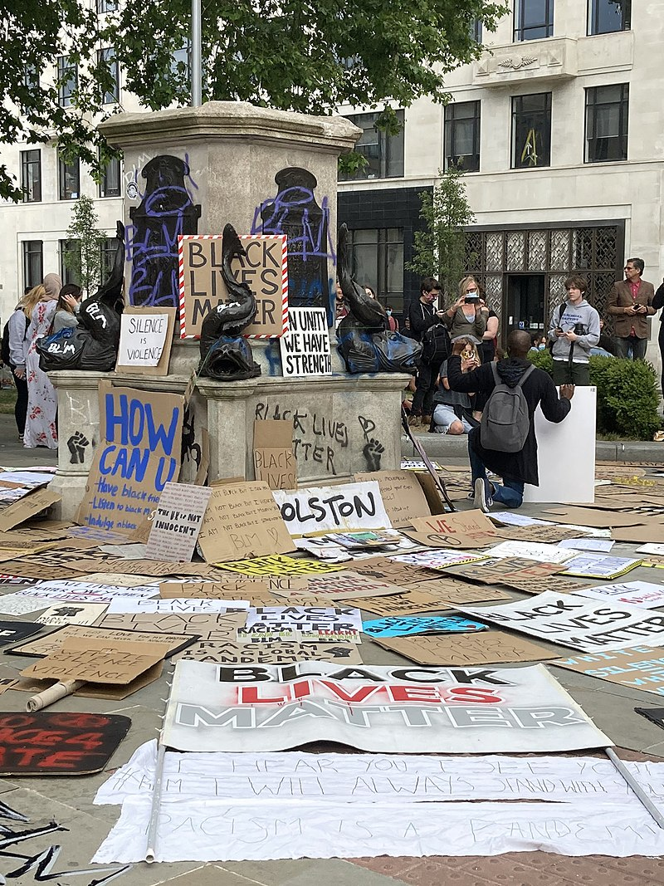
3. Difficult Histories
“The statue of Edward Colston in Bristol is a constant reminder of his inhumanity"
Miles Chambers, Poet 2018
On 7 June 2020, during the global protests following the killing of George Floyd in the United States, the statue was pulled down by demonstrators.
They then jumped on it and daubed it in red and blue paint, before rolling it down Anchor Road and pushing it into Bristol Harbour.
Notes:
Image: https://commons.wikimedia.org/wiki/File:Edward_Colston_-_empty_pedestal.jpg
Image Attribution: Caitlin Hobbs / CC BY (https://creativecommons.org/licenses/by/3.0)
The empty pedestal of the statue of Edward Colton in Bristol, the day after protesters felled the statue and rolled it into the harbour. The ground is covered with Black Lives Matter placards. Watch this film to find out more: https://www.youtube.com/watch?v=l70SI9I1UPk
https://counteringcolston.wordpress.com/
https://en.wikipedia.org/wiki/Killing_of_George_Floyd

Slide 36
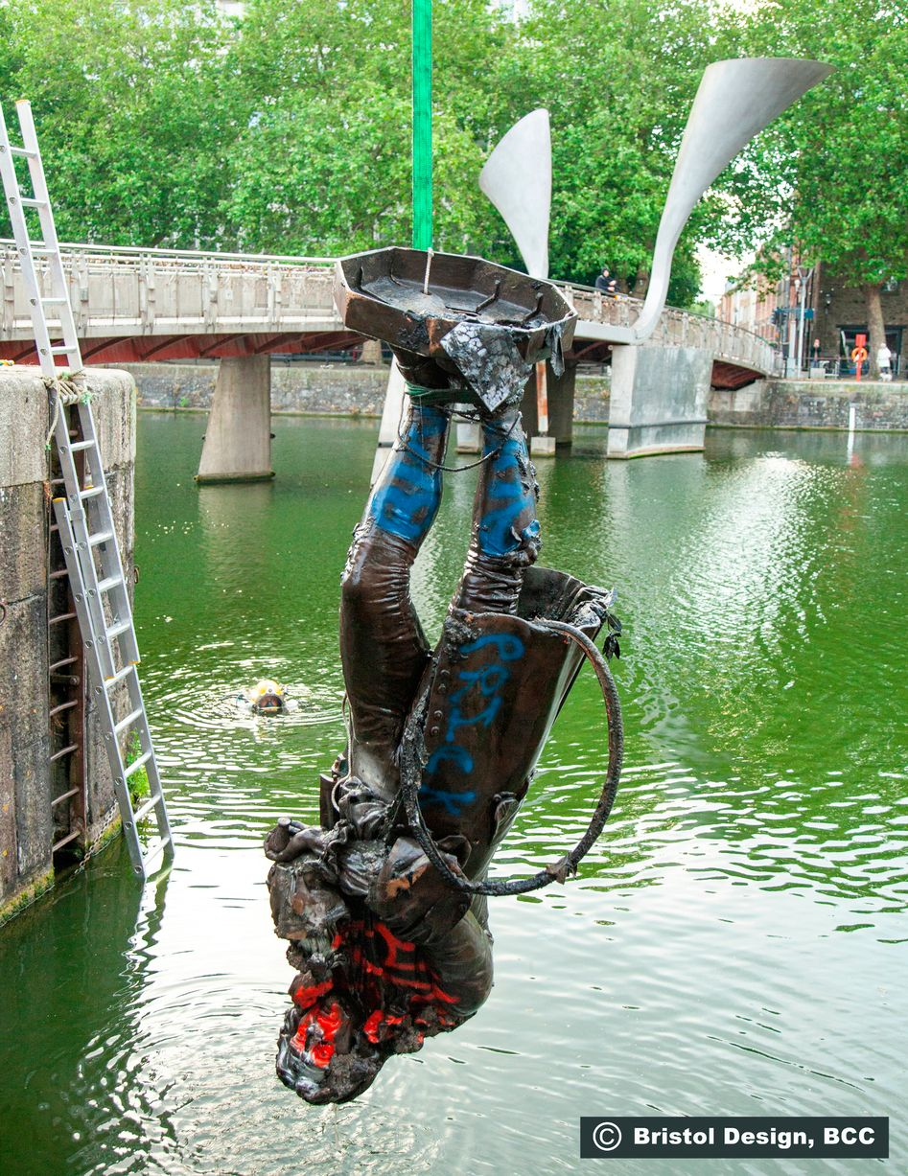
3. Difficult Histories
At 5am on 11 June 2020, the statue was retrieved from Bristol harbour by Bristol City Council, who plan to exhibit it in a museum without removing the graffiti and ropes placed on it by the protesters.
Do you think the protestors were right to pull down the statue?
Do you agree with Bristol City Council’s plans for what to do with it?
Notes:
Image: https://www.bristolpost.co.uk/news/bristol-news/gallery/removal-edward-colston-statue-bristol-4215124
Image Attribution: Bristol City Council (BCC), via Bristol Design
NB:This information about the plan to exhibit it in a museum is treu as of July 2020

Slide 37
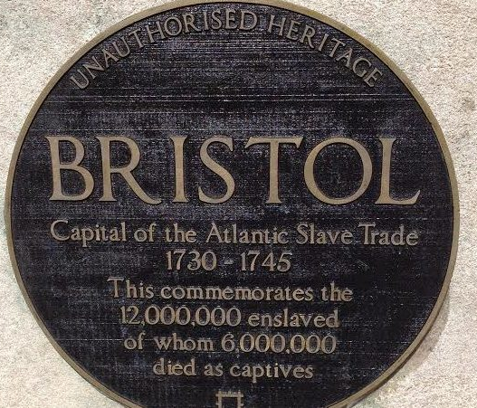
3. Difficult Histories
People had campaigned for many years to have the Colston statue removed . There were also various attempts to reinterpret the statue to ensure people understood Colston’s role in the slave trade
In 2017 an unofficial plaque was placed on the plinth by the artist Will Coles. The plaque, which resembles the famous blue plaques installed on the sites of historic building by English Heritage, draws attention to Bristol’s historic role in the slave trade which Edward Colston benefited from.
Do you think this was a successful way to reinterpret the statue?
Notes:
Image: https://www.bristol247.com/news-and-features/news/sculptor-behind-plaque-brands-bristol-slavery-capital-speaks/
Image Attribution: Bristol Post/Will Coles

Slide 38
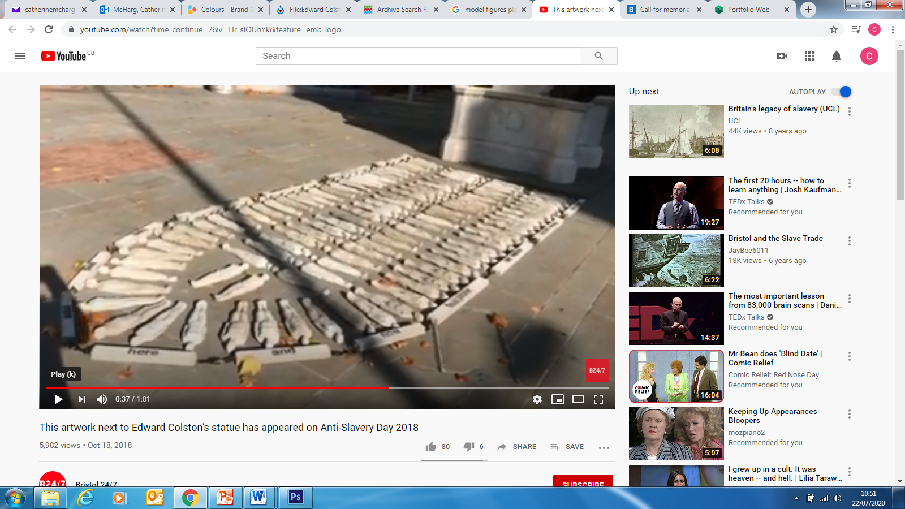
3. Difficult Histories
Notes:
Image: https://youtu.be/EIr_sIOUnYk

Slide 39
3. Difficult Histories
These model figures were placed temporarily at the foot of Bristol’s Colston statue on Anti-Slavery Day 2018.
They are inspired by this drawing of a ship transporting enslaved people.
Do you think this was a successful way to reinterpret the statue?
Notes:
Image: https://youtu.be/EIr_sIOUnYk
Image: https://commons.wikimedia.org/w/index.php?curid=36788710
Image Attribution: Andrew Hull Foote / Public domain - This file is from the Mechanical Curator collection, a set of over 1 million images scanned from out-of-copyright books and released to Flickr Commons by the British Library. View image on FlickrView all images from bookView catalogue entry for book., Public Domain.

Slide 40
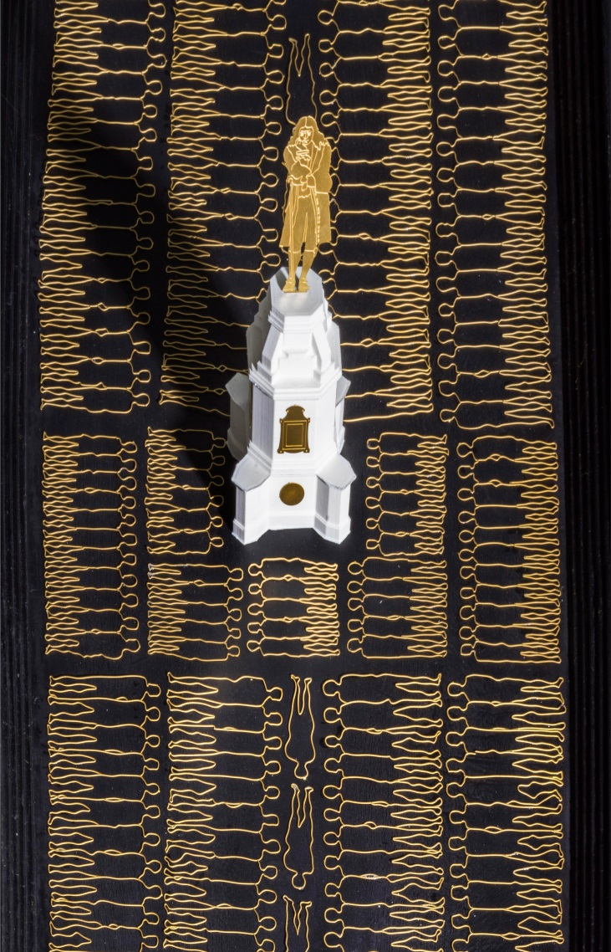
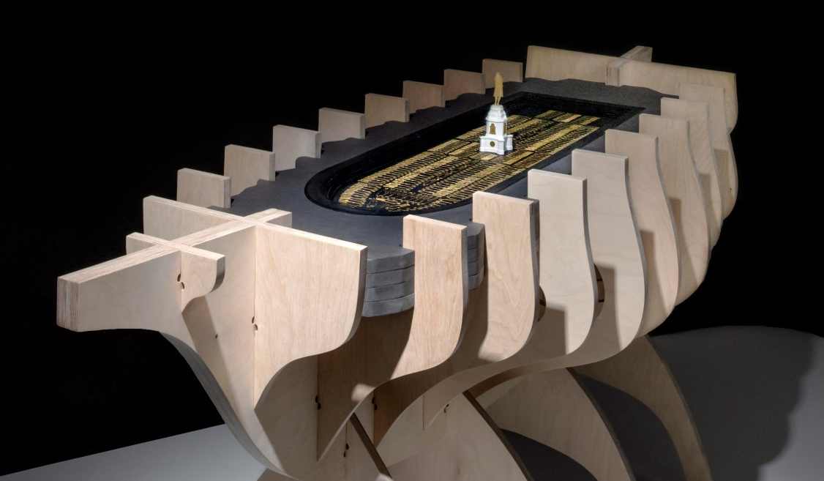
3. Difficult Histories
A similar theme was taken by MSMR Architects in 2018 when they created their ‘Contextualising Colston’ sculpture for Historic England’s Immortalised Exhibition.
Do you think this was a successful way to reinterpret the statue?
Notes:
Image: https://historicengland.org.uk/get-involved/help-write-history/immortalised/competition/#Section8Text
Image Attribution: © Historic England Archive ref: DP232600 & DP232603

Slide 41
3. Difficult Histories
In this image the artist Hew Locke has challenged the hidden story of how Edward Colston became a wealthy man.
He has edited a photo of the statue to make it appear that Colston is dripping in chains, jewels, trade tokens and other loot.
“[I’m] making the semi-visible more visible”
Hew Locke, Artist
What do you think about his approach of editing a photo of a statue, rather than the statue itself, to get his views across?
Notes:
Have now looked a series of reinterpretations of the statue before it’s removal students could discuss which they felt was the most successful.
Image: https://www.ppowgallery.com/exhibition/5241/work/fullscreen_exhib#&panel1-2
Image Attribution: Hew Locke/P.P.O.W Gallery

Slide 42
Research
Ask your students to research other controversial figures and their statues.
Are there any in the local area?
Create a poster about them explaining how there are different stories/ narratives to be told. Ask them to split the page into two sections and write down on one side the achievements of the person remembered, and then on the other side, a different perspective or point of view.
What other stories can be told?
Brave
Wealthy
Talented
Notes:
Examples of controversial figures
Oliver Cromwell is credited by many with being a key figure in the development of Western democracy. But he also stands accused of leading massacres in Ireland.
Cecil Rhodes was an imperialist, businessman and politician who played a dominant role in southern Africa in the late 19th Century, driving the annexation of vast swathes of land. He founded the De Beers diamond firm which until recently controlled the global trade. (Oxford)
Robert Clive, the former mayor of Shrewsbury and first British governor of Bengal, has a statue in the Shropshire town’s main square. Clive, a military officer and East India Company official, amassed a huge personal fortune by seizing control of a vast swathe of India and surrounding parts of Asia. He oversaw atrocities including famines caused by disastrous crop production policies, and has been described by historian William Dalrymple as an “unstable sociopath”.
Henry Havelock was a British General known for his role in brutally suppressing the Indian rebellion of 1857. Havelock sieged and retook the city of Kanpur from anti-Empire rebels and massacred its occupiers. In the conflict as a whole, 800,000 Indians were killed by British troops. (sunderland)

Slide 43
Activity
Making the invisible visible
Taking the work of Hew Locke as inspiration, ask your students to use the research they’ve done on a monument, memorial or sculpture to a figure who provokes debate (such as Queen Victoria, Oliver Cromwell, Cecil Rhodes, Robert Clive, Henry Havelock etc.) to create a digital piece of art.
Use a digital image of a monument, memorial or statue and editing software, such as ‘paint’, to alter the image by adding in text, drawings or images of different objects to highlight it’s challenging history.
Notes:
Image: https://www.ppowgallery.com/exhibition/5241/work/fullscreen_exhib#&panel1-2
Image Attribution: Hew Locke/P.P.O.W Gallery
Examples of controversial figures
Oliver Cromwell is credited by many with being a key figure in the development of Western democracy. But he also stands accused of leading massacres in Ireland.
Cecil Rhodes was an imperialist, businessman and politician who played a dominant role in southern Africa in the late 19th Century, driving the annexation of vast swathes of land. He founded the De Beers diamond firm which until recently controlled the global trade. (Oxford)
Robert Clive, the former mayor of Shrewsbury and first British governor of Bengal, has a statue in the Shropshire town’s main square. Clive, a military officer and East India Company official, amassed a huge personal fortune by seizing control of a vast swathe of India and surrounding parts of Asia. He oversaw atrocities including famines caused by disastrous crop production policies, and has been described by historian William Dalrymple as an “unstable sociopath”.
Henry Havelock was a British General known for his role in brutally suppressing the Indian rebellion of 1857. Havelock sieged and retook the city of Kanpur from anti-Empire rebels and massacred its occupiers. In the conflict as a whole, 800,000 Indians were killed by British troops. (sunderland)

Slide 44
Extension Activity
Some people disagree with the removal of statues and see it as erasing history. They favour retaining the statues but installing plaques, putting the actions of those honoured in context. However others like David Olusaga, think that some statues should be removed as they are so contentious. He has said:
“Statues aren’t the mechanism by which we understand history. We learn history through museums, through books, through television programmes. Statues are about adoration.”
How far do you agree with this statement from David Olusaga?
In groups come up with arguments that support or challenge these view points.
Are statues important in order to preserve our history?
Is reinterpretation better than removal?
Would it be better if there were no statues at all?
Notes:
These discussions could take place in a classroom setting or online in your school approved virtual discussion areas.
Other resources:
https://historicengland.org.uk/services-skills/education/teaching-activities/are-we-right-to-commemorate-the-life-of-a-slave-trader

Slide 45
4. Everyday People
This theme encourages students to address the following questions:
How do we remember everyday people and events?
How do we tell the stories of ordinary people?
Should memorials and statues commemorate ordinary people? Why? Why not?
Should statues remember British glories of the past, ordinary people in the past, or should they actually highlight the local heroes of the present day?

Slide 46
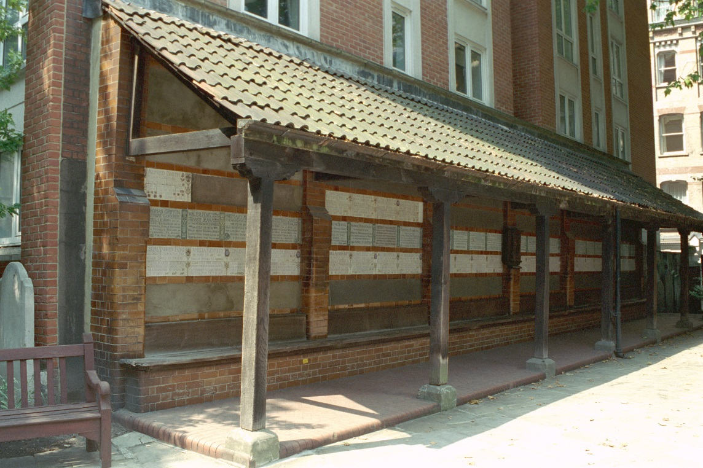
4. Everyday People
Postman’s Park Memorial to Heroic Self-Sacrifice is a monument commemorating ‘heroism in everyday life’ which opened in the City of London in 1900.
It is a wooden structure with a wall of fifty-four memorial tablets commemorating sixty-two men, women and children who lost their lives while attempting to save another.
Notes:
Image: https://historicengland.org.uk/images-books/photos/item/IOE01/03436/11
Image Attribution: Copyright IoE Mr Paul Howard. Source Historic England Archive ioe01_03436_11

Slide 47
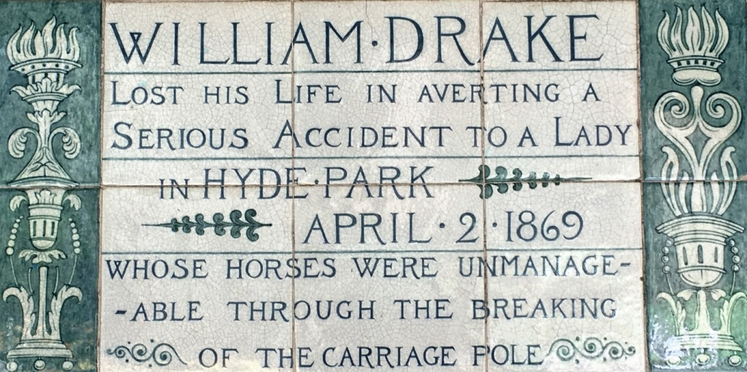
4. Everyday People
The memorial was the idea of an artist called George Frederic Watts who wanted to give recognition to working class people who would have remained ‘hidden from history’.
Watts collected hundreds of newspaper cuttings of ordinary people who had shown incredible bravery, and the names of these people were added to ceramic tiles and placed in the wooden structure.
Notes:
Image: https://historicengland.org.uk/whats-new/news/public-call-out-uncovers-englands-secret-and-unknown-memorials/
Image: https://historicengland.org.uk/images-books/photos/item/IOE01/03436/11
Image Attribution: Copyright IoE Mr Paul Howard. Source Historic England Archive ioe01_03436_11

Slide 48
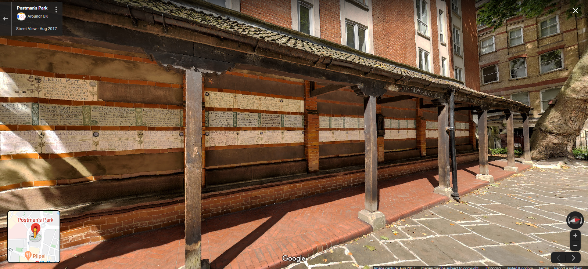
4. Everyday People
Use Google Street View to look at the memorial
Notes:
https://www.google.com/maps/@51.5168354,-0.0977893,3a,75y,282.1h,93.07t/data=!3m8!1e1!3m6!1sAF1QipP2KqZRqFd77CAnHh1TRXvg4OZTEgCto0srleSN!2e10!3e11!6shttps:%2F%2Flh5.googleusercontent.com%2Fp%2FAF1QipP2KqZRqFd77CAnHh1TRXvg4OZTEgCto0srleSN%3Dw203-h100-k-no-pi-0-ya92.496666-ro-0-fo100!7i11652!8i5826

Slide 49
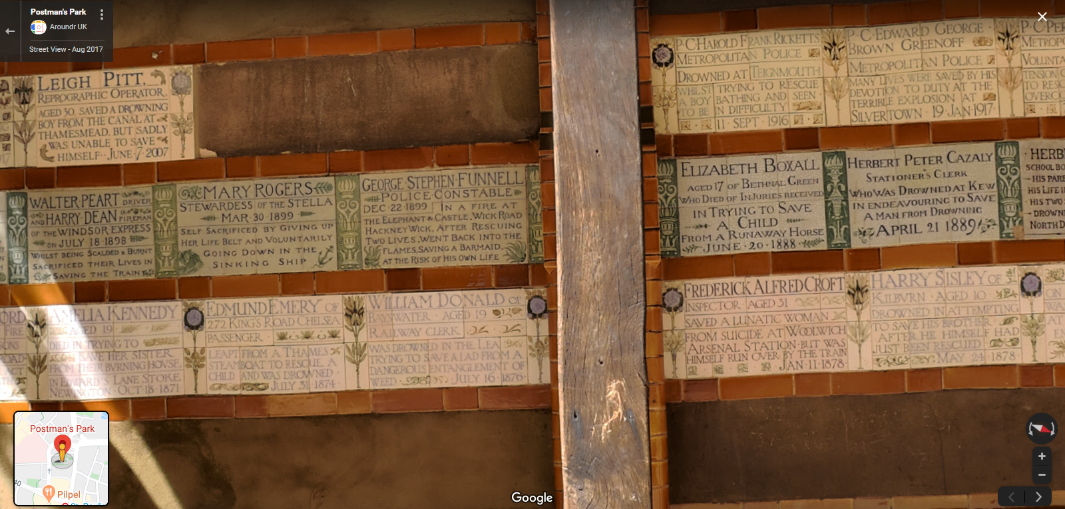
4. Everyday People
Zoom in to see how many of the different plaques you can read
What were the most common ‘acts of bravery’?
If you were to create a new memorial like this in your town today what ‘acts of bravery’ would you commemorate on it?
Notes:
Find out more about some of the plaques – either by zooming in on Google Street View or doing a search for images.
What makes a hero in 21st century England – is it different from the ones in the past?
(https://www.google.com/search?q=Postman%E2%80%99s+Park+Memorial+to+Heroic+Self-Sacrifice&rlz=1C1GGRV_enGB748GB748&sxsrf=ALeKk02-6SFGlrwqvpZMfL4wsLkz9A_VzQ:1592567898223&source=lnms&tbm=isch&sa=X&ved=2ahUKEwjItOre6Y3qAhVHasAKHftSC-AQ_AUoAXoECAwQAw&biw=1600&bih=740
https://www.google.com/maps/@51.5168354,-0.0977893,3a,75y,282.1h,93.07t/data=!3m8!1e1!3m6!1sAF1QipP2KqZRqFd77CAnHh1TRXvg4OZTEgCto0srleSN!2e10!3e11!6shttps:%2F%2Flh5.googleusercontent.com%2Fp%2FAF1QipP2KqZRqFd77CAnHh1TRXvg4OZTEgCto0srleSN%3Dw203-h100-k-no-pi-0-ya92.496666-ro-0-fo100!7i11652!8i5826

Slide 50
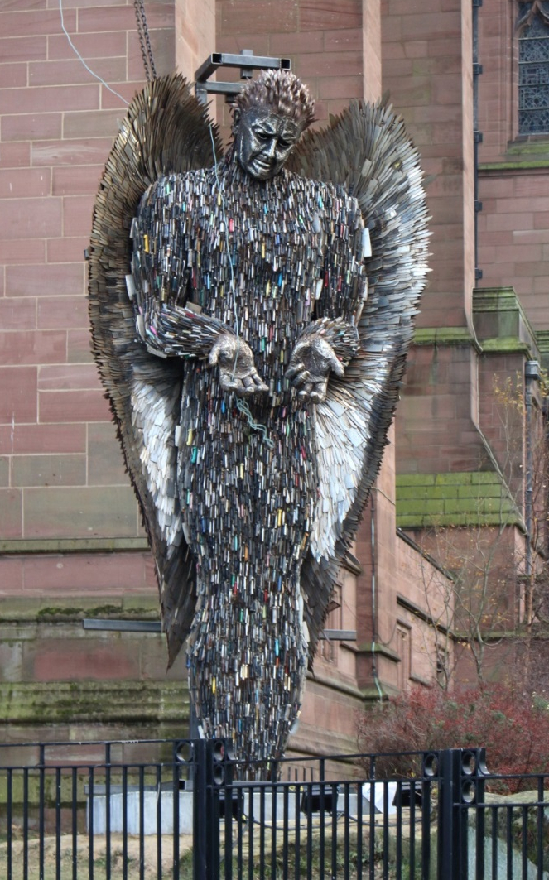
Activity
Look at the images and descriptions of the memorials on the following slides.
As you look at the monuments start to think about what categories you could use to describe the people/events being immortalised.
How do they compare to the memorials of the ‘Great and Good?
Extra-ordinary
events
Freedom of expression
Protest
Notes:
Students could look at and research all the following memorials – or be asked to look at one in-depth and report back to other about it.
Image: https://commons.wikimedia.org/wiki/File:Knife_Angel_installation_8.jpg
Image Attribution: Rodhullandemu / CC BY-SA (https://creativecommons.org/licenses/by-sa/4.0)
Image: https://en.wikipedia.org/wiki/Monuments_and_memorials_to_Horatio_Nelson,_1st_Viscount_Nelson#/media/File:Lord_Nelson,_Nelson's_Column.JPG
Image Attribution: By RedCoat - Own work, CC BY-SA 4.0, https://commons.wikimedia.org/w/index.php?curid=3084840

Slide 51
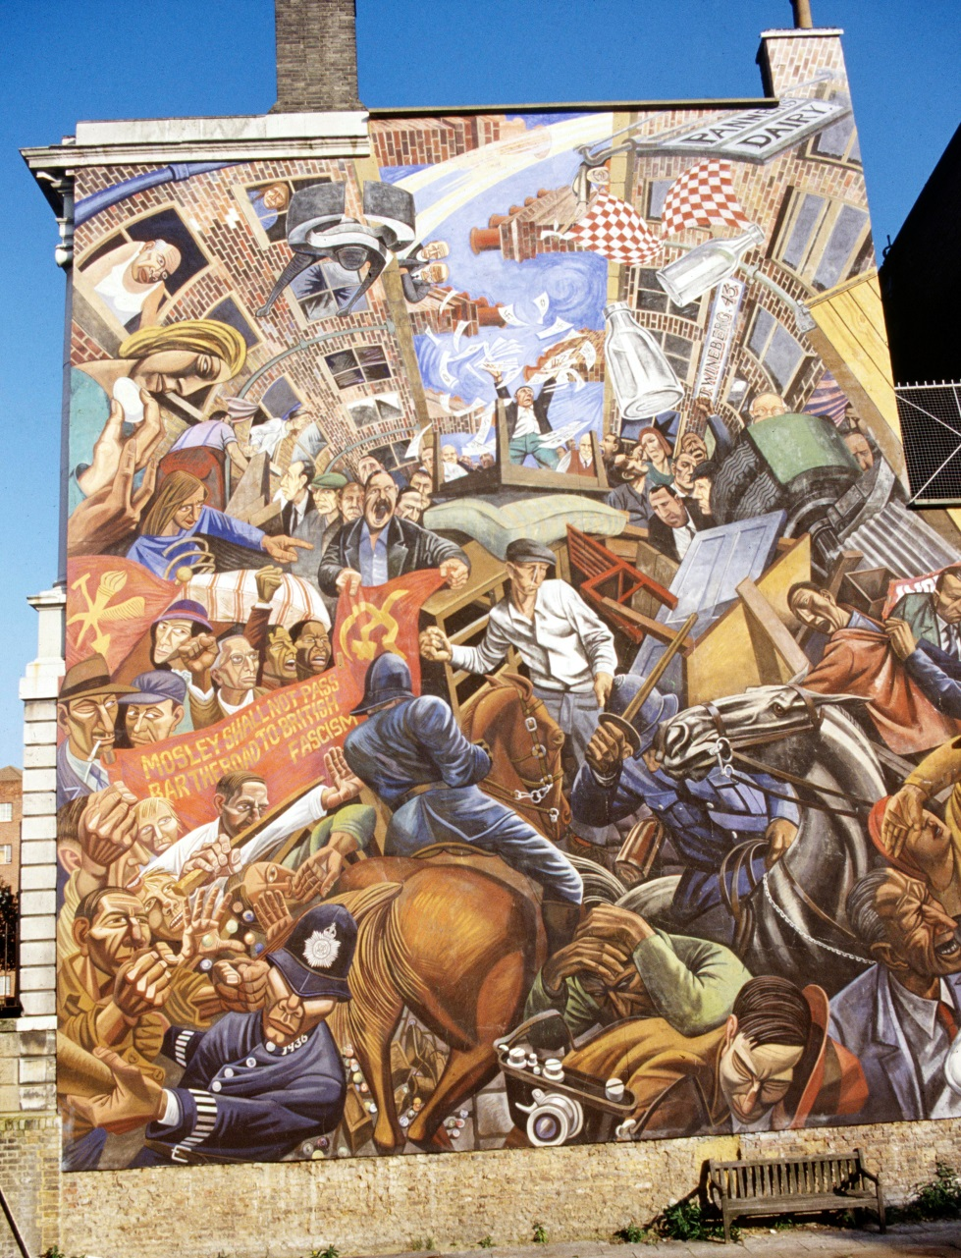
Cable Street Mural, London The Battle of Cable Street took place on Sunday 4 October 1936 in Cable Street, to protest against a fascist march that was taking place. Local Jewish, socialist, anarchist, Irish and communist groups, clashed with the Metropolitan Police, who attempted to remove barricades they’d put up to stop the fascist march from passing through Cable Street.
Notes:
Image: https://historicengland.org.uk/images-books/photos/item/AAA02/01/S0412
Image Attribution: Copyright Graham Cooper and Doug Sargent. Source Historic England Archive Ref: aaa02_01_s0412

Slide 52
Knife Angel, Liverpool ‘Knife Angel’ is a giant 26-foot-tall sculpture in the UK, built entirely out of 100,000 donated knives. It is a monument to remember the victims who have fallen to the increasing amount of knife crime in the UK. The angel’s creator, Alfie Bradley, spent two years designing and building the sculpture which features donated knives through the “Save a Life, Surrender Your Knife,” amnesty, in 2017, through which people could anonymously donate their knives to the project.
Notes:
Image: https://commons.wikimedia.org/wiki/File:Knife_Angel_installation_8.jpg
Image Attribution: Rodhullandemu / CC BY-SA (https://creativecommons.org/licenses/by-sa/4.0)

Slide 53
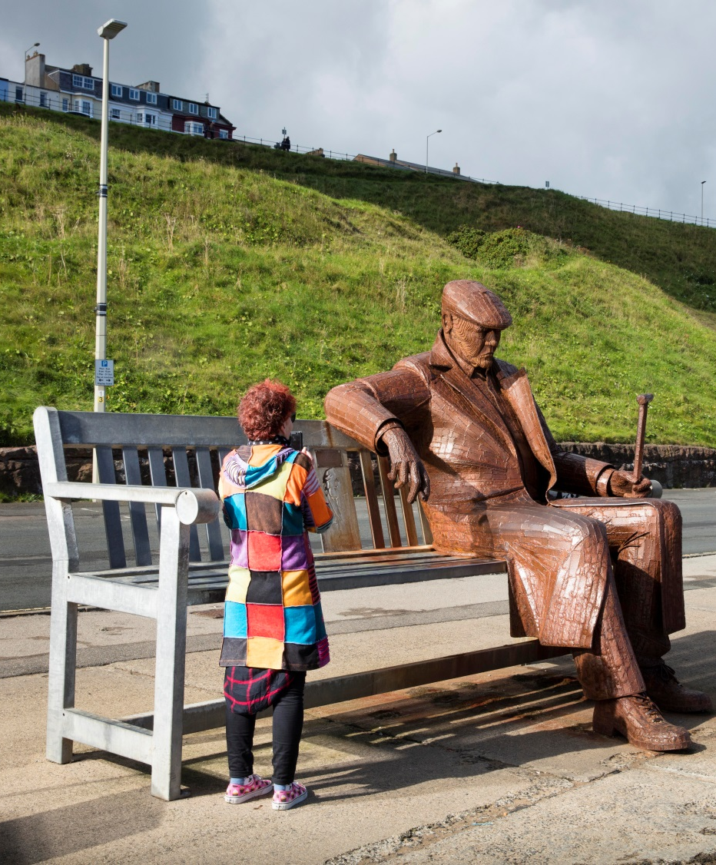
The plaque on the sculpture reads: ‘They said for king and country, we should do as we were bid. They said old soldiers never die, but plenty young ones did.’
Freddie Gilroy, Scarborough The sculpture is based on a former miner from County Durham who, as a soldier shortly before his 24th birthday, was one of the first allied troops to enter Bergen-Belsen concentration camp in Germany in April 1945. They found more than 60,000 prisoners, most of them seriously ill. Freddie Gilroy and the Belsen Stragglers represents ordinary people pulled out of ordinary lives because of war, who involuntarily experienced extraordinary things and whose lives were profoundly affected consequently.
Notes:
The inscription on the sculpture's plaque reads: ‘They said for king and country, we should do as we were bid. They said old soldiers never die, but plenty young ones did.’
Image: https://artsandculture.google.com/asset/freddie-gilroy-and-the-belsen-stragglers-sculpture-royal-albert-drive-north-bay-scarborough-north-yorkshire-alun-bull-historic-england/pAHZAhnsVfpLaQ
Image Attribution: Copyright Historic England Archive Ref: DP174982

Slide 54
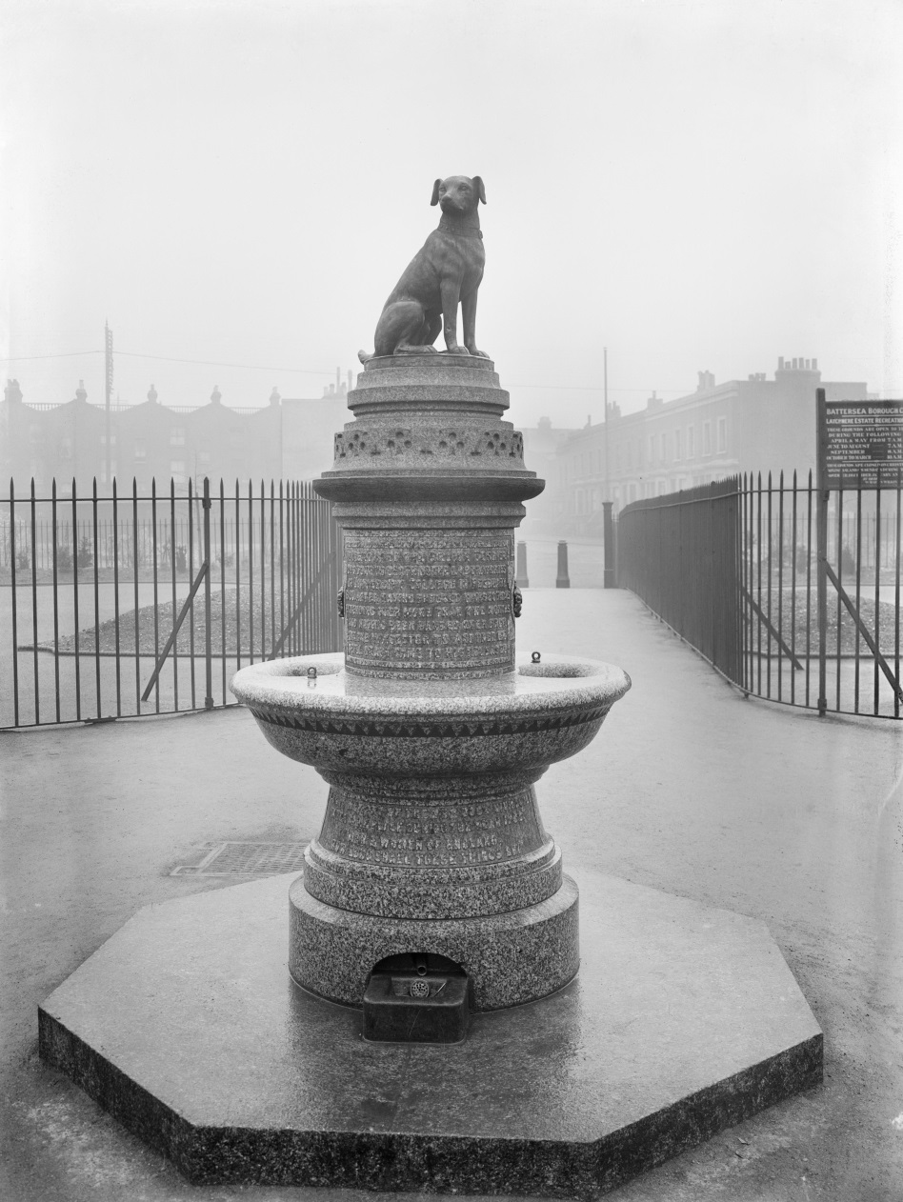
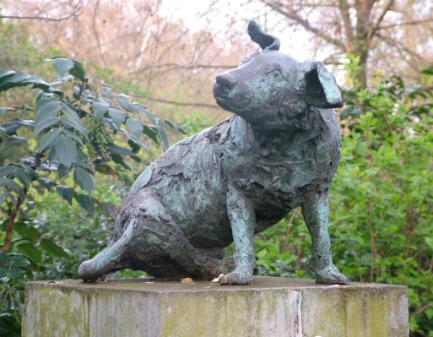
Brown Dog Statue Battersea Park, London The Brown Dog Affair was a political controversy about animal testing that raged in England from 1903 until 1910 resulting in anti-animal testing protestors clashing with people who were supporters of animals being tested on in medical laboratories. The original statue (right) was built in 1906, but melted down in 1910. This statue (below) was made in 1985.
Notes:
Image: https://commons.wikimedia.org/wiki/File:Brown_Dog_-_Battersea_Park_-_2008-04-09.jpg
Image Attribution: Tagishsimon / CC BY-SA (https://creativecommons.org/licenses/by-sa/4.0)
Image: https://historicengland.org.uk/images-books/photos/item/CC73/03126
Image Attribution: Source: Historic England Archive Ref: cc73_03126

Slide 55
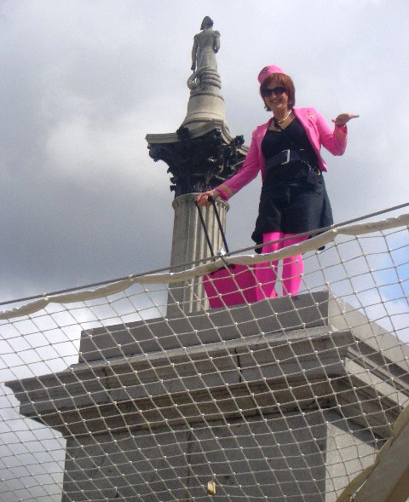
Antony Gormley’s Fourth Plinth ‘One and Other’, Trafalgar Square, London The artist Antony Gormley created a living artwork for the plinth in Trafalgar Square in 2009. The plinth was a memorial to ordinary people, and was occupied for 100 consecutive days, 24 hours a day, by members of the public who had applied to be part of the project. The image shown is from 16.00 to 17.00 on 17 July 2009: Karen Ogilvie flying paper kites and distributing hundreds of sweets all with written advice such as “Be friendly to a stranger today”.
How do these monuments compare to the memorials of the ‘Great and Good?
Discuss.
Notes:
Image: https://commons.wikimedia.org/wiki/File:One%26Other-AntonyGormley-KarenOgilvie-20090717.jpg
Image Attribution: Duncanogi at en.wikipedia. / Public domain

Slide 56
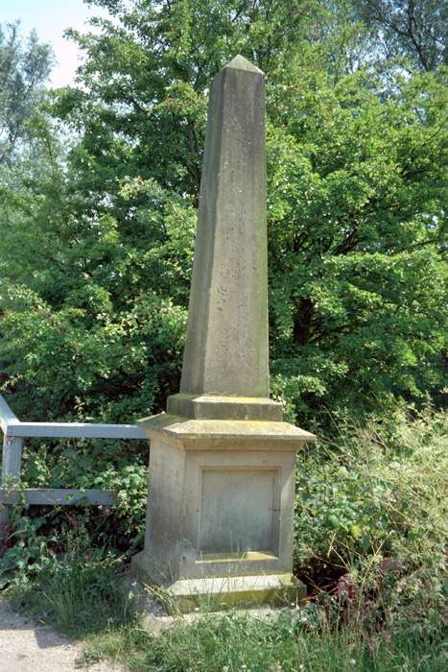
Activity
Having now seen several types of monument, search online or ask family and friends to find local examples of monuments to ‘everyday people’.
Did you find any at all?
Can people still be living
or do they have to have
died to be ‘immortalised’?
In 2020 the Covid-19 pandemic turned ordinary NHS staff and other ‘key workers’ into heroes. Use online news articles or your own knowledge to research a local person/people. Design a monument so that people in the future will remember their ‘acts of bravery’.
Notes:
Open a discussion about whether or not people have to have died to have a monument in their name – or can they still be living and celebrated in their own lifetime. Has Covid-19 forced us to reassess what we consider ‘acts of bravery’?
Image: https://historicengland.org.uk/services-skills/education/educational-images/memorial-south-of-osney-lock-oxford-7639
Image Attribution: © Mr Roger Cumming. Source Historic England Archive ref: 245911
Image: https://historicengland.org.uk/services-skills/education/educational-images/memorial-drinking-fountain-newark-7556
Image Attribution: © Ralph Bennett ARPS. Source Historic England Archive ref: 385075
Image: https://historicengland.org.uk/services-skills/education/educational-images/heroes-memorial-st-nicholas-place-liverpool-9015
Image Attribution: © Mr David Cross. Source Historic England Archive ref: 359429

Slide 57
Creative Activity 1
Air-dry clay sculpting
Using air-drying (or an alternative modelling material), create a small sculpture for a memorial park. Students can choose the inspiration for their sculpture, creating a sketch for their design before they make the model. Some suggestions are:
An abstract interpretation of a statue to an everyday person
An animal who a student would like to remember
An event or person in the history of the community where the school is located
An event or person that students feel inspired by
Notes:
Open a discussion about whether or not people have to have died to have a monument in their name – or can they still be living and celebrated in their own lifetime. Has Covid-19 forced us to reassess what we consider ‘acts of bravery’?
Image: https://historicengland.org.uk/services-skills/education/educational-images/memorial-south-of-osney-lock-oxford-7639
Image Attribution: © Mr Roger Cumming. Source Historic England Archive ref: 245911
Image: https://historicengland.org.uk/services-skills/education/educational-images/memorial-drinking-fountain-newark-7556
Image Attribution: © Ralph Bennett ARPS. Source Historic England Archive ref: 385075
Image: https://historicengland.org.uk/services-skills/education/educational-images/heroes-memorial-st-nicholas-place-liverpool-9015
Image Attribution: © Mr David Cross. Source Historic England Archive ref: 359429

Slide 58
Creative Activity 2
Memorials through a lens
Find a photograph online of a memorial, statue or monument and take a screenshot (or take a photograph if there is a memorial or statue in your area).
Use PowerPoint or an image annotating app, such as SKITCH, to add reflections, observations, thoughts & comments - write directly on to the image.
Who built the memorial or statue?
What was the name of the artist who designed it?
Who paid for it?
When was the statue unveiled (and who unveiled it)?
Where is the statue located?
What is the statue made from?
What / who is the memorial remembering?
What is the message?
How do you feel about this memorial?
What would you add / remove?
Notes:
When you’re done you could share your image and observations with the rest of the class.

Slide 60
Creative Activity 3
Tactile Tiles
Create a tactile tile for a memorial park or garden. There are lots of different materials that would work for this activity – felt, wool, artificial grass, card, paper made into 3D shapes – ask students to select a range of materials and design and decorate their tile.
Once the tiles are finished, arrange them in a grid (as in Postman Park) and attach to a wall for everyone to see.
What materials were used?
Where did students get their ideas?
What is their favourite design?

Slide 61
Creative Activity 4
Human Sculptures
As you’ve already seen, the artist Antony Gormley created a living artwork for the plinth in Trafalgar Square in 2009.
Working in small groups, students should research and make decisions about which event or person (or people) will inspire their human sculpture.
When students have decided who their human sculpture represents, ask each group to stand on an imaginary plinth or stage and be an installation.
They can use props and can move or stand completely still. The rest of the class tries to guess what or who the group is representing.
Take a photograph of each group to create a display of ‘memorials to everyday people and events’.
Notes:
As and when ‘social distancing’ rules no longer apply.

Slide 62
Extension Activity
Start a debate
Read out the two quotes below. Split the students into two groups, one assigned to each quote. Ask them to prepare a statement in defence of their quote and one to argue against the other quote.
“The heroics of ordinary people have long been recognised in war memorials, of which there are about 10,000 in the UK. But in recent years the ‘unknown soldier’ has become more inclusive to recognise the part played by women (Whitehall) and even animals in war (Park Lane)”
Tom Geoghegan, BBC News Magazine
“Major historical figures are being overlooked for ‘sentimental’ memorials to lesser-known people”
Tim Knox, Director, Sir John Soane’s Museum, London
Notes:
Open a discussion based on advocating for or against the above quotes.

Slide 63
5. LGBTQI
(Lesbian, Gay, Bisexual, Transgender, Queer and Intersex)
This theme encourages students to address the following questions:
Are LGBTQI people represented in monuments, memorials and statues? Can we find some examples? And if not, why not?
Why might the story of LGBTQI people from history be part of a hidden history? Why might their stories have not been told?
What does it mean to have to hide who you are & to have suffered prejudice because of it?

Slide 64
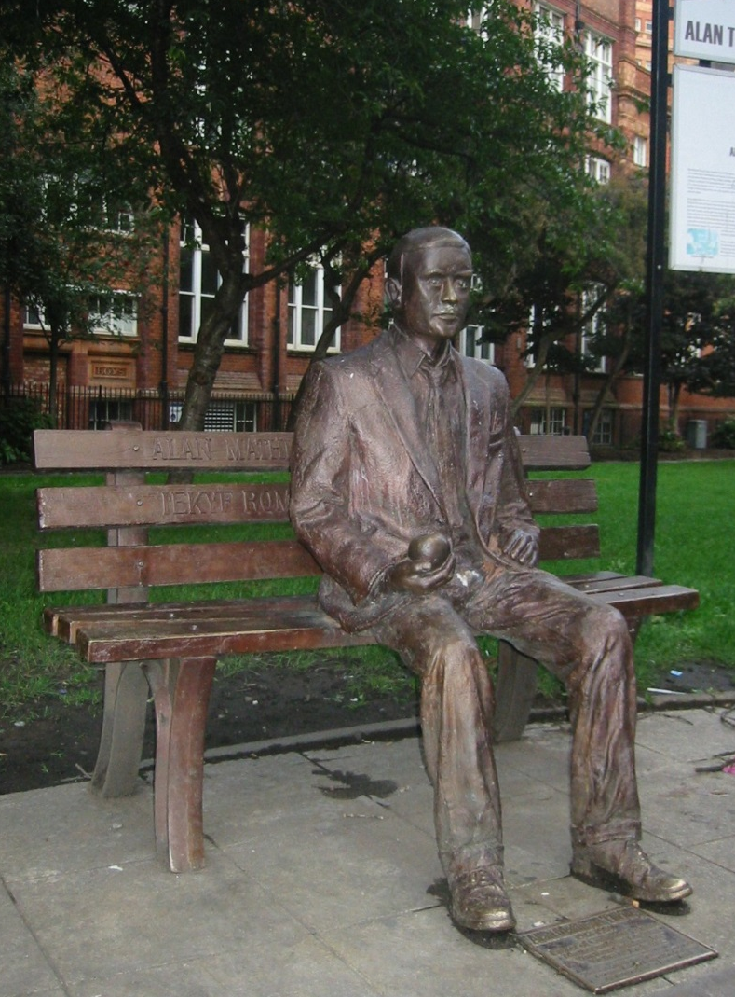
5. LGBTQI
Alan Turing is widely acknowledged as the father of the computer and artificial intelligence.
You can find this statue of him in Manchester's Sackville Park, between Canal Street's gay village and Manchester University where he once worked.
Alan Turing was a man who was forced to lead a double life, existing between two worlds. That of his work on cracking the enigma code during WWII at Bletchley Park and also as a gay man when homosexuality was against the law in Britain.
In the memorial Alan is shown holding an apple – the forbidden fruit.
Notes:
Image: https://commons.wikimedia.org/wiki/File:Alan_Turing_Memorial_Closer.jpg
Image Attribution: Photograph taken by en:User:Lmno 18 September 2004 with Canon IXUS.

Slide 65
5. LGBTQI
The cast bronze bench carries in relief the text
"Alan Mathison Turing 1912–1954" and the motto "Founder of Computer Science" as it would appear if encoded by an Enigma machine; 'IEKYF RQMSI ADXUO KVKZC GUBJ'.
He was a pioneer of modern computing but in 1954 it is believed he committed suicide after being convicted of homosexual acts.
There are a few other examples of monuments that commemorate an LGBTQI person’s contributions to society as well as their identity in respect to LGBTQI history, rights and advocacy movements – as is shown by Alan’s holding of the apple here.
Notes:
Find out more bout Alan: https://www.bbc.co.uk/teach/alan-turing-creator-of-modern-computing/zhwp7nb
Image: https://commons.wikimedia.org/wiki/File:Alan_Turing_Memorial_Closer.jpg
Image Attribution: Photograph taken by en:User:Lmno 18 September 2004 with Canon IXUS.

Slide 66
Activity
Look at the images and descriptions of the memorials on the following slides.
As you look at the monuments start to think about what categories you could use to describe the people/events being immortalised.
Extra-ordinary
events
Freedom of expression
Protest

Slide 67
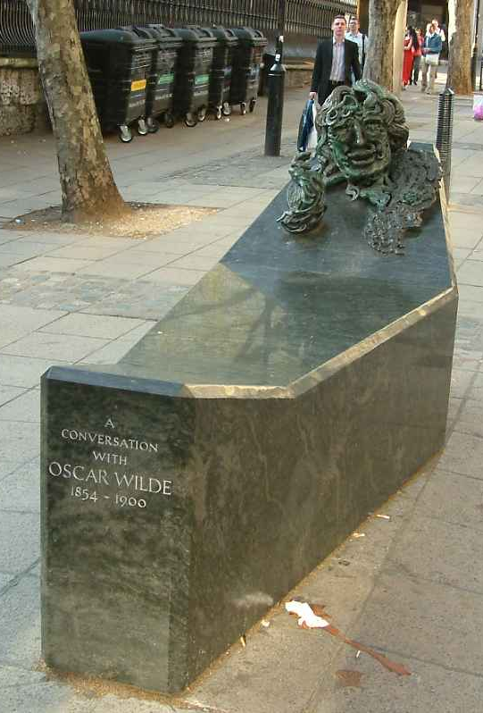
Oscar Wilde memorial, Covent Garden, London This bronze and granite sculpture to writer and playwright Oscar Wilde can be found behind St Martin’s in the Field’s Church near Covent Garden in London. It is titled ‘A Conversation with Oscar Wilde’. It has the inscription: “We are all in the gutter but some of us are looking at the stars” which is a quote from one of Oscar Wilde’s plays. He was arrested, tried and convicted for gross indecency with men. He was sentenced to two years' hard labour, the maximum penalty, and was jailed from 1895 to 1897.
Notes:
Image: https://commons.wikimedia.org/wiki/File:A_Conversation_With_Oscar_Wilde_-_London_-_240404.jpg
Image Attribution: "A conversation with Oscar Wilde" - Statue by Maggi Hambling - Adelaide Street, near Trafalgar Square, London - 240404
Taken by Tagishsimon 24th April 2004
Image: https://commons.wikimedia.org/wiki/File:A_Conversation_with_Oscar_Wilde_-_inscription.jpg
Image Attribution: Prioryman / CC BY-SA (https://creativecommons.org/licenses/by-sa/4.0)

Slide 68
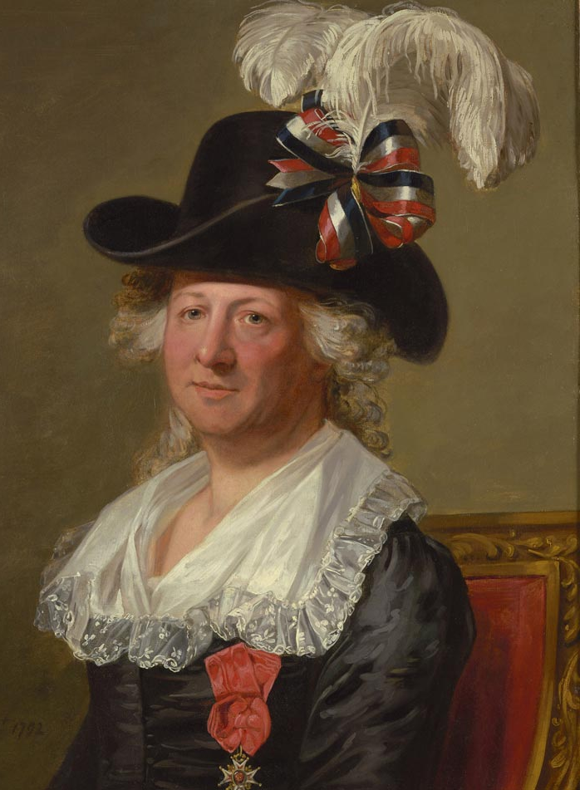
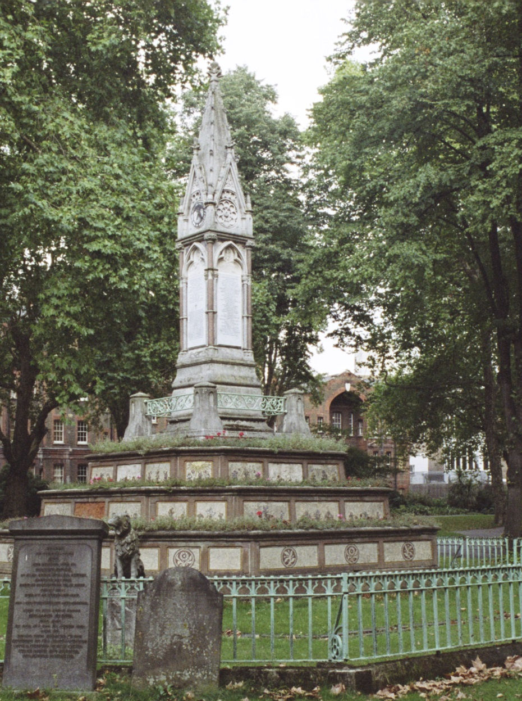
Burdett-Coutts Memorial, Old St Pancras Churchyard, London The Burdett Coutts Memorial Sundial was built in Old St Pancras churchyard in 1877–79, on the orders of of Baroness Burdett-Coutts. It includes a memorial to the Chavalier d’Eon (1728 – 1810), a spy and French Diplomat. During his career d'Eon successfully infiltrated the court of Empress Elizabeth of Russia by presenting as a woman. He is often identified as one of the first examples of a self-identifying trans woman.
Notes:
Image: https://historicengland.org.uk/images-books/photos/item/IOE01/16604/17
Image Attribution: Copyright IoE Tim Belcher. Source Historic England Archive ioe01_16604_17
Image: https://commons.wikimedia.org/wiki/File:Thomas_Stewart_%E2%80%93_Chevalier_d%27Eon.jpg
Image Attribution: After Jean-Laurent Mosnier / Public domain
Link: https://www.newhistorian.com/chevalier-deon-spy-celebrity-europes-first-transgender-person/7982/

Slide 69
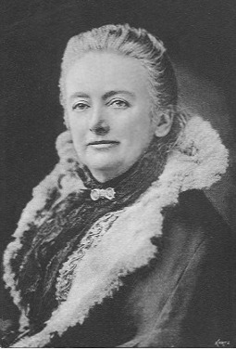
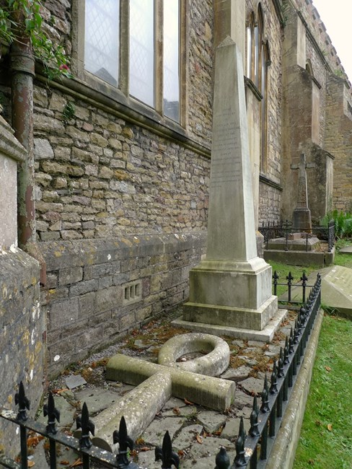
Amelia Edwards’ Grave, Bristol The gravestone of 19th Century Egyptologist and writer Amelia Edwards is in St Mary's Churchyard in Bristol. She is buried next to her ‘beloved friend’ Ellen Braysher and Ellen’s daughter Sarah. The ankh (Egyptian symbol of life) was added in honour of her love of Egypt. Her particular concern at the neglect of ancient monuments in Egypt led her to actively campaign for their scientific excavation and protection, resulting in the formation of the Egypt Exploration Fund (later the Egypt Exploration Society) on 27th March 1882.
Notes:
It is believed that Ellen was Amelia’s partner – find out more about Amelia’s relationships with women here: https://www.historypin.org/en/prideofplace/geo/54.046575,-2.80074,13/bounds/54.01421,-2.844131,54.078915,-2.757349/search/tag:grave%20of%20amelia%20edwards/sort/popular/paging/1/pin/1029807/state/gallery
Image: https://historicengland.org.uk/research/inclusive-heritage/lgbtq-heritage-project/homes-and-domestic-spaces/under-scrutiny-at-home/
Image Attribution: The tomb of Amelia Edwards, her partner Ellen Drew Braysher and Braysher’s daughter Sarah Harriet, at St Mary’s Churchyard, Henbury, Bristol. Used with permission
Image: https://commons.wikimedia.org/wiki/File:Amelia_B_Edwards_1890_in_Amerika.jpg
Image Attribution: unbekannt - entweder der Verlag oder eine Zeitung / Public domain

Slide 70
Research Task
Try to find any other LGBTQI monuments in England.
Did you find any more?
Why have these stories been less told?
Might the story of LGBTQI people from history be part of a ‘hidden history’?
Should more effort be put into uncovering these ‘hidden histories’ and telling their stories?
Notes:
Using the previous two slides as inspiration try to recreate them, but using local examples instead – village/town, county, region….what is local?
Some more information can be found here: https://www.bbc.co.uk/news/uk-37438800 & https://www.historypin.org/en/prideofplace/geo/52.219684,-2.544675,6/bounds/47.322398,-18.936277,56.63082,13.846927/paging/1

Slide 71
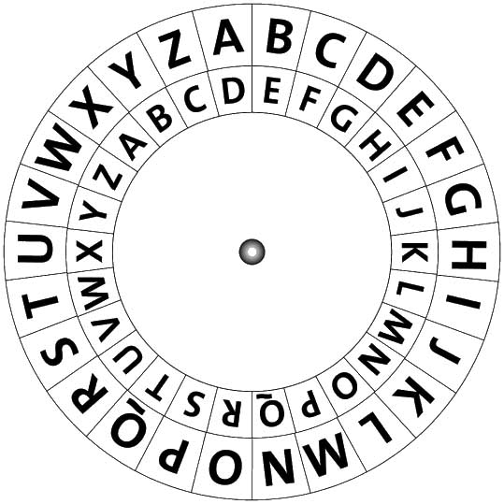
Research Task
Hidden Histories
Research and write short sentences about the life and career of Alan Turing or any of the LGBTQI figures you’ve learnt about.
Then create your own encrypted messages (hidden histories) by using the code on the cypher.
Swap your encrypted message with someone else in the class, so they can break the code and uncover the information.
Discuss the things done by these people and how they are reflected in the monuments.

Slide 72
Activity
Talking Statues
The project ‘Talking Statues’ aims to give voice to statues and sculptures all over England, including Alan Turing.
Choose a monument, memorial or sculpture and then write a short script as if the people or person were/was speaking to an audience. What would they say, what would they tell you if they could speak?
Record your scripts and listen to them as a class together, exploring the theme of giving a voice to people who haven’t had one before. Why is it important to give a voice to people who haven’t had one before?

Slide 73
6. Ethnic Diversity
This theme encourages students to address the following questions:
How can we learn about the history of ethnically diverse people in the UK by looking at statues and monuments dedicated to hidden/forgotten histories?
Why is it important to commemorate England’s ethnic diversity?
What inspired Yinka Shonibare to make an artwork about Nelson’s Ship HMS Victory?
How can history be represented in art? Is this a powerful way to tell stories? Why, or why not?

Slide 74
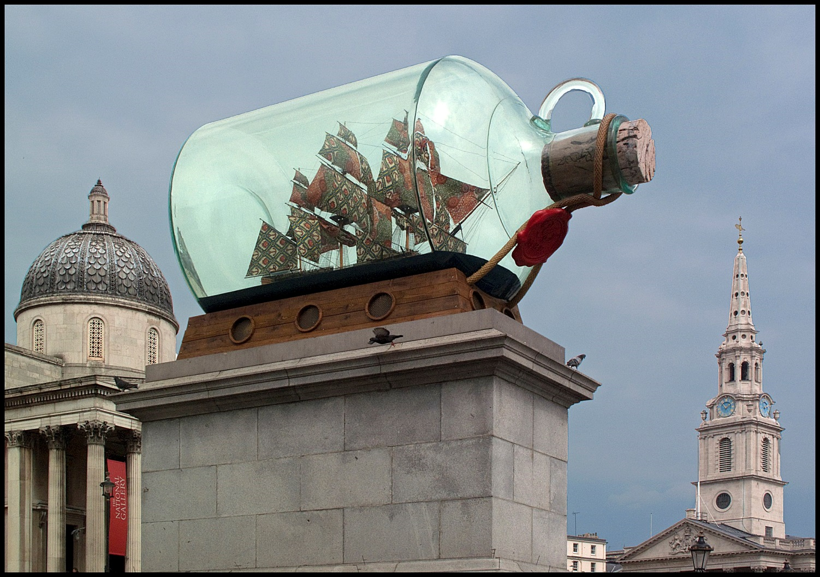
6. Ethnic Diversity
Nelson’s Ship in a Bottle by Yinka Shonibare MBE, Fourth Plinth, Trafalgar Square, London
3.25m
5m
Notes:
Image: https://commons.wikimedia.org/wiki/File:The_Fourth_Plinth._%27Nelson%27s_Ship_in_a_Bottle%27_by_Yinka_Shonibare,_Trafalgar_Square,_London._-_panoramio.jpg
Image Attribution: brian gillman / CC BY (https://creativecommons.org/licenses/by/3.0)

Slide 75
6. Ethnic Diversity
Nelson’s Ship in a Bottle is a scale replica of HMS Victory in a giant bottle, that commemorates the Battle of Trafalgar. It was created by leading Anglo-Nigerian artist Yinka Shonibare and unveiled in May 2010.
He was the first black British artist to be commissioned (by the Mayor of London) to make a piece of artwork for the fourth plinth in Trafalgar Square.
It reflects the multiculturalism of London by exploring the legacy of British colonialism, trade and Empire, the freedom of the seas and new trade routes that Nelson’s victory provided.
Notes:
Compare this interpretation of the Battle of Trafalgar with the work on Nelson’s Column in Section 2 on the Great and the Good (from slide 22 onwards)
Image: https://commons.wikimedia.org/wiki/File:The_Fourth_Plinth._%27Nelson%27s_Ship_in_a_Bottle%27_by_Yinka_Shonibare,_Trafalgar_Square,_London._-_panoramio.jpg
Image Attribution: brian gillman / CC BY (https://creativecommons.org/licenses/by/3.0)

Slide 76
6. Ethnic Diversity
The ship’s 37 large sails are made of richly patterned textiles associated with African dress and symbolic of African identity and independence.
"The sails are a metaphor for the global connections of contemporary people. This piece celebrates the legacy of Nelson – and the legacy that victory at the battle of Trafalgar left us is Britain's contact with the rest of the world, which has in turn created the dynamic, cool, funky city that London is”.
Yinka Shonibare, MBE
Notes:
Although the textiles were thought to have come from Africa, they were in fact, mass produced by the Dutch and sold to the colonies in West Africa.
Image: https://commons.wikimedia.org/wiki/File:The_Fourth_Plinth._%27Nelson%27s_Ship_in_a_Bottle%27_by_Yinka_Shonibare,_Trafalgar_Square,_London._-_panoramio.jpg
Image Attribution: brian gillman / CC BY (https://creativecommons.org/licenses/by/3.0)

Slide 77
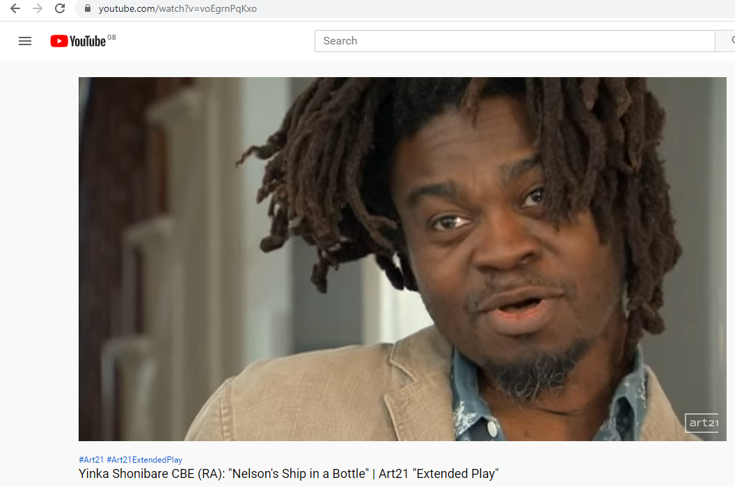
6. Ethnic Diversity
Watch this film of Shonibare and others discussing his artwork
Shonibare’s artwork brings history to life and prompts us to look at the past in a different way.
Is this a powerful way to tell stories?
Why, or why not?
Notes:
After it was on the fourth plinth it was moved to a permanent home outside the Greenwich Maritime Museum

Slide 78
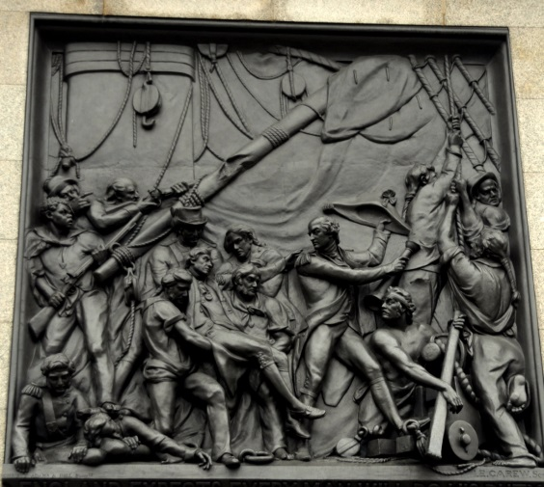
Activity
How else can history be represented in art?
The Battle of Trafalgar is often epitomised by the famous quote:
“England expects that every man will do his duty”
This was the flag-signal sent by Vice-Admiral of the Royal Navy Horatio Nelson, from his flagship HMS Victory as the Battle of Trafalgar as it was about to commence on 21 October 1805.
However, the Victory muster book listed only 441 on board as English on the morning of the battle.
Notes:
https://www.independent.co.uk/news/uk/this-britain/the-black-heroes-of-trafalgar-320576.html
Watch: https://www.bbc.co.uk/iplayer/episode/b083bv43/black-and-british-a-forgotten-history-2-freedom
Did you know! The bronze relief which is on the base of Nelson’s Column is made from melted French canons
Image: https://commons.wikimedia.org/wiki/File:Nelson%27s_column_-_Death_of_Nelson_at_Trafalgar_relief.jpg
Image Attribution: Eluveitie / CC BY-SA (https://creativecommons.org/licenses/by-sa/3.0)
Image: https://commons.wikimedia.org/wiki/File:The_Death_of_Nelson_at_the_Battle_of_Trafalgar,_21_October_1805_RMG_BHC0547.tiff
Image Attribution: Samuel Drummond / Public domain

Slide 79
Activity
The remaining 222 were from a seafaring United Nations:
64 Scots, 63 Irish, 18 Welsh, 3 Shetlanders, 2 Channel Islanders, 1 Manxman, 21 Americans,
7 Dutch, 6 Swedes, 4 Italians, 4 Maltese, 3 Norwegians, 3 Germans, 2 Swiss, 2 Portuguese, 2 Danes, 2 Indians, 1 Russian, 1 Brazilian,
1 African, 9 West Indians, and 3 French volunteers.
The one African is believed to have been 23-year-old George Ryan who worked on many ships throughout his life.
Notes:
https://www.independent.co.uk/news/uk/this-britain/the-black-heroes-of-trafalgar-320576.html
Watch: https://www.bbc.co.uk/iplayer/episode/b083bv43/black-and-british-a-forgotten-history-2-freedom
Did you know! The bronze relief which is on the base of Nelson’s Column is made from melted French canons
Image: https://commons.wikimedia.org/wiki/File:Nelson%27s_column_-_Death_of_Nelson_at_Trafalgar_relief.jpg
Image Attribution: Eluveitie / CC BY-SA (https://creativecommons.org/licenses/by-sa/3.0)
Image: https://commons.wikimedia.org/wiki/File:The_Death_of_Nelson_at_the_Battle_of_Trafalgar,_21_October_1805_RMG_BHC0547.tiff
Image Attribution: Samuel Drummond / Public domain

Slide 80
Activity
Can you identify the man thought to be George Ryan in the sculpture on Nelson’s Column?
Notes:
https://www.independent.co.uk/news/uk/this-britain/the-black-heroes-of-trafalgar-320576.html
Watch: https://www.bbc.co.uk/iplayer/episode/b083bv43/black-and-british-a-forgotten-history-2-freedom
Image: https://commons.wikimedia.org/wiki/File:Nelson%27s_column_-_Death_of_Nelson_at_Trafalgar_relief.jpg
Image Attribution: Eluveitie / CC BY-SA (https://creativecommons.org/licenses/by-sa/3.0)

Slide 81
Activity
Can you identify any other people of colour in this section of the painting of ‘The Death of Nelson at the Battle of Trafalgar’? Compared to the crew list does this seem like a historically accurate portrayal of events?
Both of these artworks show ‘The Death of Nelson’. Compare and contrast the two as historical sources of evidence for the battle. You may wish to do further research into the paintings and the artists who created them.
Discuss your findings.
Notes:
Follow the image link below to see the whole of this painting – it can be downloaded at a high resolution to let students really see it in detail. You could even spilt it into sections and give different groups of students different sections of it to study.
Image: https://upload.wikimedia.org/wikipedia/commons/b/bd/Daniel_Maclise_-_The_Death_of_Nelson_-_Google_Art_Project.jpg
Image Attribution: Daniel Maclise / Public domain

Slide 82
Activity
What can we learn about the history of ethnic diversity in the UK by looking at statues and monuments?
Look at the images and descriptions of the memorials on the following slides.
As you look at the monuments start to think what categories you could use to describe the people/events being immortalised.
?
?
?
Notes:
Students could look at and research all the following memorials – or be asked to look at one in-depth and report back to other about it.

Slide 83
Noor Inayat Khan, Gordon Square, London Noor was a wartime British secret agent of Indian descent who was the first female radio operator sent into Nazi-occupied France by the Special Operations Executive (SOE). In 1943, she was captured and kept in chains and in solitary confinement. Despite repeated torture, she refused to reveal any information. In 1944 she was moved to Dachau concentration camp where on 13 September she was shot. She was posthumously awarded the George Cross in 1949.
Notes:
Read this newspaper article to find out more about Noor and this statue: https://www.independent.co.uk/news/uk/home-news/british-asian-spy-noor-inayat-khan-who-was-executed-by-the-nazis-get-memorial-in-londons-gordon-8298194.html
Image: https://commons.wikimedia.org/wiki/File:NoorInayatKhan.jpg
Image Attribution: Henk van der Wal / CC BY-SA (https://creativecommons.org/licenses/by-sa/3.0)

Slide 84
Bronze Woman Statue, Stockwell, London Bronze Woman is the first memorial to women in the Caribbean community. It was based on the now famous poem of the same name by Cécile Nobrega who lived in Stockwell until her passing in 2013. The poem was written around 50 years ago, celebrating Caribbean women, with lines like ‘find me a place/ in the sun’ and ‘there I will set her/ honoured, free’. The statue also marked the 60th anniversary of the arrival of the ship Empire Windrush to Britain in 2008.
Notes:
Find out more about the statue: https://www.southlondonclub.co.uk/blog/a-deeper-look-into-stockwells-bronze-woman-statue
Image: https://commons.wikimedia.org/wiki/File:Bronze_Woman,_Stockwell,_Lambeth_Walk_(32984700893).jpg
Image Attribution: subherwal from London, United Kingdom / CC BY (https://creativecommons.org/licenses/by/2.0)

Slide 85
Caribbean Servicemen and woman who served in WW1 and WW2, Brixton, London Unveiled in June 2017, this memorial is in Windrush Square in Brixton, and commemorates the service personnel of African and Caribbean heritage who fought in WW1 and WW2. It is inscribed with the name of every regiment from Africa and the Caribbean who served in World Wars I and II, as well as where they served, and when.
Notes:
Find out more about the statue: https://en.wikipedia.org/wiki/African_and_Caribbean_War_Memorial
Image: https://commons.wikimedia.org/wiki/File:African_and_Caribbean_Memorial,_31_July_2017_01.jpg
Image Attribution: Kelly Foster / CC BY-SA (https://creativecommons.org/licenses/by-sa/4.0)

Slide 86
Platforms Piece, Brixton Station Platforms Piece is a three-figure sculptural group created in 1985-6, by Kevin Atherton. Atherton wanted his three figures to represent the real inhabitants of Brixton, and took much time seeking the right models. The three he chose were Peter Lloyd, Joy Battick and Karin Heistermann, each of whom had a particular connection to Brixton. It was ‘listed’ in 2016 as it is believed to be the first sculptural representation of British black people in England in a public art context.
Notes:
Find out more about the statue: https://historicengland.org.uk/listing/the-list/list-entry/1438640
Image: https://commons.wikimedia.org/wiki/File:Male_Platform_Piece.jpg
Image Attribution: Oxfordian Kissuth / CC BY-SA (https://creativecommons.org/licenses/by-sa/3.0)

Slide 87
Statue commemorating Sikh soldiers who fought in WW1, National Arboretum, Staffordshire The statue commemorates the 130,000 Sikh men who took part in the First World War. More than 150 people pledged over £22,000 between them to pay for it. The founder and chairman of the charity, Jay Singh-Sohal, said some Sikhs left their towns and villages for the first time "to venture abroad to fight for Great Britain" and "made a contribution when Britain itself didn't have the troops“.
Notes:
Find out more about the statue: http://www.sikhmuseum.org.uk/statue-for-ww1-sikh-soldiers-unveiled-at-national-memorial-arboretum/
Image: https://www.iwm.org.uk/memorials/item/memorial/72125
Image Attribution: © Mark Newton 22.09.2017 (WMR-72125)

Slide 88
Activity
What is the most common type of memorial?
Do they fully represent ethnically diverse communities in England today, or in the past?
Why is it important to commemorate ethnically diverse people & communities?
Who else from these communities today or in the past should also be ‘immortalised’?
?
?
?
Notes:
Students could look at and research all the following memorials – or be asked to look at one in-depth and report back to other about it.
Image: https://commons.wikimedia.org/wiki/File:NoorInayatKhan.jpg
Image Attribution: Henk van der Wal / CC BY-SA (https://creativecommons.org/licenses/by-sa/3.0)

Slide 89
Creative Activity 1
Message in a bottle – Draw or write a message in a bottle to a person of ethnically diverse heritage who inspires you (living or dead) – this can be a poem, a letter, a drawing etc. Who will you choose, and why?

Slide 90
Creative Activity 2
Stories of the Seas
On board HMS Victory were men from 22 countries other than England.
Write a story or poem about one of the soldiers on board the ship.
What was life like?
What or who was left behind?
What would they find in England at the end of their journey?
What was it like living in a new country so far away from home?

Slide 91
Creative Activity 3
Designing a memorial
Create a memorial commemorating an ethnically diverse person who was an inspirational figure.
Why did you choose this person/people?
How should they be remembered?
Where would you place the memorial?
Would the memorial be used to create debate, or to encourage and inspire?
What would it be made from?
Would it be temporary or permanent?
The memorial can be:
Drawn/painted
Made from clay
Created using lino cutting or printmaking techniques
Sculpted
3D printed (if the school has one)
Collaged using different materials
Created as a mural (whole class)
A mosaic or decorated tile

Slide 92
7. Women
This theme encourages students to address the following questions:
Why are there more statues to men than women in the UK?
What does that tell us about how society has seen women’s roles in the past and today?
What role have women played, historically, in the public life of our nation?
How do we tell stories that have been side-lined/ ignored in the past?
Is this just an issue for women or are there are other people who have been missed out/ ignored?

Slide 93
7. Women
The Women of Steel is a bronze sculpture that commemorates the women of Sheffield who worked in the city's steel industry during World War I and World War II.
During WWI and WWII, thousands of women from across South Yorkshire were conscripted to aid the war effort by taking jobs in the factories and steel mills, because the male workers were away fighting. At the end of both wars these women workers were dismissed and went back to the a more traditional role of looking after their family and home.
Notes:
Image: https://commons.wikimedia.org/wiki/File:Women_of_steel.jpg
Image Attribution: Artaxerxes100 / CC BY-SA (https://creativecommons.org/licenses/by-sa/4.0)

Slide 94
7. Women
For many years the vital role women played in the war effort was forgotten and side-lined, a ‘hidden heritage’.
In 2011 four of the surviving women, Kathleen Roberts, Kit Sollitt, Ruby Gascoigne and Dorothy Slingsby, took action.
With the support of journalist Nancy Fielder, they came forward on behalf of all their fellow steelworkers and made the case for their hard work, stamina and bravery to finally be publicly acknowledged.
The statue was sculpted by Martin Jennings and unveiled in June 2016.
Notes:
Image: https://commons.wikimedia.org/wiki/File:Women_of_steel.jpg
Image Attribution: Artaxerxes100 / CC BY-SA (https://creativecommons.org/licenses/by-sa/4.0)

Slide 95
7. Women
Women of Steel is just one example of where the role of women in the past had been hidden.
That fact that less than 3% of all statues in the UK are of ordinary women, yet they make up c. 50% of the population is significant.
Can you name any statues to women that you know of?
Are there any statues to women in your local area – like the Women of Steel example?
Notes:
Discuss each of the three questions as a class or in groups, if in groups allow all groups to feedback to the whole class. This could be done face-to-face in class or as a series on online discussion forum on the school learning platform/approved online space.
Image: https://commons.wikimedia.org/wiki/File:Women_of_steel.jpg
Image Attribution: Artaxerxes100 / CC BY-SA (https://creativecommons.org/licenses/by-sa/4.0)

Slide 96
7. Women
"In London there are more statues to men named John than there are to non-fictional, non-royal women”.
Caroline Criado-Perez 2016
But why is there such a lack of monuments, memorials and statues to women on display in our society? Does this situation accurately reflect the achievements of great, talented, brave and everyday women throughout history?
Recently, Criado-Perez, amongst others, was involved in successfully campaigning to have Jane Austen appear on the £10 bank note and for a statue of Suffragette Millicent Fawcett to be unveiled in Parliament Square.
Notes:
Students may also like to read this new article by Caroline Criado-Perez: https://www.newstatesman.com/politics/feminism/2016/03/i-sorted-uk-s-statues-gender-mere-27-cent-are-historical-non-royal-women

Slide 97
Activity
What can statues tell us about the role women have played, historically, in the public life of our nation?
Look at the images and descriptions of the statues on the following slides.
As you look at the monuments start to think what categories you could use to describe the women being immortalised.
?
?
?
Notes:
Students could look at and research all the following memorials – or be asked to look at one in-depth and report back to other about it. You may also want students to view this images gallery: https://www.telegraph.co.uk/women/life/14-statues-inspiring-brave-ballsy-womenaround-britain/. You may also want to remind them of Justine Simon’s quote on slide 16: “If aliens landed in London, what conclusions would they draw from our monuments? As things stand, they might look at our memorials and conclude that we are a nation of kings and generals, we’ve mastered asexual reproduction (there are hardly any women) and our primary transport mode is the horse.”

Slide 98
Amy Johnson, Herne Bay Amy Johnson CBE (1903 – 1941) was a pioneering English aviator. She was the first woman to fly solo to Australia, landing in Darwin on 24 May 1930 after 19 and a half days. Amongst many other achievements she was the first pilot to fly from London to Moscow in one day. She died when her plane crashed into the Thames Estuary near Herne Bay in January 1941. She had taken off from Blackpool Airport to deliver an RAF aircraft to Kidlington airbase in Oxfordshire for the Air Transport Auxiliary. How she ended up 100 miles off-course remains a mystery.
Notes:
Find out more about the statue: https://www.bbc.co.uk/news/uk-england-37395430
Image: https://commons.wikimedia.org/wiki/File:Amy_Johnson,_Herne_Bay_20191030_112310_(48984660488).jpg
Image Attribution: Irid Escent / CC BY-SA (https://creativecommons.org/licenses/by-sa/2.0)

Slide 99
Millicent Fawcett, Parliament Square, London Dame Millicent Garrett Fawcett GBE (1847 – 1929) was an intellectual, political leader, activist and writer. She was a leading Suffragist and campaigner for equal rights for women, giving her first public speech in favour of votes for women in 1869. She remained a prominent figure until 1919, a year after women were finally given the vote. A statue to her was unveiled in Parliament Square, London in 2018. It is the first statue of a women ever to stand in Parliament Square.
Notes:
Find out more about the statue: https://www.bbc.co.uk/news/uk-politics-43868925
Image: https://commons.wikimedia.org/wiki/File:Millicent_Fawcett_Statue,_Parliament_Square_(48031936507).jpg
Image Attribution: Loz Pycock from London, UK / CC BY-SA (https://creativecommons.org/licenses/by-sa/2.0)

Slide 100
Mary Seacole, Lambeth, London Mary Seacole (1805 - 1881) was a pioneering nurse and heroine of the Crimean War. She established the British Hotel near Balaclava to provide "comfortable quarters for sick and convalescent officers" and also nursed the wounded on the battlefield. She became known as "Mother Seacole" and, at the time, her reputation rivalled that of Florence Nightingale. Unveiled in 2016, this statue is believed to be the UK's first in honour of a named black woman.
Notes:
Find out more about the statue: https://www.bbc.co.uk/news/uk-england-london-36663206 & more about Mary: https://www.maryseacoletrust.org.uk/learn-about-mary/
Image: https://commons.wikimedia.org/wiki/File:Mary_Seacole_Statue_-_Side_View.jpg
Image Attribution: Sumit Surai / CC BY-SA (https://creativecommons.org/licenses/by-sa/4.0)

Slide 101
Gracie Fields, Rochdale Dame Gracie Fields, DBE (1898 – 1979) was an English actress, singer and comedian and star of both cinema and music hall. She was born in Rochdale, Lancashire. In the 1930s she was the highest paid actress in the world. Her travelling performances for troops during World War Two led her to become known as "a forces' sweetheart“. This was the first statue of a woman to be erected in Greater Manchester for more than 100 years.
Notes:
Find out more about the statue: https://aboutmanchester.co.uk/gracie-fields-statue-unveiled-in-her-hometown-of-rochdale/
Image: https://commons.wikimedia.org/wiki/File:Statue_of_Dame_Gracie_Fields_in_Rochdale,_Lancashire,_England.jpg
Image Attribution: Poorlyglot / CC BY-SA (https://creativecommons.org/licenses/by-sa/4.0)

Slide 102
Amy Winehouse, Camden Lock, London Amy Winehouse (1983-2011) was a singer and songwriter who was known for her eclectic mix of musical genres, including jazz, soul and rhythm and blues. She lived and often performed in Camden in North London. According to Amy’s dad, Mitch – “I had a meeting with Camden council and they told me they don’t usually allow statues until 20 years after someone has died, but in Amy’s case they made an exception.”
Notes:
Find out more about the statue: https://www.spin.com/2014/08/amy-winehouse-statue-london-camden-square-home/
Image: https://commons.wikimedia.org/wiki/File:Amy_Winehouse_Statue_J._Linwood.jpg
Image Attribution: Jim Linwood / CC BY (https://creativecommons.org/licenses/by/2.0)

Slide 103
Activity
What categories did you come up with to describe why these women are being commemorated?
What makes them inspirational/unique/talented?
Were they recognised in their own time? If so why, if not, why not?
Do they fully represent women in England today, or even in the past?
Why are there more statues to men than women in the UK?
What do you think that tells us about how society has seen women’s roles in the past and today?
Notes:
Students could look at and research all the following memorials – or be asked to look at one in-depth and report back to other about it. You may also want students to view this images gallery: https://www.telegraph.co.uk/women/life/14-statues-inspiring-brave-ballsy-womenaround-britain/. You may also want to remind them of Justine Simon’s quote on slide 16: “If aliens landed in London, what conclusions would they draw from our monuments? As things stand, they might look at our memorials and conclude that we are a nation of kings and generals, we’ve mastered asexual reproduction (there are hardly any women) and our primary transport mode is the horse.”

Slide 104
Creative Activity 1
Campaign for change
This info-graphic was made as part of the successful campaign to get a statue of Millicent Fawcett put up in Parliament Square, London.
Which women from history do you think should have a statue?
Research your chosen woman and create a poster to show why she deserves her own statue.
Where do you want your statue to be put up?
Come up with a social media advertising campaign to get your statue built. As a class decide which group’s statue should be built!
Notes:
Students should work in groups on their campaign’s, culminating in a whole class discussion to decide who’s done the best campaign and which statue should get built.

Slide 105
8. Disability Representation
This theme encourages students to address the following questions:
Why are there so few statues to people with disabilities? What does that tell us about how society has seen the role of disabled people in the past and today?
What role have people with disabilities played, historically in the public life of our nation?
Why do you think there are not as many public statues, monuments and memorials to people with disabilities?
Should there be more?

Slide 106
8. Disability Representation
This statue is in Alexandra Park, Oldham. It commemorates Joseph Howarth, known as ‘Blind Joe’. He was a celebrated local personality.
He was born blind and had an amazing memory. It is said that he could recite chapters from the Bible once they had been read to him.
He was elected as the town’s bellman (Town Crier) in 1820. One of his jobs was to ring his bell to open and close Tommyfield Market, where he also had a pie and muffin stall.
Notes:
Image: https://www.geograph.org.uk/photo/3356934
Image Attribution: © Copyright David Dixon and licensed for reuse under this Creative Commons Licence.

Slide 107
8. Disability Representation
The statue of Joe dressed in his heavy coat, holding his bell in his right hand and walking stick in the other, is mounted on a stone pedestal.
The statue was unveiled on the 9th May 1868, Joe having died in 1862, aged 76. During the unveiling his own bell was rung as a mark of respect.
‘Blind Joe’ was remembered as an honest and religious man, and people admired him for his life of struggle and working-class self-improvement. Known as a lay preacher, his statue was erected to commemorate his services to religion.
Notes:
Image: https://www.geograph.org.uk/photo/3356934
Image Attribution: © Copyright David Dixon and licensed for reuse under this Creative Commons Licence.

Slide 108
8. Disability Representation
People with disabilities want to be treated as equals in our society, but this is often not the case. The media (television, newspapers, social media etc.) don’t always portray disability positively, so people with disabilities must work very hard to challenge how they are represented in the mainstream media. This statue is a very positive sculpture to a man who was loved by his community.
In the 1800’s it would have been even more challenging to be accepted in society. The sculpture shows that, despite being blind from birth, he was able to live a fulfilling life of religious belief, bell ringing, and running a stall in the market.
Notes:
Image: https://www.geograph.org.uk/photo/3356934
Image Attribution: © Copyright David Dixon and licensed for reuse under this Creative Commons Licence.

Slide 109
Activity
Look at the statue of Joe and the monuments on the following slides.
As you look at the monuments start to think about what categories you could use to describe the people/events being immortalised.
Can you find local monuments to people with disabilities?
?
?
?
Notes:
Students could look at and research all the following memorials – or be asked to look at one in-depth and report back to other about it.
Image: https://www.geograph.org.uk/photo/3356934
Image Attribution: © Copyright David Dixon and licensed for reuse under this Creative Commons Licence.

Slide 110
Gold Postbox to Paralympian Sophie Wells, Lincoln Sophie Wells MBE (1990 -) is a British para-equestrian who won three medals at the 2012 Summer Paralympics, helping the team win gold. As part of the London 2012 Olympics all British gold medal winners had their local postbox painted gold to celebrate their achievements. She was appointed Member of the Order of the British Empire in 2013 for services to equestrianism. Sophie also won a gold at Rio 2016 Summer Paralympics.
Notes:
Find out more about the gold postboxes: https://en.wikipedia.org/wiki/2012_Summer_Olympics_and_Paralympics_gold_post_boxes
Image: https://commons.wikimedia.org/wiki/File:Lincoln_Gold_Postbox.jpg
Image Attribution: MOTORAL1987 / CC BY-SA (https://creativecommons.org/licenses/by-sa/3.0)

Slide 111
Stephen Hawking Memorials, Westminster Abbey & Caius College, University of Cambridge Stephen Hawking CH CBE FRS FRSA (1942-2018) was a physicist, cosmologist, and author. “…Stephen Hawking has, uniquely, been elevated to the status of a National Treasure, whose mortal remains are interred between those of Newton and Darwin in Westminster Abbey, because of his combination of scientific excellence and his productive survival for more than 50 years despite the most debilitating of illnesses…..”
Notes:
Find out more about the statue: Quote by Master Professor Sir Alan Fersht - https://www.cai.cam.ac.uk/news/memorial-professor-stephen-hawking
His voice was also projected into space and there is a video of quotes by Stephen: https://www.independent.co.uk/news/science/stephen-hawking-memorial-death-voice-black-hole-vangelis-song-a8400486.html
Image: http://www.ctc.cam.ac.uk/news/180618_newsitem.php
Image Attribution: (Picture credit: Westminster Abbey)
Image: https://www.cai.cam.ac.uk/news/memorial-professor-stephen-hawking
Image Attribution: University of Cambridge

Slide 112
Damian Hirst’s statue ‘Charity’, London & other This is a seven-metre high sculpture of a disabled girl clutching a teddy bear and a collection tin. It highlights an "outdated vision of charity and disability”. (Alan Gosschalk, fundraising director at Scope – 2015) It is intended to depict the historical tradition of representing charity and disability as a pitiful image. The sculpture was created to raise awareness of the disability charity SCOPE, and to encourage conversations about disability in London.
Notes:
Find out more about the statue: https://www.culture24.org.uk/art/art530990-londons-yearly-public-art-exhibition-starts-to-take-shape-as-damien-hirsts-charity-is-set-to-be-installed-opposite-the-gherkin
Image: https://www.flickr.com/photos/seattlecamera/24851881879
Image Attribution: John K Thorne (CC – no rights)

Slide 113
Activity
What categories did you come up with to describe why these monuments were built?
What makes the people who are remembered inspirational/unique/talented?
Do they fully represent disabled communities in England today, or even in the past?
Why do you think there are not more monuments highlighting the role played by people with disabilities now and in the past?
What do you think that tells us about how society has seen people with disabilities in the past and today?
Notes:
Image: https://www.geograph.org.uk/photo/3356934
Image Attribution: © Copyright David Dixon and licensed for reuse under this Creative Commons Licence.

Slide 114
Research Task
A History of Disability: 1050 to the Present Day
In groups you will research one of these time periods and create a summary of it to feedback to the class.
Use the summaries to pick out the most important events and create a timeline of disability history.
Discuss the events in your timeline and how they are or aren’t reflected in the monuments you’ve seen.
Notes:
https://historicengland.org.uk/research/inclusive-heritage/disability-history/
Split the class in to groups and ask each group to research one of the 6 time periods to learn more about the history of disability. Groups then report back so that everyone learns about each period. Ask students to then pick out the most important events and create a timeline of disability history.

Slide 115
Activity
How do we recognise achievement?
Not all disabilities are visible. Look at the images of famous people on the following slides. They all have disabilities. Research each of them to discover what they are.
In pairs, choose one of the famous people, and discuss the following:
Has their disability stopped them achieving their goals? Why/Why not?
Which famous disabled person inspires you? Why?
Which other famous people can you think of who have a disability?
Was there anything that surprised you? What did you learn?
Be inspired by Power 100 – Britain’s most influential disabled people
Notes:
Ask student’s to followed their work on Disability Representation by look at the Shaw Trust’s list of the 100 most influential disabled people in Britain – it really is inspirational
https://disabilitypower100.com/wp-content/uploads/2019/10/Power_100_2019-web.pdf

Slide 116
Ruby Wax: Comedienne, activist | Blaine Harrison: Singer
Richard Branson: Virgin boss | Dame Evelyn Glennie: Musician
Notes:
Image:https://commons.wikimedia.org/wiki/File:Ruby-Wax-2016_(cropped).jpg
Image Attribution: Andrew Lih (User:Fuzheado) / CC BY-SA (https://creativecommons.org/licenses/by-sa/3.0)
Image:https://commons.wikimedia.org/wiki/File:Mystery_Jets_BML_2011_1.jpg
Image Attribution: Man Alive! / CC BY (https://creativecommons.org/licenses/by/2.0)
Image:https://commons.wikimedia.org/wiki/File:Richard_Branson.jpg
Image Attribution:NASA
Image:https://www.flickr.com/photos/powderphotography/6320259298/in/photostream/
Image Attribution:© https://www.flickr.com/photos/powderphotography/ https://creativecommons.org/licenses/by-nc-nd/2.0/

Slide 117
Stephen Fry: Actor, writer | Jonnie Peacock: Paralympian
Hannah Cockcroft: Paralympian | Stephen Hawking: Scientist
Notes:
Image:https://commons.wikimedia.org/wiki/File:Stephen_Fry_@_BorderKitchen_BW.jpg
Image Attribution: Marco Raaphorst from The Hague, The Netherlands / CC BY (https://creativecommons.org/licenses/by/2.0)
Image:https://commons.wikimedia.org/wiki/File:Jonnie_Peacock.jpg
Image Attribution: Ed Clayton / CC BY (https://creativecommons.org/licenses/by/2.0)
Image:https://commons.wikimedia.org/wiki/File:Hannah_Cockroft_wins_T34_100m_qualifying_heat.jpeg
Image Attribution: ian_fromblighty / CC BY (https://creativecommons.org/licenses/by/2.0)
Image: https://commons.wikimedia.org/wiki/File:Stephen_Hawking_in_Cambridge.jpg
Image Attribution: Doug Wheller / CC BY (https://creativecommons.org/licenses/by/2.0)

Slide 118
Alex Brooker: Journalist, comedian | Warwick Davis: Actor
Ellie Simmonds: Paralympian | Liz Carr: Actress, activist, comic
Notes:
Image:https://www.bbc.co.uk/news/entertainment-arts-53179538
Image Attribution: BBC
Image:https://commons.wikimedia.org/wiki/File:Warwick_Davis_interviewed_2.jpg
Image Attribution: Official Star Wars Blog / CC BY (https://creativecommons.org/licenses/by/2.0)
Image:https://commons.wikimedia.org/wiki/File:More_British_medals_4_(3565884589).jpg
Image Attribution: allen watkin from London, UK / CC BY-SA (https://creativecommons.org/licenses/by-sa/2.0)
Image: https://disabilityhorizons.com/2020/02/disabled-actress-liz-carr-set-to-star-in-her-first-hollywood-blockbuster/
Image Attribution: Disability Horizons website

Slide 119
Creative Activity 1
Freeze frame
Imagine you are pressing the pause button on a remote control or taking a photograph.
Work in groups to come up with different situations relating to disability – this could be access for someone in a wheelchair or needing a quiet space for someone with sensory needs.
How did your group feel about their still image? Did it help raise your awareness of people with disabilities?
How would you like to develop the activity further?
Notes:
Image: https://www.scouts.org.uk/activities/freeze-frame-game/

Slide 120
Creative Activity 2
Blind sculpting
Choose an object (this can be a shell, a bowl – any everyday object) and then draw/sketch it.
Now take a lump of clay and either wear a blindfold or just close your eyes. Your challenge is to model your object without being able to see what you’re doing!
How did you do? How did it make you feel?
Notes:
Image: https://www.accessart.org.uk/using-feel-to-manipulate-clay-with-linda-green/

Slide 121
https://www.scope.org.uk/end-the-awkward/talking-about-disability
Notes:
Watch this video to find out about the charity Scope’s ‘End the awkward’ campaign – encourage your students to End the awkward!

Slide 122
Find more teaching resources at:
HistoricEngland.org.uk/Education
Notes:
https://historicengland.org.uk/services-skills/education/

Slide 123
About Historic England
Historic England is the public body that helps people care for, enjoy and celebrate England’s spectacular historic environment.
We protect, champion and save the places that define who we are and where we’ve come from as a nation. We care passionately about the stories they tell, the ideas they represent and the people who live, work and play among them.
Working with communities and specialists we share our passion, knowledge and skills to inspire interest, care and conservation, so everyone can keep enjoying and looking after the history that surrounds us all.
Notes:
https://historicengland.org.uk/

