Slide 1
Case Study : Shearbridge Mosque
Learning Aims
To explore the story of a building through changes in its appearance and use over time through four enquiries :
Outcomes
Pupils will draw inferences about the extent of change at Shearbridge Road Mosque by looking at the outside of the building.
Pupils will draw further inferences about the extent of change at Shearbridge Road Mosque by looking at the inside of the building.
Pupils will prepare presentations about the history of the Shearbridge Road Mosque using additional evidence.
Pupils will identify the relative strength or importance of links between the history of the Shearbridge Road Mosque and the history of Bradford as a whole.
This activity relates to the ‘https://historicengland.org.uk/services-skills/education/teaching-activities/stories-in-stone-shearbridge-mosque’ Teaching Activity

Slide 2
A Case Study: Shearbridge Mosque
Overarching Enquiry Question: How much has our building on Shearbridge Road changed and stayed the same since it opened?
Lesson Plans
This sequence of activities models how an historic site identified on the interactive map of Bradford as part of the Teaching Activity: Stories in Stone - Shearbridge Road Mosque Case Study could be used as the focus of local visits and the study of local history at KS1, 2 and 3.
Background Knowledge
The chosen building was originally opened in Art Nouveau style as a United Methodist Church with an attached Sunday school.
It became a mosque in the mid 1970s and has since been altered internally with additional extensions to the exterior.
As a building it has been transformed from a Non-Conformist chapel in a working class area of Bradford to a mosque attended by Muslims of mostly Pakistani descent As such it represents some of the social and cultural changes that have so altered Bradford since industrialisation.
(Other buildings identified on the interactive map could be treated as a focus of study in the same way.)

Slide 3
Enquiry One
What can we infer about this building by looking at it from the outside?

Slide 4
Minaret and tower over main entrance

Slide 5
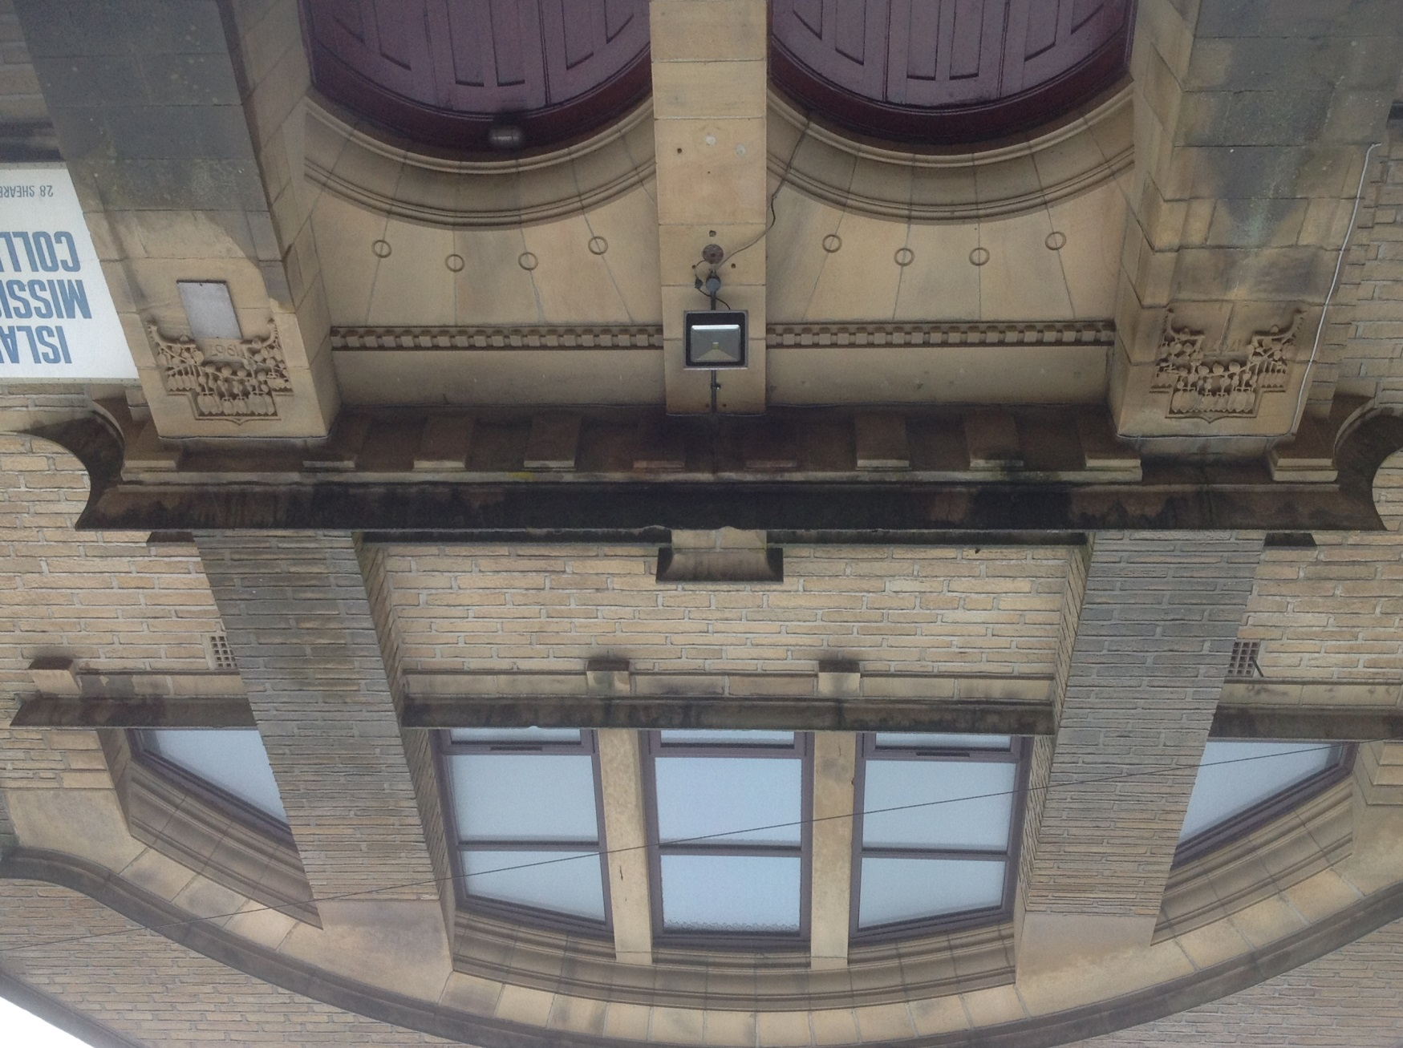
Former church entrance

Slide 6
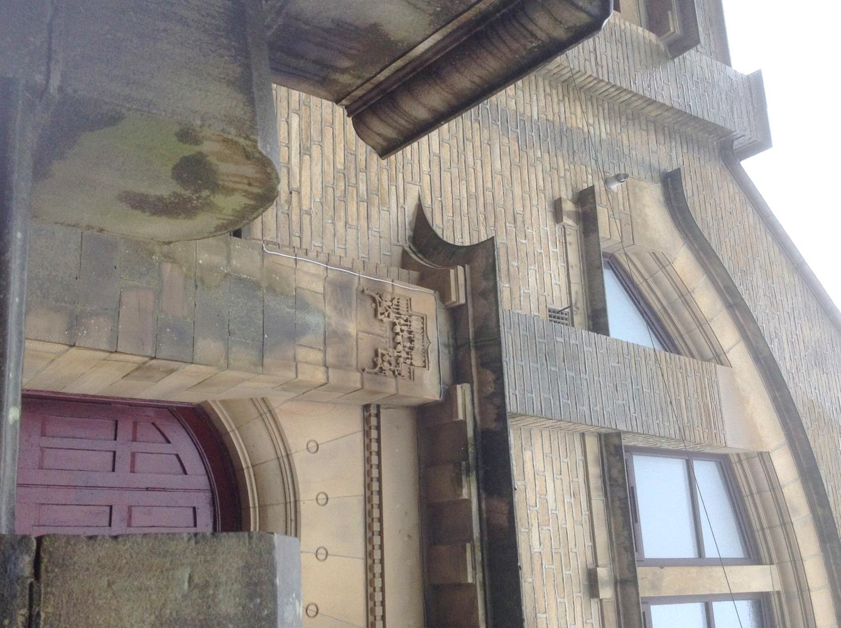
Date of 1797 inscribed on pillar
1797

Slide 7
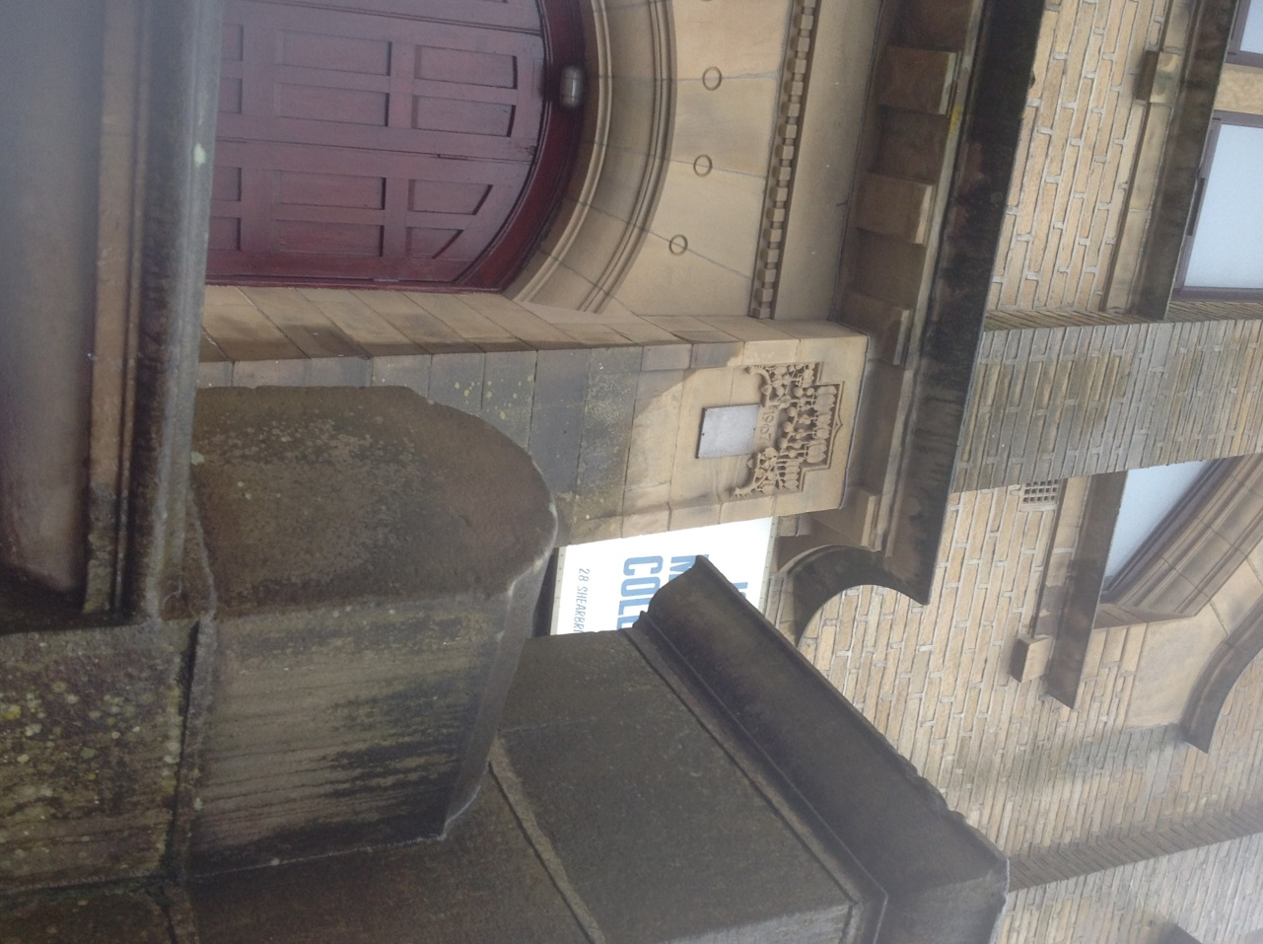
Date of 1907 inscribed on pillar
1907

Slide 8
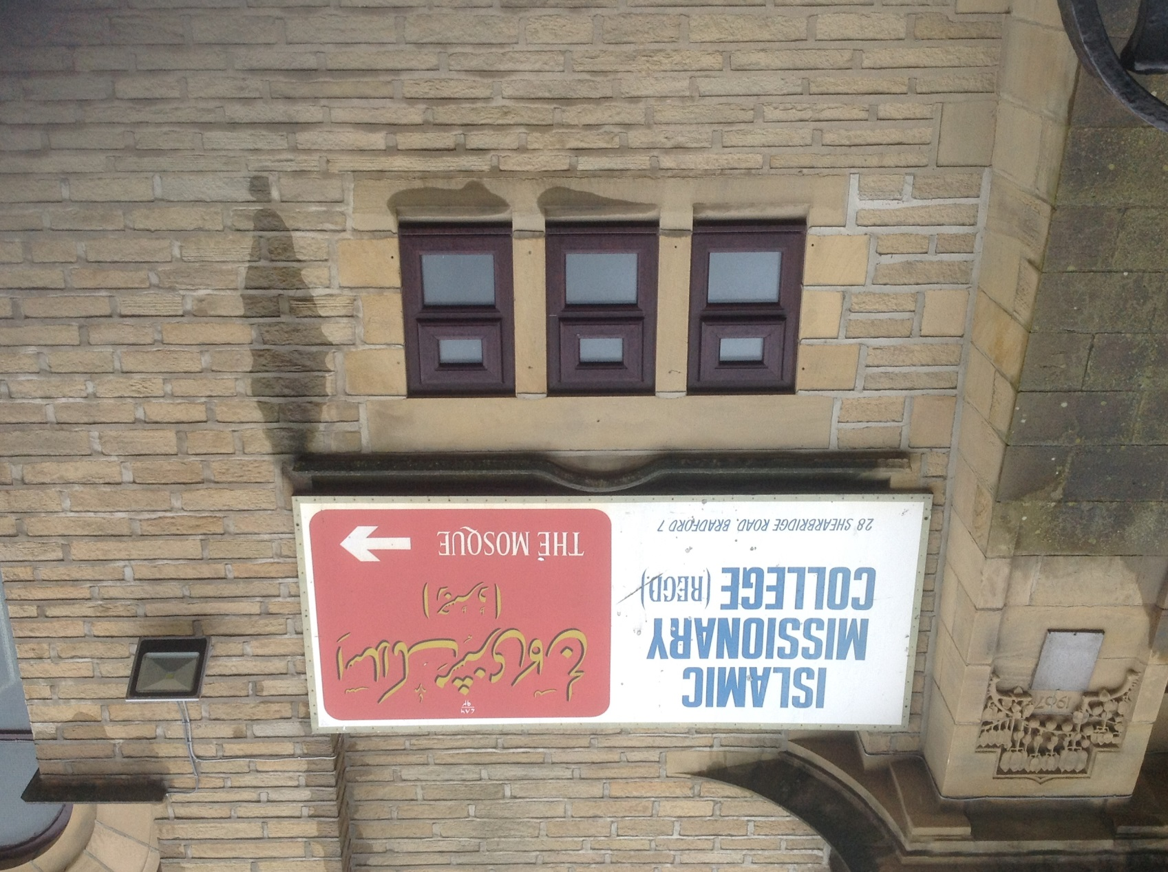
Large sign on outside wall

Slide 9
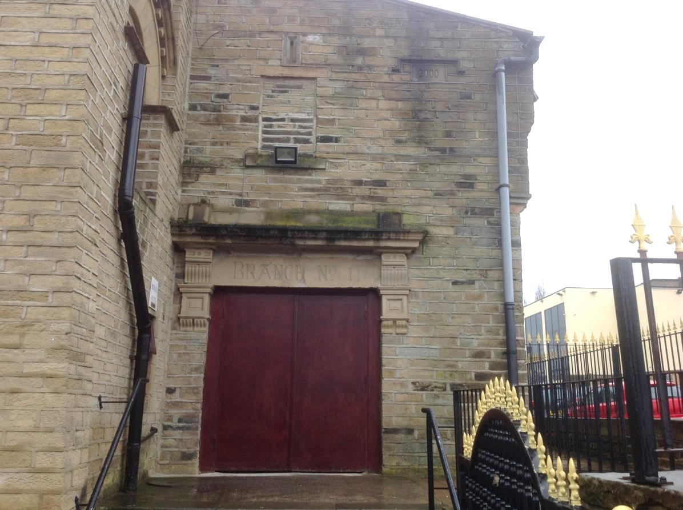
“BRANCH No 11” inscribed over outside door
Branch No 11

Slide 10
Date 2000 inscribed on outside wall
2000

Slide 11
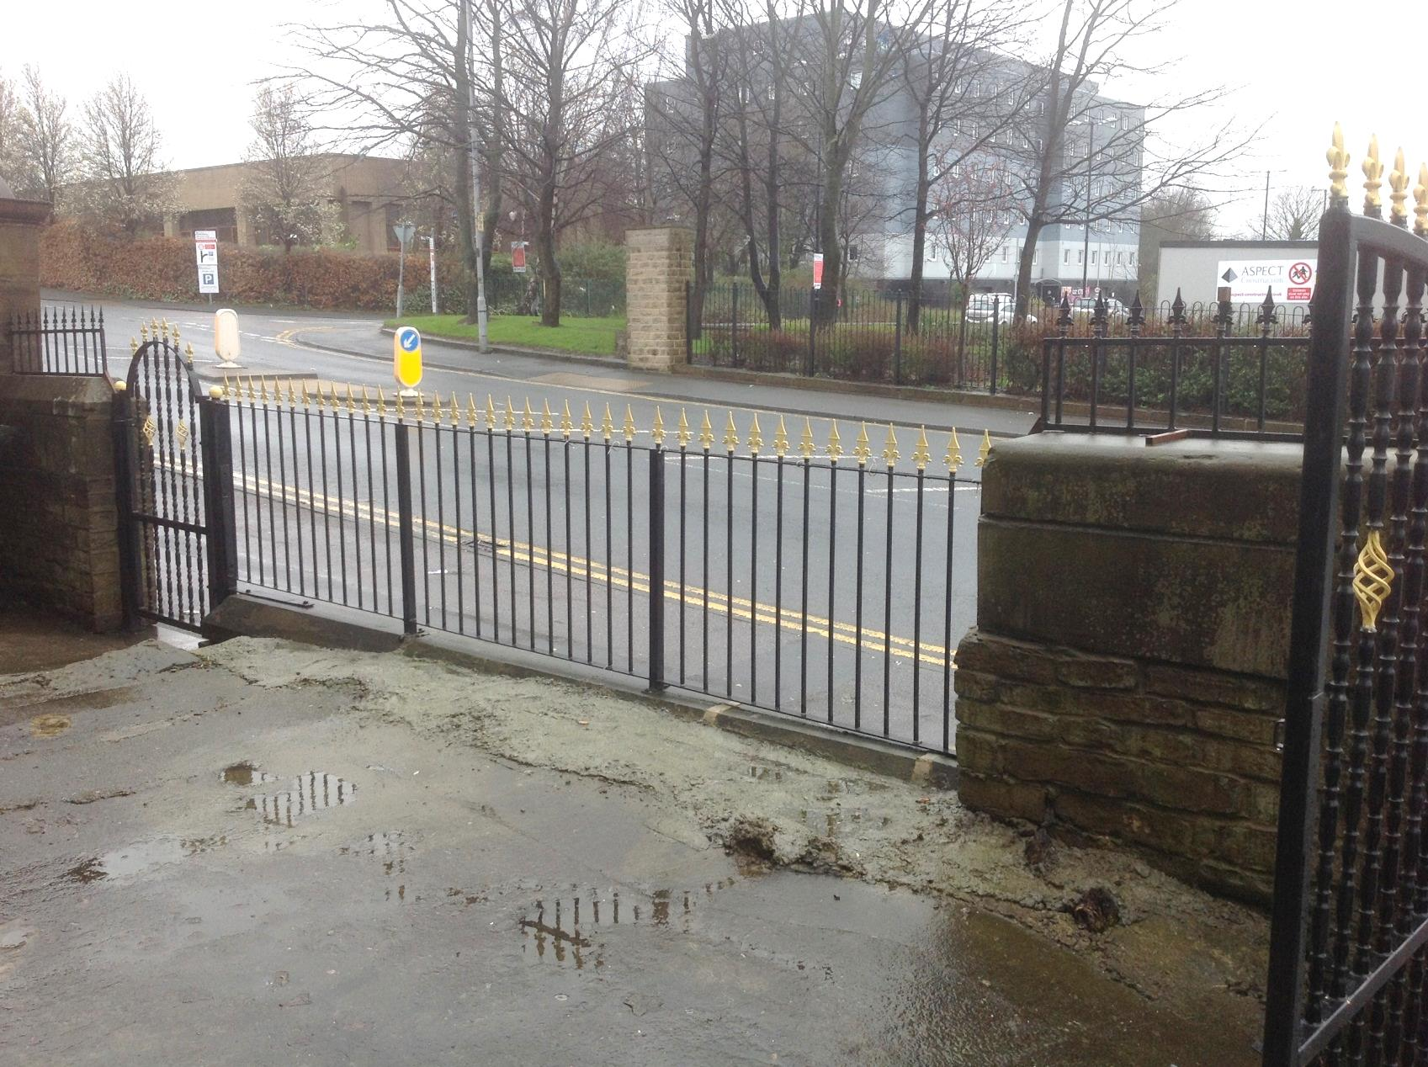
Railings outside the building

Slide 12
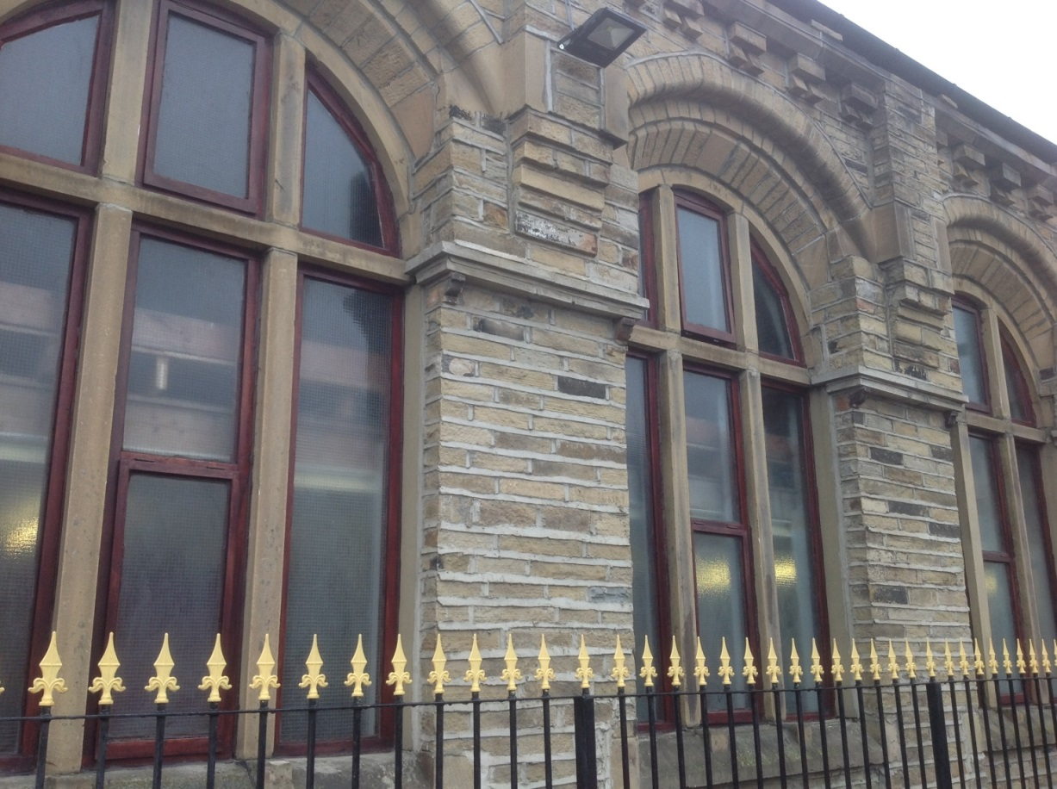
Railings outside the modern extension made in the same style and materials as the original church building

Slide 13
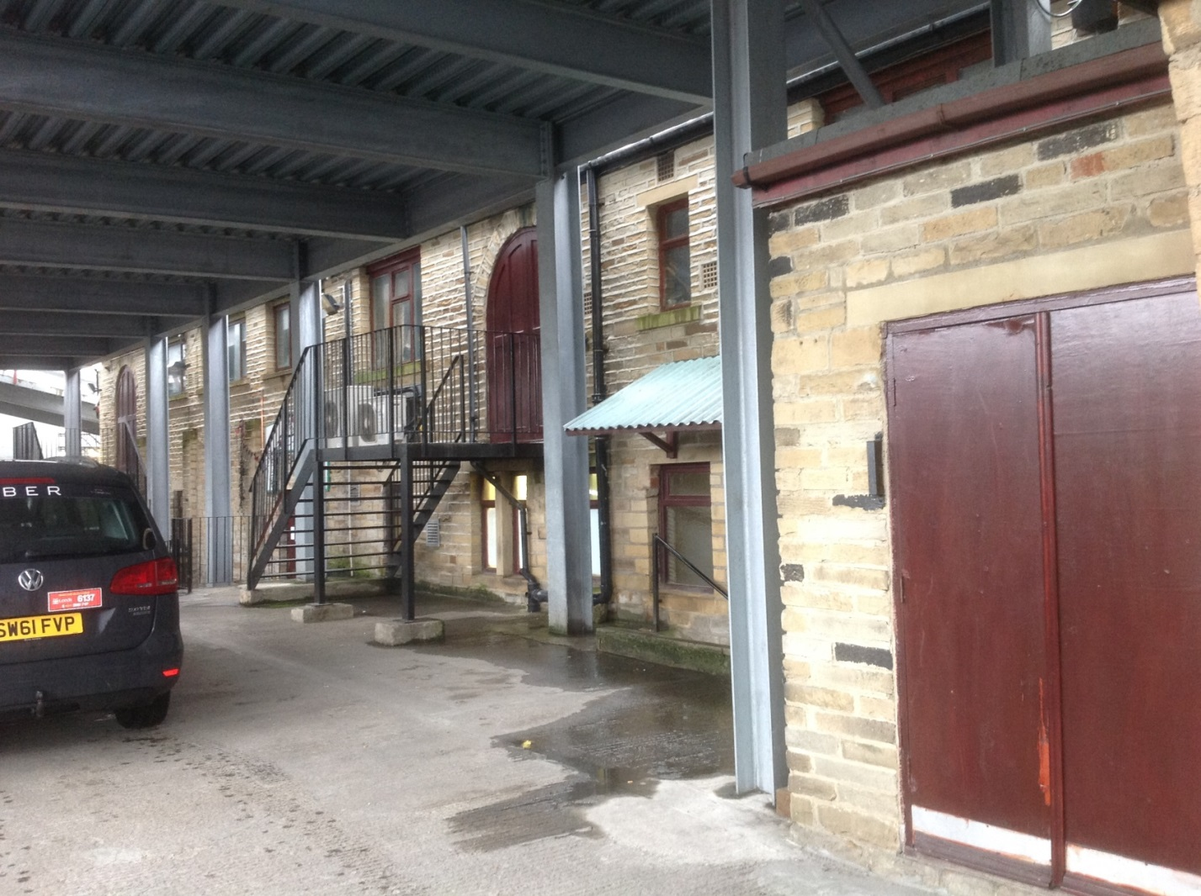
Side view of the outside showing the modern car port

Slide 14
Enquiry Two
What can we infer about this building by looking at it from the inside?

Slide 15
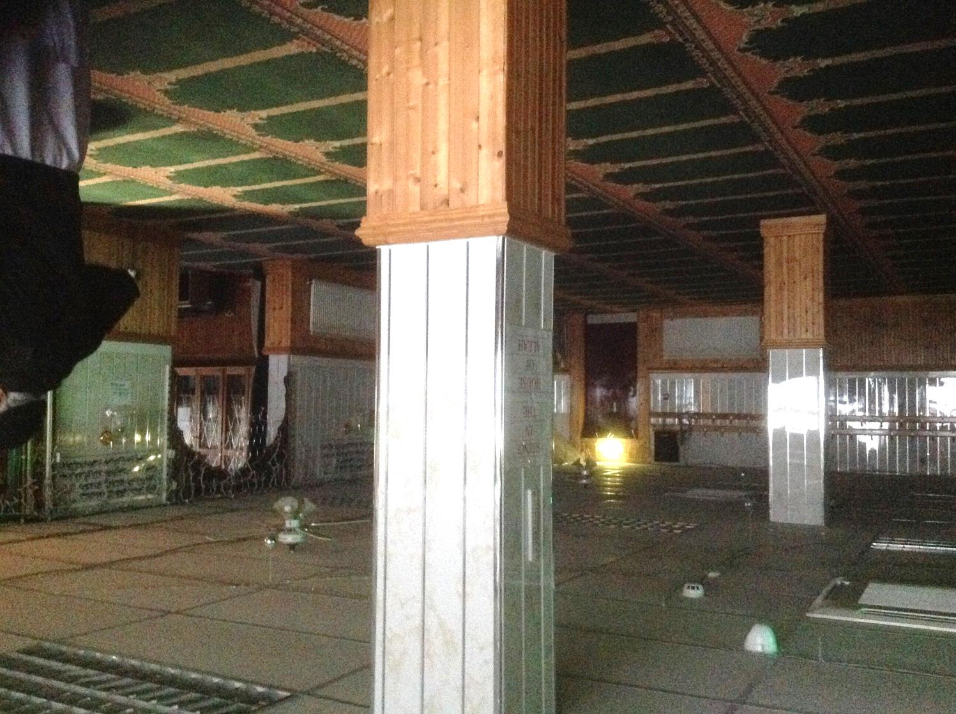
Lower ground floor of mosque
(sited on ground floor of former Methodist Sunday School)

Slide 16
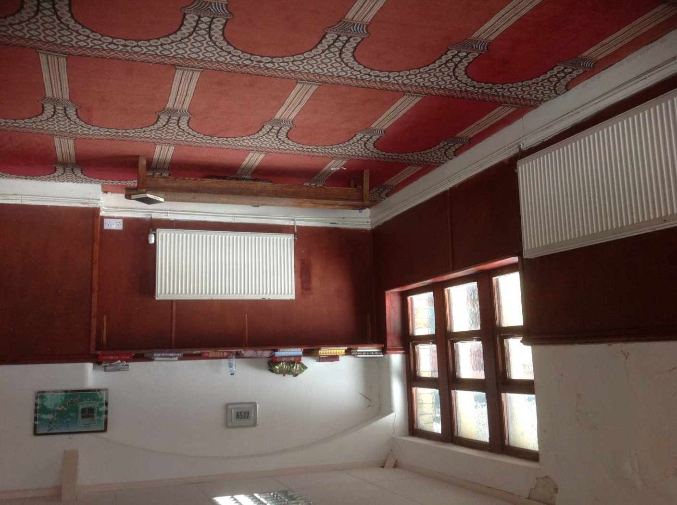
Former Methodist Sunday School Room with traditional Islamic carpet design

Slide 17
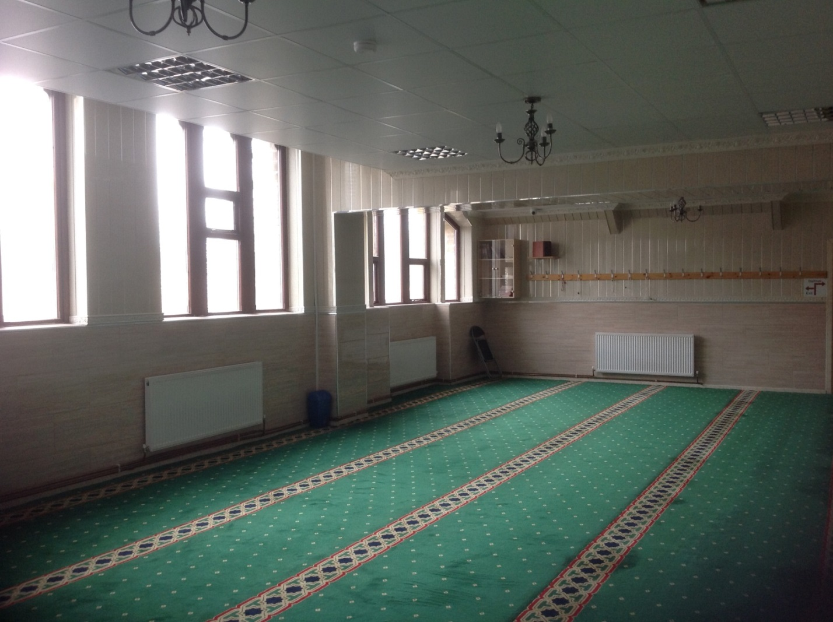
Former Methodist Sunday School Room with traditional Islamic carpet design

Slide 18
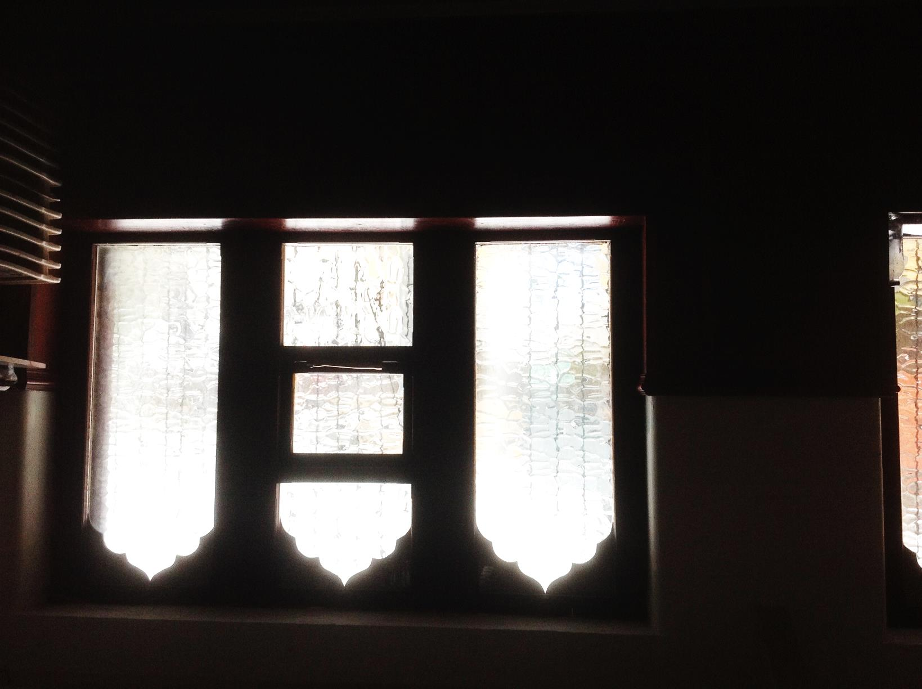
Interior windows with traditional Islamic arches inserted

Slide 19
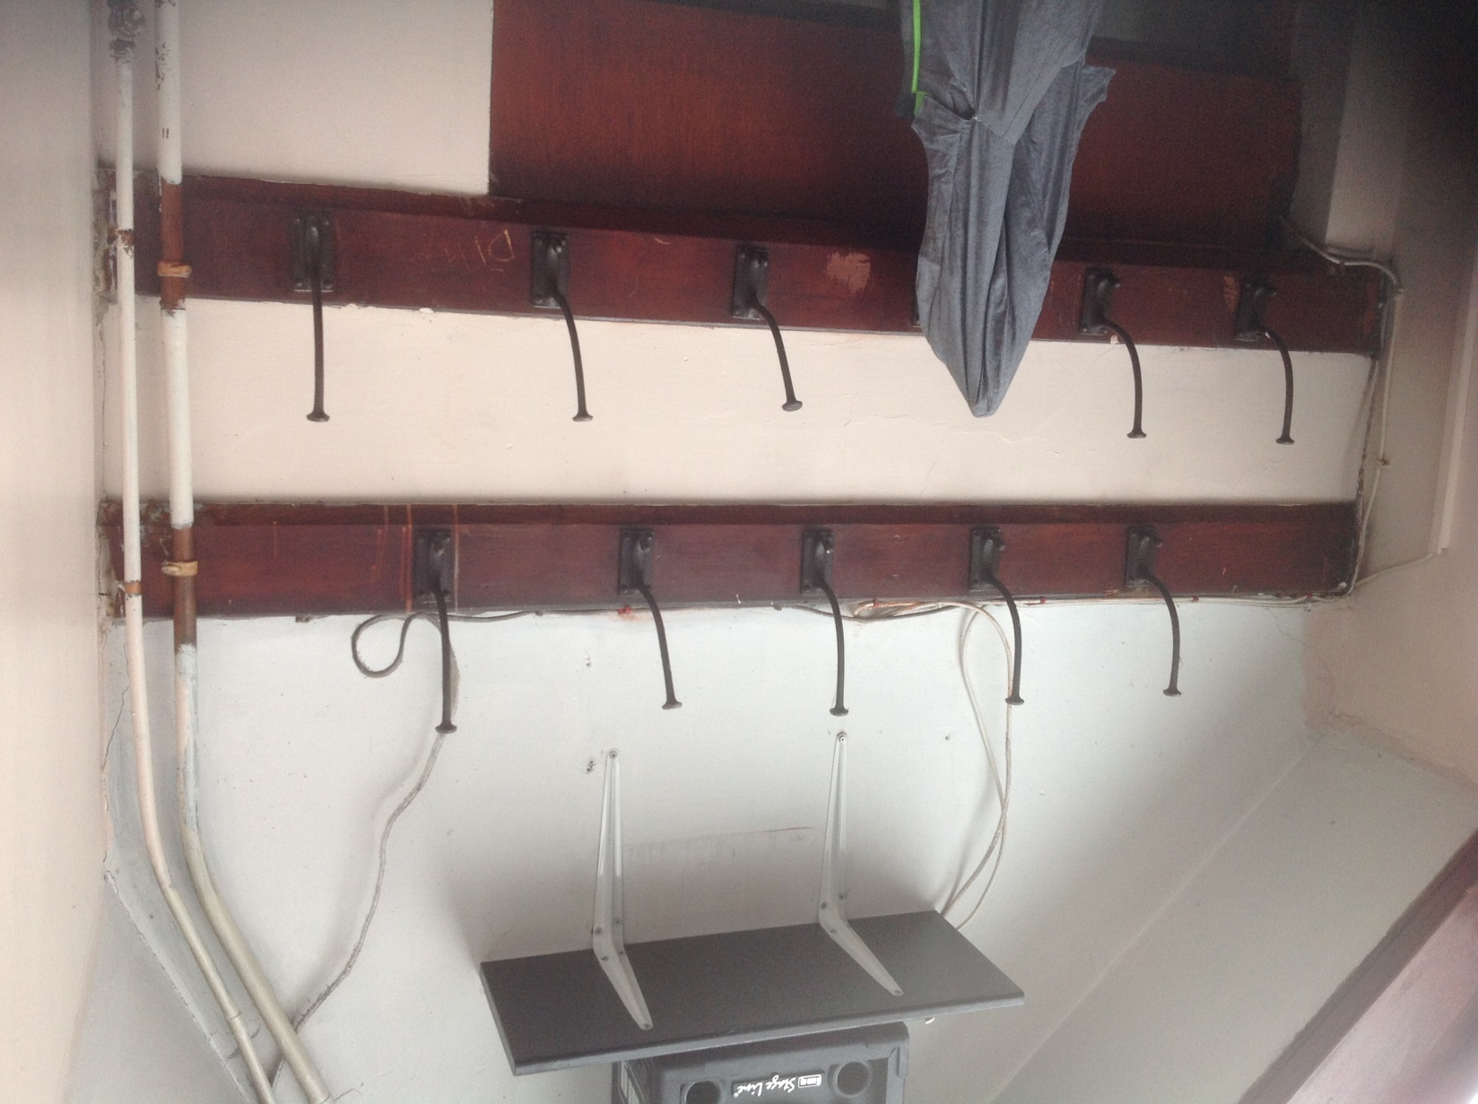
Original coat hooks from the Methodist Sunday School

Slide 20
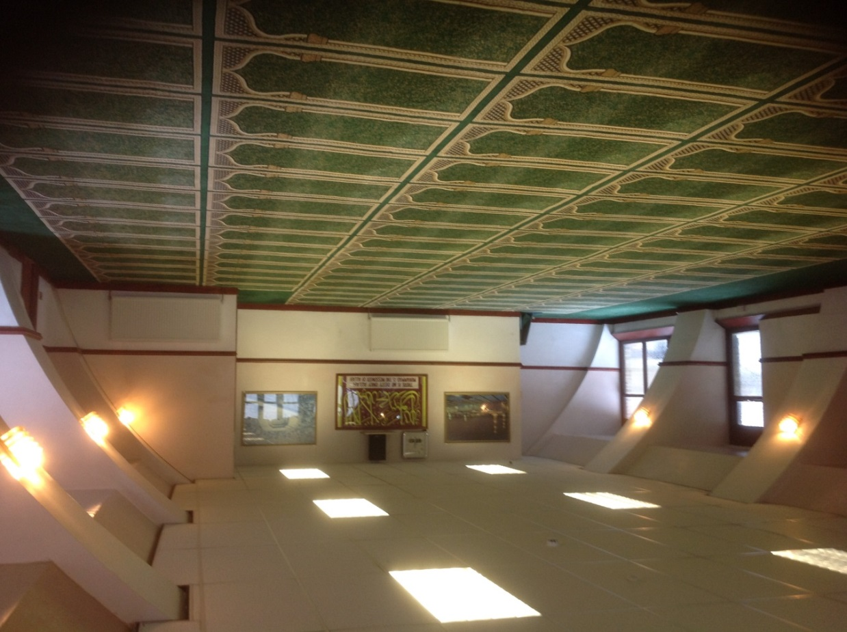
Upper room of Methodist Sunday School with traditional Islamic style carpet, Arab calligraphy and images of Islamic sites

Slide 21
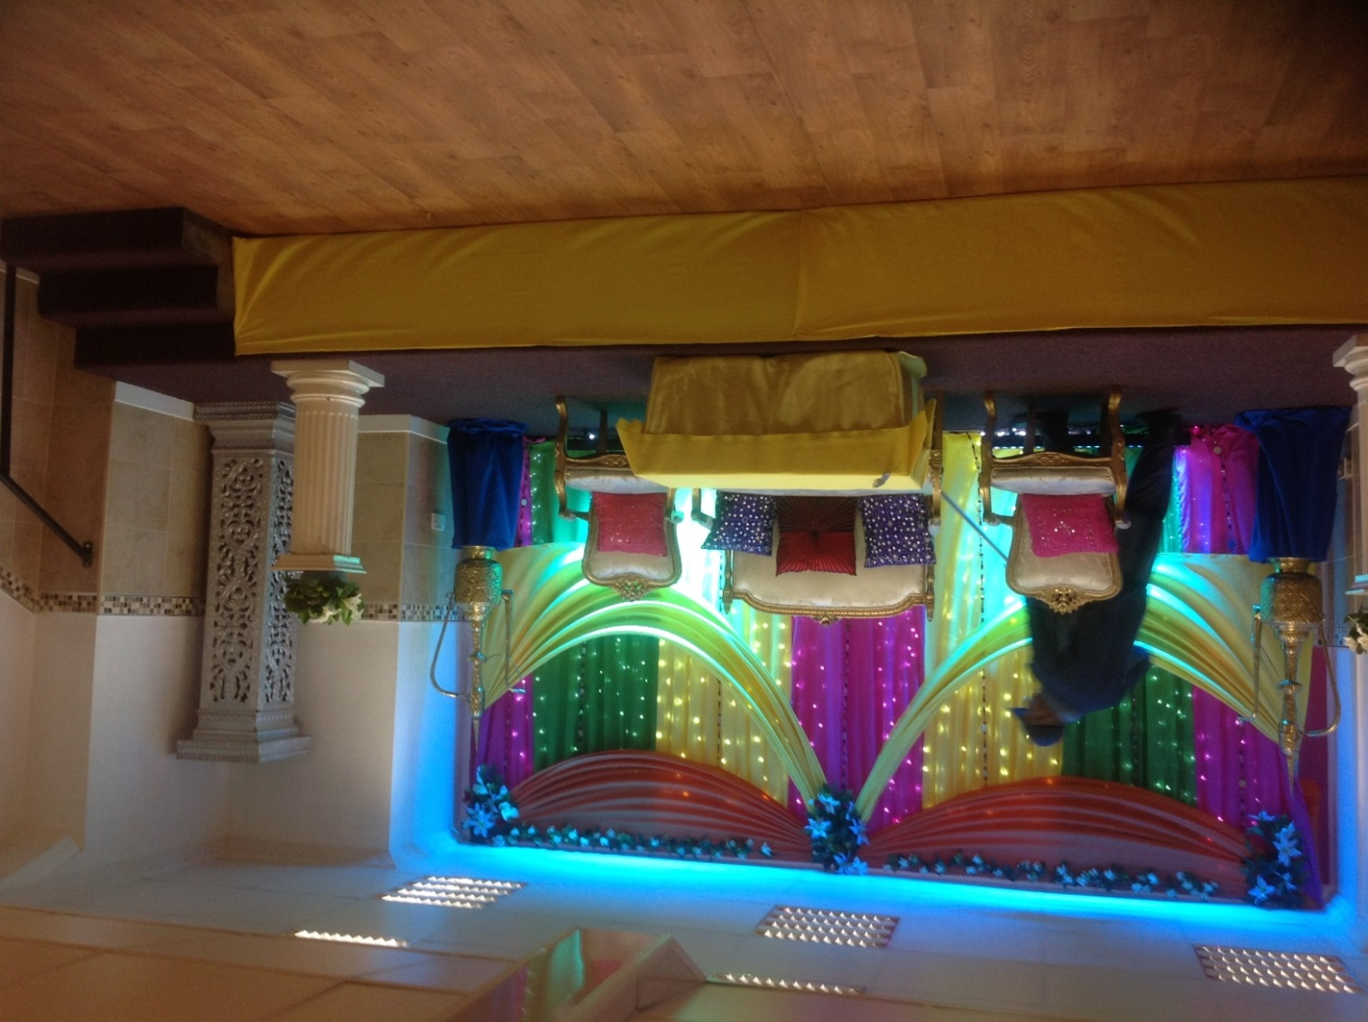
Dais in function room of the ground floor of the former church building with wedding furniture

Slide 22
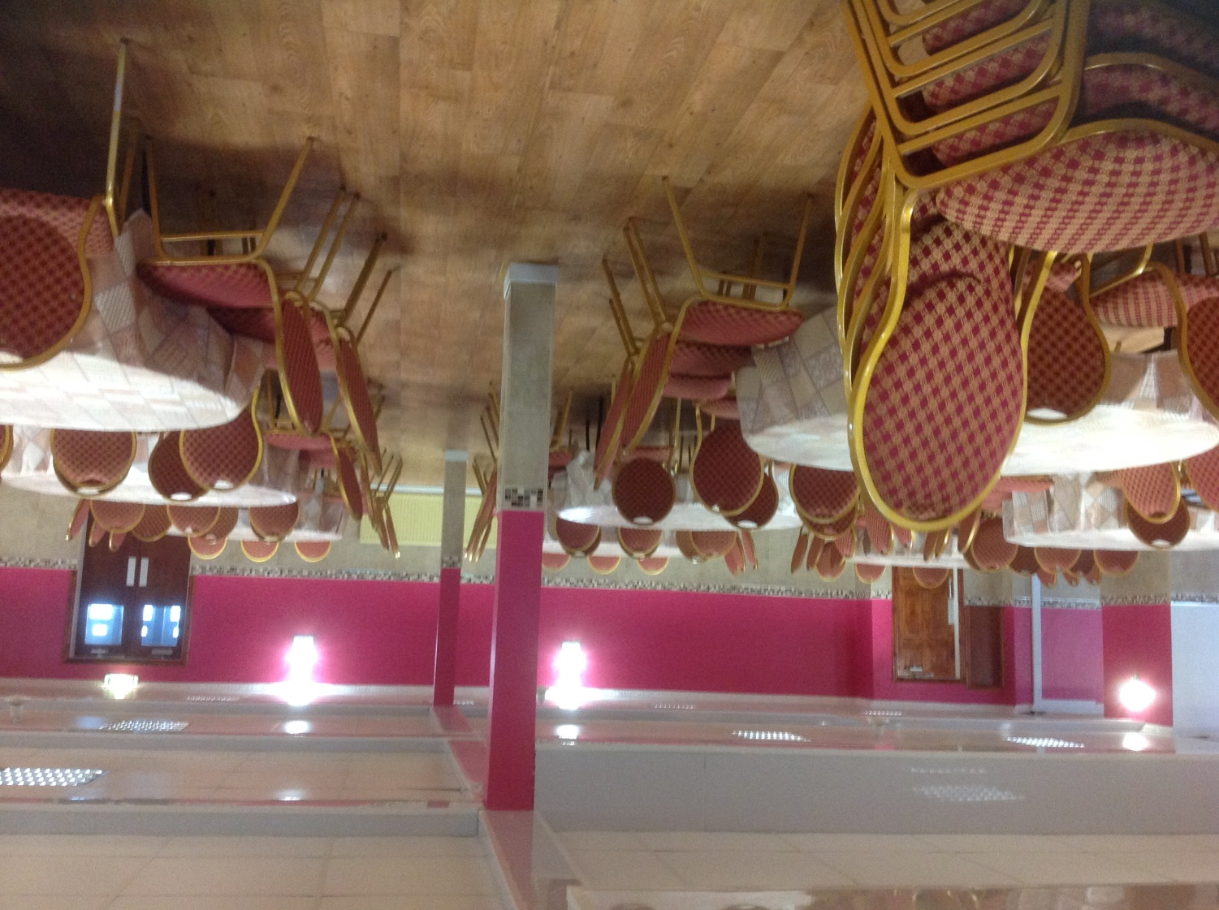
Ground floor function room of the former church building

Slide 23
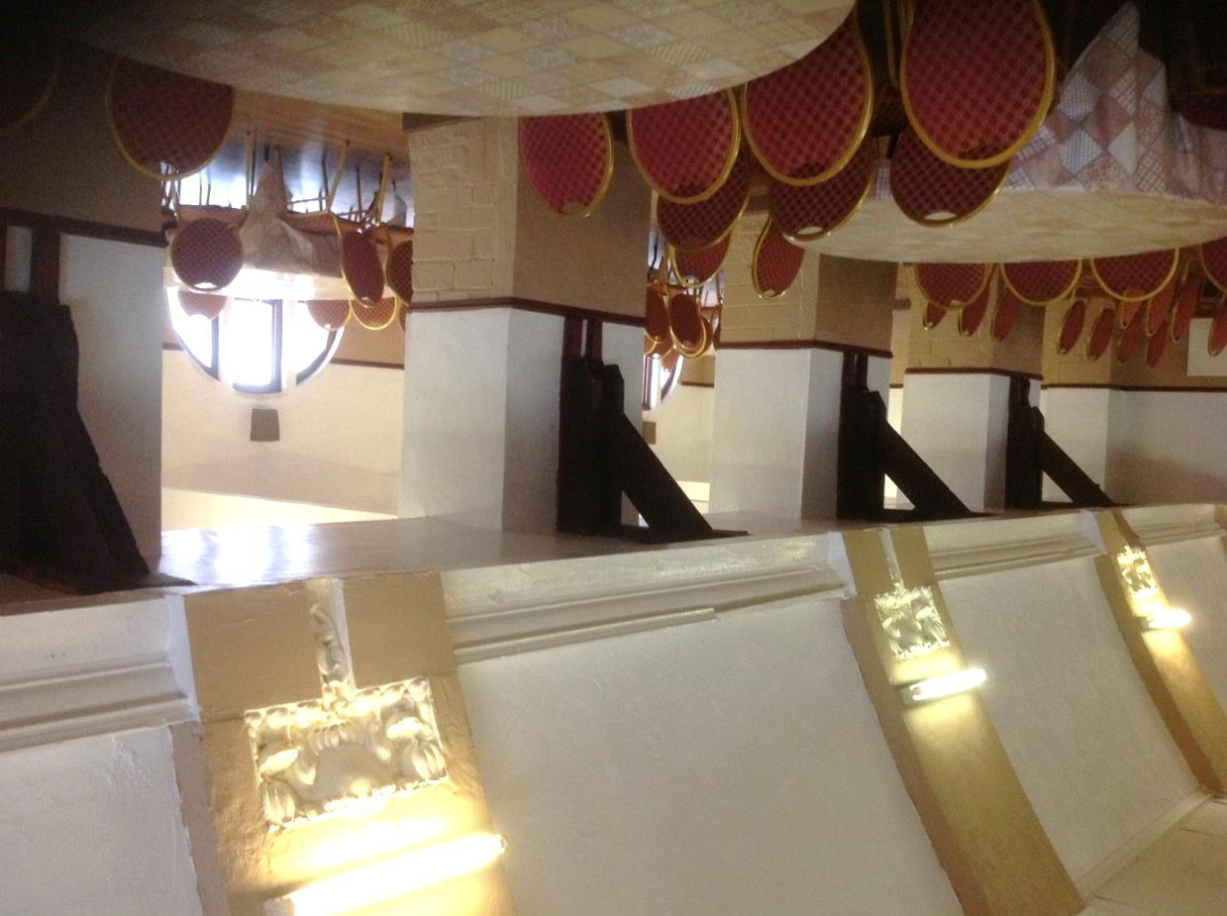
Upper floor function room of the former church building , showing modern extension beyond original pillars

Slide 24
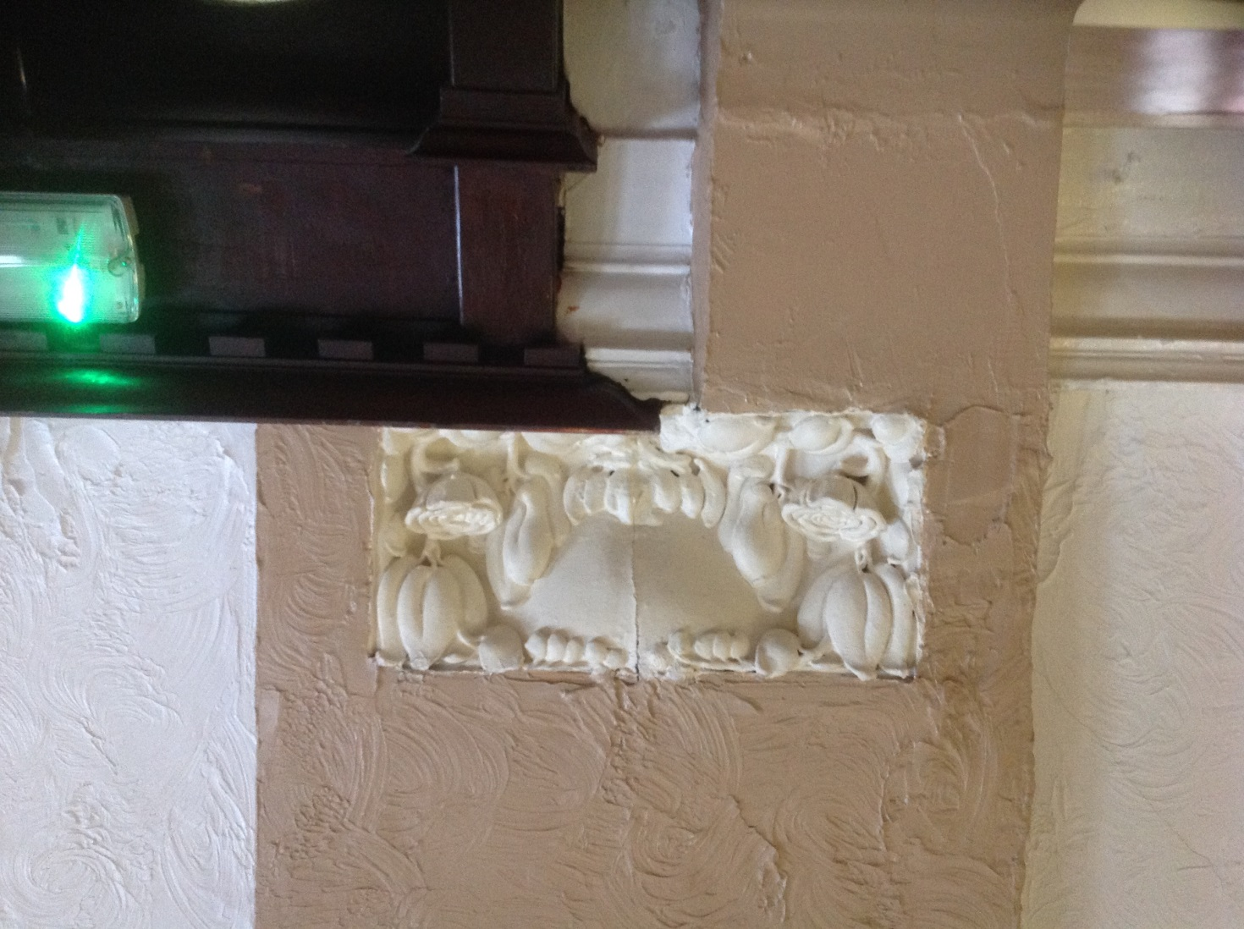
Detail of original Art Nouveau foliage plaster panel between pillars in the upper function room (formerly the rafters of the Methodist Church)

Slide 25
Enquiry three
What can other evidence tell us about our building?

Slide 26
1907 – Methodist Christians built a new church and Sunday School on empty ground in Shearbridge Road.
(Children went to Sunday School to learn about God and the Bible on the Christian holy day- Sunday).

Slide 27
1974-1975 - Methodist Christians closed their church on Shearbridge Road.
The buildings stood empty until some Bradford Muslims bought the church building for £40,000. Now it became a mosque.
It was used for special prayers on Fridays now - the Muslim holy day - not Sunday.

Slide 28
1993 - A dome and minaret (special tower) were built over the door of the mosque.

Slide 29
2000 - The mosque was made larger on one side.
Builders used old stone to make sure that the new walls looked just like the old ones.
They put the date 2000 in the new wall.

Slide 30
2000 - The builders also used some old stone from a Bradford building that had got knocked down before.
That is why a bit of the wall over a door says “Branch No 11” on it.

Slide 31
“Methodist New Connexion was a ……church (this means that some Methodist Christians created a new Christian organisation called the Methodist New Connexion).
It was formed in 1797”.
From World Heritage Encyclopedia

Slide 32
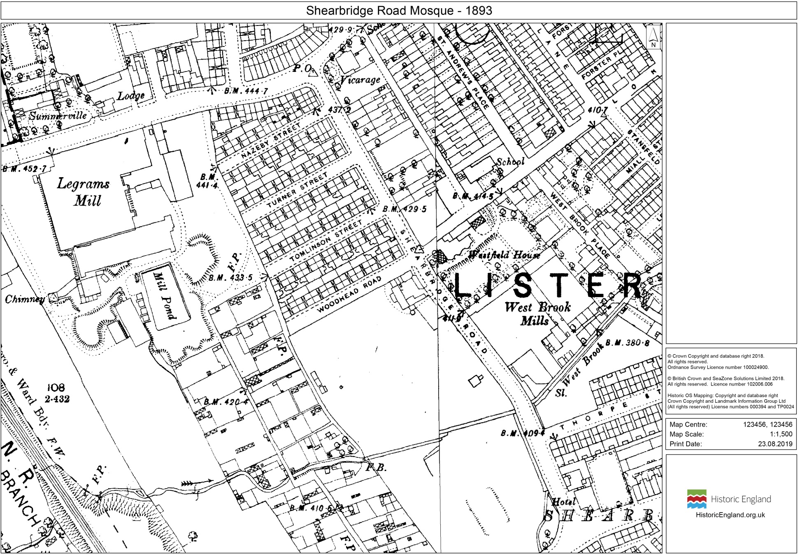
Buildings on the site of Shearbridge Road Methodist Church (later Shearbridge Road Mosque) on the 1893 map
Notes:
© Crown Copyright and database right 2018.
All rights reserved.Ordnance Survey Licence number 100024900.
Historic OS Mapping: Copyright and database right
Crown Copyright and Landmark Information Group Ltd
(All rights reserved) License numbers 000394 and TP0024cil)

Slide 33
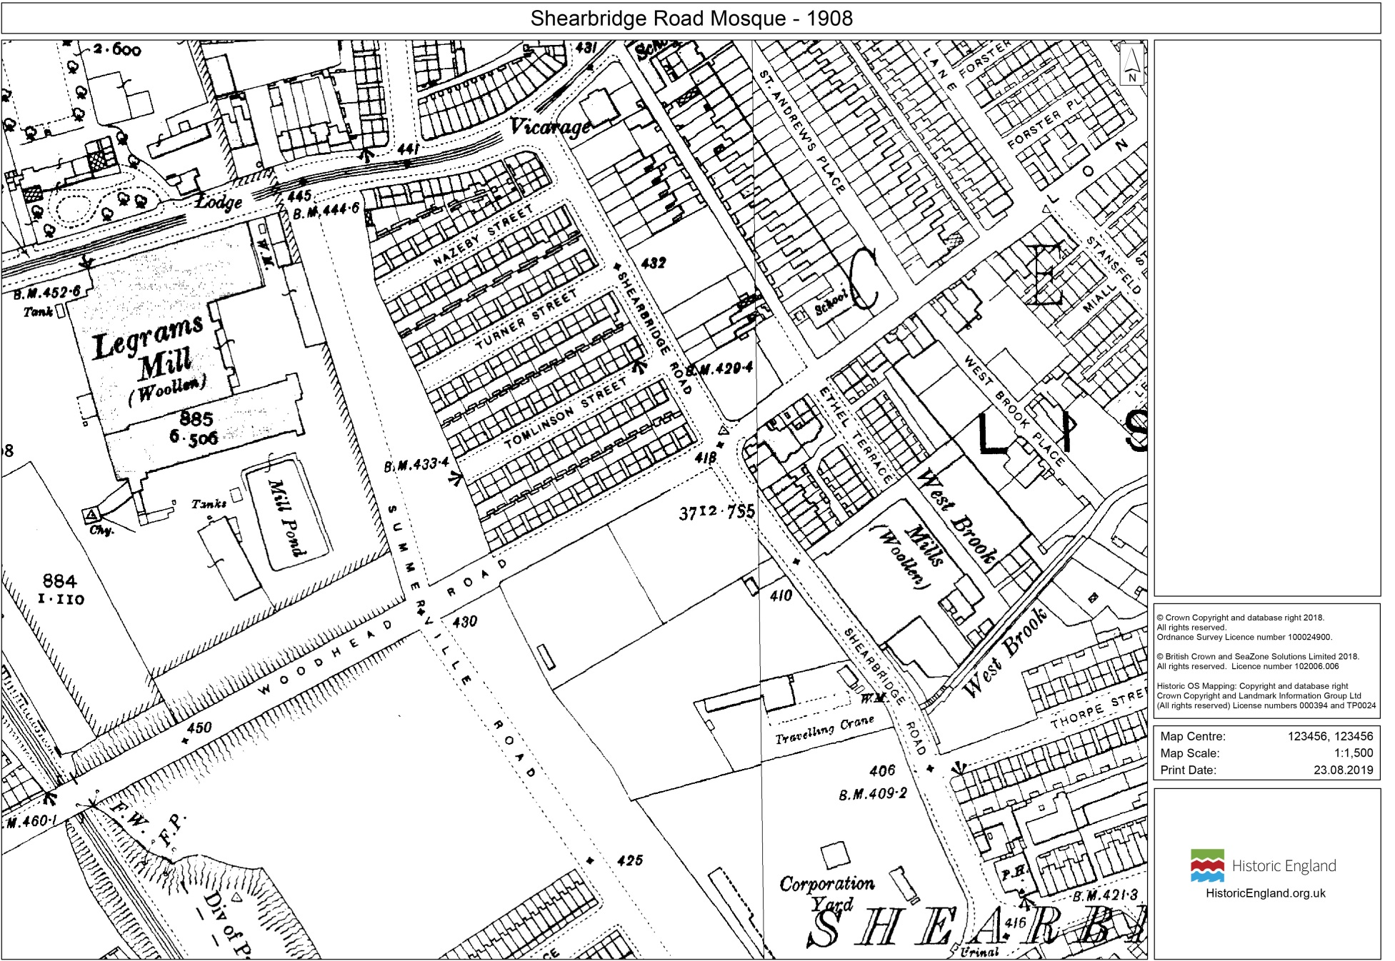
No buildings on the site of Shearbridge Road Methodist Church (later Shearbridge Road Mosque) on the 1908 map
Notes:
© Crown Copyright and database right 2018.
All rights reserved.Ordnance Survey Licence number 100024900.
Historic OS Mapping: Copyright and database right
Crown Copyright and Landmark Information Group Ltd
(All rights reserved) License numbers 000394 and TP0024cil)

Slide 34
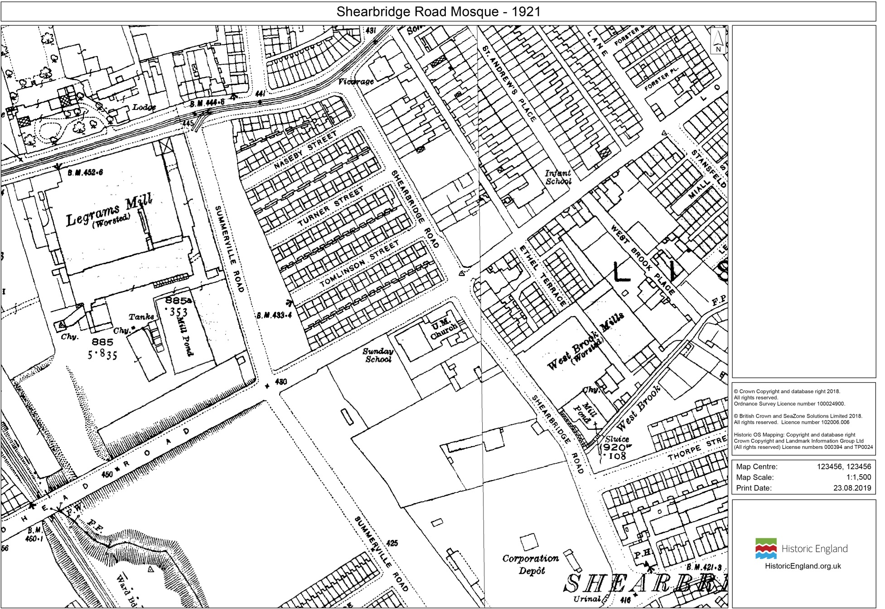
Shearbridge Road Methodist Church/Sunday School (later Shearbridge Road Mosque) now built on the 1921 map
Notes:
© Crown Copyright and database right 2018.
All rights reserved.Ordnance Survey Licence number 100024900.
Historic OS Mapping: Copyright and database right
Crown Copyright and Landmark Information Group Ltd
(All rights reserved) License numbers 000394 and TP0024cil)

Slide 35
“Richmond-Shearbridge Methodist Chapel. 1906-1907 by Edgar Parkinson (a Bradford architect).
Art Nouveau design (this was a popular type of art in Europe at this time).”
From Pevsner Architectural Guides

Slide 36
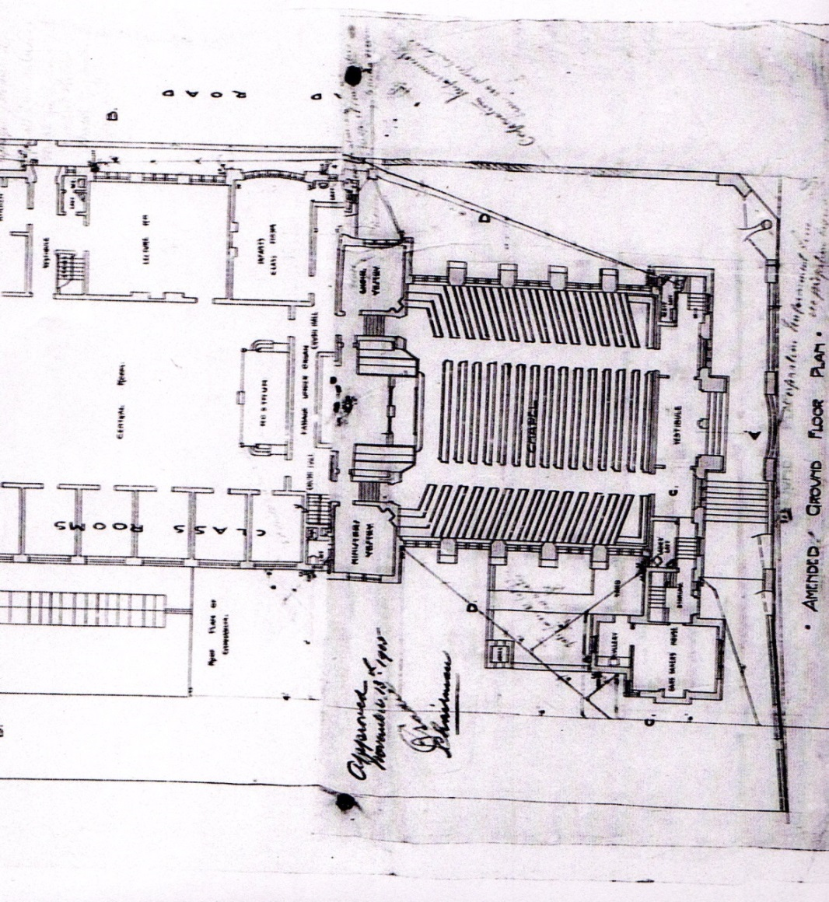
Ground plan of Shearbridge Road Methodist Church (later Mosque) in 1905
1797 date on pillar
1907 date on pillar

Slide 37
Names of dead servicemen (these could be soldiers, sailors or airmen) recorded on a First World War Memorial inside Shearbridge Road Methodist Church.
( It is not known where the memorial now is.)
Banks, Herbert | Mawson, Charles
Booth, Herbert | Newby, Charles
Lister, Herbert | North, Edgar

Slide 38
The Registrar General, being satisfied that RICHMOND SHEARBRIDGE METHODIST CHURCH, Shearbridge Road, Bradford in the registration district of Bradford in the Metropolitan District of Bradford is no longer used as a place of worship by the congregation on whose behalf it was, on 22nd December 1906, registered for marriages in accordance with the Marriage Act 1836, has cancelled the registration.
Extract from the London Gazette 3rd August 1974

Slide 39
Summary of the extract from the London Gazette 3rd August 1974
The Shearbridge Methodist Church, on Shearbridge Road, Bradford is no longer used as a place of Christian worship.
Its original licence for marriages to legally happen there has was removed and people could no longer get married there.

Slide 40
“I became Mosque manager in the 1980’s. We gradually changed the building but we had to be careful how we did this. The Muslims who came to worship here wanted it to look familiar – like mosques in Pakistan, otherwise they would not have come. That is why we put the tower and minaret on the outside and why we chose Asian carpets woven to Islamic patterns for the floors. We also made some windows look as if they had arches you might get in mosques that were built as mosques. We were only allowed to build an extension on to the old church building in 2000 as long as we planned to copy the style of the church building and use the same materials. Our builder used some materials from another Bradford building that was knocked down. That’s how we ended up with that stonework that says Branch No 11 on it. This building was never a bank or shop though”.
Based on an interview with “Mister Yusuf” April 2017

Slide 41
“I have worshipped here since 1974-1975 when we bought the building. At first we were migrants - we just worshipped in terraced houses.
The building cost £40,000, a huge amount of money then. It was all paid for by Bradford Muslims apart from a loan of £10,000 from a local Muslim businessman. At first we only used the old Sunday School building. The old church building was not used until the late 1980s. It is mostly Muslims whose families came from Pakistan who worship here”
Based on an interview with a Muslim who worships at Shearbridge Rd Mosque April 2017

Slide 42
Year | Description of the planning permission by Bradford Council to change the building
1988 | Bradford Council agreed that the mosque could extend the building at the back to form a new kitchen and dining room.
1989 | Bradford Council agreed that the mosque could build a new entrance to the building.
1993 | Bradford Council agreed that the mosque could build a dome and minaret above the new entrance to the building.
1995 | Bradford Council refused to agree to the building of an extension to the old church building.
1999 | Bradford Council agreed that the mosque could build an extension to the rooms already used for washing before worship.

Slide 43
Year | Description of the planning permission by Bradford Council to change the building
2000 | Bradford Council agreed that the mosque could extend the side of the old church to make the rooms on both floors larger (These had to be built in the style and using the same materials as the church building).
2005 | Bradford Council agreed that the mosque could turn a basement store in to funeral rooms.
2010 | Bradford Council agreed that the mosque could create a larger car park for more car parking spaces.

Slide 44
Enquiry four
What can Shearbridge Road Mosque tell us about the history of Bradford?

Slide 45
1911
The population of Bradford was 288,458.
Many people worked in textile mills making cloth and lived hard lives in crowded houses.
Many families belonged to Christian churches or chapels close to where they lived.
Some parents sent their children to Sunday School on Sunday mornings to give themselves some peace but did not go to church themselves.

Slide 46
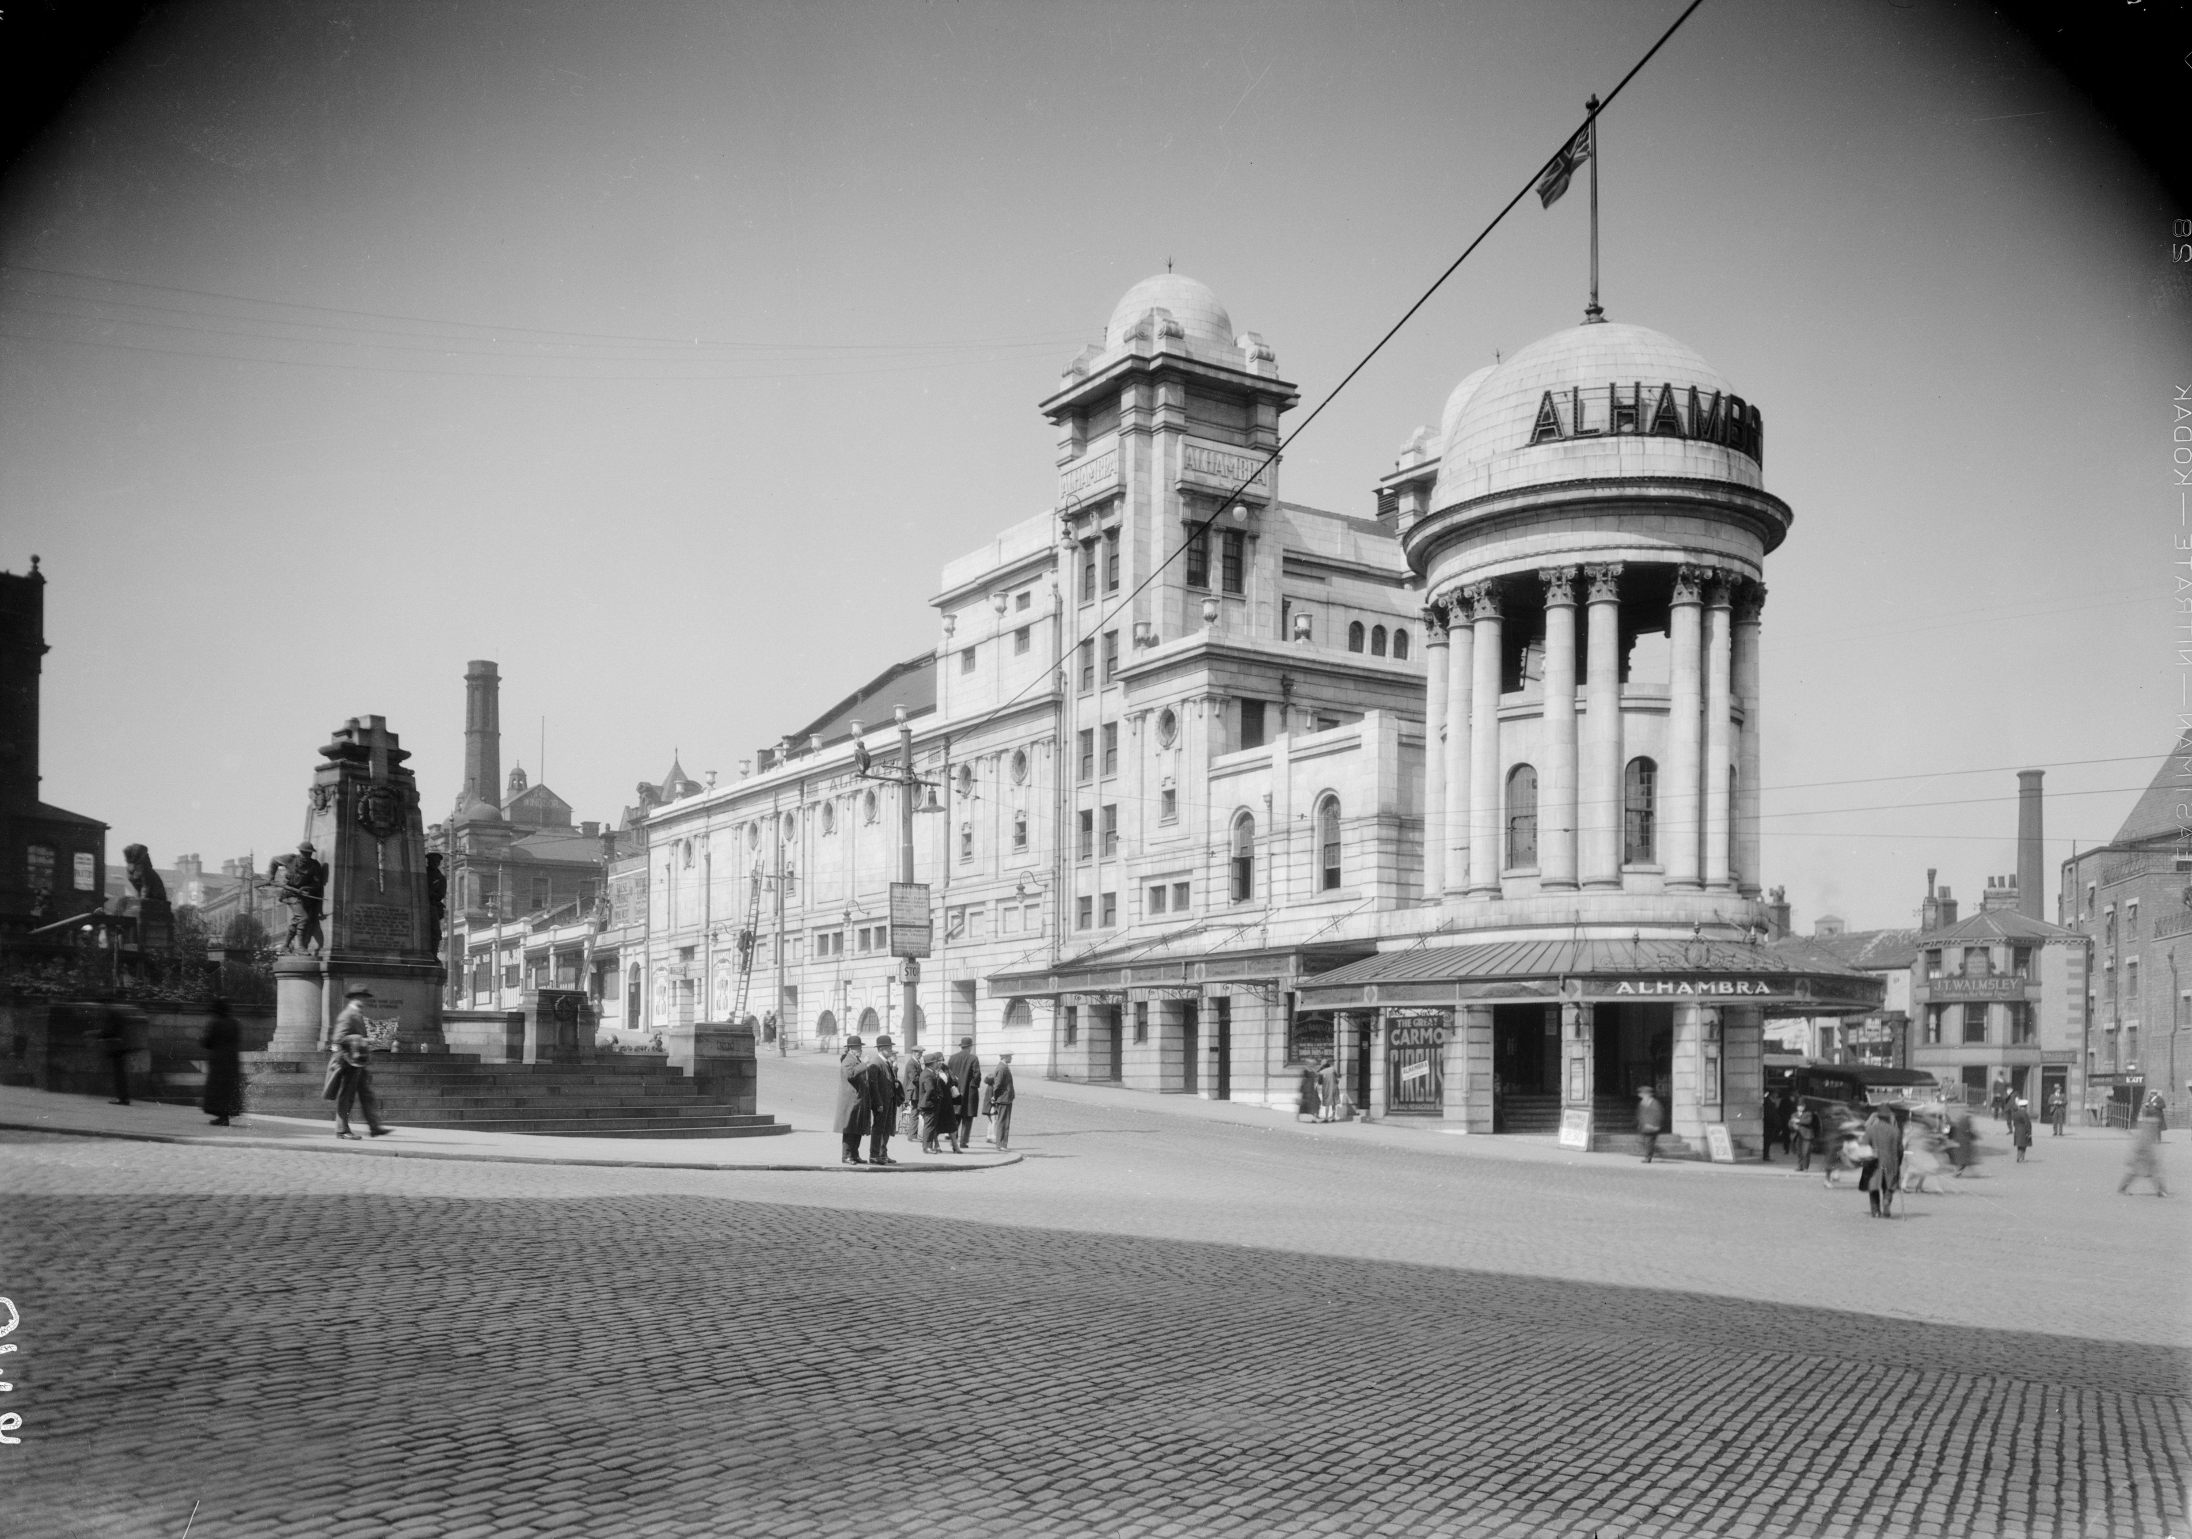
1914
The Alhambra Theatre opened in Bradford.
Notes:
Image
WSA01/01/G0410 - © Historic England Archive

Slide 47
1914-1918
Thousands of ordinary Bradford men volunteered to join the Army and the Navy during the First World War. Many died with their friends from the same areas of the city because they joined up together in Pals Battalions. Some Germans living in Bradford were treated badly but the city welcomed Belgian refugees.
Notes:
Image: Wydean

Slide 48
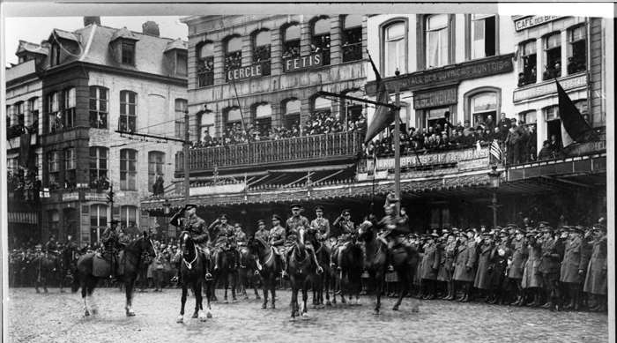
1919
In February several hundred Belgian refugees returned to Belgium from Bradford
Notes:
Image: bl26630, November 1918, © Reproduced by permission of Historic England Archive. Canadian troops massed in front of buildings on the west side of the town square, Le Grand Place, at Mons, Belgium. It was taken in the last days of the First World War. Canadian troops marched to liberate Mons during the final hundred days of the war. It ended with a vicious battle in and around the town. Fighting went on for two days prior to the Armistice on the 11th of November 1918. Only after this was it safe for Bradford’s Belgian refugees to return to Belgium.

Slide 49
1931
35,000 men and women could not find work in Bradford. Life was really hard in many British cities during what was called the Great Depression.
Despite this textile mills in Bradford still employed most workers.

Slide 50
1939
A house (which later became the Carlton Hotel) in Bradford was bought to house 24 Jewish boys and one girl brought to Britain from Nazi Germany. This was part of the Kindertransport scheme that helped Jewish children escaping Nazi persecution.
Notes:
Image: Modern statue commemorating the children of the Kindertransport Credit: Wikipedia Commons Wjh31

Slide 51
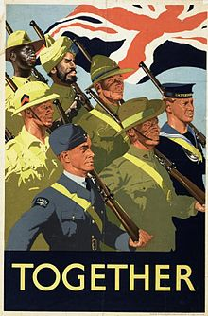
1939-1945
Thousands of Bradford men and women fought for Britain during the Second World War. Unemployed seamen (lascars) from South Asia living in British ports found well-paid work in Bradford mills from 1941. They were among the first South Asians to settle in the city.
Notes:
Image: https://commons.wikimedia.org/wiki/File:Together_Art.IWMPST3158.jpg

Slide 52
1940s-1950s
From the late 1940s migrants settled in Bradford from Central and Eastern Europe, particularly Poland.
Early South Asian migrants to Bradford lodged in low rent houses owned by Poles, near their work. South Asian Muslims from Pakistan (usually men away from their families) generally worshiped together in private homes, regardless of their background. The first Bradford mosque opened in a terraced house in 1958.

Slide 53
1960s-1970s
Like lots of British people, many Bradford Christians stopped going to church. Churches closed and the buildings were used for other purposes.
In the meantime South Asian migrants brought over their families to live with them in Bradford. In the 1970s many mills and factories closed throwing Bradford people out of work.
South Asians and others were sometimes treated badly.

Slide 54
1982
Bradford Council agreed to serve Halal meat in Bradford schools (Muslims are only allowed to eat halal meat).
Notes:
Image
DP060520 - © Historic England Archive

Slide 55
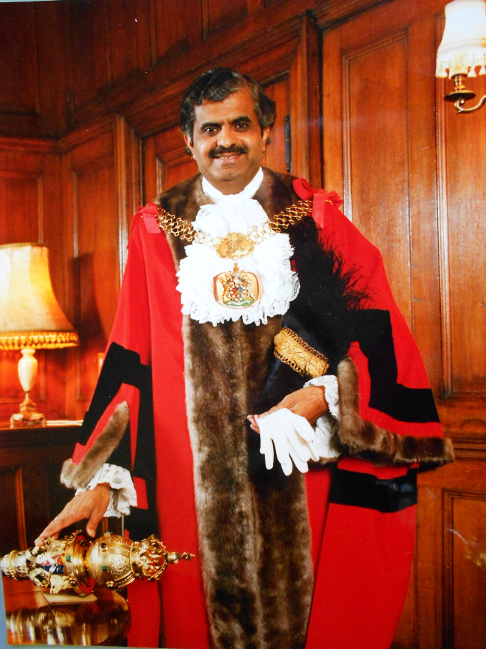
1985
Mohammmed Ajeeb became Bradford’s first South Asian and Muslim Lord Mayor
Notes:
Image
DP060520 - © Historic England Archive

Slide 56
1986
The Alhambra Theatre was restored and re-opened.
Notes:
Image
WSA01/01/G0410 - © Historic England Archive

Slide 57
2001
The population of Bradford was 467,665. There were 84,000 whose families originally came from South Asia (India, Pakistan and Bangladesh). Of these 67,994 were mostly Muslims from Pakistani families.

Slide 58
2001
In July there were riots in part of Bradford involving young people from South Asian communities, white young people and the police.
Some people blamed racist attacks on Asian people because of their skin colour for the riots. There were also similar riots in other towns and cities in Northern England.

Slide 59
2009
Bradford Council planned a new pool with fountains in the city centre.
Notes:
Image
Credit;bradfordbuzz.com

Slide 60
2011
The population of Bradford was 522,452. Of this 26.83% was Asian and 24.7% were Muslims (mostly from Pakistani families).
There were 8,335 people with jobs in Bradford who came from other European Union countries (of these 3,827 came from Poland).

Slide 61
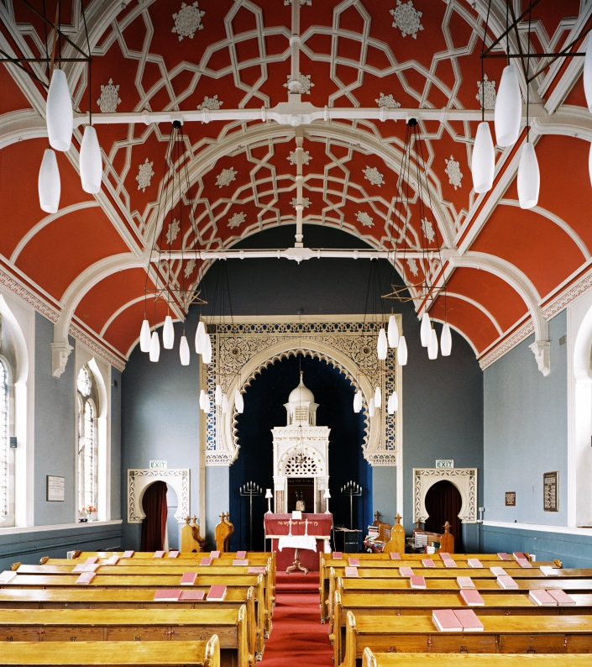
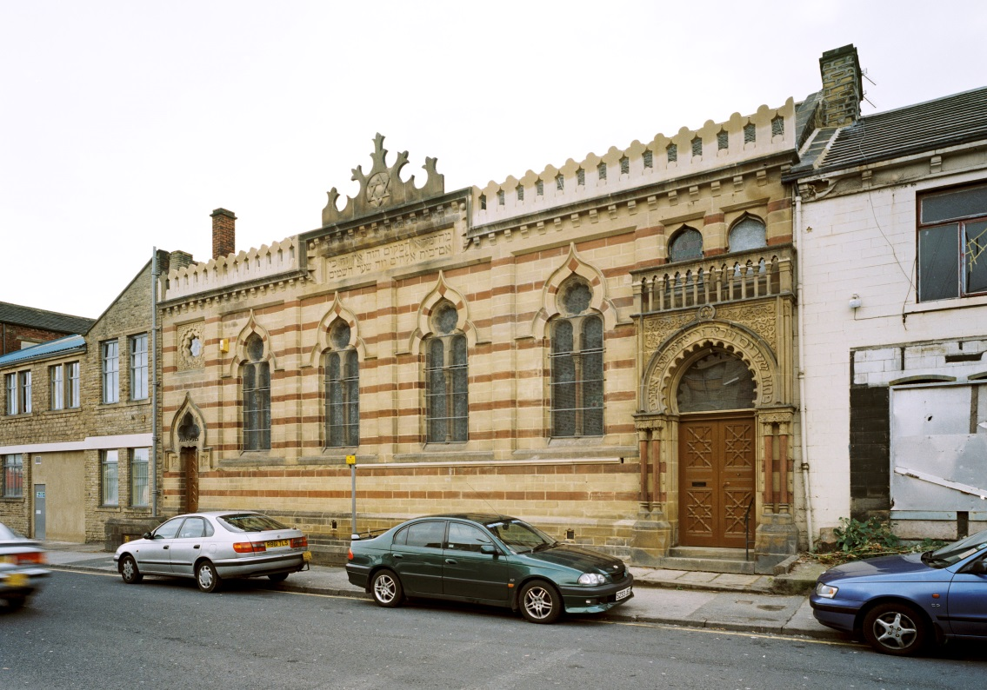
2013
Bradford Muslims gave money to save Bradford’s last Jewish synagogue from closing down.
Notes:
Image
aa038929 & aa038923 - © Historic England Archive

Slide 62
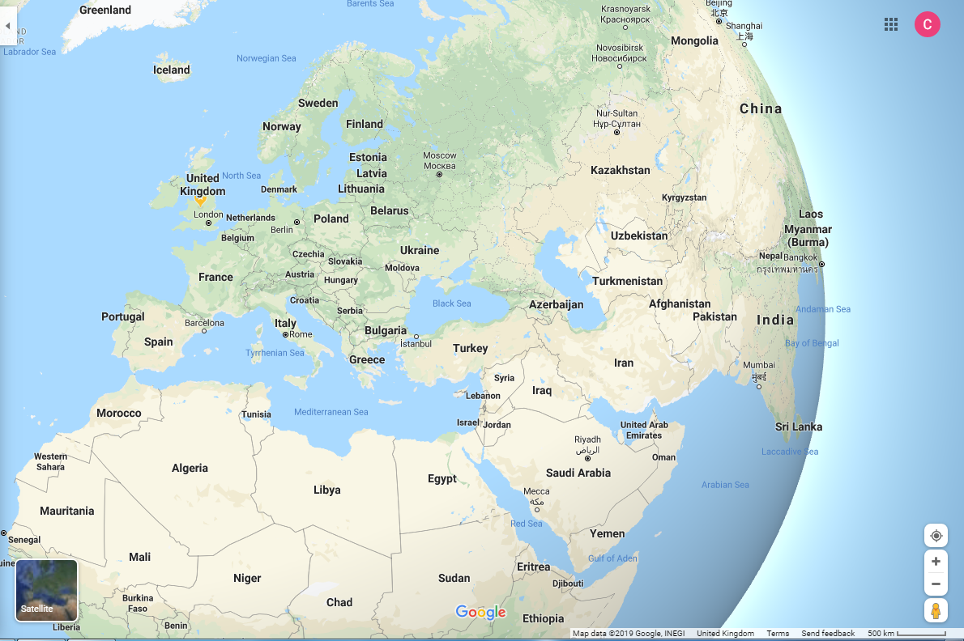
2016
158 Syrian refugees settled in Bradford.

Slide 63
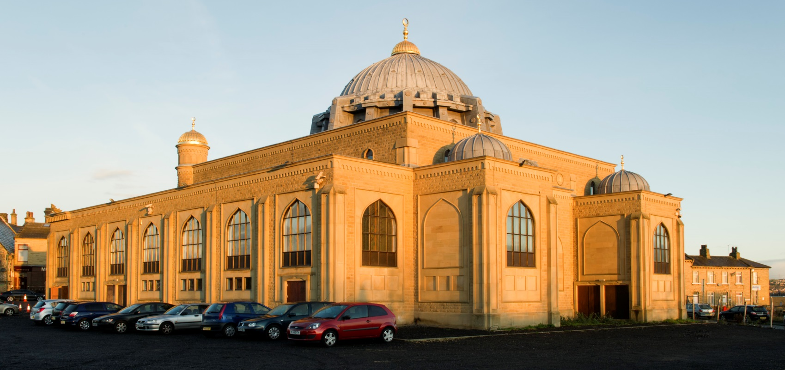
2017
There are around 90 mosques in Bradford. Many started out as other buildings but some, like the Central Mosque, were built as mosques.
Notes:
Image
aa038929 & aa038923 - © Historic England Archive

Slide 64
Year | Timeline for Shearbridge Road Mosque
1893 | The First Edition Ordnance Survey map shows that the future site of Shearbridge Road Mosque was occupied by unidentified buildings around a courtyard. The area was in the process of development with woollen mills and working class back to back terraced housing close by.
1905 | Planning permission was granted for the building of a Methodist New Connexion Chapel at the now vacant site on Shearbridge Road. The plans provided for a church and large attached Sunday School. The Methodist New Connexion were a breakaway Methodist denomination founded originally in 1797 in Sheffield who emphasised the role of lay people (i.e. ordinary congregation members, not clergy) in the government of their churches. Many Non-Conformist (i.e. protestant Christians who would not conform to the established Church of England) churches became important hubs for local communities.

Slide 65
Year | Timeline for Shearbridge Road Mosque
1906-7 | According to Pevsner Architectural Guides Richmond-Shearbridge Methodist Chapel was built 1906-1907 by Edgar Parkinson (a local Bradford architect). The architecture is described as Art Nouveau, a popular style in Europe at this time. The dates 1907 and 1797 were inscribed on pillars either side of the main entrance to the church. The date 1797 is when the Methodist New Connection branch of the religion was formed. The date 1907 may also refer to the merger of three Methodist denominations (including the Methodist New Connexion) in that year to form the United Methodist Church. According to a reference in the London Gazette of 1974 the Richmond-Shearbridge Methodist Church was registered on December 22nd 1906 to be allowed hold weddings.
1908 | The Second Edition Ordnance Survey map shows that the future site of Shearbridge Road Mosque is empty

Slide 66
Year | Timeline for Shearbridge Road Mosque
1914-8 | A war memorial was created in the church to commemorate six servicemen who died during the First World War. They were Herbert Banks, Herbert Booth, Herbert Lister, Charles Mawson, Charles Newby & Edgar North. Five of these men were Bradford born (it has not been possible to trace the service of Herbert Banks) and were probably from families who attended the church or who may have attended the church themselves. The current whereabouts of the memorial are unknown.
1974 | According to the London Gazette the permission to conduct marriages at Richmond Shearbridge Methodist Church was withdrawn on 3rd August. The wording implies that the church had already closed. The 1960s and 1970s saw a steep decline in attendance across all Christian churches in the UK, leading to the closure of many church buildings. It coincided with the rapid decline of the textile industry in Bradford which increased unemployment and poverty.

Slide 67
Year | Timeline for Shearbridge Road Mosque
1974-75 | A group of Bradford Muslims from the Sufi Bareilvi tradition (to which around 60% of Pakistani Muslims adhere) purchased now closed Shearbridge Methodist Church and Sunday School for £40,000, a very large sum at the time. This was raised from donations by local Bradford Muslims and assisted by a loan of £10,000 from a local Muslim businessman. The first South Asian Muslim migrants (many from the rural Mirpur district of Kashmir in Pakistan) had tended to worship in private homes or terraced houses. The purchase of this previously Christian building for use as a mosque formed part of a trend which saw South Asian communities in Bradford buy and convert a range of buildings including redundant churches and synagogues for their own use. During this period original migrants brought over their families to settle in Britain and the need arose for more communal buildings as places of worship, meeting rooms, clubs and education.
1980s | Until the 1980s only the old Sunday School building was used as a mosque, the main church was not used.

Slide 68
Year | Timeline for Shearbridge Road Mosque
1988 | Bradford Council agreed that the mosque could extend the building at the back to form a new kitchen and dining room.
1989 | Bradford Council agreed that the mosque could build a new entrance to the building.
1993 | Bradford Council agreed that the mosque could build a dome and minaret above the new entrance to the building. This decision showed that those running the mosque felt sufficiently confident of their faith and position in Bradford to make the exterior of the building more obviously Islamic. It also shows that Bradford Council were prepared to consider this kind of application positively.
1995 | Bradford Council refused to agree to the building of an extension to the old church building.

Slide 69
Year | Timeline for Shearbridge Road Mosque
1999 | Bradford Council agreed that the mosque could build an extension to the rooms already used for washing before worship.
2000 | Bradford Council agreed that the mosque could extend the side of the old church to make the rooms on both floors larger (These had to be built in the style and using the same materials as the church building). A local builder recycled stone from a demolished Bradford building placing a classical pediment over a new doorway with the wording “BRANCH No 11” over it which may refer to a bank or some commercial function. Interestingly the date 2000 was also inscribed in the new wall, deliberately choosing the Christian calendar commonly used in the UK rather than the Islamic dating system.

Slide 70
Year | Timeline for Shearbridge Road Mosque
2005 | Bradford Council agreed that the mosque could turn a basement store in to funeral rooms.
2010 | Bradford Council agreed that the mosque could create a larger car park for more car parking spaces. Worshippers who attend the Mosque are still of predominantly Pakistani descent but also include Muslims from a variety of backgrounds, partly because of the proximity to the university.

Slide 71
Find more teaching resources at:
HistoricEngland.org.uk/Education

