Slide 1
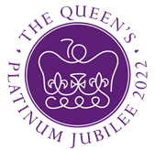
Queen Elizabeth II Platinum Jubilee
Story Map – West Midlands Region Images
Key Stage 2: History & Geography
Learning Aims and Outcomes
Pupils understand more about the role of the Queen by exploring the Story Map of some of her visits to different places across England
Pupils learn about the Queen’s visits to significant places/events in their region of the country through her 70-year reign
Pupils develop a sense of place through mapwork
Pupils can identify regions of England and locate places in the region they live in
Pupils take part in celebrating a significant historical event
This learning resource supports the Historic England Platinum Jubilee Story Map & Platinum Jubilee Activities PPT
Notes:
This resource is intended to be used with the Historic England Jubilee Story Map which documents some of the many places the Queen has visited throughout her reign. Pupils are able to explore the pins on the map of their region of the country to find out about the significant buildings and events the Queen has visited. The Story Map contains information about the visit, a brief history of the building and images of the Queen and the building.

Slide 2
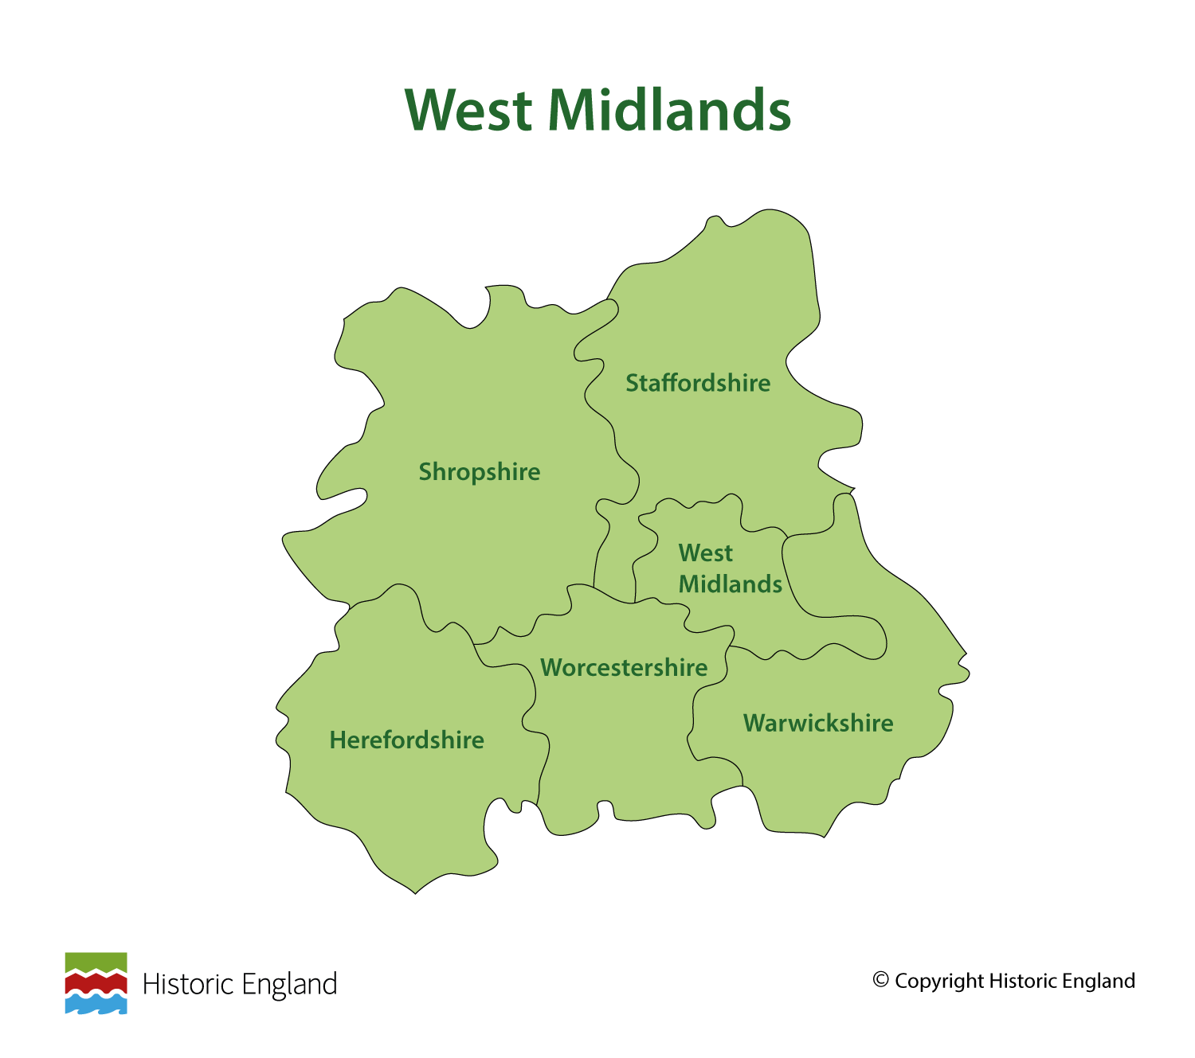
Notes:
Before following the link to your regional Story Map you may wish to discuss with pupils what counties are covered in your region.

Slide 3
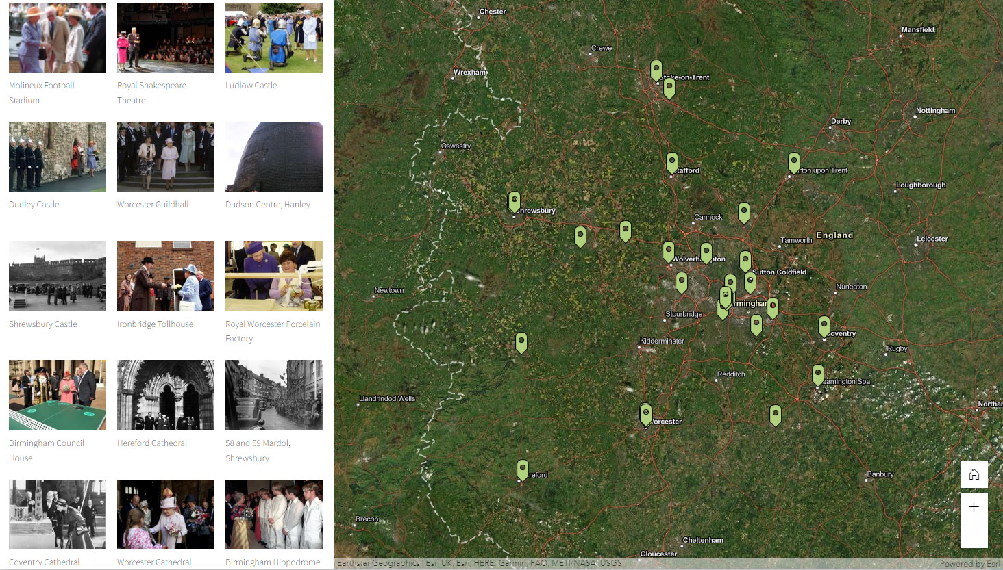
Notes:
Follow the link to your regional Story Map - https://storymaps.arcgis.com/stories/b14df00fdfa7442996375cab5ccbabc8

Slide 4
Molineux Football Stadium
The Queen visited Molineux on 23 June 1994, to unveil a plaque marking the completion of redevelopment work at the stadium. She had previously visited in May 1962.
Molineux was built in 1889. Its name originates from Benjamin Molineux, who bought the land in 1744 and built Molineux House. The land eventually passed to Northampton Brewery who rented the ground to Wolverhampton Wanderers.
Molineux hosted the first ever floodlit game, in September 1953. It subsequently hosted a series of friendlies with European sides, before European competitions were established. Jack Hayward’s takeover of the club, in 1990, led to a wholescale redevelopment of the ground. The original Molineux House, now a hotel, is a Grade II listed building.
Find out more on the National Heritage List.

Slide 5
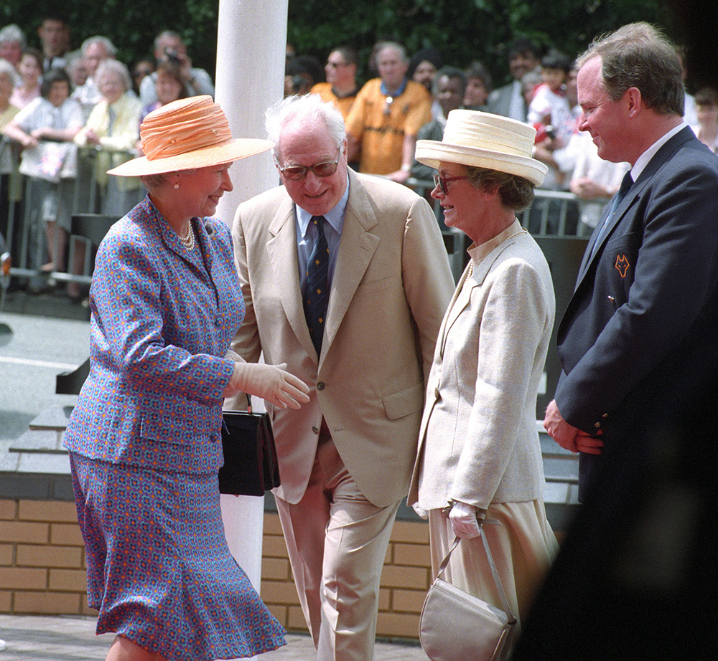
Notes:
The Queen greets Sir Jack and Lady Hayward and Jonathan Hayward whilst visiting Molineux the home of Wolverhampton Wanderers Football Club. © Alamy - J3J9YB - 23 June 1994

Slide 6
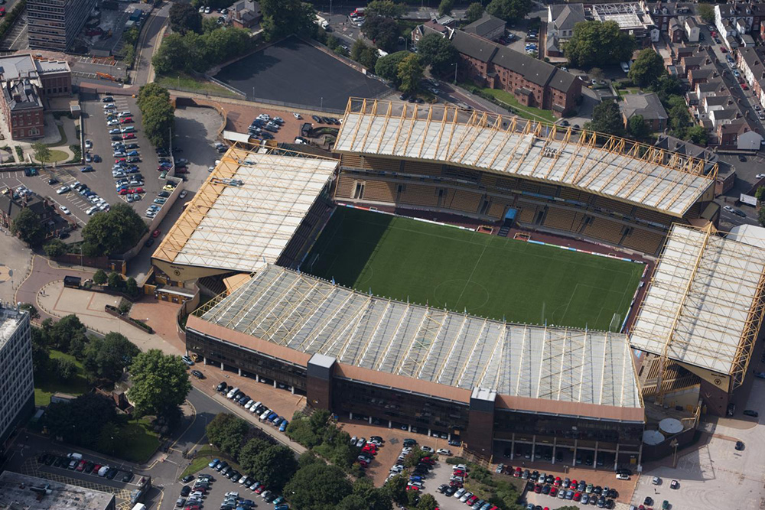
Notes:
An aerial view of the football ground and stands. © Historic England Archive - 26737_028 – 01 SEP 2010

Slide 7
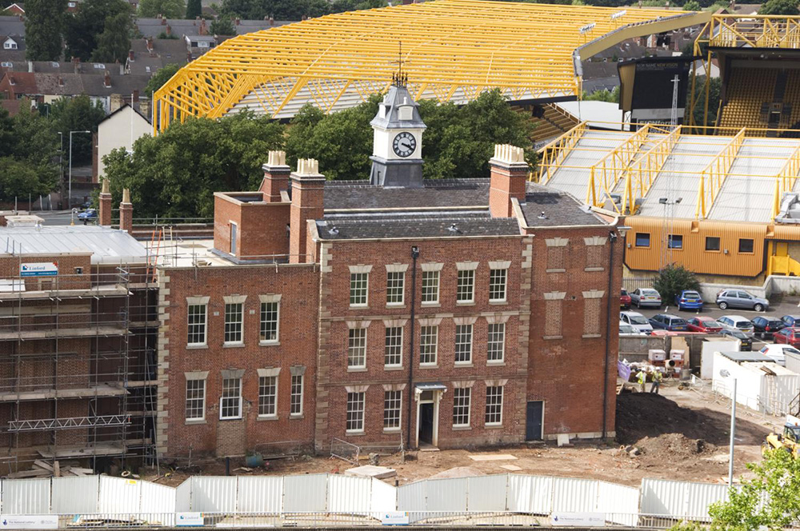
Notes:
A general view of the south-east elevation of the Molineux Hotel, taken from the south-east showing Molineux Stadium in the background. © Historic England Archive - DP059852 - 29 Jul 2008

Slide 8
Royal Shakespeare Theatre
The Queen and Prince Philip opened the new theatre on 4 March 2011. The original theatre opened in 1879 after funding was secured, largely by the efforts of the brewer Edward Flower and his son, Charles.
The building was designed by William Frederick Unsworth and Edward John Dodgshun and included a museum, water tower and library. In 1926, a fire destroyed much of the building and a new theatre, adjoining the original, was designed by Elizabeth Scott. Opened in 1932, it was the first major public building in Britain to be designed by a woman.
A building project, to expand and modernise the theatre, began in 2007. This included a new 1040 capacity theatre space, a rooftop restaurant and improved backstage facilities for actors and stage crew.
Find out more on the National Heritage List.

Slide 9
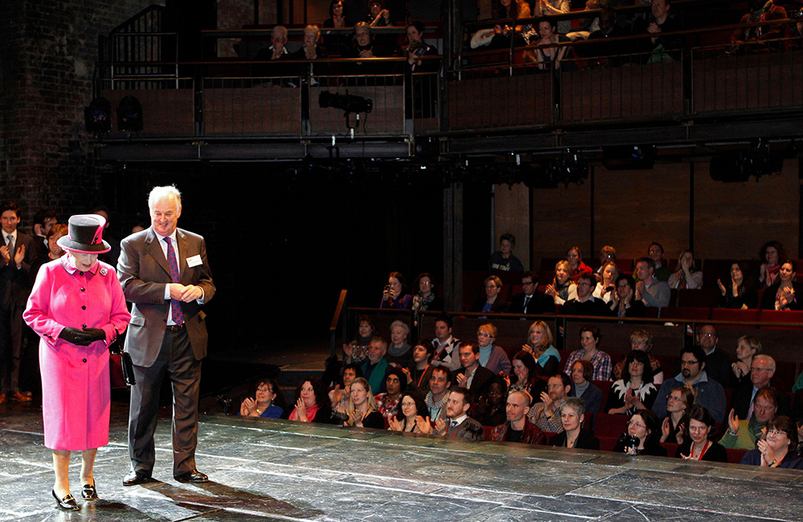
Notes:
The Queen walks on stage with chairman of the Royal Shakespeare company Christopher Bland, during her visit to the Royal Shakespeare Theatre in Stratford-upon-Avon. © Alamy - 2CYNKD1 - 4 March 2011

Slide 10
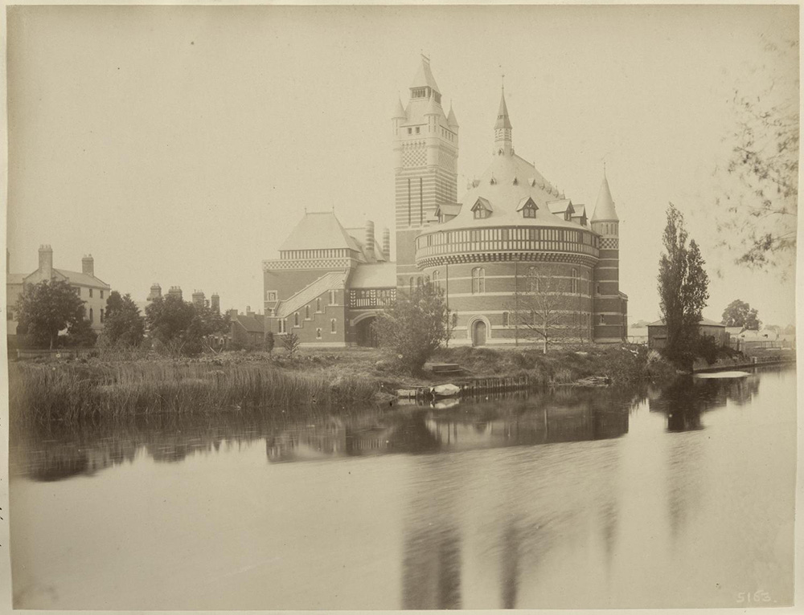
Notes:
A sepia coloured photo of the original theatre viewed from across the river. Source: Historic England Archive - BL05163 - 23 May 1884

Slide 11
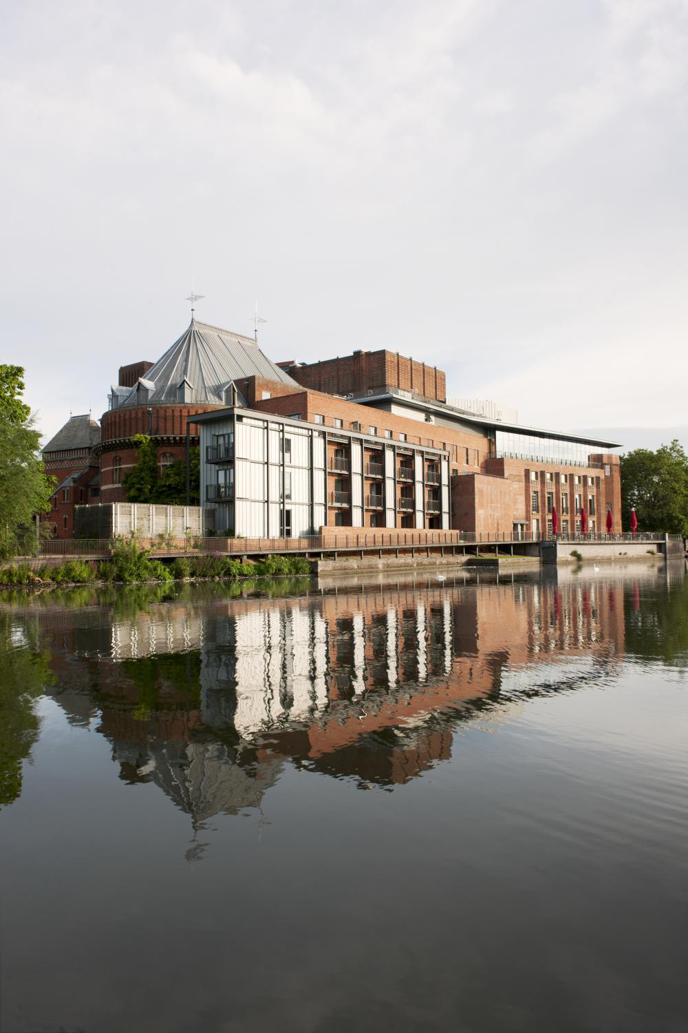
Notes:
The theatre showing a glass fronted addition which faces out over the river. © Historic England Archive - DP154486 - 23 Aug 2012

Slide 12
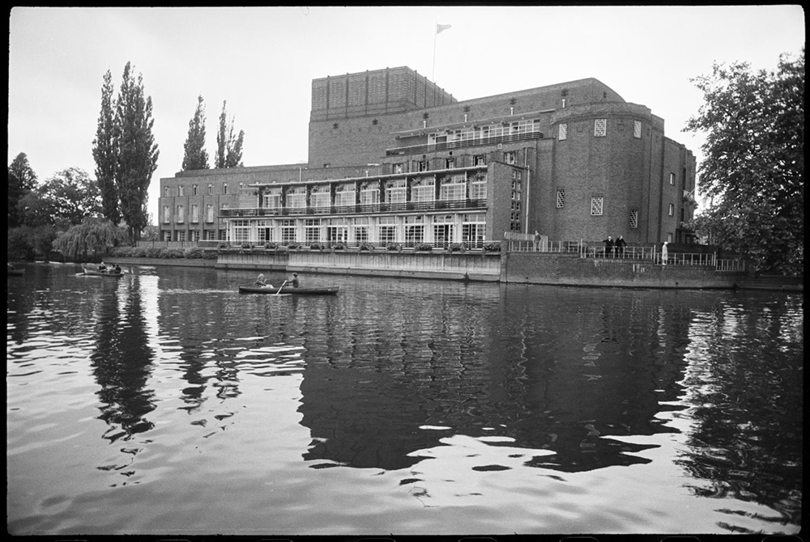
Notes:
Black and white view of the west front of the Royal Shakespeare Theatre, fronting the River Avon. It shows the terraced front, polygonal tower to the left, and blind walling on the far right. © Historic England Archive - UXC01/01/01/0007/04 - c1955 - c1980

Slide 13
Ludlow Castle
The Queen visited the Museum and the Ludlow Festival at Ludlow Castle on 10 July 2003. This was the first time a monarch had visited Ludlow in 300 years. Ludlow Castle was built by the Normans as a fortress against the Welsh.
It was home to the de Lacy and Mortimer families and was later the base for Richard Plantagenet. It features examples of architecture from the Norman, Medieval and Tudor periods. In 1322 its owner, Roger Mortimer, conspired in the overthrow of King Edward II.
In 1501 Prince Arthur honeymooned with Catherine of Aragon in the castle, before dying there the following year. From Between the late 15th and 17th centuries, it was the base for the Council of the Marches of Wales.
Find out more on the National Heritage List.

Slide 14
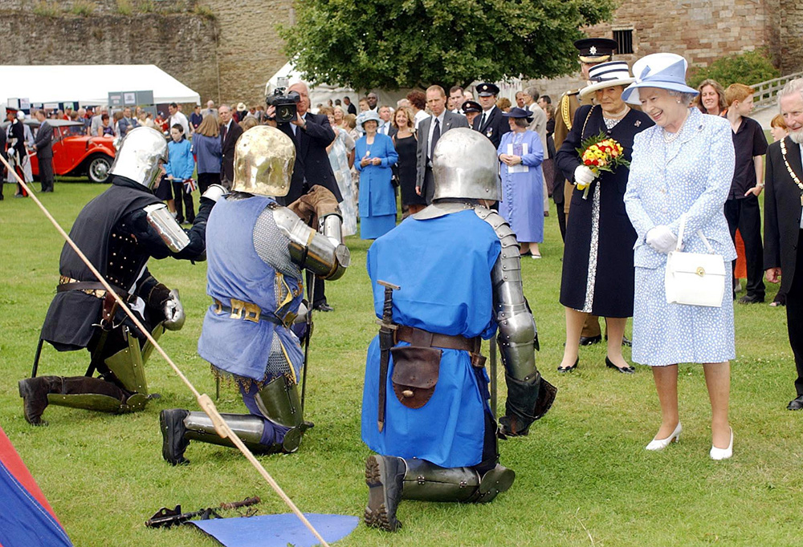
Notes:
The Queen smiles as three men, dressed as medieval knights in armour, kneel before her in the grounds of Ludlow Castle. © Alamy - G6EFNF - 10 July 2003

Slide 15
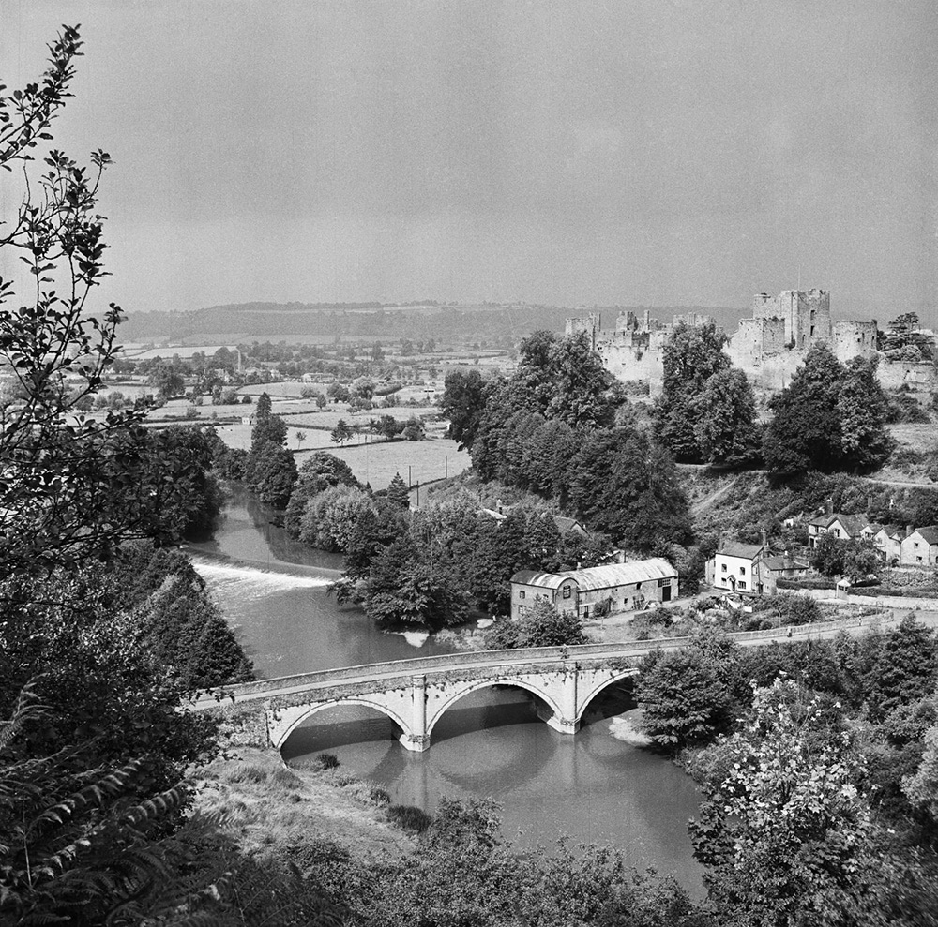
Notes:
A general view of Dinham Bridge in Ludlow from an elevated position showing the river Teme in the foreground and the castle in the background. © Historic England Archive - AA98/04933 - 1945 - 1980

Slide 16
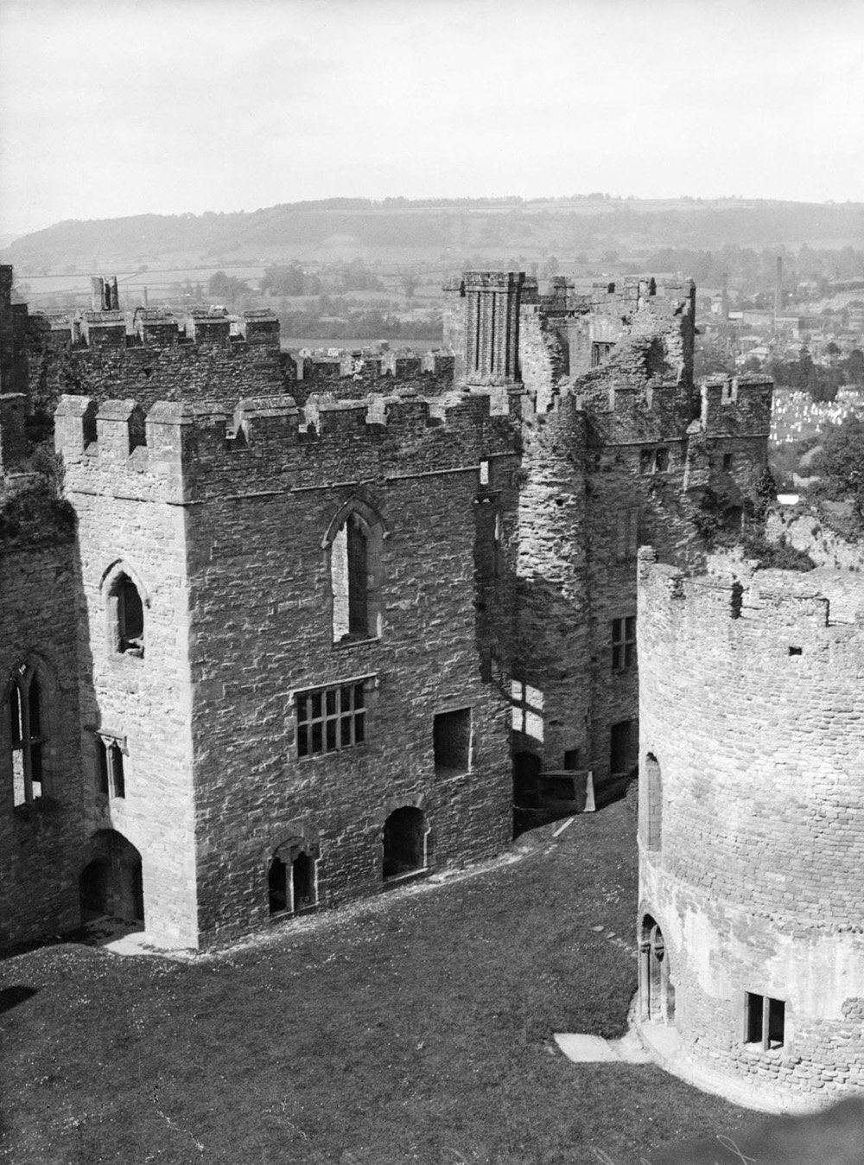
Notes:
An elevated view looking north over the Inner Bailey at Ludlow Castle, with the chapel in the foreground. Source Historic EnglandArchive - OP19565 - 1920 – 1947

Slide 17
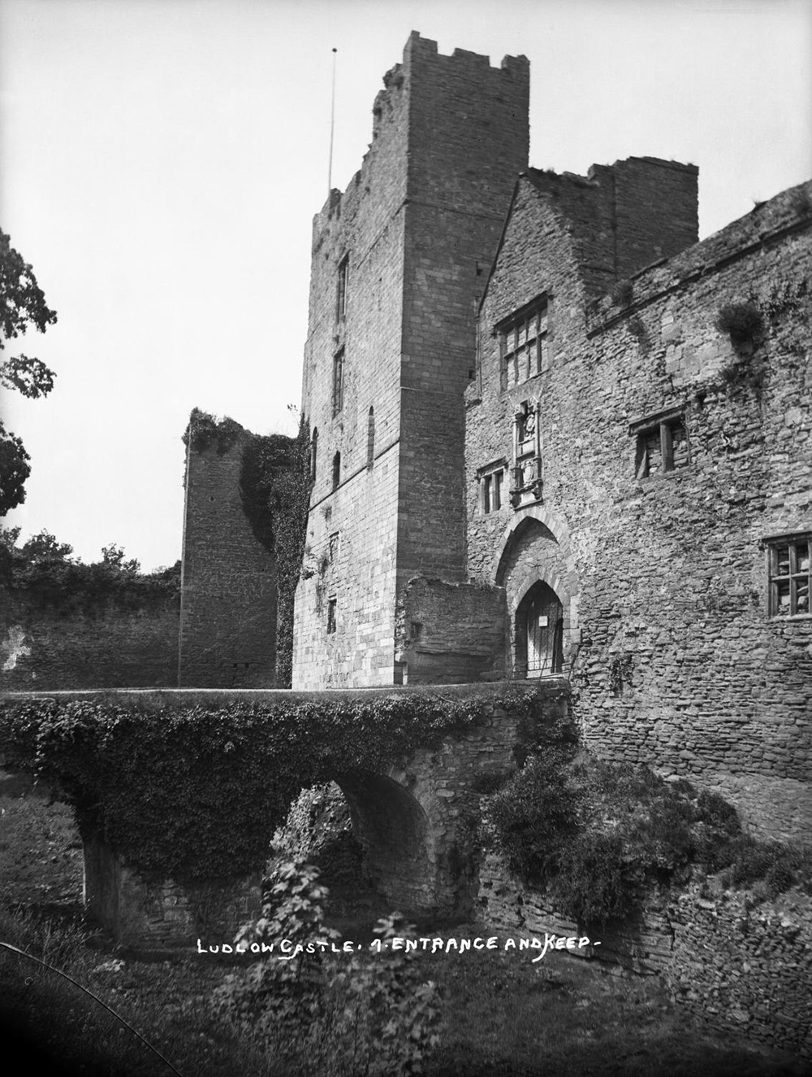
Notes:
A view showing the entrance bridge, spanning the moat, and the keep at Ludlow Castle. © Historic England Archive - BB67/06898 - 1880 - 1930

Slide 18
Dudley Castle
The Queen visited Dudley Castle and Zoo on 24 June 1994, to open the new Interpretation Centre. The original Norman castle was built by Ansculf de Picquigny in 1070. The castle became home to the Paganel Family, and then the Lords of Dudley.
In 1537, the Sharington Range was added by John Dudley, who later became Lord Protector to Edward VI. In 1575, Queen Elizabeth I visited the castle, which was also considered as a possible location to imprison Mary Queen of Scots.
After being held as a Royalist Garrison in the Civil War, key parts of the castle were slighted. Since a devastating fire in 1750, the castle has been a ruin.
Find out more on the National Heritage List.

Slide 19
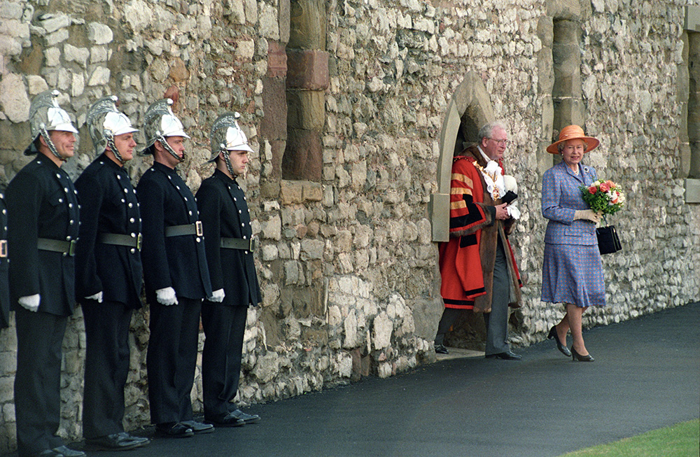
Notes:
The Queen steps out of a door in the castle, passing a group of guards in a smart uniform, which includes a silver helmet. © Alamy - M8PABN - 24 June 1994

Slide 20
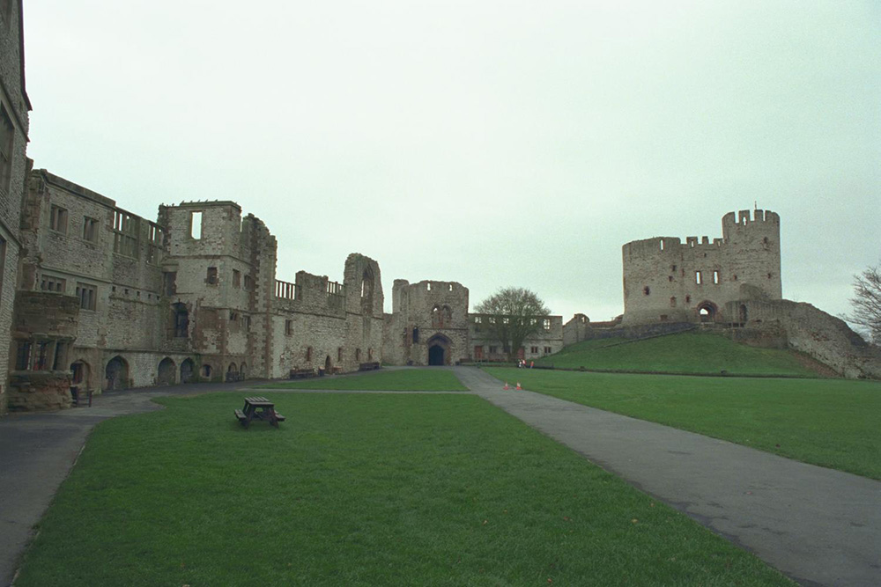
Notes:
A view from the castle bailey, showing the inside of walls, and ruins of the original tower on its 'motte' or mound. © Mr Colin Cundy. Source: Historic England Archive - IOE01/01584/11- 7 Nov 1999

Slide 21
Worcester Guildhall
The Queen and Prince Philip attended a reception at the Guildhall, on 11 July 2012, during her national Diamond Jubilee tour. The Guildhall dates from 1721 and replaced an earlier building.
It has always hosted musical events, including the Three Choirs Festival, featuring choirs from Worcester, Hereford and Gloucester. In the 18th Century, Worcester’s MPs were elected there. The Guildhall also housed a courtroom and a prison below the building.
For much of the 20th Century the building was the headquarters of the Worcester County Council and now houses Worcester City Council.
Find out more on the National Heritage List.

Slide 22
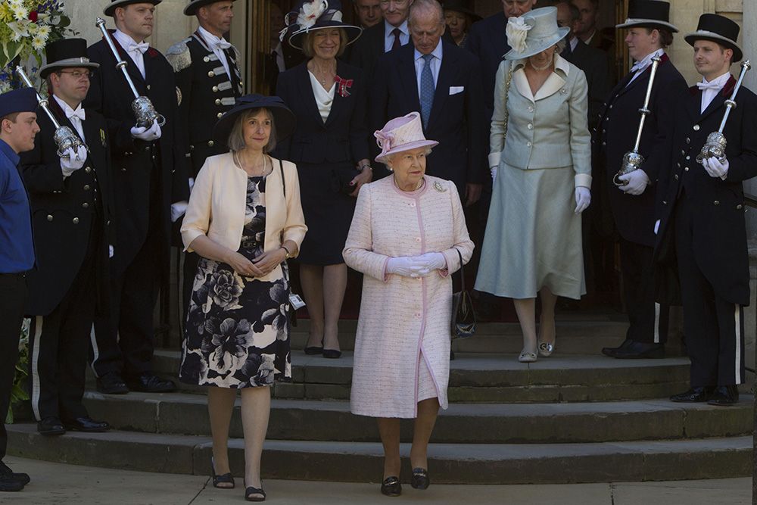
Notes:
The Queen and Prince Philip, surrounded by local dignitaries, as they step out of the Guildhall. © Alamy - G5A74W - 11 July 2012

Slide 23
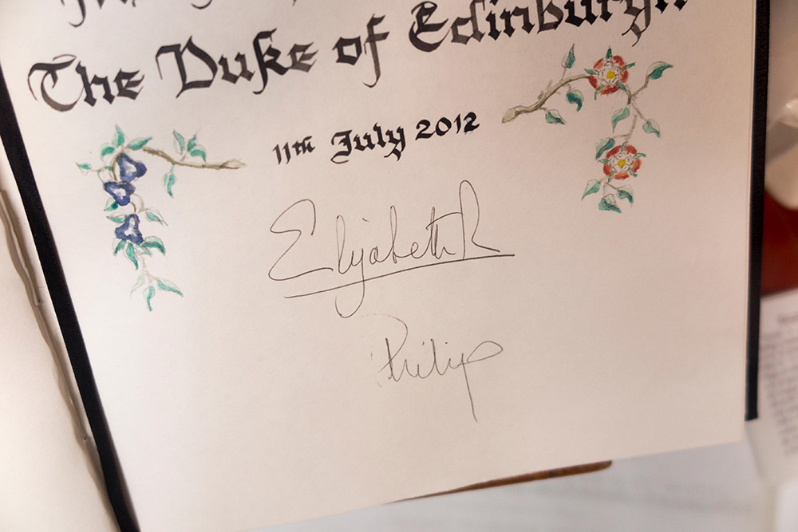
Notes:
Signatures of the Queen Elizabeth & Prince Philip, written on a beautifully decorated page during their visit to Worcester Guildhall. © Alamy - GG0ETM - 22 July 2017

Slide 24
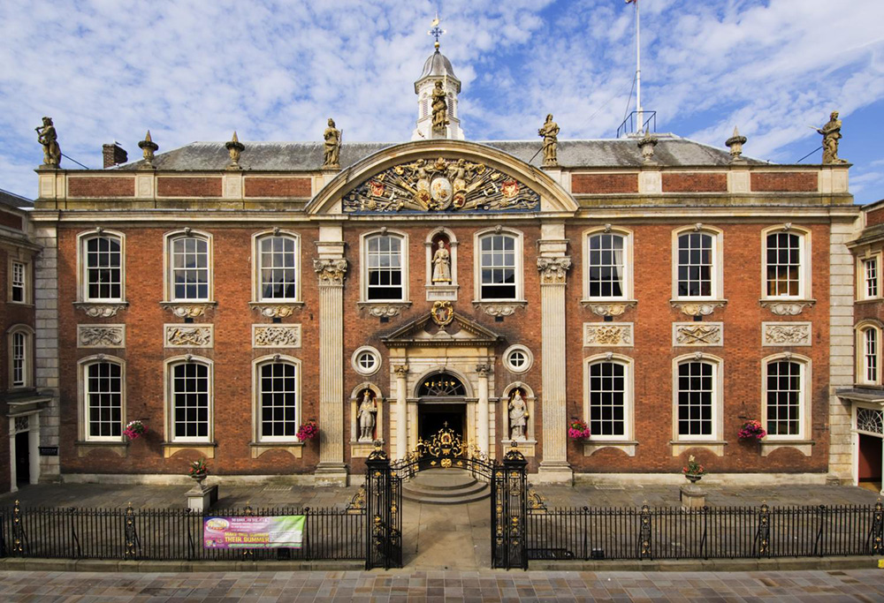
Notes:
A view of the beautiful red brick, classically styled, Guildhall Hall. © Historic England Archive - DP031147 - 17 Jul 2006

Slide 25
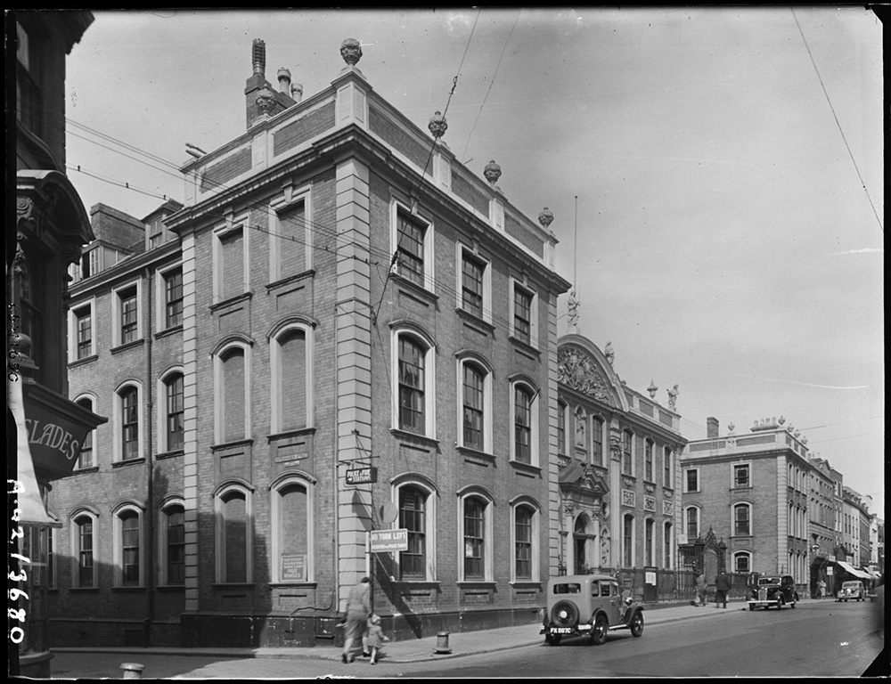
Notes:
Black and white image of the Guildhall viewed from the south east with the junction of Copenhagen Street in the foreground. People and cars can also be seen on the street. © Historic England Archive - AA42/03680 - APR 1942

Slide 26
Dudson Centre, Hanley
The Queen opened the Dudson Centre on 28 October 1999. The Dudson Pottery factory was established by Richard Dudson in 1800. It produced attractive domestic ware until James Thomas Dudson took over the company.
He saw the opportunities provided by the expansion of the railways, tourism and the hotel trade. Dudsons became specialists in producing tableware for the hospitality industry. By the 1980s the Hope Street factory was no longer suitable for production and the factory moved to Tunstall, until production ended in 2019.
In 1994 the Dudson family donated the Hope Street site to the voluntary sector. The centre houses the Dudson Museum and facilities for voluntary and community organisations. As part of this visit the Queen received a garland of flowers from members of the Hindu community who use the centre.
Find out more on the National Heritage List.

Slide 27
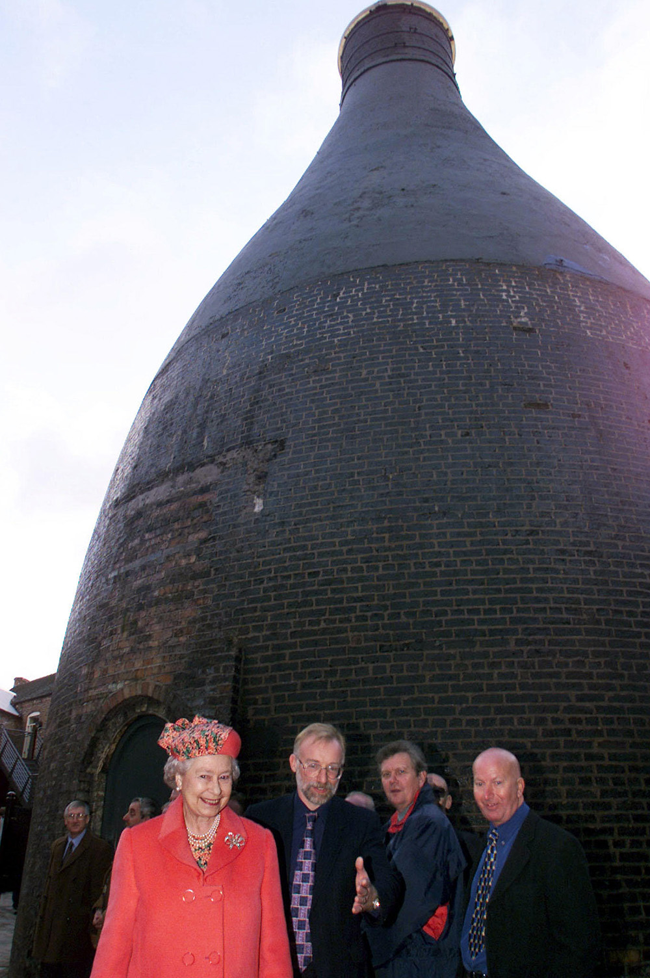
Notes:
The Queen being escorted away from a Bottle Kiln she had just been inside. © Alamy - G4T539 - 28 October 1999

Slide 28
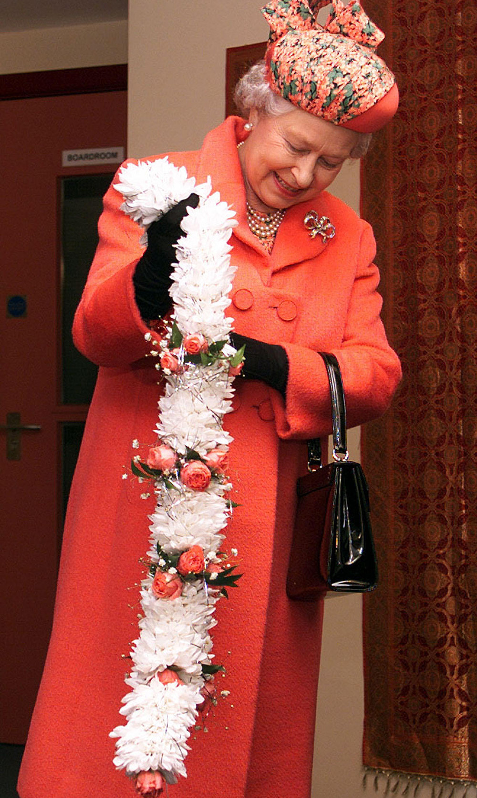
Notes:
The Queen receives a garland of flowers from members of the Hindu community at the Dudson Centre. © Alamy - G4T537 - 28 October 1999

Slide 29
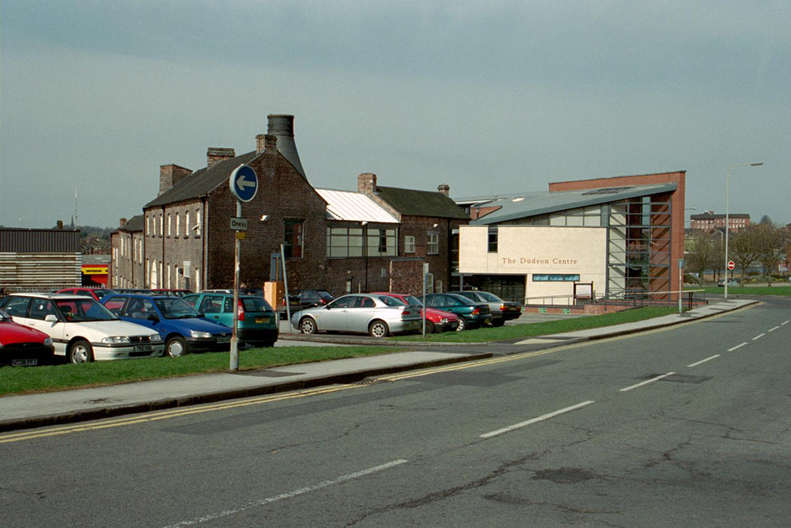
Notes:
A view of the old factory buildings on the left, with the new Dudson Centre building adjoining them on the right. © Mr Brian Peach. Source: Historic England Archive - IOE01/03134/10 - 21 Apr 2001

Slide 30
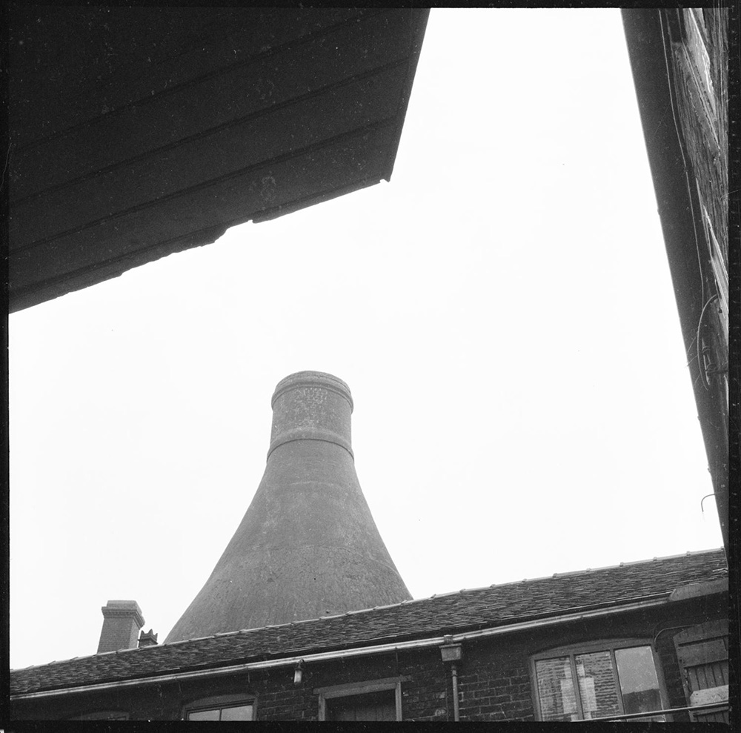
Notes:
The top of the bottle kiln at Dudson's Works poking up above the surrounding buildings. © Historic England Archive - DES01/04/0736 - 1965 – 1968

Slide 31
Shrewsbury Castle
The Queen and Prince Philip visited Shrewsbury Castle on 24 October 1952. The Queen inspected Army cadets, as part of their visit to Shrewsbury School, which was celebrating its fourth centenary. Still eight months before her coronation, the visit was one of her first as the new monarch.
Shrewsbury Castle was built after the Norman Conquest and was extended by Roger de Montgomery c1070, as a defence against the Welsh. Some outer parts of the castle were lost as the town expanded. Some repairs were made after the English Civil War and, again, from 1780, by Thomas Telford.
From 1924, it served as the town’s council chamber and, since 1985, the castle has housed the Regimental Museum of the Kings Shropshire Light Infantry.
Find out more on the National Heritage List.

Slide 32
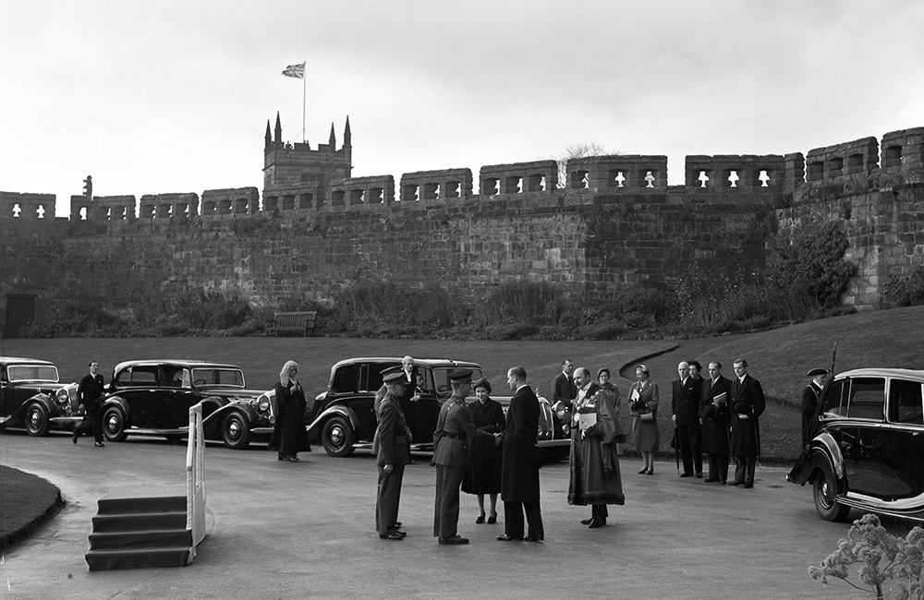
Notes:
The Queen and Prince Philip are greeted by dignitaries, standing in front of a row of cars with the grounds of Shrewsbury Castle. © Alamy - FFHXT8 - 24 October 1952

Slide 33
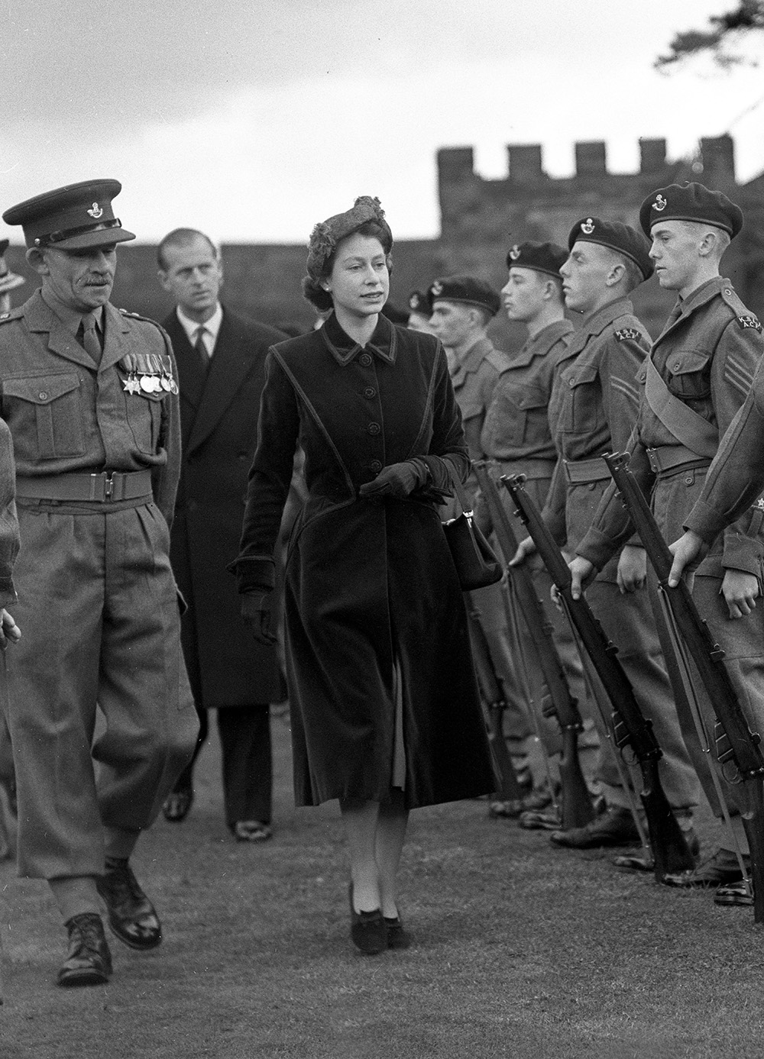
Notes:
A black and white image of the Queen inspecting army cadets within Shrewsbury Castle. © Alamy - CYTAT7 - 24 October 1952

Slide 34
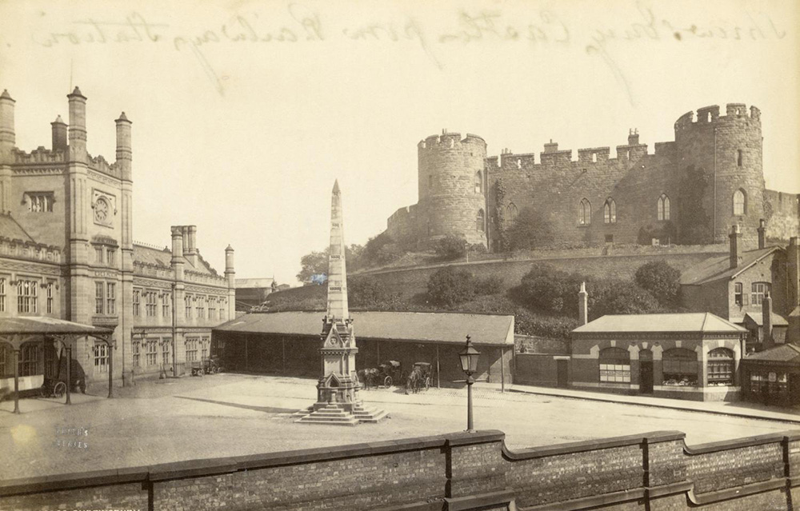
Notes:
A sepia image looking from the station looking towards Shrewsbury Castle, with the Clement Memorial in the foreground. Source: Historic England Archive - OP05960 - 1850 – 1900

Slide 35
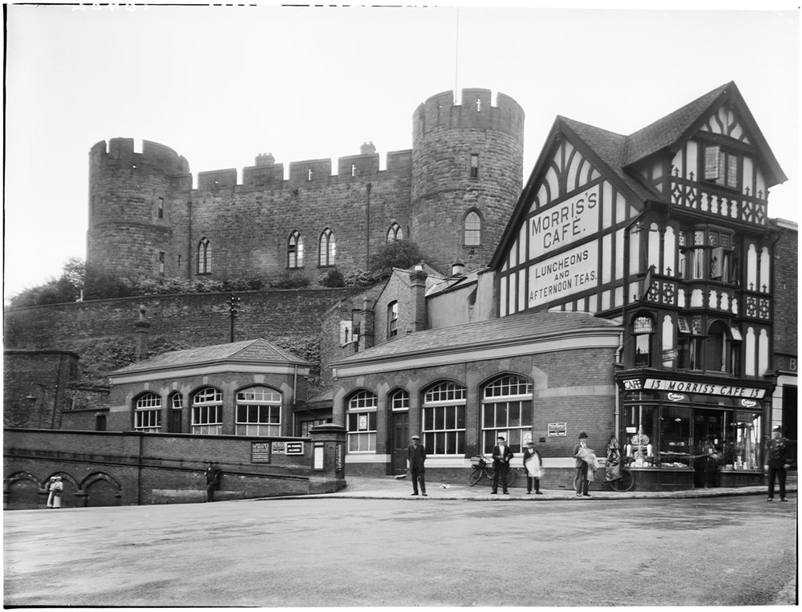
Notes:
Black and white image of people standing outside Morris's Cafe at 13 Castle Gates, with the main hall of Shrewsbury Castle atop the hill behind. Source: Historic England Archive - CC80/00503 - 14 Aug 1933

Slide 36
Ironbridge Tollhouse
The Queen visited Ironbridge on 10 July 2003, as part of a wider visit to Telford, during the town’s 40th anniversary celebrations. She walked across the Iron Bridge and visited the Toll House, which is now a visitor centre. The Iron Bridge was the world’s first bridge to be constructed from iron and was built in 1779, by Abraham Darby III.
The Tollhouse is estimated to have been built by 1835. It may have either replaced, or extended, an earlier building. Until 1950, all pedestrians, without exception, had to pay a toll to cross the bridge. A sign, still visible today, advised: 'Every officer or soldier whether on duty or not, is liable to pay toll for passing over as well as any baggage wagon, mail coach or the Royal Family.'
In 1932, an elephant walked across the bridge to promote Chapman's Zoo-Circus. Whether or not the elephant paid a toll is not known!
Find out more on the National Heritage List.

Slide 37
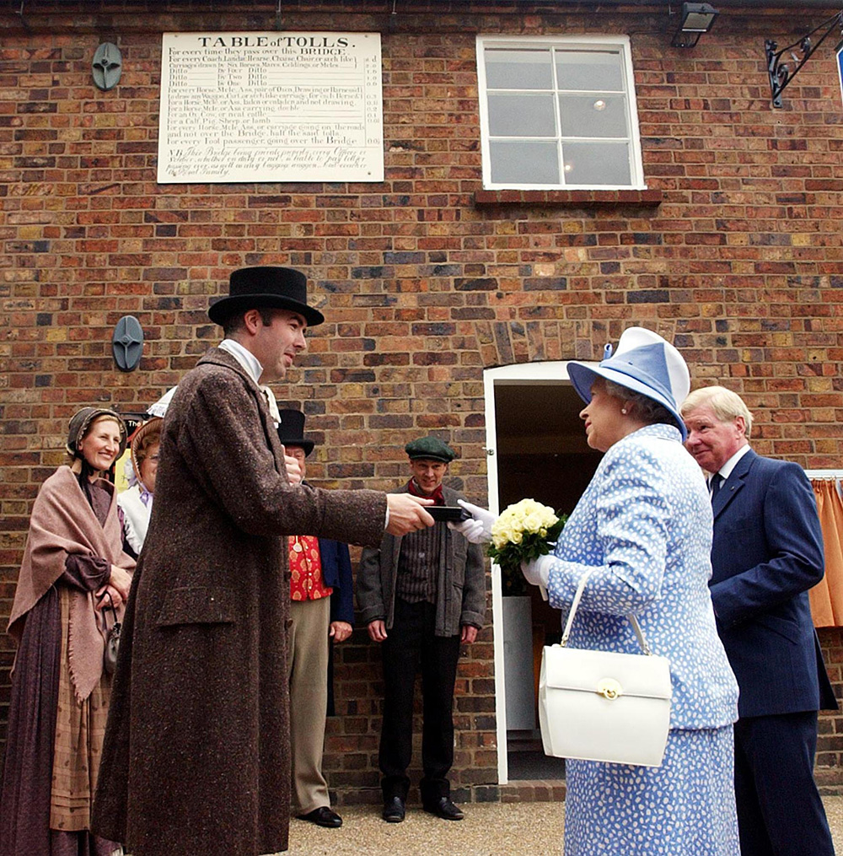
Notes:
The Queen pays a half penny toll to Toll Keeper Guy Rowland, to cross the bridge. The Toll Keeper and others watching are wearing Victorian clothing. © Alamy - G6EEMM - 10 July 2003

Slide 38
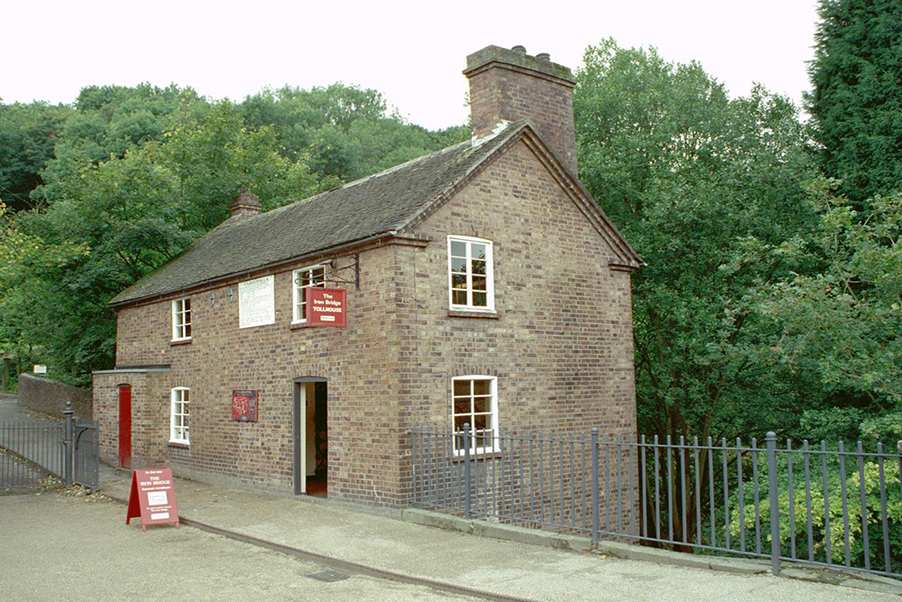
Notes:
A view of the brick built Tollhouse on the entrance to the Iron Bridge. © Mr Matthew Murray. Source: Historic England Archive - IOE01/05320/19 - 29 Sep 2001

Slide 39
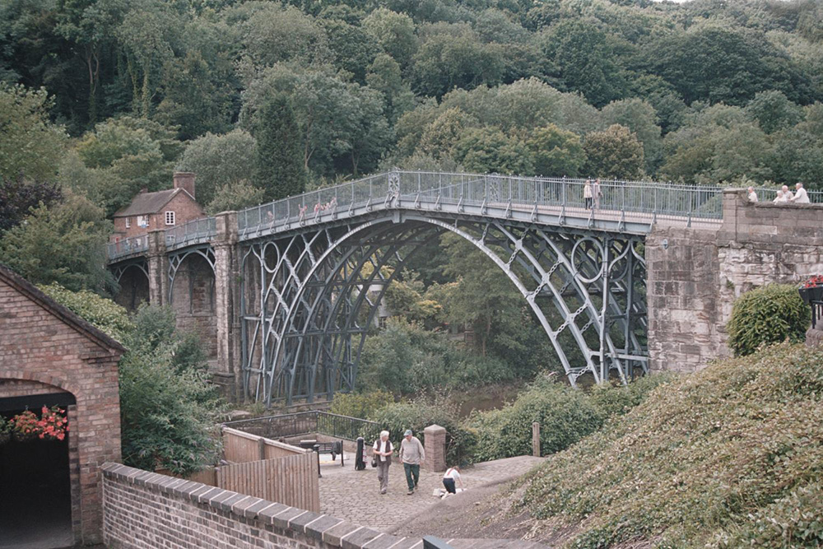
Notes:
A view of the Iron Bridge, with the Tollhouse just visible at the far end. © Mr John Cousens. Source: Historic England Archive - IOE01/16428/05 - 10 Jul 2007

Slide 40
Royal Worcester Porcelain Factory
The Queen and Prince Philip visited the Royal Worcester Porcelain Factory on 1 March 2001 to unveil a plaque, as part of the company’s 250-year celebrations.
The factory’s story began when Dr John Wall and William Davis experimented with materials required to copy the porcelain made in the Far East. They secured funding from 13 local businessmen and established the factory in 1751. In 1783 John Flight bought the company and, after a visit by George III, the factory gained a royal warrant, becoming the Royal Porcelain Works.
The 19th and 20th centuries saw a succession of different owners of the works. Eventually, the Royal Worcester was bought by Portmeirion Pottery. Production moved entirely to Stoke on Trent and production work ended at the Worcester factory in 2009.
Find out more on the National Heritage List.

Slide 41
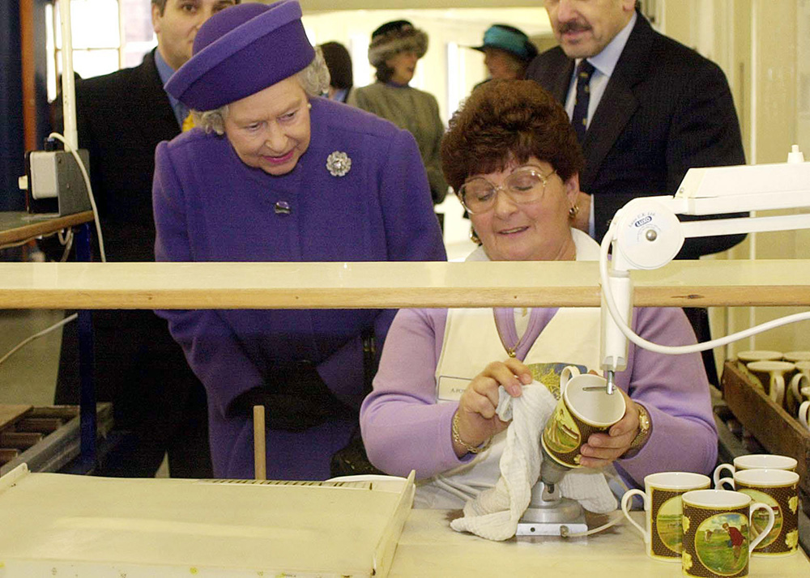
Notes:
The Queen watches worker, Anne Fowler, decorate a mug. © Alamy - G5A7E4 - 1 March 2001

Slide 42
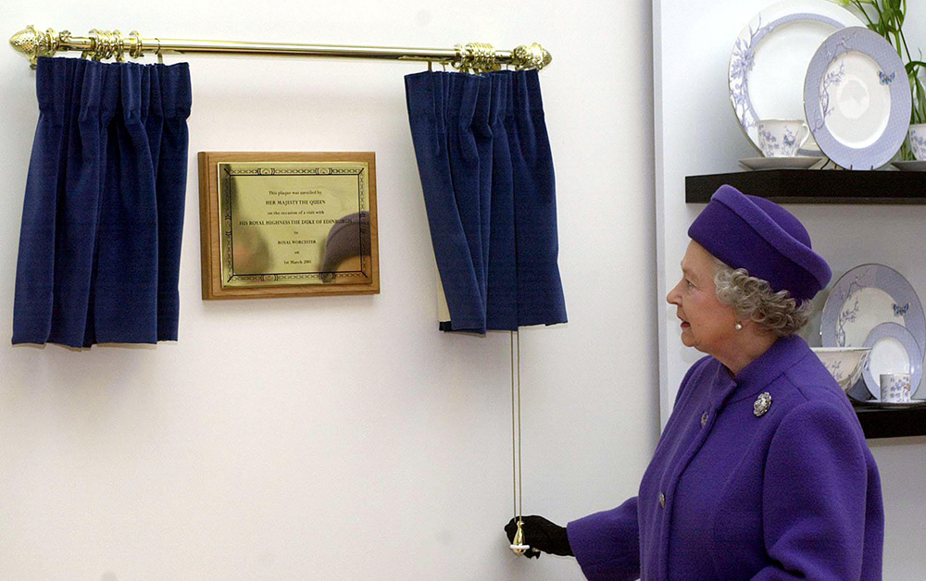
Notes:
The Queen pulling a curtain to unveil a plaque commemorating her visit and the company's 250th anniversary. © Alamy - G5A7E5 - 1 March 2001

Slide 43
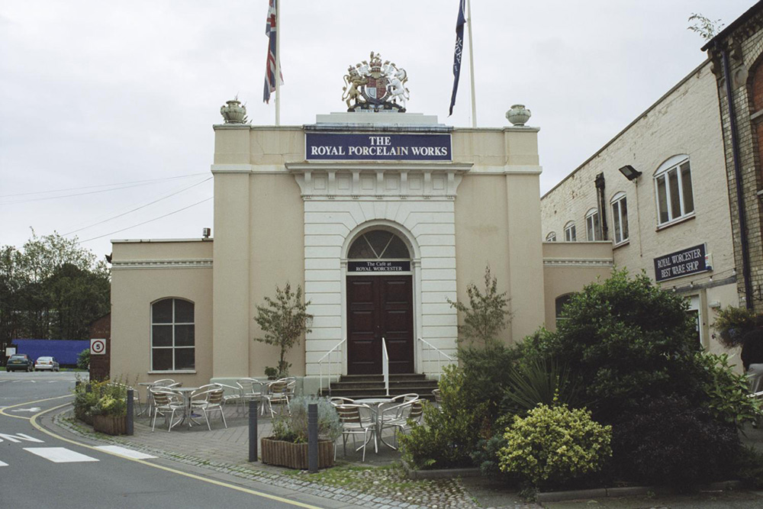
Notes:
A cream coloured building with a white painted stone surround around the door, with a coronet on its roof. © Mrs Ann Vint. Source: Historic England Archive - IOE01/13079/31- 30 Aug 2004

Slide 44
Birmingham Council House
The Queen visited Central Birmingham on 12 July 2012, as part of her Diamond Jubilee celebrations. In 1871 Birmingham Council decided to build a purpose-built council building and a design competition was held.
Henry Richard Yeoville Thomason won and the Council House was completed in 1879. It was soon extended, with the addition of the Museum and Art Gallery and the Corporation Gas Department. Above the main entrance is a mosaic by Salviati Burke and Co. of Venice and a carved pediment depicting Britannia receiving the manufacturers of Birmingham.
Victoria Square was once occupied by Christ Church, which was demolished in 1899. The Square was pedestrianised in 1993 and a new fountain and sculptures by the Indian sculptor Dhruva Mistry were added.
Find out more on the National Heritage List.

Slide 45
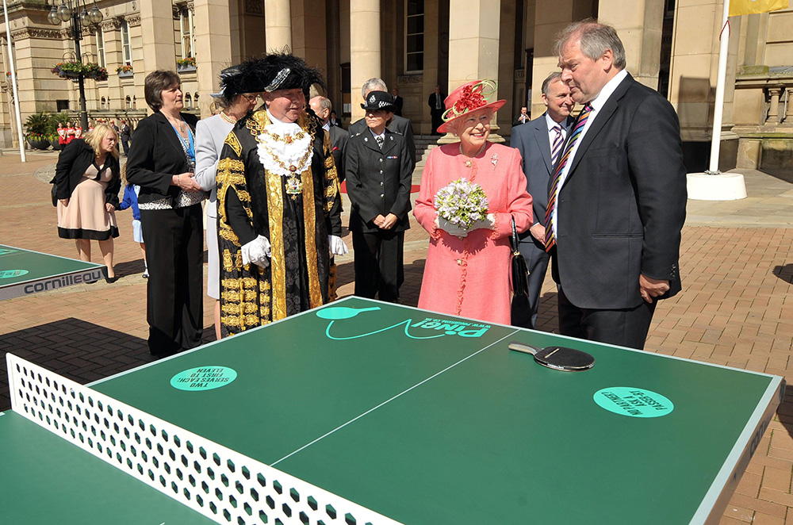
Notes:
The Queen views a public table tennis table outside the Council House in Victoria Square, Birmingham. She is accompanied by the Lord Mayor of Birmingham Councillor, John Lines, and other dignitaries. © Alamy - G5AYWK - 12 July 2012

Slide 46
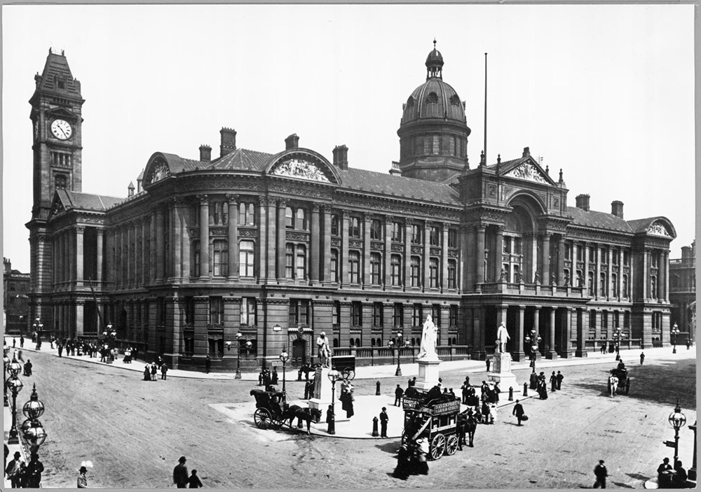
Notes:
Black and white view from the south-west of the Council House on Colmore Row, showing horse and carts and people in the foreground. Source: Historic EnglandArchive - OP32691 – 1901

Slide 47
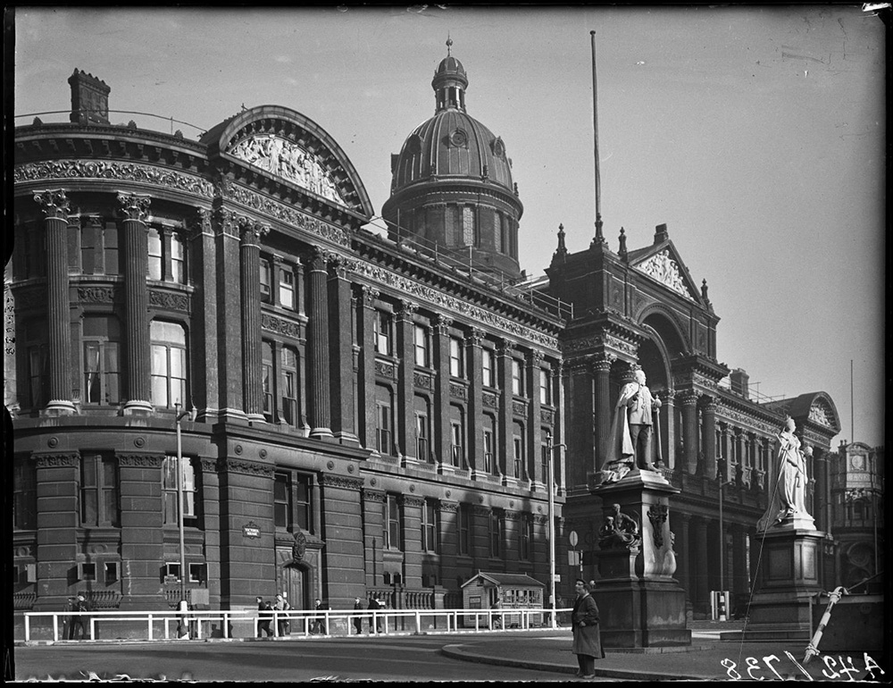
Notes:
A black and white view of Birmingham Council House as seen from Victoria Square. © Historic England Archive - AA42/00738 – 1941

Slide 48
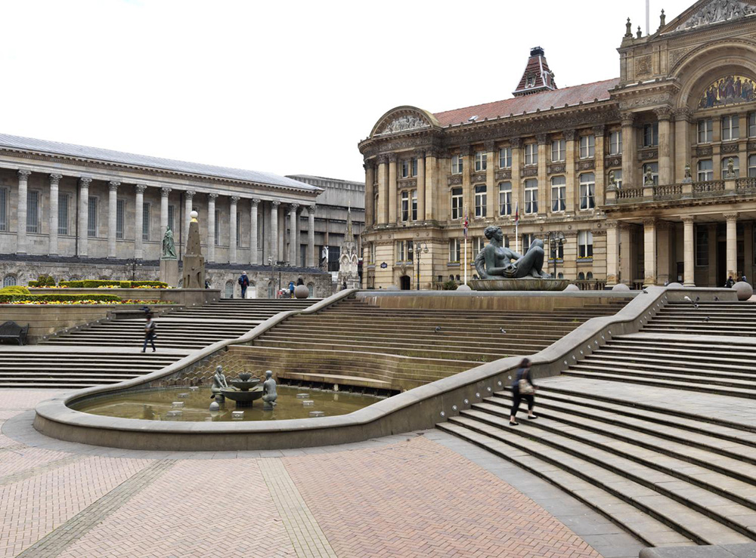
Notes:
A general view of the fountain and the sculptures 'The River' and 'Youth' by Dhurva Mistry in Victoria Square, from the east. © Historic England Archive - DP167090 - 6 Mar 2015

Slide 49
Hereford Cathedral
Queen Elizabeth II and Prince Philip first visited Hereford Cathedral on 24 April 1957. During the visit, the Queen also opened a new sale ring at Hereford Cattle Market. The Queen has been to Hereford on at least 7 occasions. In 1976, she distributed Maundy Money at the Cathedral.
The remains of Ethelbert, King of the Angles were interred at Hereford Cathedral, after he was murdered at the Palace of King Offa of Mercia’s. The Cathedral, re-built after the Norman Conquest, is dedicated to St Ethelbert, jointly with the Blessed Virgin Mary.
It houses one of the four copies of the Magna Carta, dating from 1217, the Mappa Mundi - Richard of Holdingham’s Medieval map of the world - and the largest chained library in Europe.
Find out more on the National Heritage List.

Slide 50
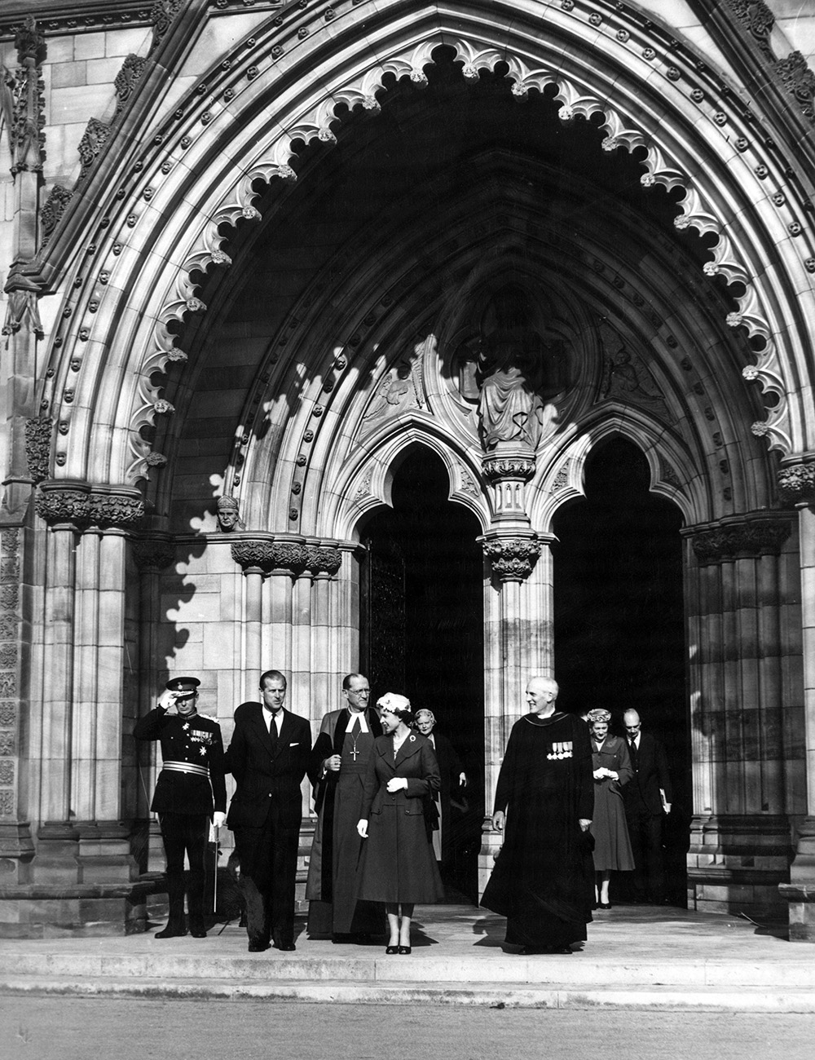
Notes:
The Queen and Prince Philip leaving Hereford Cathedral accompanied by member of the clergy and other dignitaries. © Alamy - 2HJ66HY - 24 April 1957

Slide 51
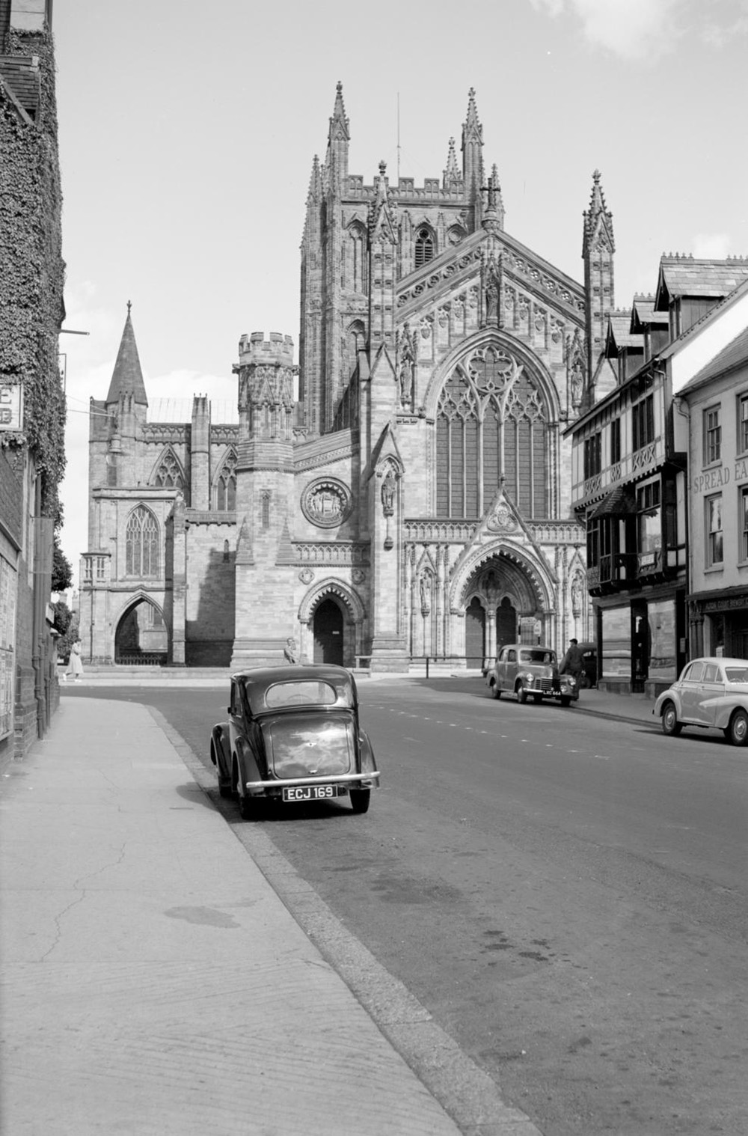
Notes:
A black and white view looking towards the west front of the Cathedral from King Street, showing cars parked on either side of the street. © Historic England Archive - AA002157- 1945 – 1965

Slide 52
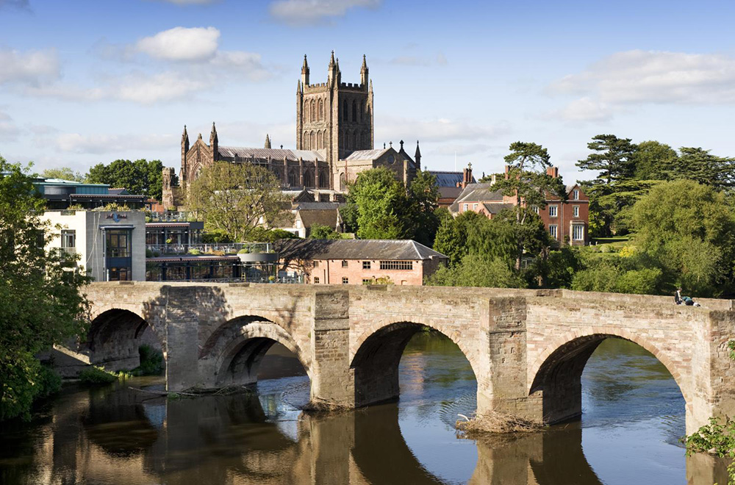
Notes:
A view of the cathedral and the Wye Bridge from the south-west. © Historic England Archive - DP083580 - 28 May 2009

Slide 53
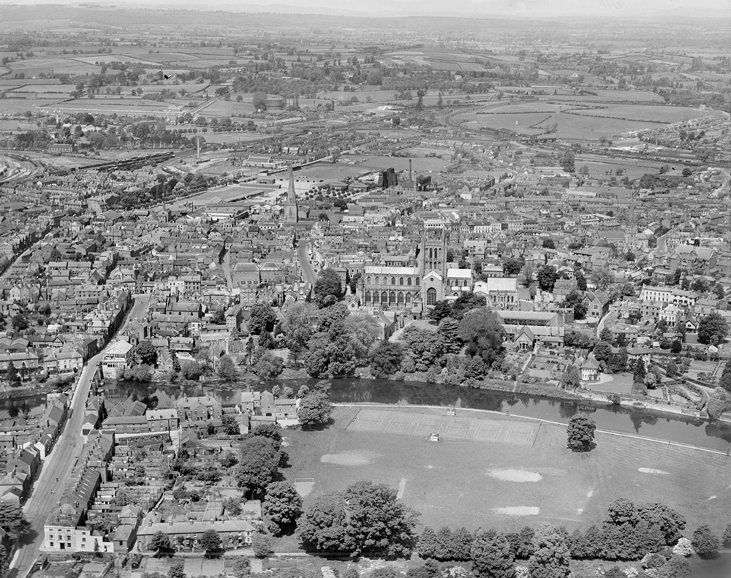
Notes:
A black and white aerial view of Bishop's Meadow, Hereford Cathedral and the city, from the south. © Historic England Archive(Aerofilms Collection) - EPW041222 – May 1933

Slide 54
58 and 59 Mardol, Shrewsbury
On 24 October 1952, crowds lined the pavements, on both sides of Mardol, as the Queen was driven from Shrewsbury Castle to Shrewsbury School. There, she opened a new terrace to commemorate the school’s 400th anniversary.
Mardol connects Mardol Quay, alongside the River Severn, with the town’s main shopping area. There are no less than 35 listed buildings along Mardol alone, representing a wide range of architectural styles. Some buildings originate from the 15th and 16th centuries.
58 and 59 Mardol is a former shop and public house, dating from around 1800. It can be seen next to the front car, just behind the ‘Long may she reign’ banner, in the photograph.
Find out more on the National Heritage List.

Slide 55
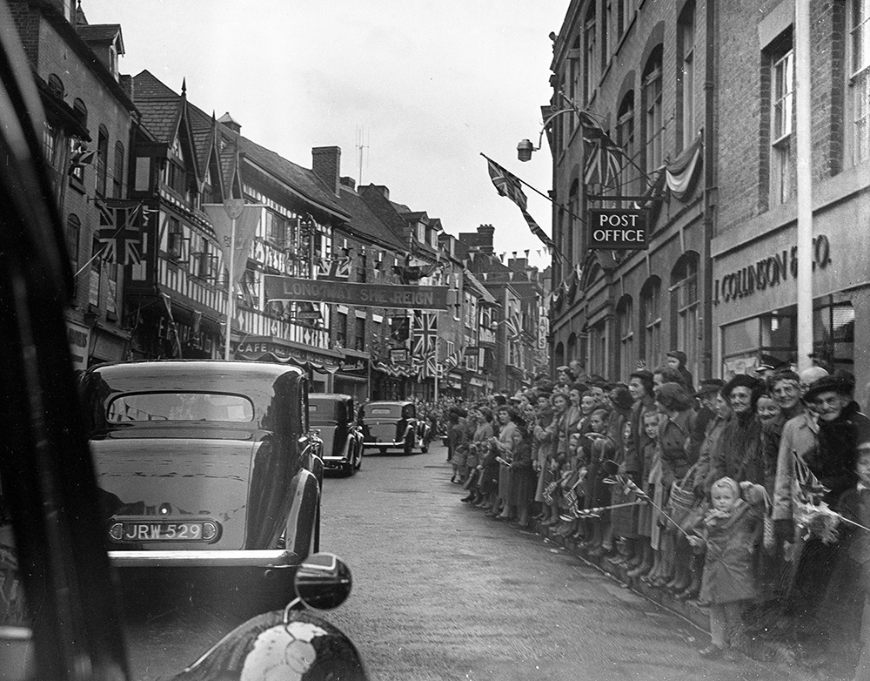
Notes:
Crowds, waving flags, lined the pavements of on both sides of Mardol as the Queen was driven from Shrewsbury Castle to Shrewsbury School. The street are also decorated with flags and bunting. © Alamy - JF92RJ - 24 October 1952

Slide 56
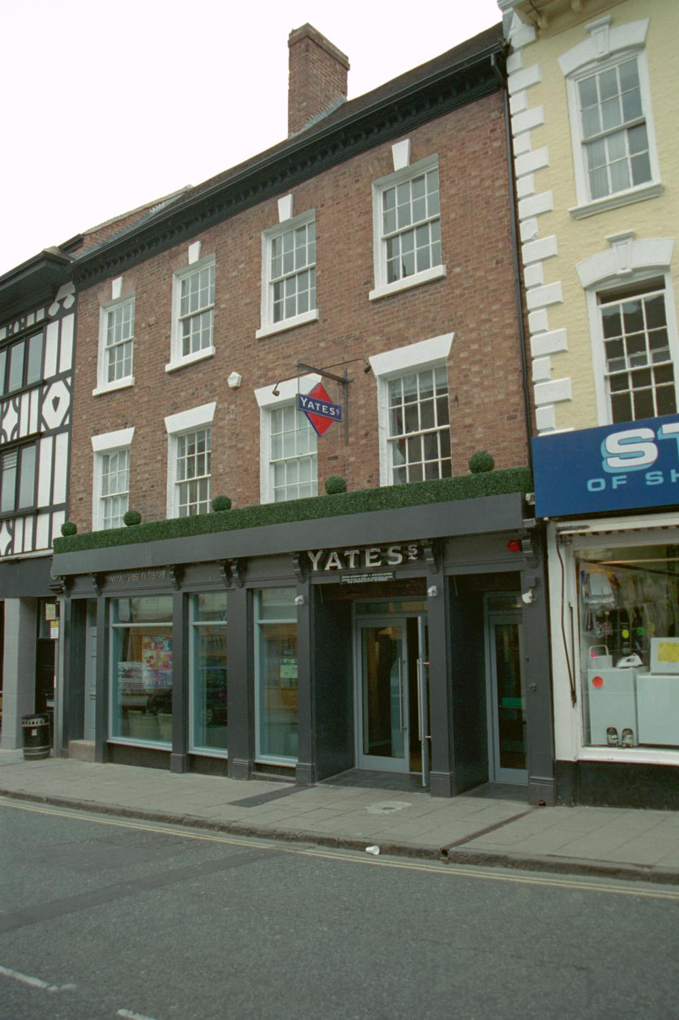
Notes:
A view of a 3 storey red brick Georgian building, with big glass shop windows on the ground floor. © Mr M. I. Joachim. Source: Historic England Archive - IOE01/10231/07- 10 Apr 2003

Slide 57
Coventry Cathedral
The Queen laid the foundation stone for the new Coventry Cathedral on 23 March 1956. The ‘old Cathedral’, originally St Michael’s church, was destroyed by incendiary bombs on 14 November 1940.
The current cathedral is Coventry’s third. The original Cathedral of St Mary was founded by Loefric and his wife, Godiva, in 1043. The architect of the current cathedral, Sir Basil Spence, designed a spectacular modernist building, famous for its use of concrete, etched and coloured glass, sculptures and altar tapestry.
The builders of the new cathedral were John Laing. Coventry Cathedral houses the Ministry of Peace and Reconciliation. The Queen returned to the cathedral on 25 May 1962, to witness its consecration.
Find out more on the National Heritage List.

Slide 58
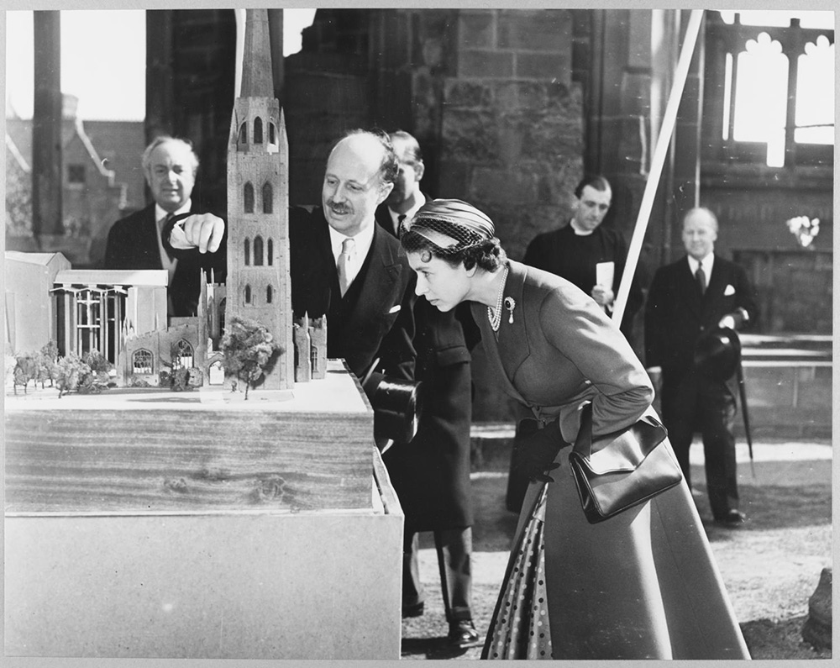
Notes:
A black and white image of the architect Basil Spence using an architectural model to explain the site of the new Coventry Cathedral to the Queen. © Historic England Archive.John Laing Photographic Collection - JLP01/01/025/06 - 23 Mar 1956

Slide 59
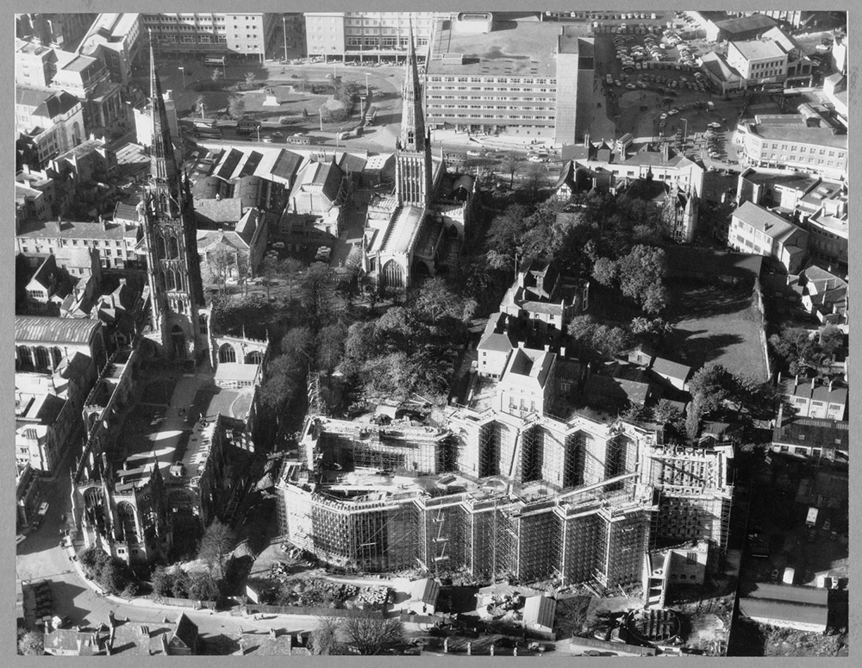
Notes:
A black and white aerial view showing the construction site of the new Coventry cathedral next to the ruins of the old cathedral. © Historic England Archive. John Laing Photographic Collection - JLP01/01/026/01 - 1 Nov 1958

Slide 60
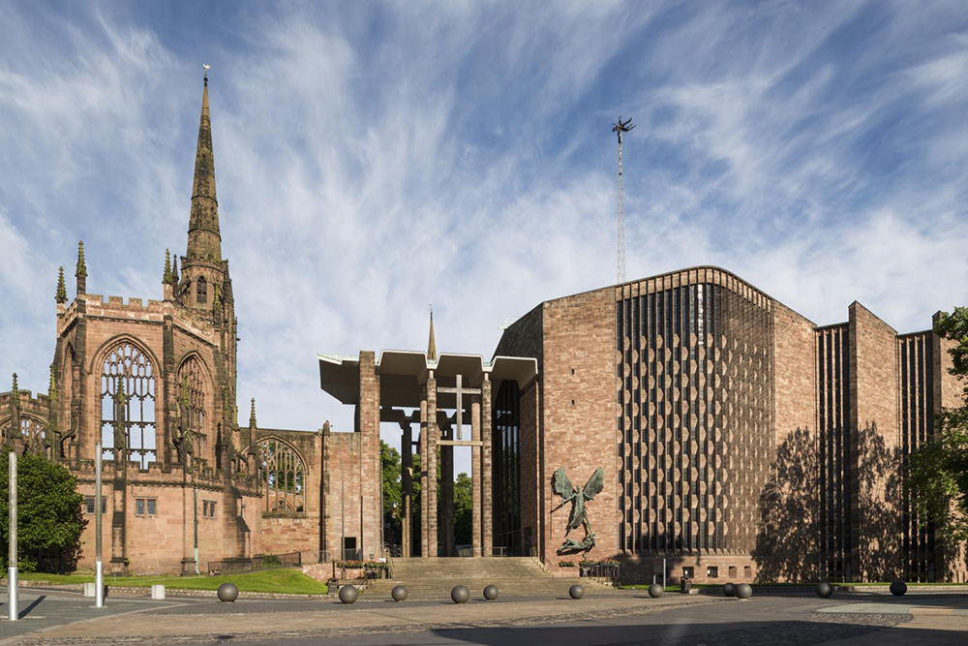
Notes:
A view of the old and new Cathedral buildings from the east. © Historic England Archive - DP164703 - 13 Jun 2014

Slide 61
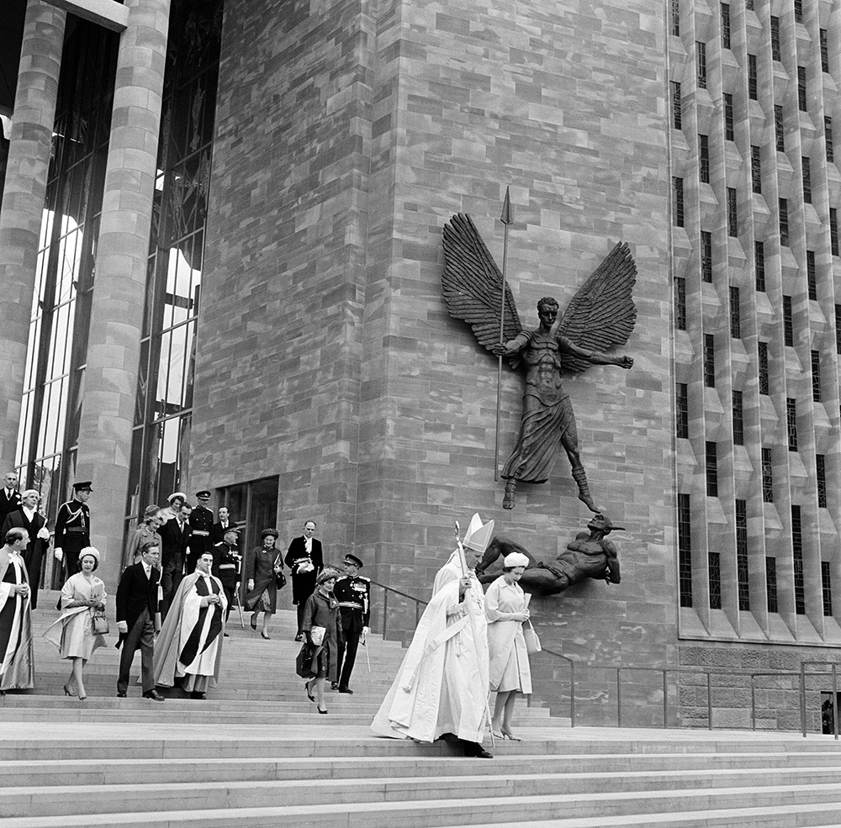
Notes:
A black and white image of the Queen and a Bishop walking down the steps outside of new Coventry Cathedral. Princess Margaret and other dignitaries follow behind. © Alamy - 2HJAMW5 - 25 May 1962

Slide 62
Worcester Cathedral
The Queen visited Worcester Cathedral on 11 July 2021, as part of her national Diamond Jubilee tour. An earlier cathedral was founded in 680, with a Northumbrian priest, Tatwine, the first Bishop. The current cathedral dates from 1084.
It contains many architectural styles including Norman and Perpendicular Gothic. The multi-columned crypt is the oldest surviving part of the cathedral. It was built during the time of Bishop St Wulfstan, the Anglo-Saxon bishop who was, unusually, retained after the Norman Conquest.
The cathedral was damaged during the English Civil War and was extensively renovated during the Victorian era. Most of the stained glass and fittings date from this time. The Cathedral is the burial place of King John, Prince Arthur Tudor and former Prime Minister, Stanley Baldwin.
Find out more on the National Heritage List.

Slide 63
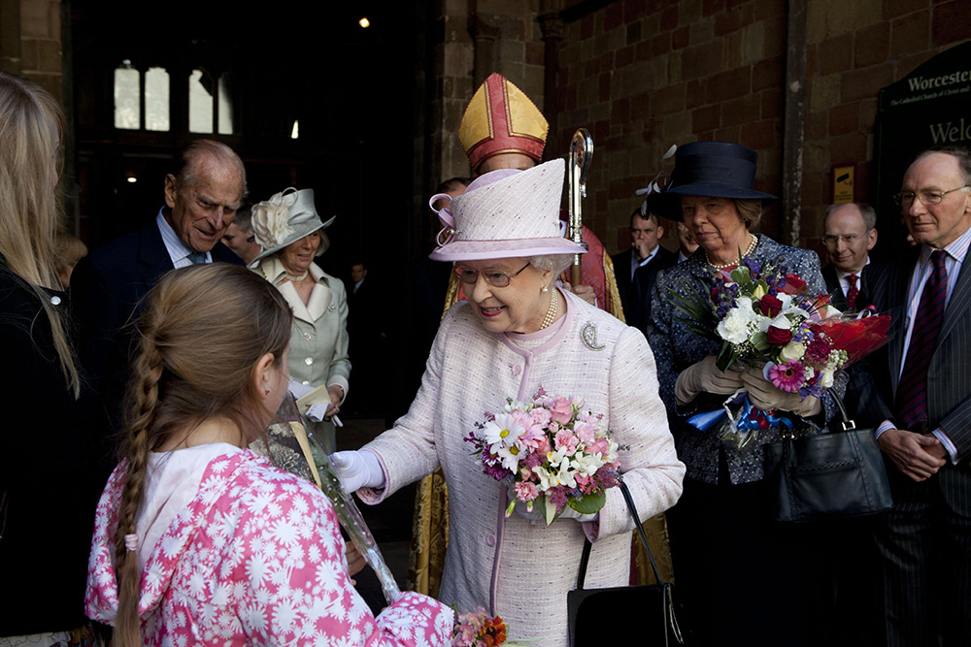
Notes:
The Queen, accompanied by Prince Philip, receives flowers from a girl inside Worcester cathedral whilst surrounded by member of the clergy and other dignitaries. © Alamy - G5A75P - 11 July 2012

Slide 64
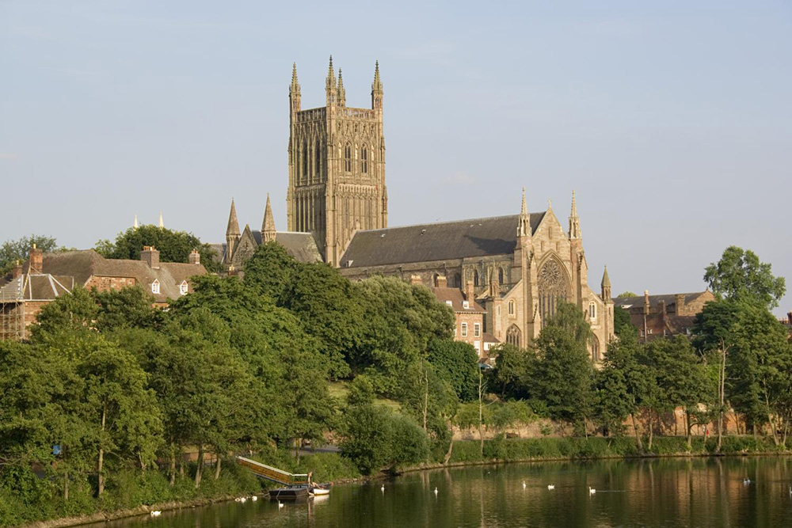
Notes:
A general view of Worcester Cathedral, looking across the river from the north-west. © Historic England Archive - DP031132 - 20 Jul 2006

Slide 65
Notes:
A black and white image of Worcester Cathedral viewed from the north west with the rear elevation of 10 College Yard in the foreground. © Historic England Archive - AA42/03653 - Apr 1942

Slide 66
Notes:
A sepia view of the nave showing the pointed arches and vaulted ceiling inside the cathedral. Source: Historic EnglandArchive - CTP02/01/07 - 1860s-1870s

Slide 67
Birmingham Hippodrome
The Queen visited the Birmingham Hippodrome on 29 November 1999, when it became the first theatre, outside London, to host the Royal Variety Performance. She returned on 11 November 2001 to officially re-open the theatre, after a £35 million re-development.
The original building was funded by James and Henry Draysey, who opened The Tower of Varieties and Circus on 9 October 1899. The whole theatre was lit by electric light and featured a tall tower with an onion shaped top (which remained until the 1960s). It closed just five weeks later.
It re-opened as the Tivoli Theatre in 1900 and it then became the Hippodrome in 1903. Famous performers at the Hippodrome have included Charlie Chaplin, Laurel and Hardy and Frank Sinatra.
Find out more about Birmingham Hippodrome.

Slide 68
Notes:
The Queens meets the 'Boy Band' Westlife and other performers back stage after a Royal Variety Performance. All 5 members of Westlife are dressed entirely in white. © Alamy - G4TG58 - 29 November 1999

Slide 69
Notes:
The exterior of the redeveloped Birmingham Hippodrome Theatre. © Historic England Archive - NWC01/01/0310 - Apr 2005 - May 2005

Slide 70
Notes:
A view from the stalls in the auditorium of the Birmingham Hippodrome Theatre, looking up towards the dress circle and boxes. © Historic England Archive - NWC01/01/0301 - 1970 - 1999

Slide 71
Aston Villa Football Club
The Queen presents the FA Cup to Aston Villa captain Johnny Dixon after his team's 2-1 win over Manchester United at Wembley on 4 May 1957.
One of the world’s oldest football clubs, Aston Villa was founded in 1874, at the Villa Cross Wesleyan Chapel in Handsworth, by four members of the cricket team who wanted to remain active in the winter.
The club was a founder member of the Football League in 1888 and dominated English football during the late Victorian era, winning their first league title in 1893-94. Aston Villa moved to their current ground, Villa Park, in 1897. They won the first post First World War FA Cup and their greatest success to date (2022) was winning the European Cup, in 1982.
Find out more about Aston Villa.

Slide 72
Notes:
A black and white photo of the Queen handing the FA Cup to the team captain and other players still dressed in their football kit. © Alamy - GBME05 - 4 May 1957

Slide 73
Notes:
A view of the beautiful red brick entrance to Aston Villa football ground. © Crown Copyright. Historic England Archive - BB93/23962 - 8 Jun 1993

Slide 74
Notes:
A black and white view looking across the pitch to the North Stand of Aston Villa football ground. © Crown Copyright. Historic England Archive - BB92/17750 - 2 Jun 1992

Slide 75
The National Exhibition Centre
The Queen officially opened the National Exhibition Centre on 2 February 1976. The NEC, located beside Birmingham Airport, was built with 7 exhibition halls and now has 18, three of which were subsequently opened by the Queen in March 1989.
One of the country’s most prominent exhibition, conference and event venues, the NEC has staged The Motor Show, Clothes Show Live, BBC Gardeners’ World Live and the BBC Good Food Show Live. It has been the home of Crufts since 1991.
The NEC has also hosted diverse range of musical performers including David Bowie, Black Sabbath, Tina Turner, Queen and the Spice Girls. In April 2020, during the Covid 19 Pandemic, the NEC was converted to an emergency Nightingale Hospital in readiness for treating Covid patients.
Find out more about the NEC.

Slide 76
Notes:
A black and white image of the Queen, holding a script, standing in front of a microphone. In the background are a group of dignitaries. © Alamy - G7W4A4 - 2 February 1976

Slide 77
Notes:
A aerial view showing the vast size of the National Exhibition Centre, with it's multiple exhibition halls, hotels and car parks. © Historic England Archive - 33658_012 – 27 June 2018

Slide 78
The Paragon China Works, Longton
Princess Elizabeth visited the Paragon China Works, in November 1949, during a two-day tour of the Potteries. The pottery was founded Star China Company, in 1903, the main partners being Herbert James Aynsley and Hugh Irving. In 1920, the company was re-named the Paragon China Company.
Based at the Atlas Works, on Sutherland Road, the company specialised in breakfast and tea bone china exporting wares to Australia, New Zealand, South Africa. In the 1930s, the company began to install electric kilns, with the intention of becoming a smokeless works.
In 1955, the Queen granted Paragon China a Royal Warrant. This followed the Royal warrants granted by Queen Mary (1933) and Queen Elizabeth, The Queen Mother (1938). The company was bought by Royal Doulton in 1972 and the Paragon name was discontinued in 1992.
Find out more about the Paragon China Works.

Slide 79
Notes:
A black and white image of a car with Princess Elizabeth in the back, driving past crowds of well-wishers, with the areas classic bottle kilns in the background. © Alamy - B5E3J1 - November 1949

Slide 80
Notes:
A black and white aerial view of Longton in 1953, showing the Paragon Works, and many other pottery factories and bottle kilns. © Historic England Archive. Aerofilms Collection - EAW050505 – 8 July 1953

Slide 81
RAF Cosford
The Queen Elizabeth and Prince Philip visited RAF Cosford on 12 July 2012. Local school children staged a pageant, as part of her Diamond Jubilee celebrations.
RAF Cosford opened as a School of Technical Training in August 1938, as the RAF was rapidly expanding. During the Second World War, over 70,000 engine and airframe mechanics and armourers attended courses at Cosford. These included air crew trainees from France, Poland, Czechoslovakia and Romania. Cosford is now home to the RAF Museum and the National Cold War Museum.
RAF Cosford’s most notable building is the Fulford Block, named after a pioneer of military aviation, John Duncan Bertie Fulton. The huge block was designed by J H Binge, in 1937, to provide accommodation for 1,000 men, with associated mess rooms and administrative offices.
Find out more on the National Heritage List.

Slide 82
Notes:
The Queen waves and smiles as she walks past a line of well-wishers. © Alamy - CT7R9F - 12 July 2012

Slide 83
Notes:
The Queen stands next to a black plaque with gold writing on, which celebrates her visit. © Alamy - G5A7KY - 12 July 2012

Slide 84
Notes:
An aerial view of RAF Cosford showing the airfield and surrounding buildings. © Historic England Archive - 26895_001 – 24 February 2011

Slide 85
Cathedral Church of St Philip, Birmingham
The Queen visited St Philip’s Cathedral on 23 March 1989 to give out Maundy Money. St Philip’s Church was built in 1715, in the Baroque style, by Thomas Archer. It was later extended, by J A Chatwin, in the late 19th century.
When the new Diocese of Birmingham was created in 1905, the church became a cathedral. The first bishop of Birmingham, Charles Gore, believed that, rather than build a new cathedral, St Philip’s could be the seat of the bishop.
Among the cathedral’s most famous features are the Burne Jones stained glass windows. At the start of the Second World War, these were removed to a Welsh coal mine, which ensured they were not destroyed when an incendiary bomb hit the building in October 1940.
Find out more on the National Heritage List.

Slide 86
Notes:
A black and white image showing the Queen handing out money to a line of pensioners inside the cathedral. © Alamy - G4N3FN - 23 March 1989

Slide 87
Notes:
A view of the southern side of the cathedral, with its impressive tower. Source:Historic England, M Philips - 2017

Slide 88
Notes:
The statue of the first bishop of Birmingham, Charles Gore, outside the entrance to the cathedral. Source:HistoricEngland, M Philips - 2017

Slide 89
Notes:
A view of the inside of the cathedral, showing the beautiful stained glass windows. Source:HistoricEngland, M Philips - 2017

Slide 90
Lichfield Cathedral
The Queen visited Lichfield Cathedral, on 20 July 2011, to attend a service of thanksgiving and present medals to 15 soldiers of the Royal Mercian and Lancastrian Yeomanry, who had completed a tour of Afghanistan. She later laid a wreath at the National Memorial Arboretum.
Lichfield Cathedral is the only medieval three-spired Cathedral in the UK and contains medieval Flemish painted glass from the Abbey of Herkenrode. An original, wooden Saxon church was replaced by a Norman stone structure, before building work began on Gothic cathedral in 1195.
In 664, the Saxon missionary, Saint Chad, moved the seat of the Diocese of Mercia to Lichfield and was later buried in the cathedral.
Find out more on the National Heritage List.

Slide 91
Notes:
The Queen shakes hands with a line of soldiers in full uniform outside Lichfield Cathedral. © Alamy - G4DTFE - 20 July 2011

Slide 92
Notes:
A hand-tinted view of Lichfield Cathedral, taken from Dam Walk (also known as Minsterpool Walk). The cathedral's spires are reflected in Minster Pool. Source: Historic England Archive - MOX01/01/001 - 1869

Slide 93
Notes:
A hand-tinted view of the west front of Lichfield Cathedral, showing scaffolding above the main door. Source: Historic England Archive - MOX01/01/002 - 1869

Slide 94
New Street Station, Birmingham
The Queen officially re-opened Birmingham New Street Station on 19 November 2015. The original New Street station opened in 1854 in a part of Birmingham’s town centre known as the Froggery.
It was built by the London North Western Railway to replace the outdated Curzon Street Station. At the time of its construction, the station featured the largest single-span arched roof in the world. The station was design by Edward Alfred Cowper and constructed by Fox, Henderson & Co. The original platform layout was designed by Robert Stephenson.
The station was completely re-built between 1964 and 1967 and incorporated the now listed signal box. A £550 million redevelopment began in 2010, with the Grand Central concourse opening on 20 September 2015.
Find out more on the National Heritage List.

Slide 95
Notes:
The Queen, followed by local dignitaries, walks through the newly opened station building. © Alamy - G8F42T - 19 November 2015

Slide 96
Notes:
A black and white image of steam trains at the platform at Birmingham New Street Station in 1900. Source: Historic England Archive - OP32683 - 1900

Slide 97
Notes:
A black and white view from the north-east showing the front elevation of the Queen's Hotel at New Street Station in 1941. © Historic England Archive - OP32675 - 1941

Slide 98
Notes:
An image of crowds of people watching the Queen on a big screen outside the newly opened New Street Station. © Alamy - F6RENA - 19 November 2015

Slide 99
Pebble Mill Studios (former site of)
The Queen visited Pebble Mills Studios, in Edgbaston on 20 November 1981. During her visit she was shown the set of the police series Juliet Bravo.
Pebble Mill Studios were designed by the architect John Madin, who also designed many notable Birmingham buildings in the 1960s and 1970s, including the Central Library. Pebble Mill was opened on 10 June 1971, by Princess Anne.
Most famous for being the home of Pebble Mill at One the studios were also the location of many famous television programmes including Midlands Today, Points of View, Gardeners’ World, Doctors and Rentaghost. It was also the recording studio for the radio series the Archers and Woman’s Hour. Pebble Mill Studios closed in 2004 and the site was demolished in September 2005.
Find out more about Pebble Mill Studios.

Slide 100
Notes:
A black and white images of the Queen stood in front of a bar, complete with pint mugs and ice bucket, which was part of the set for an episode of the TV show Juliet Bravo. © Alamy - G7FMDT - 20 November 1981

Slide 101
Notes:
A black and white view of the partially demolished BBC Pebble Mill building. © Historic England Archive - DP020407 - 11 Sep 2004

Slide 102
Colmore Row, Birmingham
The Queen visited Birmingham to officially open to the Great Charles Street Queensway Tunnel, part of a new ring road system, on 7 April 1971. During her visit she met members of the public on Colmore Row.
The photograph shows her outside the National Westminster Bank building on Colmore Row. In the background is 85, 87 and 89, Colmore Row. Originally the Union Club, this building is faced with Derbyshire limestone.
It was designed by H R Yeoville Thomason, who was also the architect for the Birmingham Council House. The building now houses Reuben Colley Fine Art.
Find out more on the National Heritage List.

Slide 103
Notes:
A black and white image of the Queen, accompanied by the Mayor and other dignitaries, stops to greet local well-wishers who have come out to meet her, one of whom is bowing in front of her. © Alamy - G4X2H2 - 7 April 1971

Slide 104
Notes:
A view of the Union Club on Colmore Row, showing its corner location and beautiful classical architecture. © Mr Geoff Dowling. Source: Historic England Archive - IOE01/01229/22 - 29 Aug 1999

Slide 105
Thinktank, Birmingham
The Queen visited Thinktank when she officially opened Millennium Point, in Digbeth, Birmingham, on 2 July 2002, during her Golden Jubilee tour. During the visit she also met teachers and pupils from Priestley Smith Primary School, Erdington.
Thinktank replaced the earlier Birmingham Museum of Science and Industry. Some exhibits were transferred to Thinktank, whilst some were retained in storage by Birmingham Museums. The whole complex was a £114 million project, funded by Birmingham City Council and the Millennium Commission.
Since then, the Eastside City Park has continued to develop and is also the location of a Birmingham City University Campus, the Birmingham Conservatoire and Birmingham Academy of Performing Arts.
Find out more about ThinkTank.

Slide 106
Notes:
The Queen smiles as she talks to children at one of the exhibits in the museum. © Alamy - G5XT5T - 2 July 2002

Slide 107
Notes:
An aerial view of the Millennium Point development, which includes the ThinkTank museum. © Historic England Archive - 33190_002 – 14 June 2017

Slide 108
The HIVE, Worcester
The Queen officially opened The Hive Library and History Centre in Worcester on 11 July 2012, during her national Diamond Jubilee tour. The Hive is Europe’s first integrated public and university library and is also home to Worcestershire’s Archives and Archaeology Service.
Building began in 2010 and was a joint project between the University of Worcester, developing its city site, and the City Council, whose library needed updating.
The architects, Feilden Clegg Bradley Studios, placed sustainability at the centre of the Hive's design. The building’s climate is managed using natural light and ventilation and the windows open and close automatically depending on temperature, rain and CO levels. The Hive’s toilets are flushed with rainwater. The whole building can be recycled at the end of its life.
Find out more about The HIVE.

Slide 109
Notes:
The Queen and Prince Philip stand next to an easel with a curtain pulled across it, waiting to open the curtain and unveil the plaque behind it. © Alamy - G5A74X - 11 July 2012

Slide 110
Notes:
A general view of The Hive library from the west, showing its large glazed windows and the beautiful gold tiles that cover its exterior. © Historic England Archive - DP154550 - 6 Sep 2012

Slide 111
Jaguar, Castle Bromwich
The Queen and Prince Philip visited Jaguar to officially open the new manufacturing plant on 30 October 1998. During the day, the Queen also visited the new Birmingham Children’s Hospital and the Castle Vale Estate.
Jaguar began car production in 1935. The Queen visited the Coventry Jaguar factory, earlier in her reign, in 1956. The new Jaguar factory is on the same site that was used for the manufacture of Spitfire and Lancaster planes during the Second World War.
It was built next to the existing the Fort Dunlop Rubber Works that produced tyres. After the war, the factory switched production from aeroplanes to cars. It was set up to produce the luxury Jaguar XE and XF saloon and the F-Type sports car.
Find out more about Jaguar Castle Bromwich.

Slide 112
Notes:
The Queen, standing in front of a car on a production line, talks to Group Leader Dave Upton in his blue work dungarees and Jaguar's Chairman/Chief Ex. Nick Scheele. © Alamy – 2D301AD - 30 October 1998

Slide 113
Notes:
A black and white aerial view showing a the large factory buildings of The Fort Dunlop Rubber Works, which are on the same site as the new Jaguar factory, surrounded by open countryside in 1937. © Historic England Archive. Aerofilms Collection – EPW055216 - 4 September 1937

Slide 114
National Brewery Centre
The Queen and Prince Philip visited the Bass Brewery Museum, now the National Brewery Centre, on 3 July 2002, as part of her Golden Jubilee tour. The museum is located next to the Bass Brewery, at one time, the world’s largest brewery.
Originally opened as the Bass Museum in 1977 to celebrate the bicentenary of the founding the Bass Brewery, it became the Coors Visitor Centre in 2003. Unsustainable running costs led to the centre’s closure in 2008.
However, after a determined campaign by a group which became the National Brewery Heritage Trust, the Museum was formally re-opened in 2010, by the Princess Royal. Exhibitions focus on the brewing heritage of Burton, a history of brewing techniques and include a collection of historic vehicles.
Find out more on the National Heritage List.

Slide 115
Notes:
The Queen smiles as she's handed a bunch of flowers by a little girl, a man in a suit stands next to her and in the background can be seen Prince Philip and a dray horse. © Alamy - G5X9H5 - 3 July 2002

Slide 116
Notes:
A view of the large 3 storey red brick building that is part of the National Brewery Centre, in front of the buildings is a dark red and cream double-decker bus with the words 'National Brewery Centre' on the side. © Alamy - C4WFK8 - 2011

Slide 117
Solihull Civic Hall (site of former)
The Queen and Princess Margaret visited Solihull, to open the new Civic Hall, on 25 May 1962. The Civic Hall was Solihull’s first purpose-built cultural venue, hosting a range of events including concerts and boxing events.
Artists such as the Kinks and ELO performed at the Civic Hall. A new council chamber and civic offices were later built alongside the Civic Hall. All the buildings were later demolished to make way for the building of the Touchwood Shopping Centre, which was also opened by the Queen, in 2001.

Slide 118
Notes:
A black and white image of the Queen and Princess Margaret smiling at each other as they walk down the steps of Solihull Civic Hall, past the Mayor in his ceremonial robes. © Alamy - 2HJAEGR - 25 May 1962

Slide 119
Notes:
A black and white image showing the large single storey Civic Hall. James Yardley, CC BY-SA 2.0 , via Wikimedia Commons - 1963

Slide 120
Walsall Council House
The Queen visited Walsall Council House on 27 July 1977, during her Silver Jubilee tour of the West Midlands and unveiled a plaque to commemorate her visit and the 600th Mayoralty of the town.
Walsall Council House replaced three buildings which had previously served as the seat of local government. It was designed by James Glen Sivewright Gibson in the Baroque style. The foundation stone was laid by Prince Christian of Schleswig-Holstein on 29 May 1902 and the building was completed in 1905.
In 1916 the mayor, Mary Slater, was hit by shrapnel and subsequently died from her injuries during an attack on the council house from a Zeppelin. The Council House continues to house the chamber for the Metropolitan Borough of Walsall.
Find out more on the National Heritage List.

Slide 121
Notes:
A black and white image of the Queen, stood next to the Mayor and other dignitaries, as she looks up at a plaque on the wall that she's just unveiled. © Alamy - 2HXKA3Y - 27 July 1977

Slide 122
Notes:
A view of the large Baroque style Council House with its impressive tower at one end. © Mr Peter Garratt. Source:Historic England Archive - IOE01/16396/34 - 30 Apr 2007

Slide 123
Church of St Mary, Stafford
The Queen attended a service of thanksgiving at the Church of St Mary on 31 March 2006, when she came to Stafford to mark the 800th anniversary of the town’s Royal Charter. She later unveiled commemorative artwork in the Market Square.
The Church was built in the 13th Century and excavations in 1954 suggest it was built next to an earlier church to St Bertelin, a hermit and Mercian prince, believed to have founded the town.
The church was developed in the 14th and 15th centuries and restored by George Gilbert Scott in the early 1840s. Lord Aston, a patron of the church, was buried there, in 1639, even though he had converted to Catholicism.
Find out more on the National Heritage List.

Slide 124
Notes:
The Queen smiles as she accepts a bunch of flowers from someone amongst the crowds of well-wishers gathered to see her, many of whom are holding Union Jack flags. © Alamy - G97NNR - 31 March 2006

Slide 125
Notes:
A view from the west of the medieval stone built church. © Mr Chris Ayre. Source: Historic England Archive - IOE01/01812/11 - 3 Sep 1999

Slide 126
Notes:
A black and white image from the south-west of St Mary's Church, looking over a grave stone towards the porch, with the octagonal tower behind. Source: Historic England Archive - BB71/02751 - 1880 – 1920

Slide 127
Sutton Coldfield Town Hall
The Queen visited Sutton Coldfield on 3 August 1957, during the World Scout Jubilee Jamboree, which was held at Sutton Park.
The building was originally built in 1865, as a hotel, close to the railway station, to accommodate visitors to the town. The tower served as a hose tower for the Fire Brigade. It closed as a hotel in 1895 but was bought by Lieutenant Colonel Wilkinson in 1896 who converted it for use as a sanatorium.
It was then bought by the local council and became the town hall in in 1901. This role ceased when Sutton Coldfield was absorbed in the City of Birmingham. It is now an arts and concert venue.
Find out more about Sutton Coldfield Town Hall.

Slide 128
Notes:
A black and white image of the Queen, stood next to the Mayoress, shaking hands with local people in the Town Hall. © Alamy - 2HJ4T1N - 3 August 1957

Slide 129
Notes:
A view of the red brick Town Hall, with its decorative stone trimmings and striking clock tower. © Alamy - C4HTC2 - 2 May 2011

Slide 130
Warwickshire Justice Centre
The Queen opened the Warwickshire Justice Centre on 4 March 2011, shortly before she visited Stratford, to open the Royal Shakespeare Theatre.
The centre houses a police station, the probation service and all the courts under one roof. It is also the location for the Youth Justice Service and the Crown Prosecution Service.
Also known as the Southern Justice Centre, the building was designed by HLM architects, costing approximately £32 million.
Find out more about the Southern Justice Centre.

Slide 131
Notes:
The Queen smiles at well-wishers as she holds bunches of flowers and it followed by a group of local dignitaries. © Alamy - CPTT09 – 4 March 2011

Slide 132
Notes:
A view of the 'chunky' looking white and glass panelled Justice Centre, with the steps leading up to the Police Station part of it in the foreground. © Alamy - BPARX1 - 22 August 2010

