Slide 1
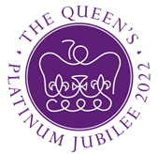
Queen Elizabeth II Platinum Jubilee
Story Map – London & South East Region Images
Key Stage 2: History & Geography
Learning Aims and Outcomes
Pupils understand more about the role of the Queen by exploring the Story Map of some of her visits to different places across England
Pupils learn about the Queen’s visits to significant places/events in their region of the country through her 70-year reign
Pupils develop a sense of place through mapwork
Pupils can identify regions of England and locate places in the region they live in
Pupils take part in celebrating a significant historical event
This learning resource supports the Historic England Platinum Jubilee Story Map & Platinum Jubilee Activities PPT
Notes:
This resource is intended to be used with the Historic England Jubilee Story Map which documents some of the many places the Queen has visited throughout her reign. Pupils are able to explore the pins on the map of their region of the country to find out about the significant buildings and events the Queen has visited. The Story Map contains information about the visit, a brief history of the building and images of the Queen and the building.

Slide 2
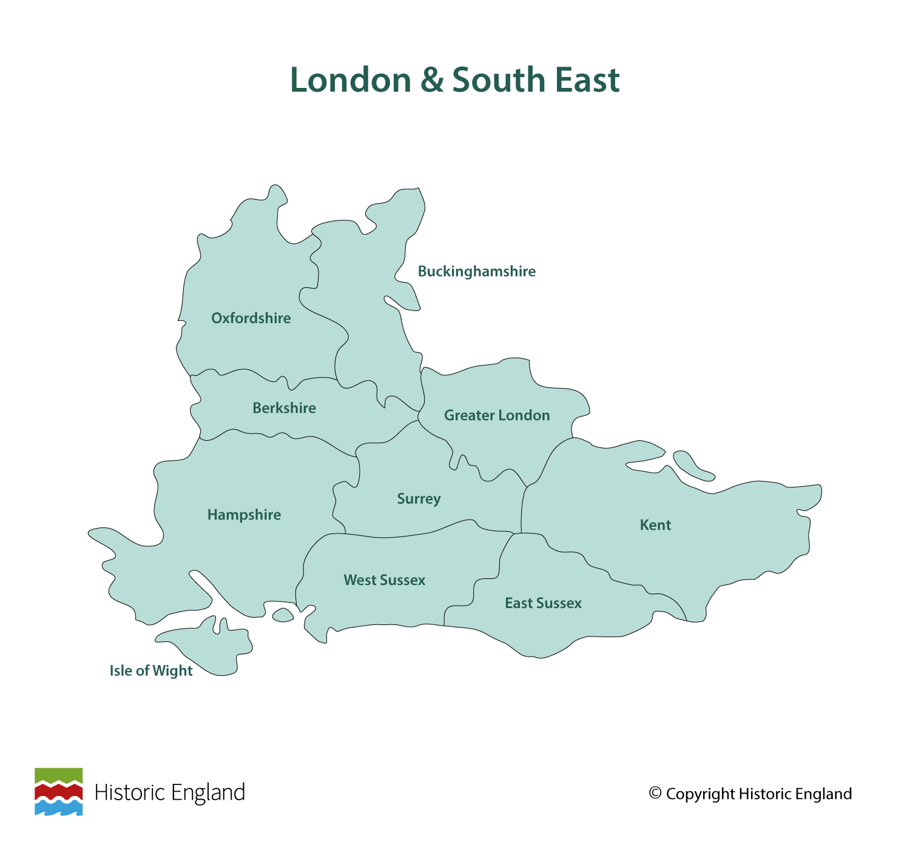
Notes:
Before following the link to your regional Story Map you may wish to discuss with pupils what counties are covered in your region.

Slide 3
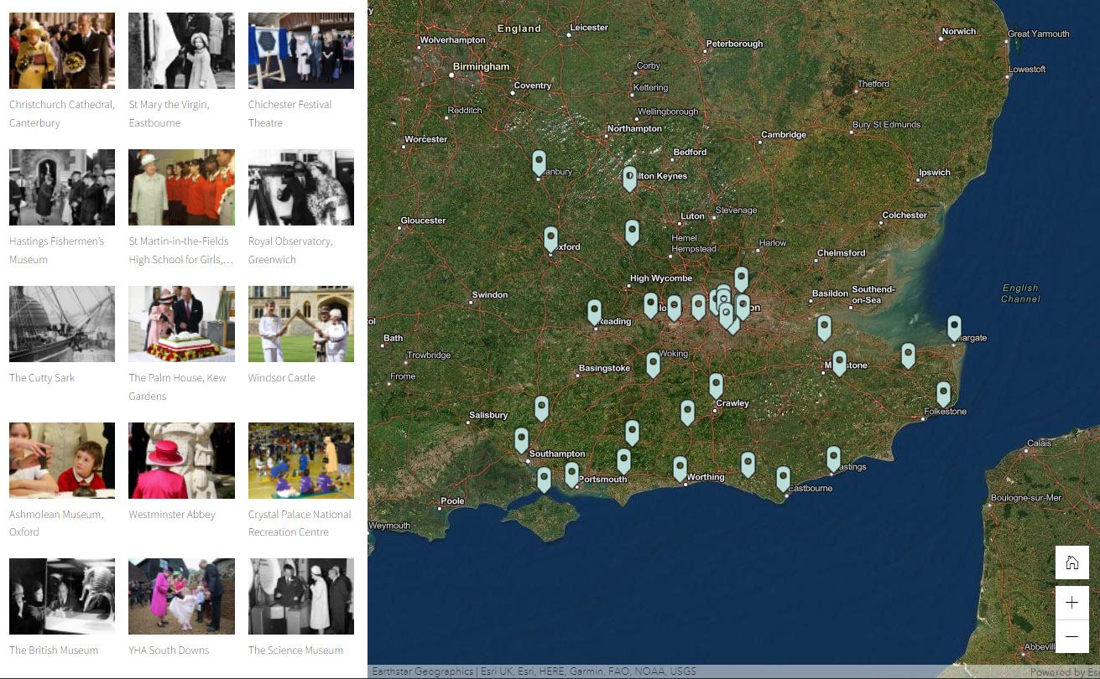
Notes:
https://storymaps.arcgis.com/stories/af12d05d55334e7ca20f072e7ae3725f

Slide 4
Christchurch Cathedral, Canterbury
The Queen and Prince Philip visited Christchurch Cathedral, Canterbury for a Royal Maundy service as part of the Queen’s Golden Jubilee tour in 2002.
Christchurch Cathedral is the seat of the Archbishop of Canterbury, leader of the Church of England. This Grade I listed medieval church, part of a World Heritage Site, tells the story of English Christianity from the arrival of Augustine who re-consecrated the original Roman church in 602AD.
The shrine to Thomas Becket, murdered in the cathedral in 1170, brings pilgrims following in the fictional footsteps of those depicted in Chaucer’s Canterbury Tales.
Find out more on the National Heritage List.

Slide 5
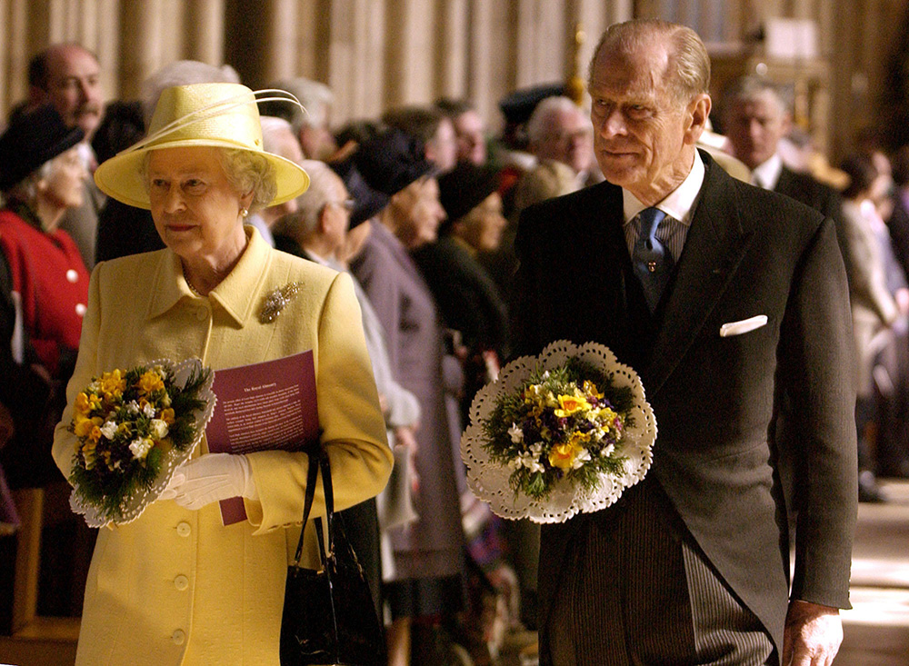
Notes:
The Queen and Prince Philip visited Christchurch Cathedral, Canterbury for a Royal Maundy service as part of the Queen’s Golden Jubilee tour in 2002. © Alamy – G5RW4G - 28 March 2002

Slide 6
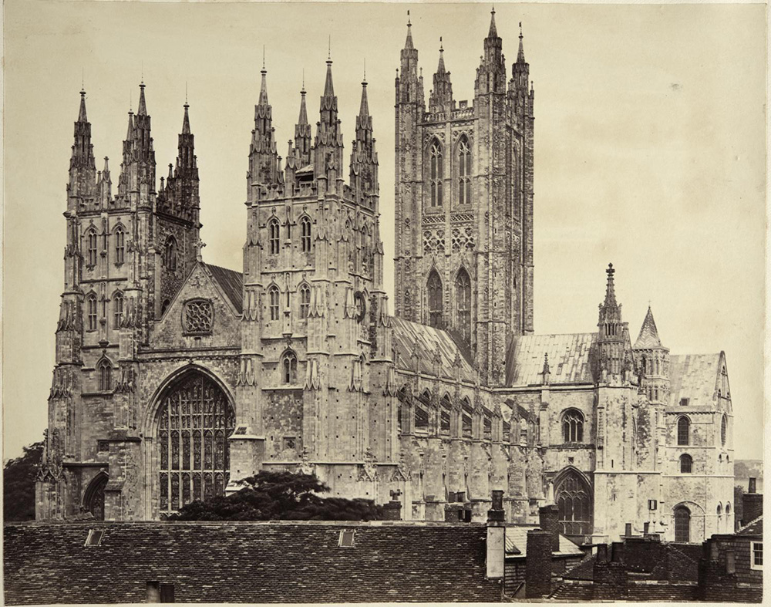
Notes:
A black and white image of the cathedral showing the two towers either side of the southern end of the cathedral in the foreground and the taller single tower at the northern end. Source: Historic England Archive - AL2400/116/01 - 1868

Slide 7
St Mary the Virgin, Eastbourne
The Queen (Princess Elizabeth at the time) between her parents, then the Duke and Duchess of York, with her sister Princess Margaret, attend a service at St. Mary's Church in Eastbourne in 1936.
St Mary’s is the parish church for Eastbourne. The earliest parts of this large Grade I listed church date back to the 12th Century, but it is mentioned in the Domesday Book. There are many medieval features remaining such as the font and screens but also more recent additions of note e.g., stained-glass windows by renowned Scottish designer, Douglas Strachan.
The royal visit took place two months after the death of King George V, who had visited St Mary’s while on holiday in Eastbourne in 1935.
Find out more on the National Heritage List.

Slide 8
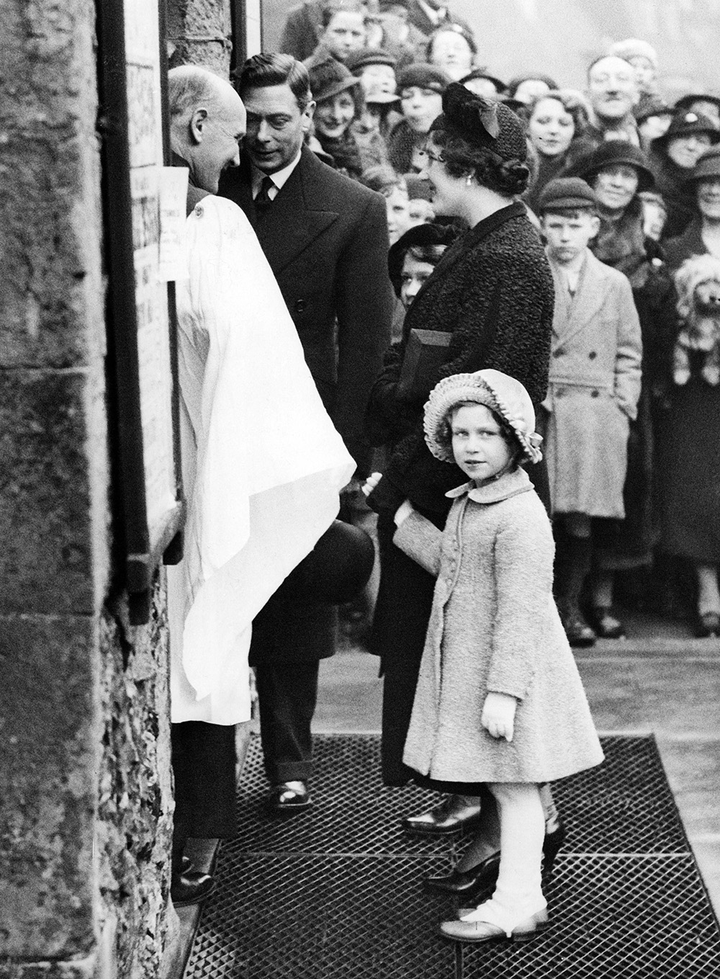
Notes:
The Queen (Princess Elizabeth at the time) between her parents, then the Duke and Duchess of York, with her sister Princess Margaret, attend a service at St. Mary's Church in Eastbourne in 1936. © Alamy – 2DBHT24 - 8 March 1936

Slide 9
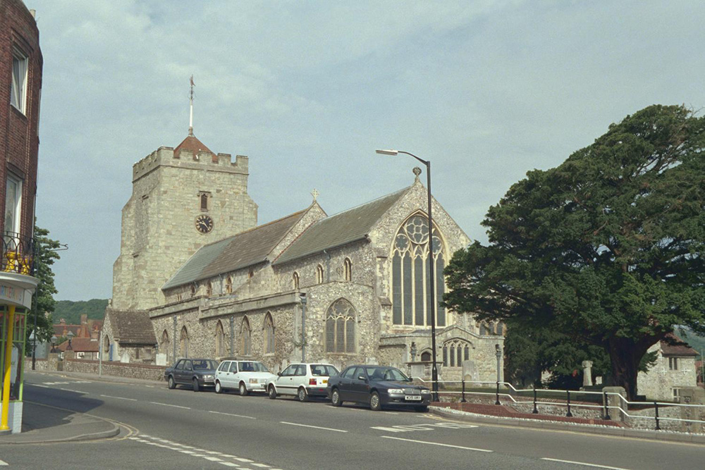
Notes:
A view of the church from across the street, looking from the west end to the tower at the east end. © Mr Michael Nash. Source: Historic England Archive - IOE01/01435/15 - 3 Aug 1999

Slide 10
Chichester Festival Theatre
The Queen unveiling a plaque on her visit to the Chichester Festival Theatre in West Sussex in 2017.
The theatre was the brainchild of local optician Leslie Evershed-Martin who wanted a ‘tent in the park’ for performances by and for the local community. Built from reinforced concrete in 1962, it was funded by subscriptions. It had the first open stage in Britain, a design inspired by Greek and Roman amphitheatres and by Elizabethan stage techniques.
Laurence Olivier was the first artistic director, and today many productions from Chichester transfer to London’s West End and tour all over the world.
Find out more on the National Heritage List.

Slide 11
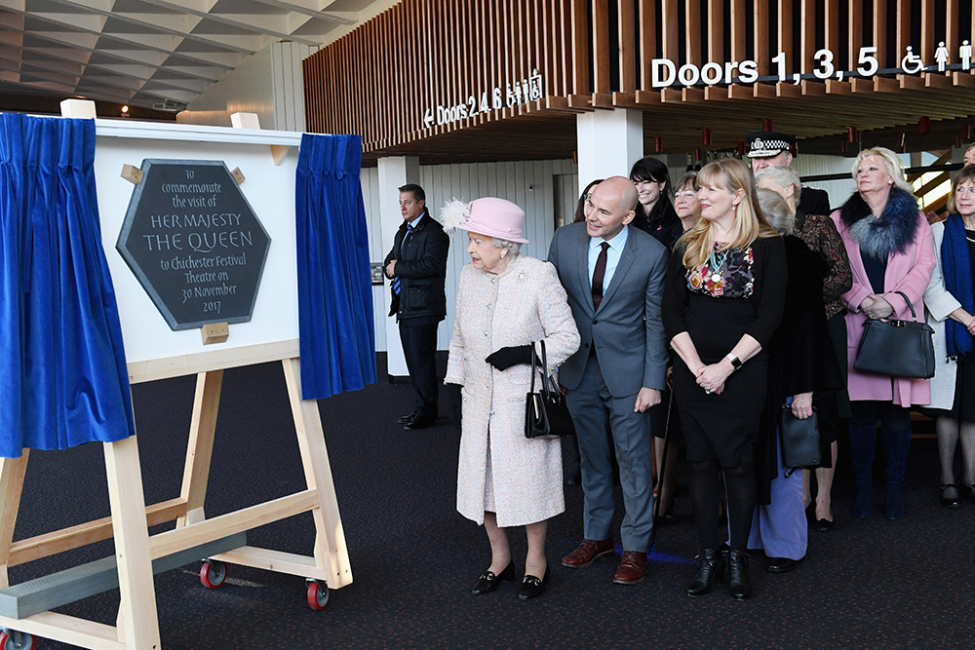
Notes:
The Queen unveiling a plaque on her visit to the Chichester Festival Theatre in West Sussex in 2017. © Alamy – KKEJ17 - 30 November 2017

Slide 12
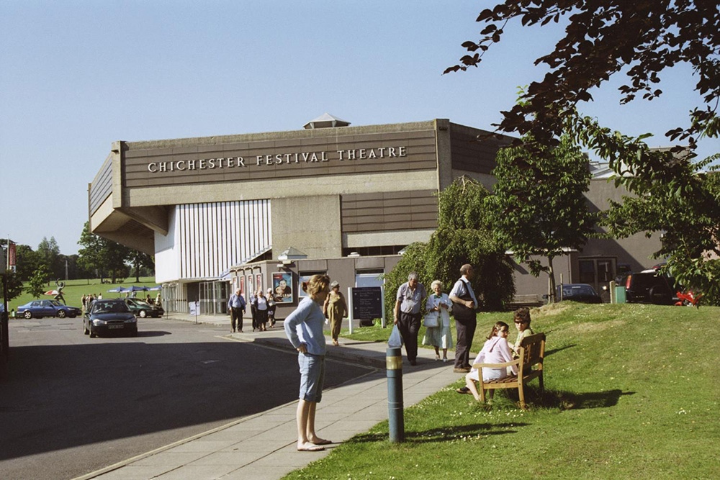
Notes:
A view of people milling about outside the distinctive hexagonal shaped theatre building. © Mr Norman Wigg. Source Historic England Archive - IOE01/14546/22 - 18 Jun 2005

Slide 13
Hastings Fishermen’s Museum
The Queen accepting a bouquet of flowers from children outside the Fishermen's Museum on her visit to Hastings Old Town in June 1997.
The Museum was originally built as the Fishermen’s Church of St Nicholas in 1854. It served the fishing community until the Second World War and became a museum in 1956.
Managed by the Old Hastings Preservation Society, a tour includes the deck of Hastings’ last sailing lugger and one of the town’s iconic (Grade II* listed) net shops where fishermen hung their nets to dry.
Find out more on the National Heritage List.

Slide 14
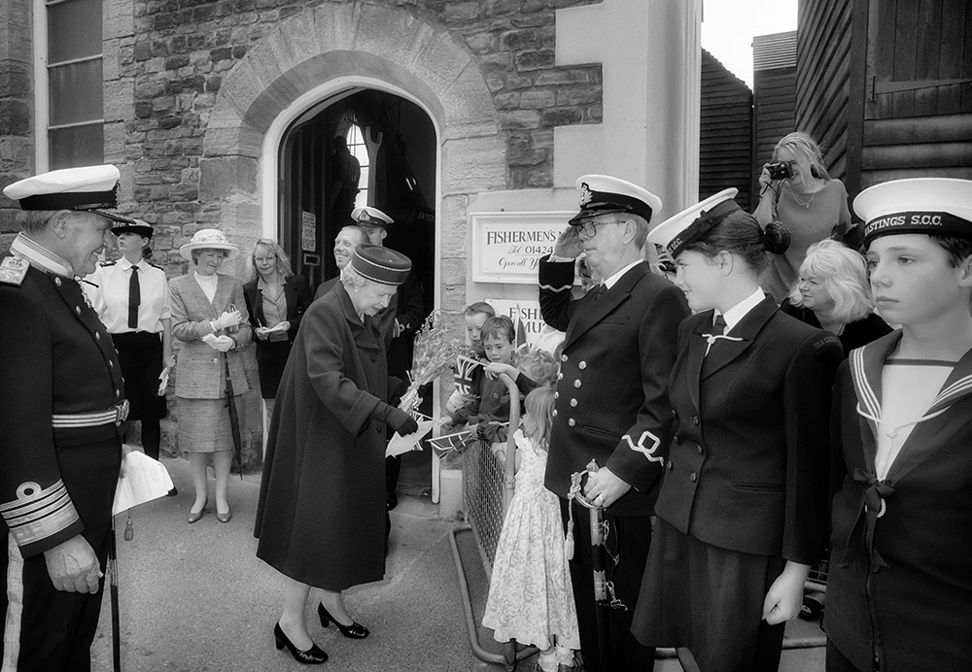
Notes:
The Queen accepting a bouquet of flowers from children outside the Fishermen's Museum on her visit to Hastings Old Town in June 1997. © Alamy – 2E8X4EK - 6 June 1997

Slide 15
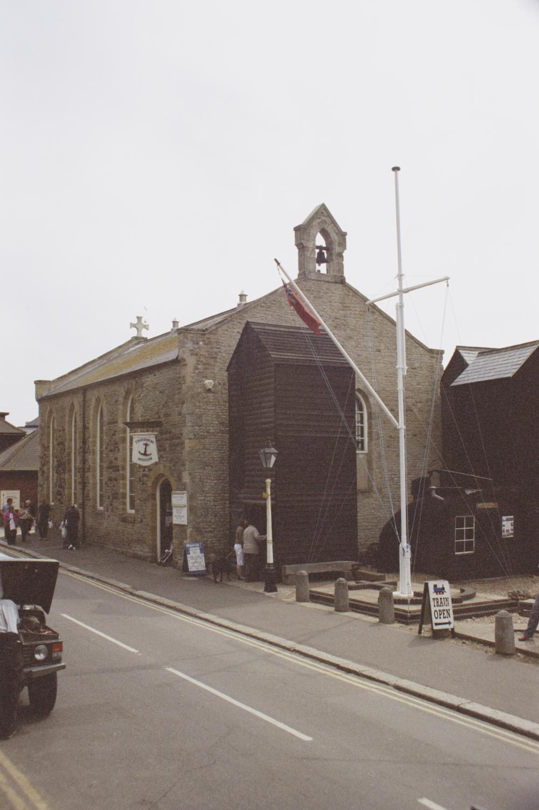
Notes:
A view of the outside of the museum, showing a bell at one end of the roof and a cross at the other, highlighting that it was originally built as a church. © Mr Mark Denison. Source Historic England Archive - IOE01/14821/31 - 16 Aug 2006

Slide 16
St Martin-in-the-Fields High School for Girls, Tulse Hill
The Queen met pupils during a visit to the St-Martin-in-the-Fields High School for Girls in Tulse Hill, Lambeth in 1999. Her visit marked the 300th anniversary of the school.
St-Martin-in-the-Fields High School for Girls is one of the oldest schools for girls in the country, founded as a charity by that parish in 1699. St Martin's Middle school for Girls was opened, near parish church, in Charing Cross Road in 1875, but outgrew the site.
In 1913 a Victorian mansion was purchased in Tulse Hill and the school moved to its new premises there in 1928. It was opened by the Queen’s mother, then Duchess of York.
Find out more on the National Heritage List.

Slide 17
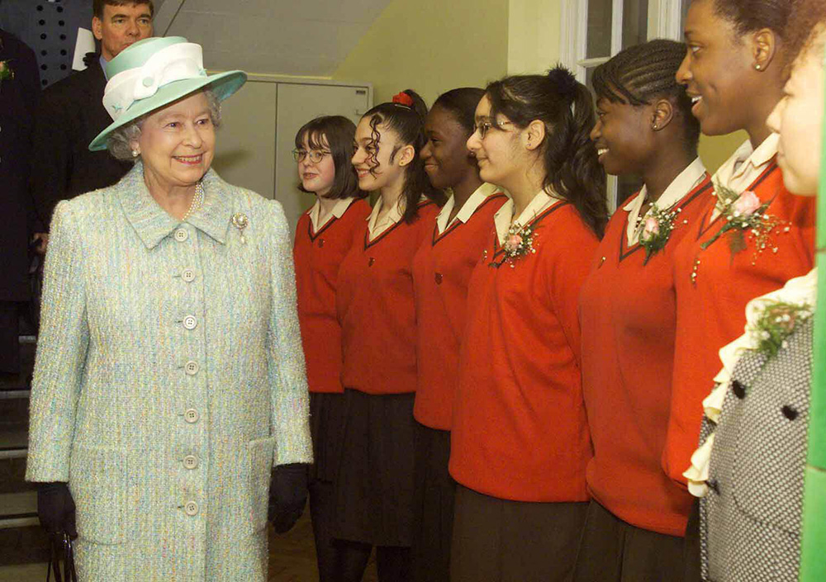
Notes:
The Queen met pupils during a visit to the St-Martin-in-the-Fields High School for Girls in Tulse Hill, Lambeth in 1999. Her visit marked the 300th anniversary of the school. © Alamy - 2D304K2 - 16 February 1999

Slide 18
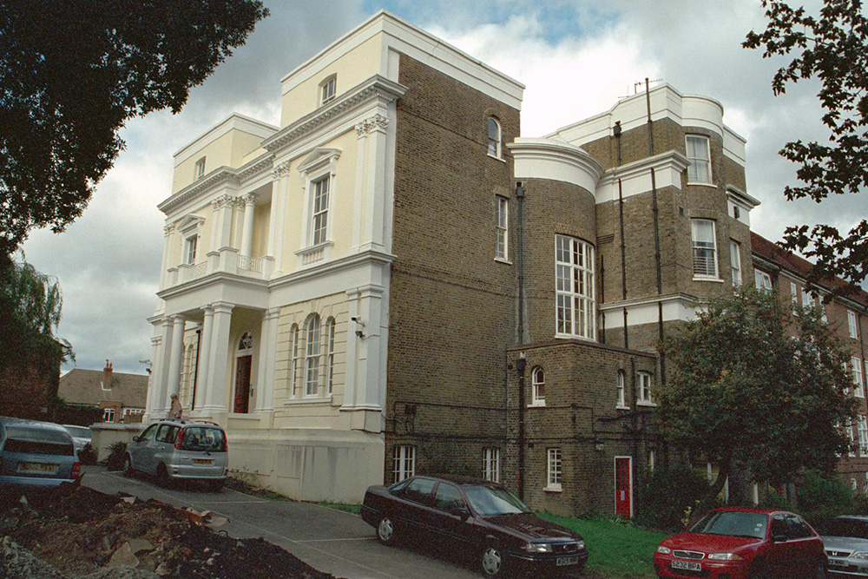
Notes:
A view of the outside of the school showing the yellowy London brick on one side and the fancier white painted classically styled plastered frontage on another side. © Mr David March. Source Historic England Archive - IOE01/07177/32 - 5 Sep 2002

Slide 19
Royal Observatory, Greenwich
The Queen visited the restored Flamsteed House, the oldest building of the old Royal Observatory at Greenwich, in 1960.
This distinctive red brick and white stone building is thought to be the work of Sir Christopher Wren. A Latin inscription states that the Observatory was founded by Charles II in 1676. Astronomers Royal, John Flamsteed and Edmond Halley, plotted all the stars in the northern and southern hemispheres.
A time ball in use since 1833, drops at 1pm everyday as an aid to navigators. The Royal Observatory has been the historic source of the Prime Meridian of the world, Longitude 0° 0' 0'' since the late 19th Century.
Find out more on the National Heritage List.

Slide 20
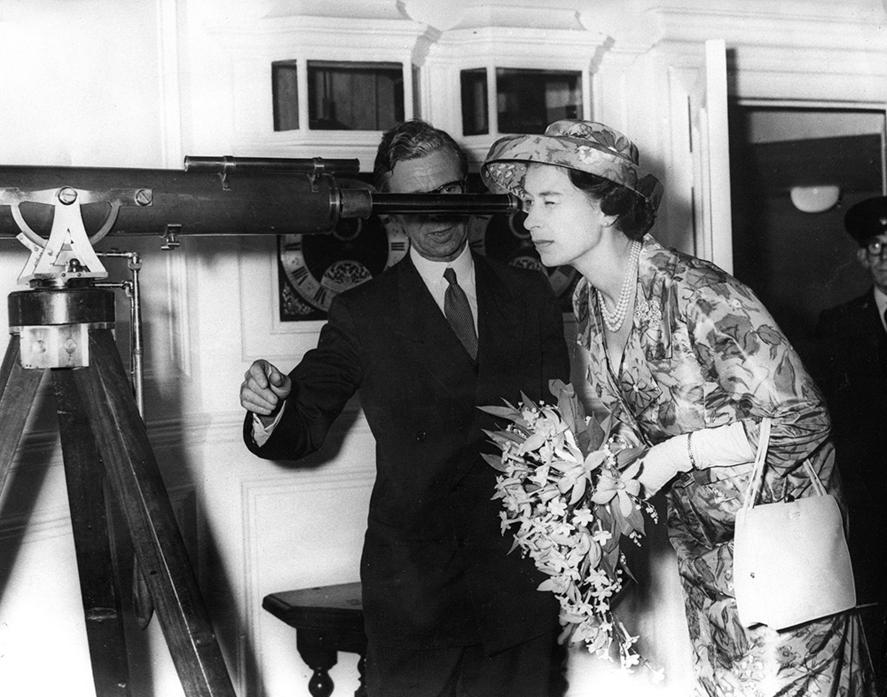
Notes:
The Queen visited the restored Flamsteed House, the oldest building of the old Royal Observatory at Greenwich, in 1960. © Alamy - G4WG0H - 6 July 1960

Slide 21
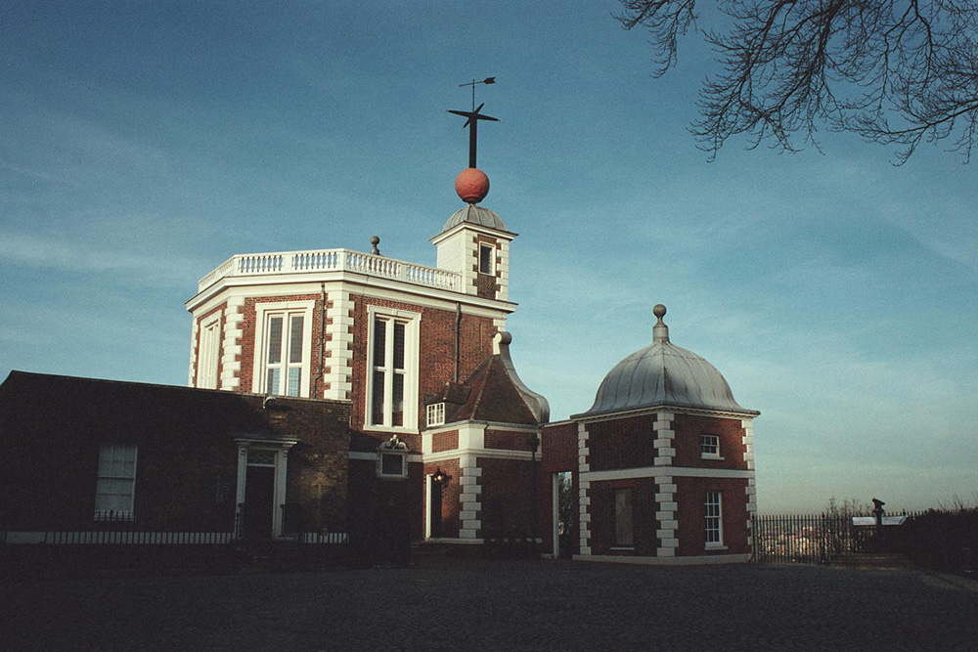
Notes:
View of the red brick observatory, with it's distinctive white edging stones (quions). © Mr Richard M. Brown. Source Historic England Archive - IOE01/11184/23 - 9 Feb 2004

Slide 22
The Cutty Sark
The Queen 'opened' the Cutty Sark at her permanent berth at Greenwich in 1957.
Cutty Sark, a tea clipper launched in 1869, was once the fastest ship on the China run. Later, it brought wool from Australia in record breaking time. It was laid up as a tribute to the Merchant Navy and permanent memorial to the days of sail in a dry dock thanks in part to the support of Prince Philip.
Restoration work was hampered by a major fire in 200 but 90% of the ship was preserved and the Queen reopened Cutty Sark in 2012.
Find out more on the National Heritage List.

Slide 23
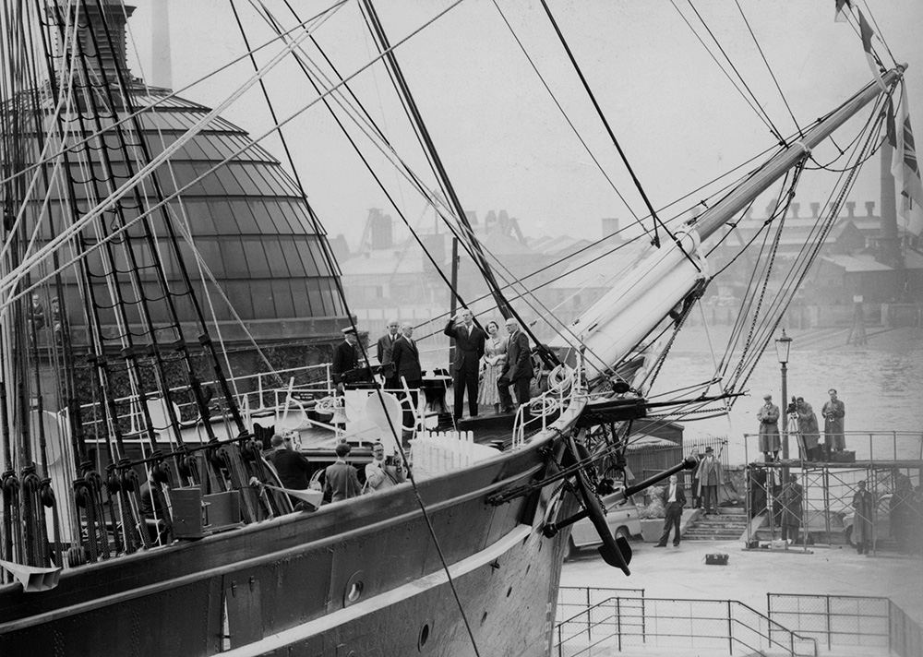
Notes:
The Queen 'opened' the Cutty Sark at her permanent berth at Greenwich in 1957. © Alamy – G9X9AD - 25 June 1957

Slide 24
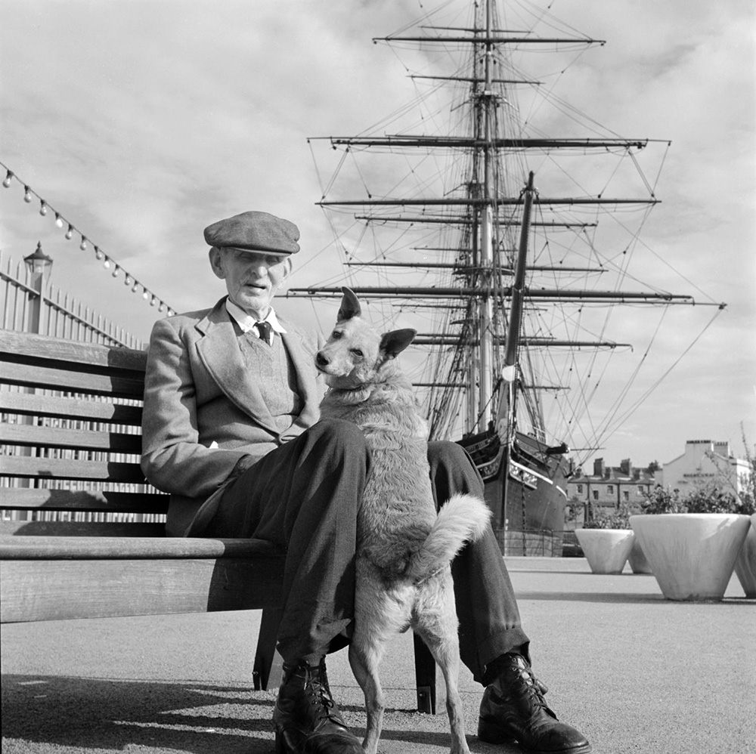
Notes:
An informal black and white portrait of an elderly man and his dog seated on a bench in front of the Cutty Sark, showing the ship and it's massive rigging. © Historic England Archive – AA054076 - 1954 - 1980

Slide 25
The Palm House, Kew Gardens
The Queen cut a cake depicting the Palm House at the Royal Botanic Gardens at Kew to celebrate its 250th Anniversary.
The Palm House was constructed in 1844 by engineer Richard Turner to a design by architect Decimus Burton. Built of glass and iron, it is 62 feet high and 362 feet long.
Specialising in palms and other tropical and subtropical plants, it is home to many endangered species and plants useful for both medical research and economic value.
Approximately 2 million people visit the Palm House at The Royal Botanic Gardens every year.
Find out more on the National Heritage List.

Slide 26
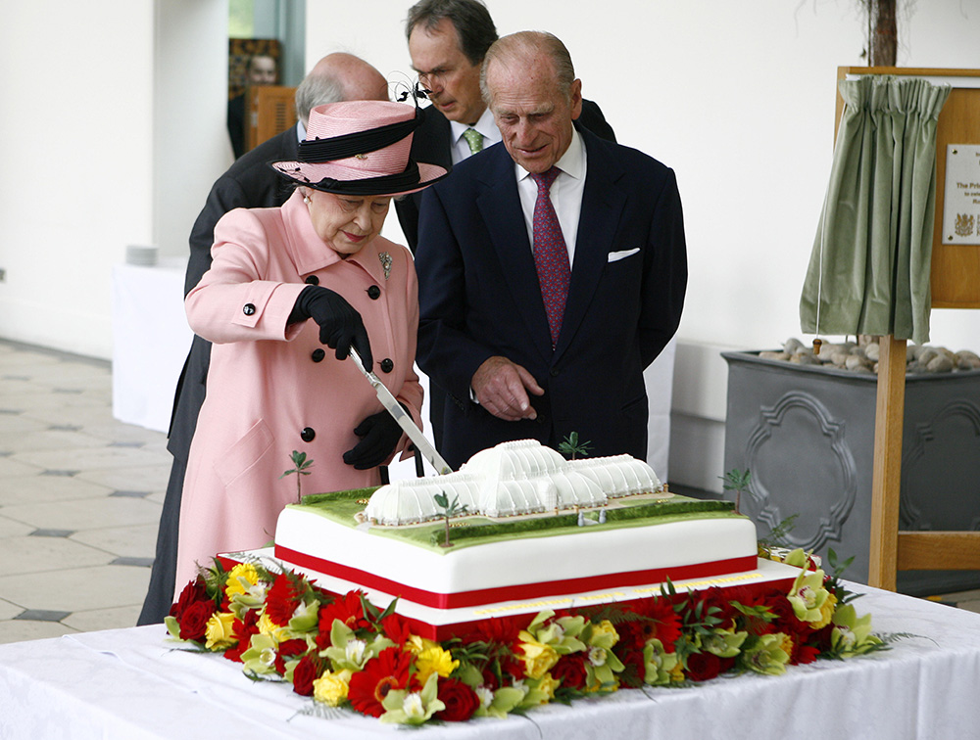
Notes:
The Queen cut a cake depicting the Palm House at the Royal Botanic Gardens at Kew to celebrate its 250th Anniversary. © Alamy – GBM2BD - 5 May 2009

Slide 27
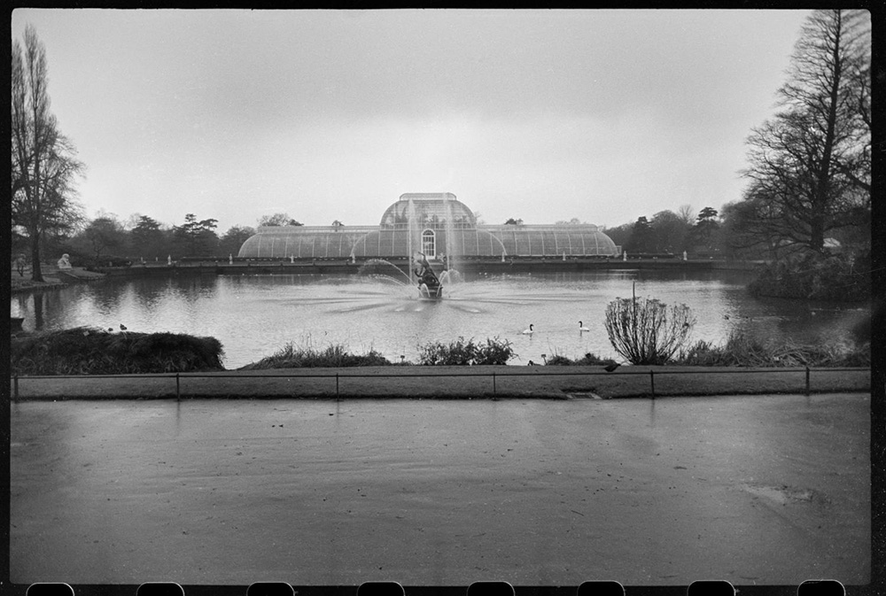
Notes:
A black and white image of the large glass built Palm House, viewed across a lake. © Historic England Archive - UXC01/01/01/0137/04 - c195-c1980

Slide 28
Windsor Castle
The Queen on Day 53 of the Olympic Torch Relay for the London 2012 Olympics. The flame passes from Gina MacGregor to Phillip Wells.
Windsor Castle is the oldest occupied castle in the world. It was founded by William the Conqueror in the 11th Century and has been home to 39 monarchs. The earliest stone buildings date back to the reign of Henry II but there have been many alterations and additions, including St George’s Chapel in the late 15th Century.
Many Royal weddings have taken place here including the marriage of Harry and Meghan, the Duke and Duchess of Sussex, in 2018.
Find out more on the National Heritage List.

Slide 29
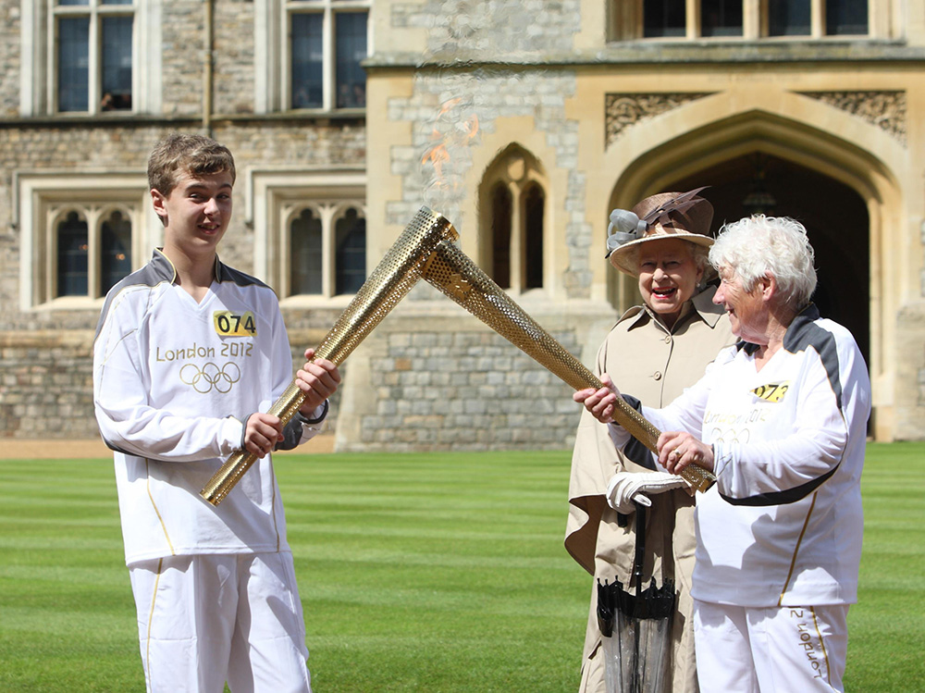
Notes:
The Queen on Day 53 of the Olympic Torch Relay for the London 2012 Olympics. The flame passes from Gina MacGregor to Phillip Wells. © Alamy – G5AJBJ - 10 July 2012

Slide 30
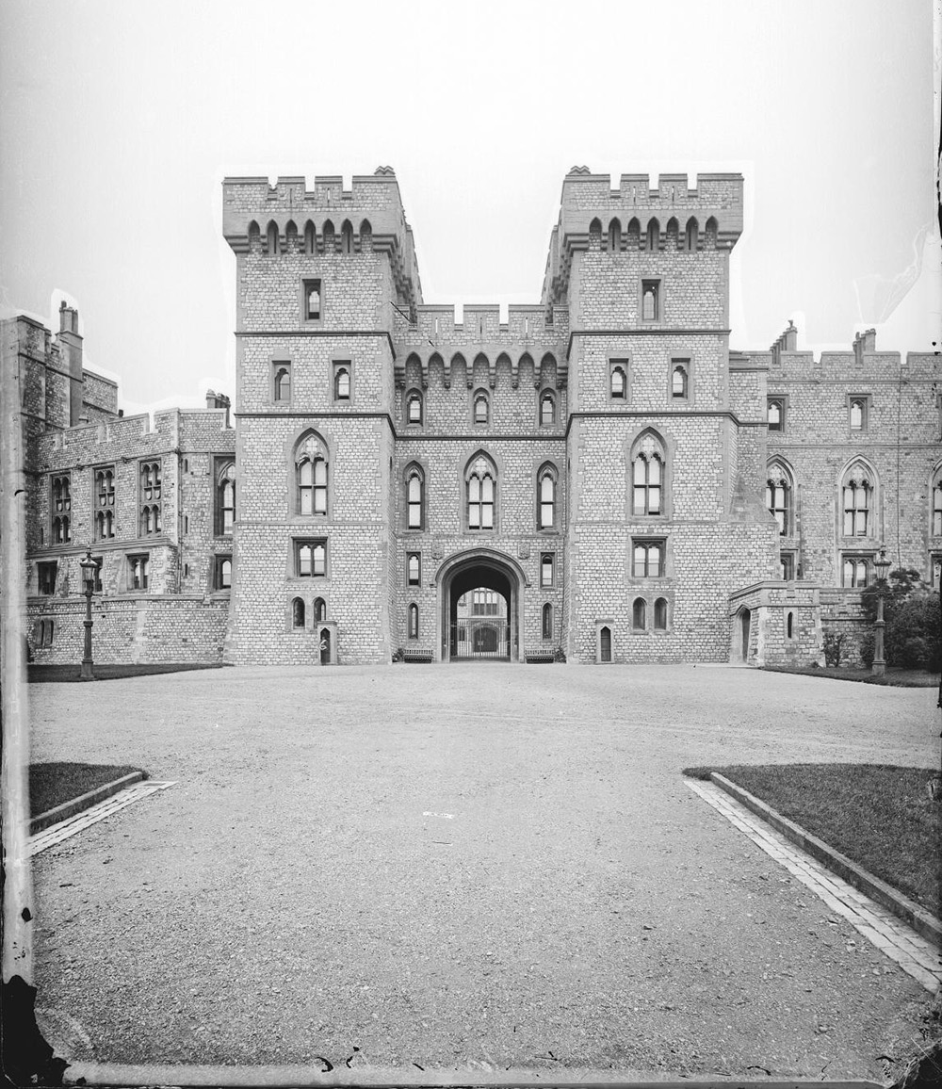
Notes:
A black and white view of York Tower at Windsor Castle. Source Historic England - CC97/00014 - 1870 - 1900

Slide 31
Ashmolean Museum, Oxford
The Queen with children from West Kidlington Primary School in the education room as she officially reopens the Ashmolean Museum in Oxford in 2009.
The Ashmolean Museum is the oldest public museum in the UK. It was founded by collector Elias Ashmole in 1683 and the original building is now the Museum of the History of Science. The current museum, designed by Charles Robert Cockerell in a neo-Greek style, was built in 1841-45.
Items in the collection include the Alfred Jewel, the death mask of Oliver Cromwell and the lantern carried by Guy Fawkes.
Find out more on the National Heritage List.

Slide 32
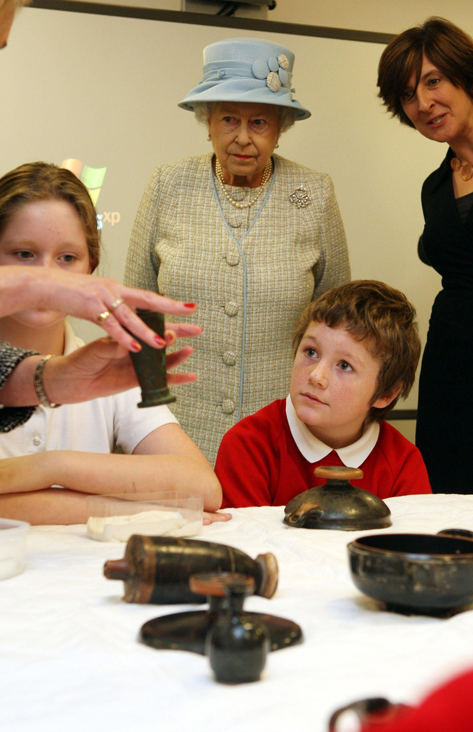
Notes:
The Queen with children from West Kidlington Primary School in the education room as she officially reopens the Ashmolean Museum in Oxford in 2009. © Alamy – GC6J82 - 2 December 2009

Slide 33
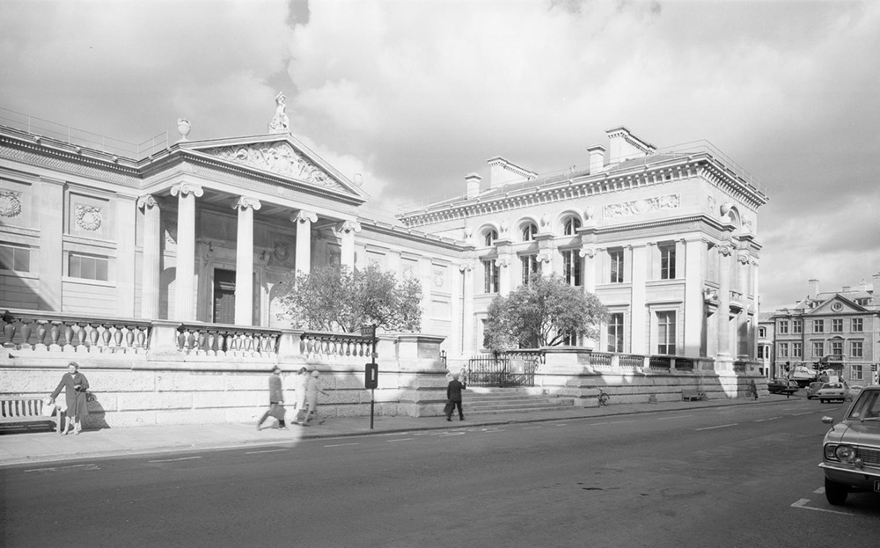
Notes:
A black and white view of the Ashmolean Museum showing its classical style of architecture with the magnificent columns and portico over the entrance. Source Historic England - AA98/04780 - 1945 - 1980

Slide 34
Westminster Abbey
The Queen looks at a statue of Queen Elizabeth I, by sculptor Matthew Spender, during a visit to Westminster Abbey in 2010 to mark the 450th anniversary of the granting of the institution's Royal Charter.
Westminster Abbey has been the site of coronations since 1066. The Gothic church built on the site of Edward the Confessor’s Abbey by Henry III took years to complete.
It is the burial place of kings, statesmen, poets, scientists, warriors and musicians and has the most important collection of monuments in the country. One of the most notable burials is that of the Unknown Warrior of the First World War.
Find out more on the National Heritage List.

Slide 35
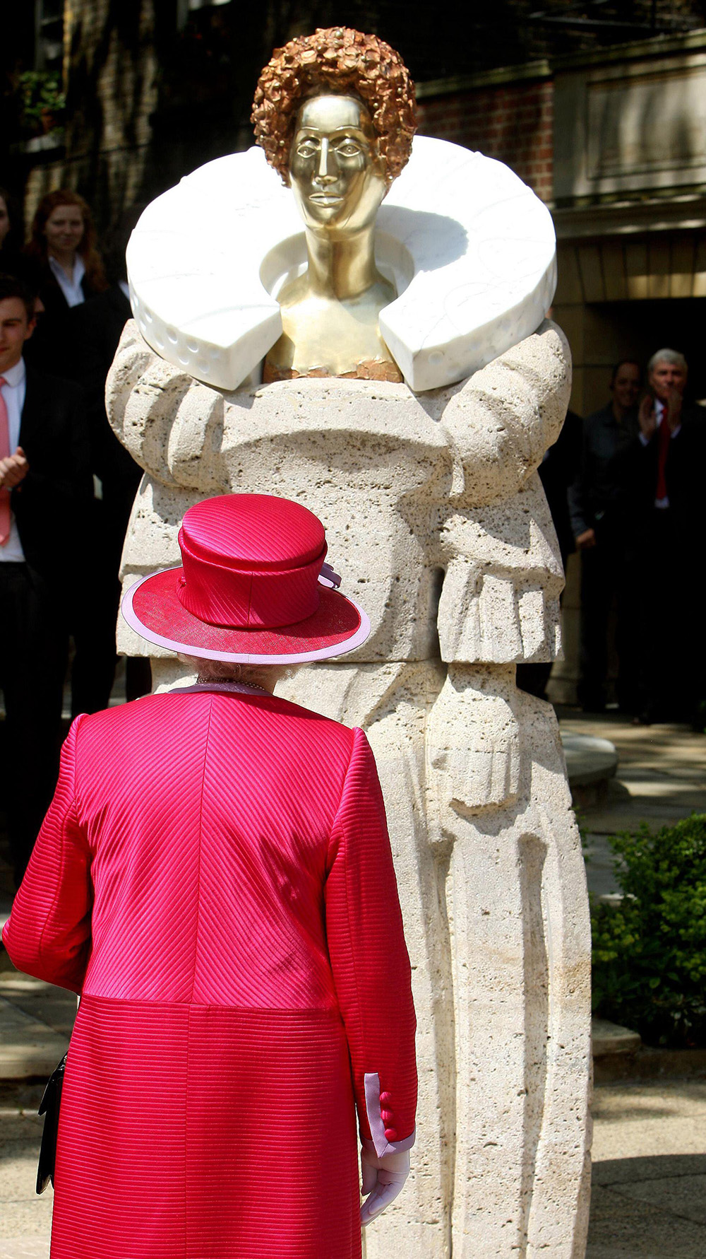
Notes:
The Queen looks at a statue of Queen Elizabeth I, by sculptor Matthew Spender, during a visit to Westminster Abbey in 2010 to mark the 450th anniversary of the granting of the institution's Royal Charter. © Alamy - 2E6Y18X - 21 May 2010

Slide 36
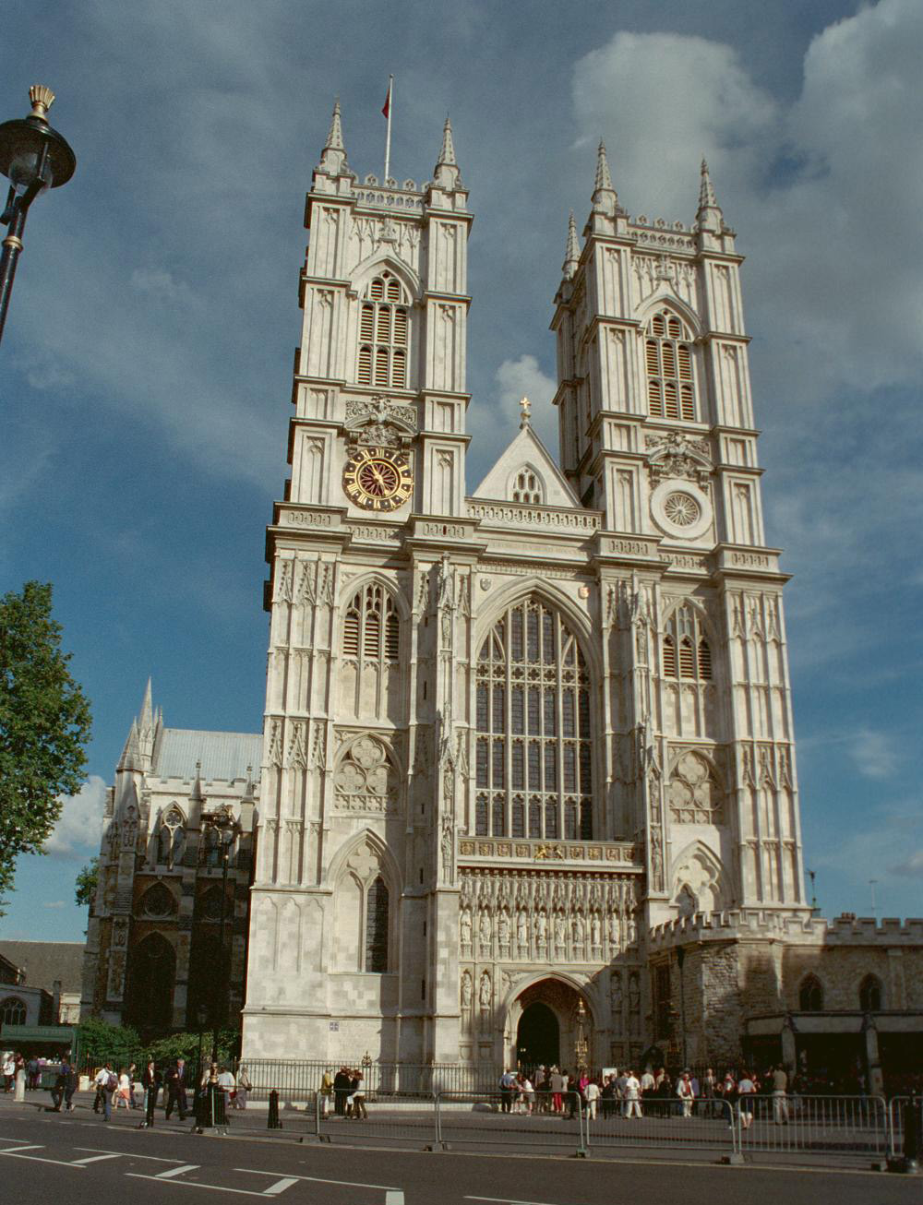
Notes:
A view of the west end of the abbey, with its twin towers either side of the entrance. © Les Kerry. Source: Historic England Archive - IOE01/05557/17 - 10 Sep 2002

Slide 37
Crystal Palace National Recreation Centre
The Queen attends the Youth Games, which started in 1977 to celebrate the her Silver Jubilee, during her Golden Jubilee visit to South London in July 2002.
The National Recreation Centre was built in 1960-64 by London County Council Architects’ department. A simple A-frame design with a central walkway enabled interaction between different sports. It boasted one of the earliest indoor multifunctional halls, with the only Olympic-sized pool in southern England.
It now forms part of the National Sports Centre and the athletics stadium hosts live music as well as sporting events.
Find out more on the National Heritage List.

Slide 38
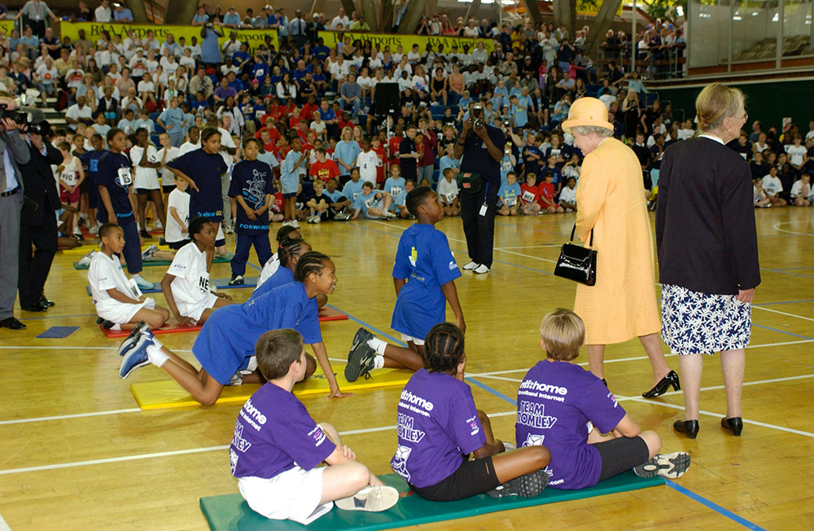
Notes:
The Queen attends the Youth Games, which started in 1977 to celebrate the her Silver Jubilee, during her Golden Jubilee visit to South London in July 2002. © Alamy – G5XAR8 - 4 July 2002

Slide 39
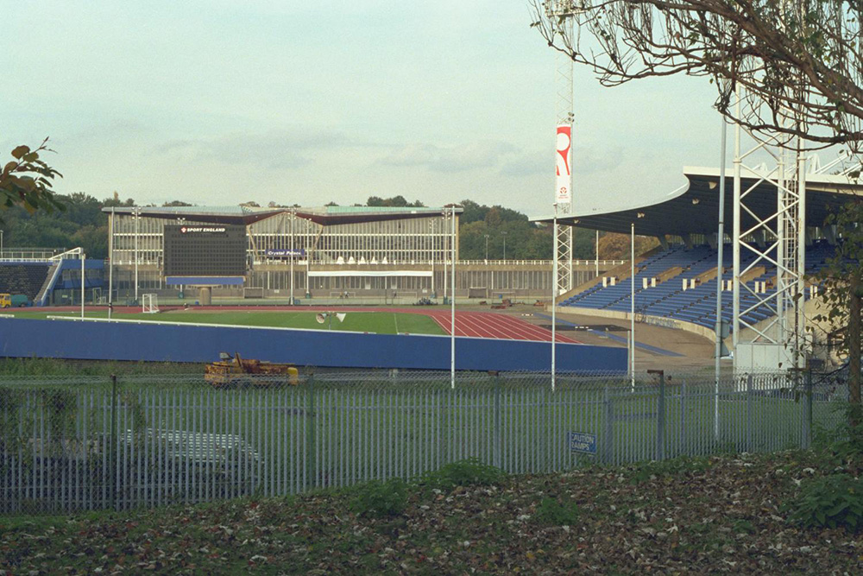
Notes:
View of the outdoor running track and stands which are just one part of the National Recreation Centre. © Dr Michael Philpot. Source Historic England Archive - IOE01/00661/04 - 28 Oct 1999

Slide 40
The British Museum
The Queen Elizabeth looks at the mask of King Tutankhamun, during the opening of the Treasures of Tutankhamun exhibition at the British Museum in 1972.
The British Museum is the world’s oldest national public museum free to all “studious and curious persons”.
Built between 1823 and 184 by Sir Robert Smirke in a Greek Revival style, it houses 8 million works relating to human history, art and culture. The Treasures of Tutankhamun exhibition was the most popular in the museum’s history, with 1.7 million people queueing for hours to see the iconic burial mask of the boy king.
In 2000, the museum was redesigned to include the Queen Elizabeth II Great Court, the largest covered public square in Europe.
Find out more on the National Heritage List.

Slide 41
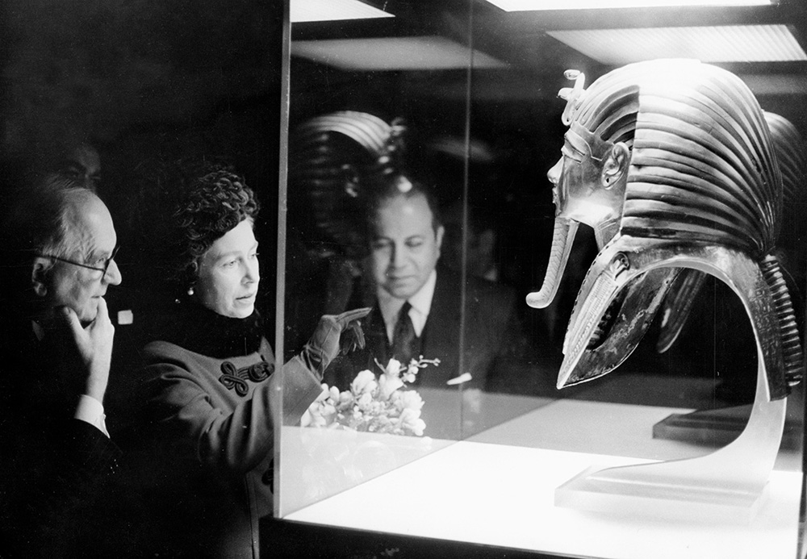
Notes:
The Queen Elizabeth looks at the mask of King Tutankhamun, during the opening of the Treasures of Tutankhamun exhibition at the British Museum in 1972. © Alamy – W7DPTJ - 30 March 1972

Slide 42
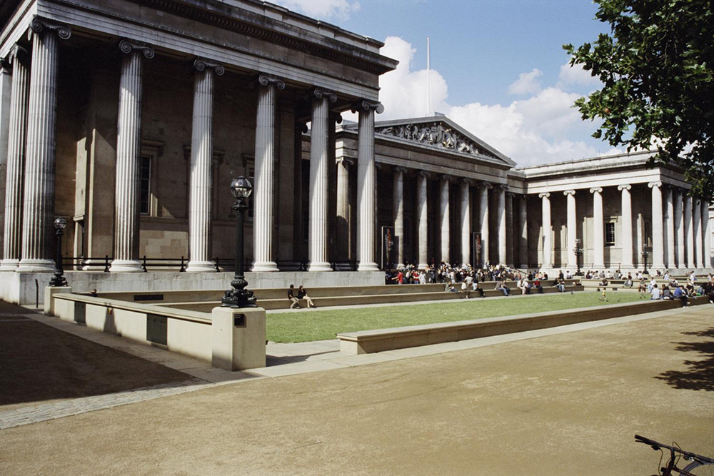
Notes:
A view of people sat on the grass outside the entrance to the museum with its classical columns and portico. © Mr Derek March. Source Historic England Archive - IOE01/12856/18 - 18 Aug 2004

Slide 43
YHA South Downs
The Queen officially opened YHA South Downs, near Lewes as part of her tour of East Sussex in 2013.
The Queen is a patron of the Youth Hostel Association, which converted the Grade II* listed 13th Century Itford Farmhouse and outbuildings into a 64-bed hostel.
The farmhouse, which has many 18th Century alterations, forms the main accommodation block and social spaces of the hostel. A few hundred metres from Southease station and directly on the South Downs Way, the hostel attracts visitors keen to explore the surrounding countryside.
Find out more on the National Heritage List.

Slide 44
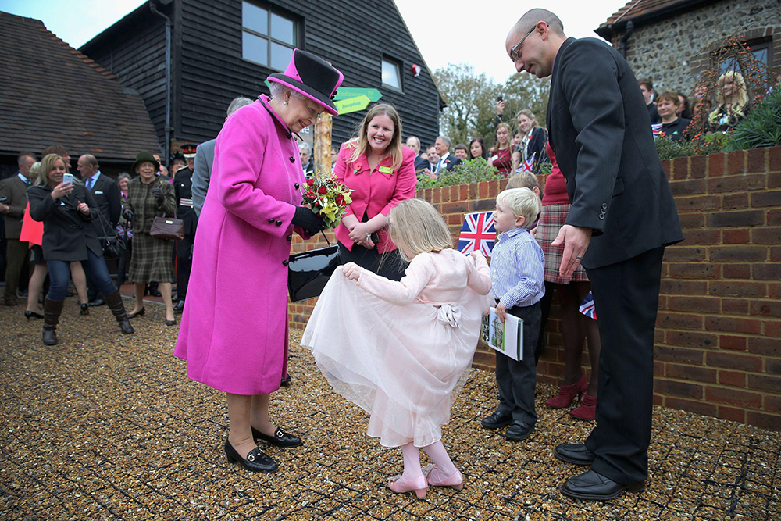
Notes:
The Queen officially opened YHA South Downs, near Lewes as part of her tour of East Sussex in 2013. © Alamy - G6GFG5 - 31 October 2013

Slide 45
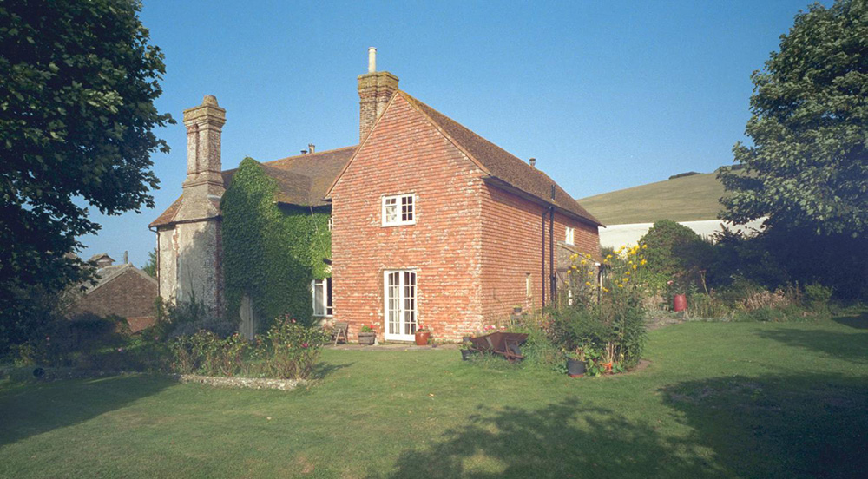
Notes:
A view of the outside of the Youth Hostel showing that one wing is made of brick and the other, older wing, is made of stone. © Mr Robert J Harvey. Source: Historic England Archive - IOE01/00580/20 - 8 Sep 1999

Slide 46
The Science Museum
The Queen watching an automatic ticket gate being demonstrated at "The Engineer's Day" exhibition at the Science Museum, London in 1966.
The South Kensington Museum was founded after the Great Exhibition in 1851, the brainchild of Prince Albert and the inventor Henry Cole. It opened on its present site in 1857 and was renamed the Victoria and Albert Museum in 1899.
The Science Museum was created in 1909 when it was decided to split the scientific and technological sections from art and design. Today, the museum’s galleries provide a remarkable record of scientific, technological and medical advancement.
Find out more on the National Heritage List.

Slide 47
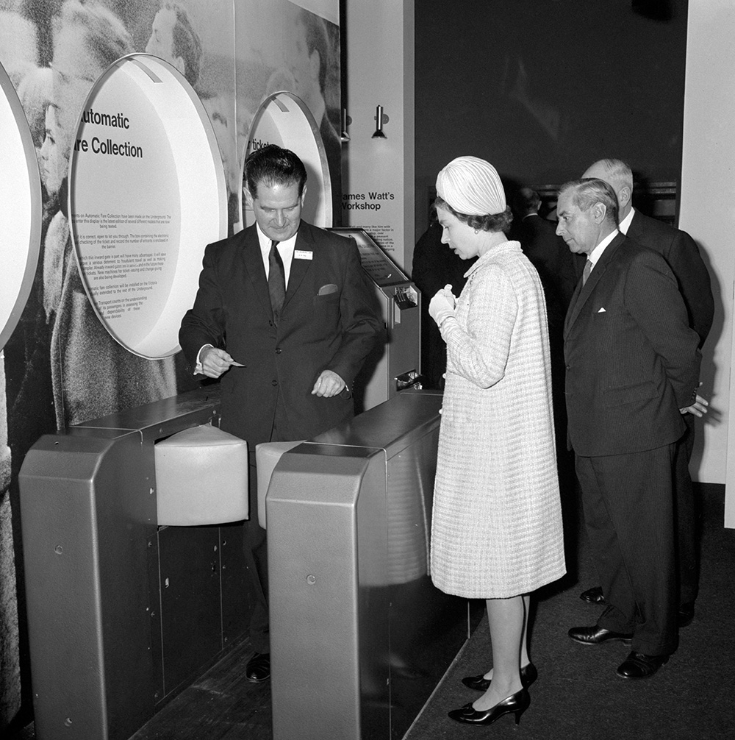
Notes:
The Queen watching an automatic ticket gate being demonstrated at "The Engineer's Day" exhibition at the Science Museum, London in 1966. © Alamy - G52DR4 - 18 November 1966

Slide 48
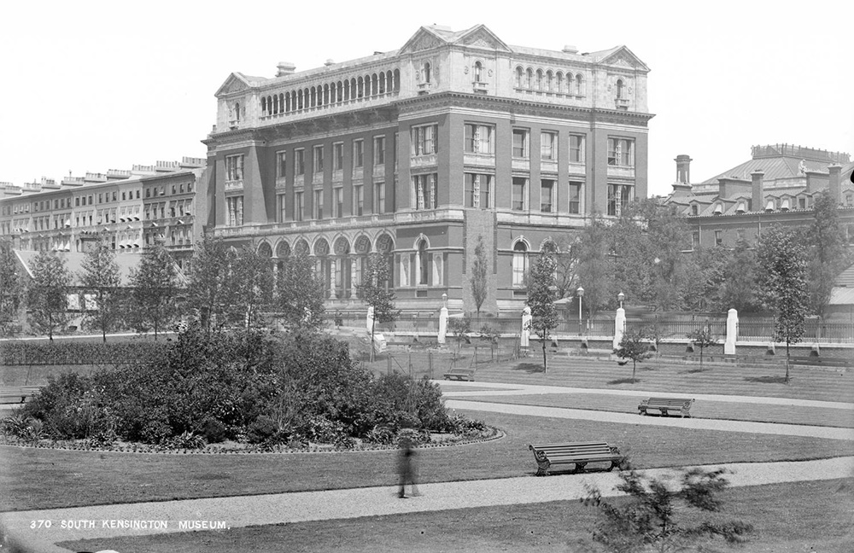
Notes:
A black and white view of South Kensington Museum with gardens in the foreground. Source Historic England - CC97/00282 - 1870 - 1900

Slide 49
Royal Yacht Squadron (RYS), Cowes Castle
The Queen leaves Cowes with Prince Philip and Earl Mountbatten of Burma, who was installed as Governor of the Isle of Wight during the visit in 1965. The original fort here was built in 1539 by Henry VIII to defend the River Medina and Newport.
Founded in 1815, the Royal Yacht Squadron (RYS) started Cowes Week regatta in 1826. The America’s Cup also originated here after a New York City yacht ‘America’ won the round the island RYS £100 Cup race in 1851. New York City Yacht Club defended the cup for 132 years, the longest winning streak in sporting history.
Cowes Castle became the RYS club house in 1856. Ladies’ facilities were added in the 1960s.
Find out more on the National Heritage List.

Slide 50
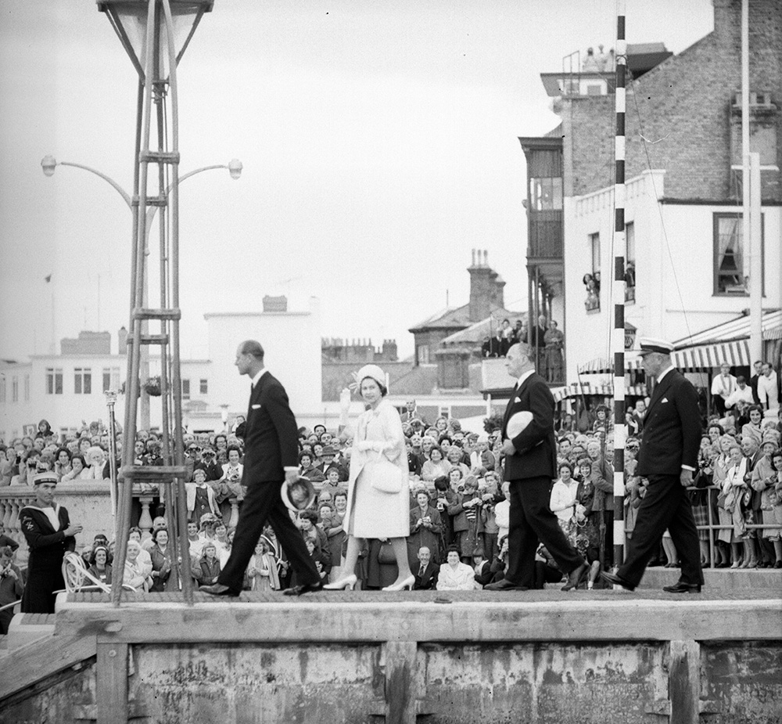
Notes:
The Queen leaves Cowes with Prince Philip and Earl Mountbatten of Burma, who was installed as Governor of the Isle of Wight during the visit in 1965. © Alamy – M619T5 - 26 July 1965

Slide 51
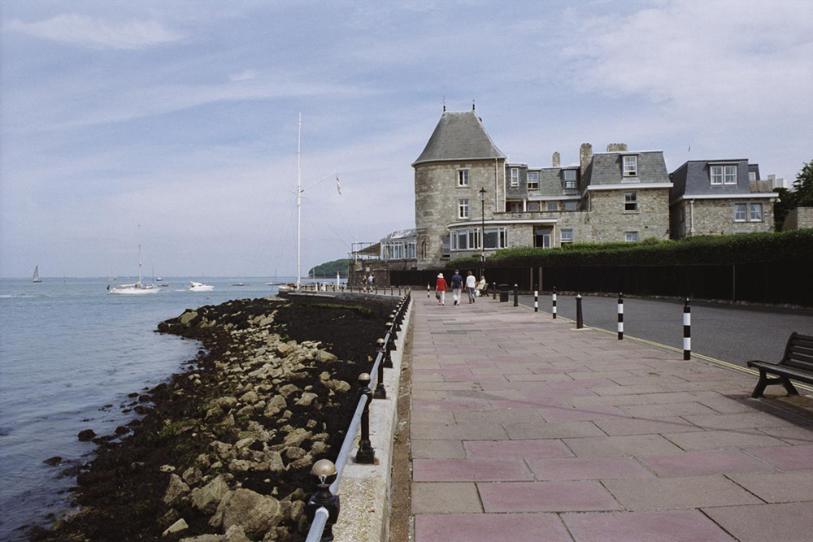
Notes:
A view along the seafront looking towards the stone built walls of the Royal Yacht Squadron, which was originally Cowes Castle. © Mr Tim Belcher. Source Historic England Archive -IOE01/14577/18 - 20 Jun 2005

Slide 52
Fort Blockhouse and HMS Dolphin, Gosport
The Queen visited HMS Dolphin, Gosport in 1959. Fort Blockhouse became the site of the Royal Navy’s first submarines. A hulk, HMS Dolphin, was brought in to provide accommodation and gave its name to the independent command established in 1912.
It was the Royal Navy’s principal submarine depot during the First World War and developed rapidly as a base for training and maintenance. While it played an important role in the D-Day landings and was responsible for the country’s nuclear deterrent in the 1960s, its significance declined with the end of the Cold War.
HMS Dolphin closed in 1998 and the site is now home to Royal Navy Submarine Museum.
Find out more on the National Heritage List.

Slide 53
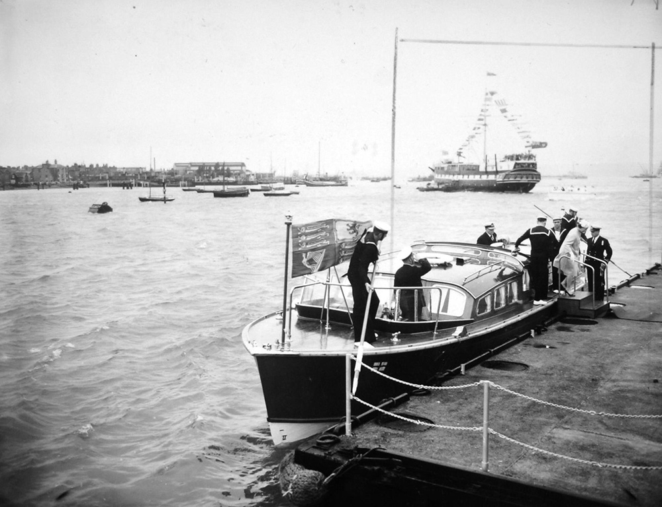
Notes:
The Queen visited HMS Dolphin, Gosport in 1959. Fort Blockhouse became the site of the Royal Navy’s first submarines. © Alamy – G4M34H - 8 June 1959

Slide 54
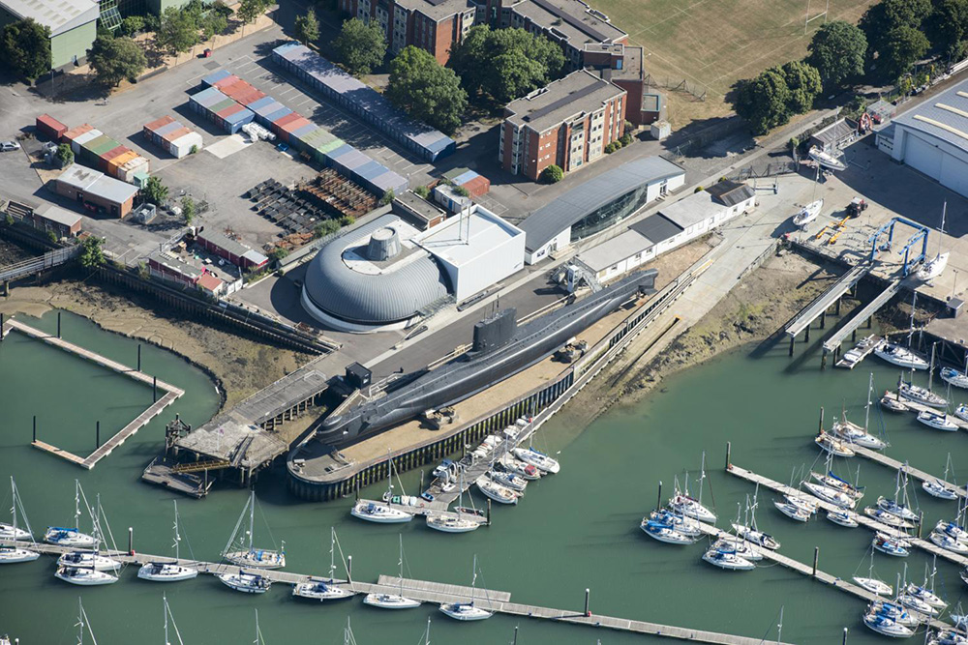
Notes:
An aerial view of the docks, museum and a submarine. © Historic England Archive - 33563_036 – 26 June 2018

Slide 55
Heathrow Airport
The Queen about to embark from Heathrow Airport with her Corgis for her annual holiday in Balmoral in 1981. Heathrow Airport originally opened in 1946 as London Airport.
The headquarters and engineering workshops for the British Overseas Airways Corporation, now British Airways, were built between 1950-55. Engineer, Sir Evan Owen Williams, who also designed the original Wembley Stadium, envisaged a flexible building that would adapt to the needs of the aviation industry. Part of a disused building has recently been repurposed with flight simulators for the British Airways Global Learning Academy.
The Queen has owned Pembroke Welsh Corgis since she was a child and has had more than 30 since she became Queen in 1952.
Find out more on the National Heritage List.

Slide 56
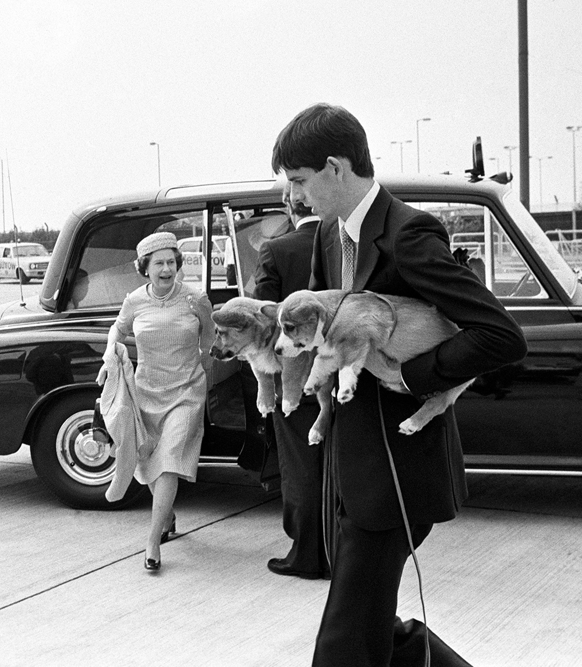
Notes:
The Queen about to embark from Heathrow Airport with her Corgis for her annual holiday in Balmoral in 1981. © Alamy – G5NW3F - 5 August 1981

Slide 57
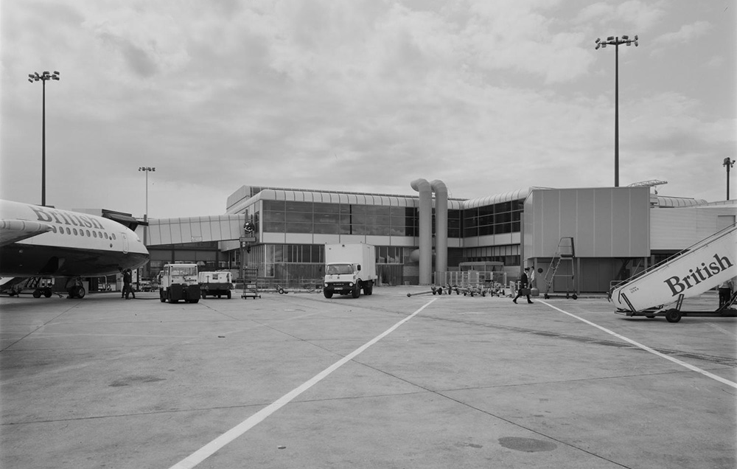
Notes:
A black and white view of the new departure lounge constructed at Pier 4 of Terminal 1 at Heathrow Airport, showing a plane and boarding steps in the foreground. © Historic England Archive. John Laing PhotographicCollection - JLP01/09/831892 - 3 Aug 1983

Slide 58
Waltham Forest Council
The Queen visited Walthamstow as part of her Diamond Jubilee tour in 2012. Waltham Forest Town Hall (formerly Walthamstow Town Hall) was designed by architect Philip Dalton Hepworth in 1932 but completion was delayed due to the Second World War.
When it finally opened in 1942 the assembly hall was used as a British Restaurant. Hepworth was one of the principal architects of the Commonwealth War Graves Commission. In 1965, the building continued to be used by the newly formed London Borough of Waltham Forest.
In 2019, Waltham Forest was the first London Borough of Culture, delivering more than 1000 events celebrating the history, diversity and culture of the area.
Find out more on the National Heritage List.

Slide 59
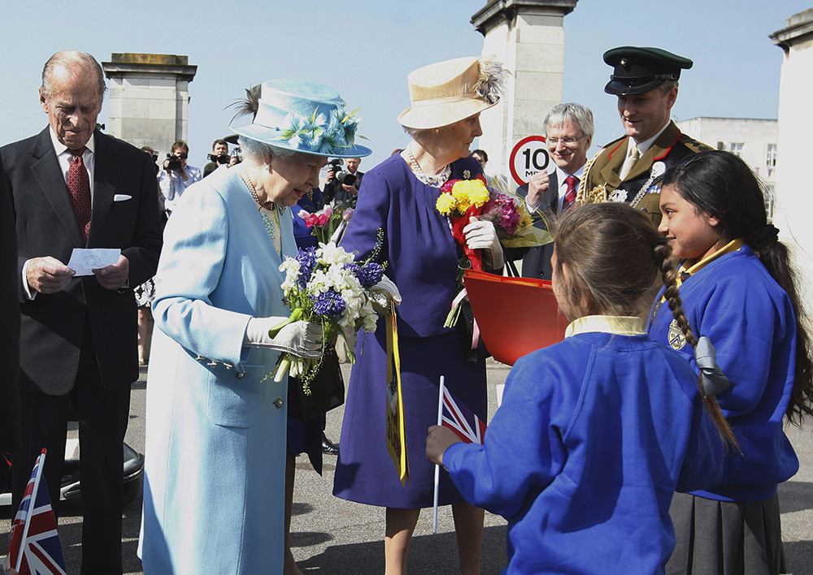
Notes:
The Queen visited Walthamstow as part of her Diamond Jubilee tour in 2012. © Alamy – G52HKR - 29 March 2012

Slide 60
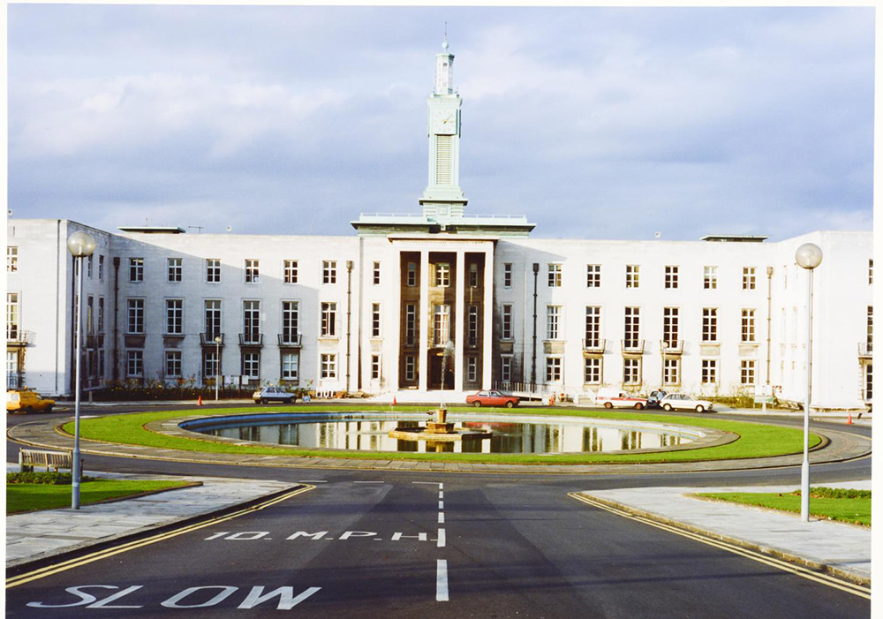
Notes:
The front of Waltham Forest Town Hall, with its approach road and circular pond in the foreground. © Ian Walker - WAL02/02/047 - 1980 - 1989

Slide 61
Bletchley Park
The Queen meets Jean Valentine, a wartime operator of the Turing Bombe machine during a visit to Bletchley Park, Milton Keynes on 15 July 2011.
Bletchley Park became the principal centre of Allied codebreaking during the Second World War. To help with decryption, automatic machinery such as Colossus, the world's first programmable digital electronic computer was devised. In the grounds is the hut in which the vital cracking of the Nazis' Enigma Code occurred. The "Ultra" intelligence from Bletchley shortened the war and helped secure victory for the Allies.
Several of the outbuildings and huts remain, including the Hut 11 complex where Bombe devices used for encryption were housed. It took local enthusiasts more than 20 years to secure the future of Bletchley Park as a heritage site, but it now welcomes 250,000 visitors each year.
Find out more on the National Heritage List.

Slide 62
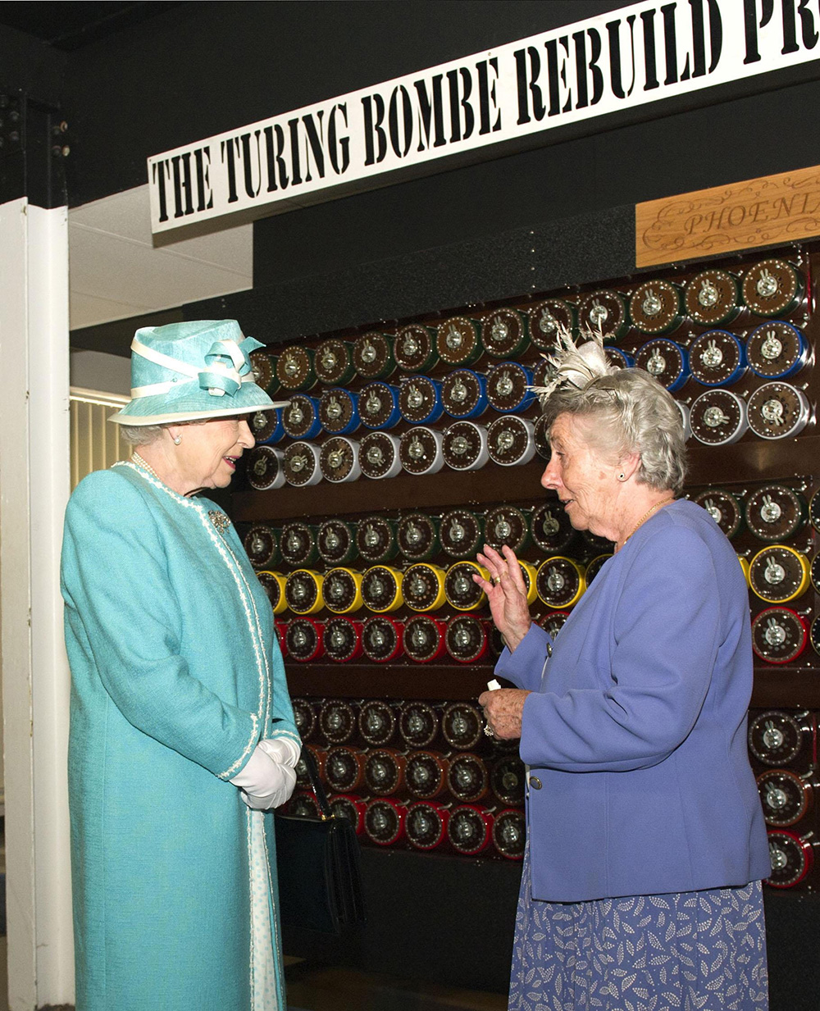
Notes:
The Queen meets Jean Valentine, a wartime operator of the Turing Bombe machine during a visit to Bletchley Park, Milton Keynes on 15 July 2011. © Alamy - G4E52K - 15 July 2011

Slide 63
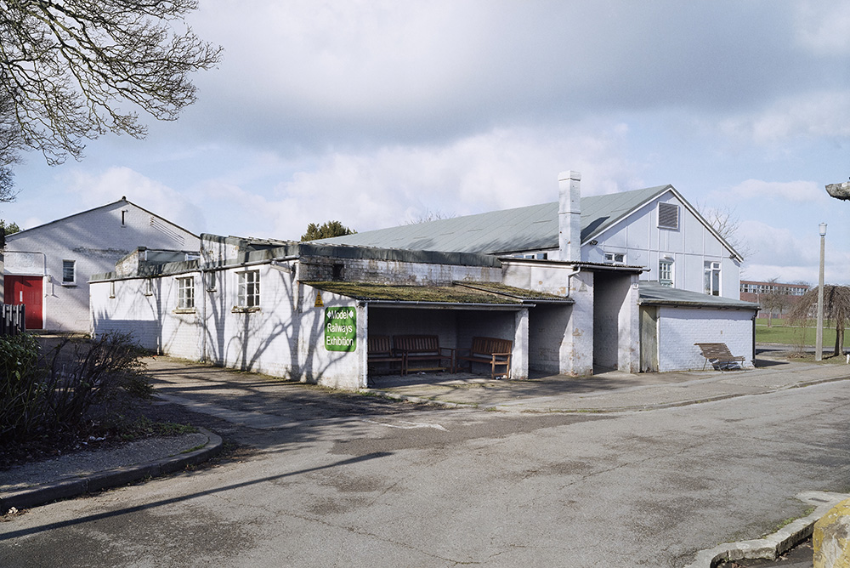
Notes:
A view of the single storied, whitewashed concrete Hut 11, Hut 11a and Hut 10, in which Second World War code breaking machines and their operators helped to win the war. © Historic England Archive - AA044320 - 19 Feb 2004

Slide 64
Former Ordnance Survey Offices, Southampton
The Queen at the opening the new headquarters of the Ordnance Survey in Southampton on 1 May 1969.
The Ordnance Survey (OS), Great Britain’s mapping agency, was formed in 1791. It originated from a military need for accurate surveys at a time of possible invasion. In the 1850s they moved to Southampton, in new purpose-built premises off London Road. These were badly damaged during the Blitz in 1940, so staff were relocated to the Maybush area of the town.
The OS moved to new purpose-built offices in Maybush in 1969 and to a business park in 2011. Today, in addition to field surveyors, the OS uses global navigation satellite systems, remote sensing and a range of advanced geographical information systems (GIS) to collect and maintain data.
Find out more about the Ordnance Survey.

Slide 65
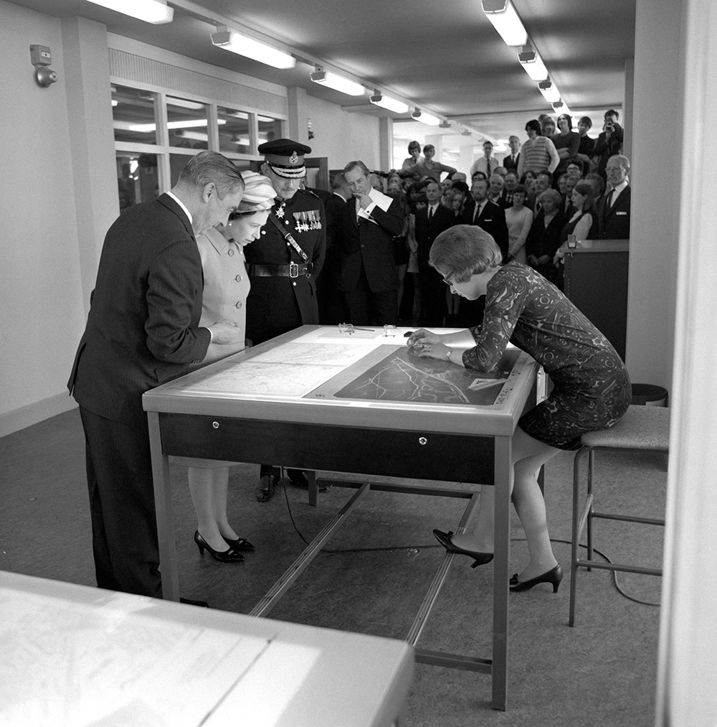
Notes:
The Queen at the opening the new headquarters of the Ordnance Survey in Southampton on 1 May 1969. © Alamy – G54BX2 - 1 May 1969

Slide 66
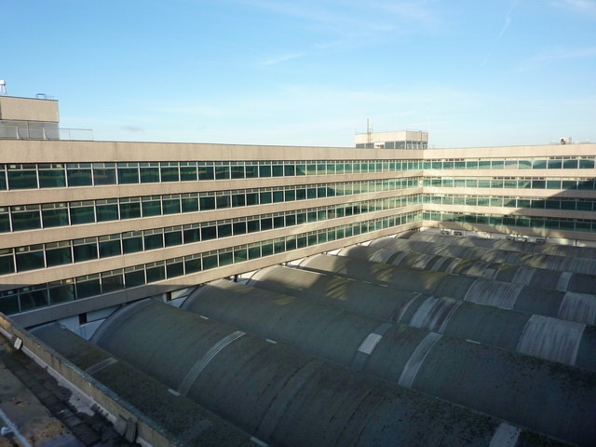
Notes:
The massive 5 storey concrete former Ordnance Survey HQ. Former Ordnance Survey HQ, Southampton, Central block by Alexander P Kapp, CC BY-SA 2.0 , via Wikimedia Commons

Slide 67
Hampshire County Council, Winchester Castle
The Queen chats with Usman Angulu Ahmed, a member of the Northern Nigerian House of Representatives, during her visit to Winchester to open the Hampshire County Council’s new offices on 8 June 1959.
The offices adjoin the remains of the Great Hall of Winchester Castle. The castle was a motte and bailey castle built by William the Conqueror from 1067, following the Conquest the previous year. By about 1110 it was the principal royal seat in the city and housed the Domesday Book.
During the Civil War Parliamentarians laid siege to the castle, which held out for a week before heavy cannon fire breached the walls. In 1649 the Council of State resolved that the defences should be permanently dismantled and the castle walls and towers were taken down.
Find out more on the National Heritage List.

Slide 68
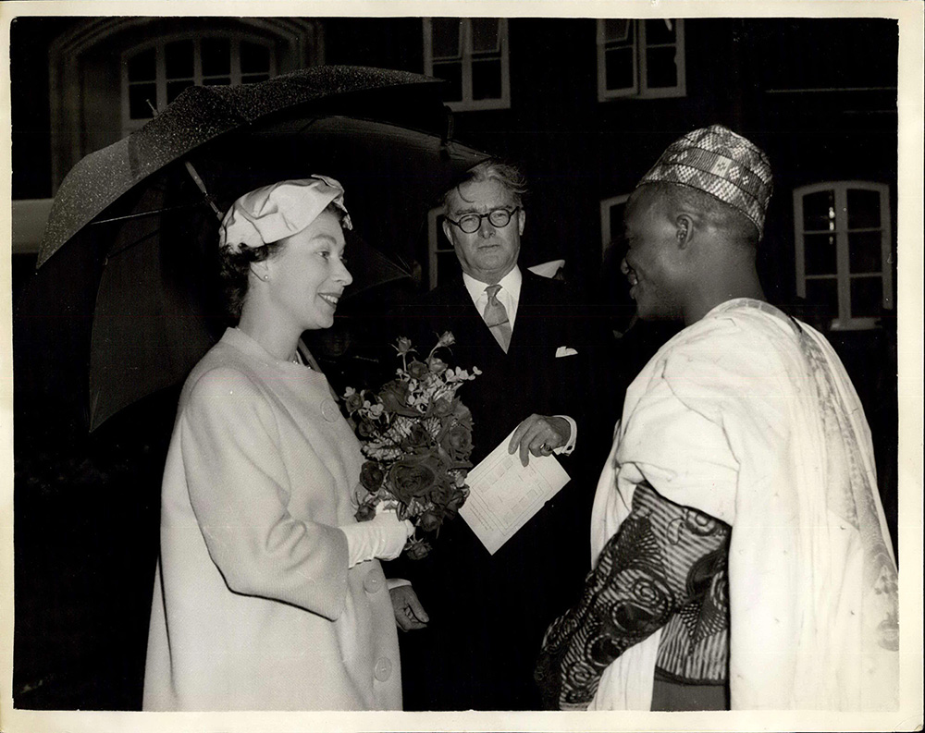
Notes:
The Queen chats with Usman Angulu Ahmed, a member of the Northern Nigerian House of Representatives, during her visit to Winchester to open the Hampshire County Council’s new offices on 8 June 1959. © Alamy – E0RG1Y - 8 June 1959

Slide 69
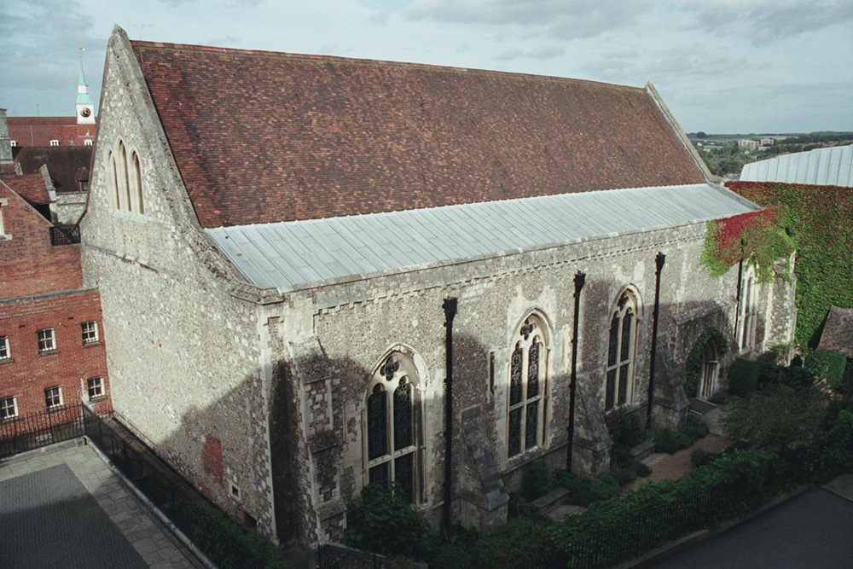
Notes:
A view of the much restored Great Hall of Winchester Castle which dates from 1252-1240. © Micaela Basford. Source: Historic England Archive - IOE01/12404/22 - 21 Sep 2004

Slide 70
Reading Station
The Queen was shown a scale model of a train during a visit to open the new station on 17 July 2014, after a £900 million redevelopment.
The new station respects an earlier Grade II listed station. It was built in 1865-67 by the architect Mr Lane, who was the Chief Engineer of the Great Western Railway Company. This itself was an enlargement and remodelling of Isambard Kingdom Brunel's original station which opened on 30 March 1840.
The 1865-67 station has been a pub since the last major redevelopment in 1989 which also saw the Queen visit to open a new station on 4 April 1989. By 2007 it became clear that this still wasn’t big enough, with passenger trains often having to wait outside the station for a platform to become available, hence the latest phase of redevelopment.
Find out more on the National Heritage List.

Slide 71
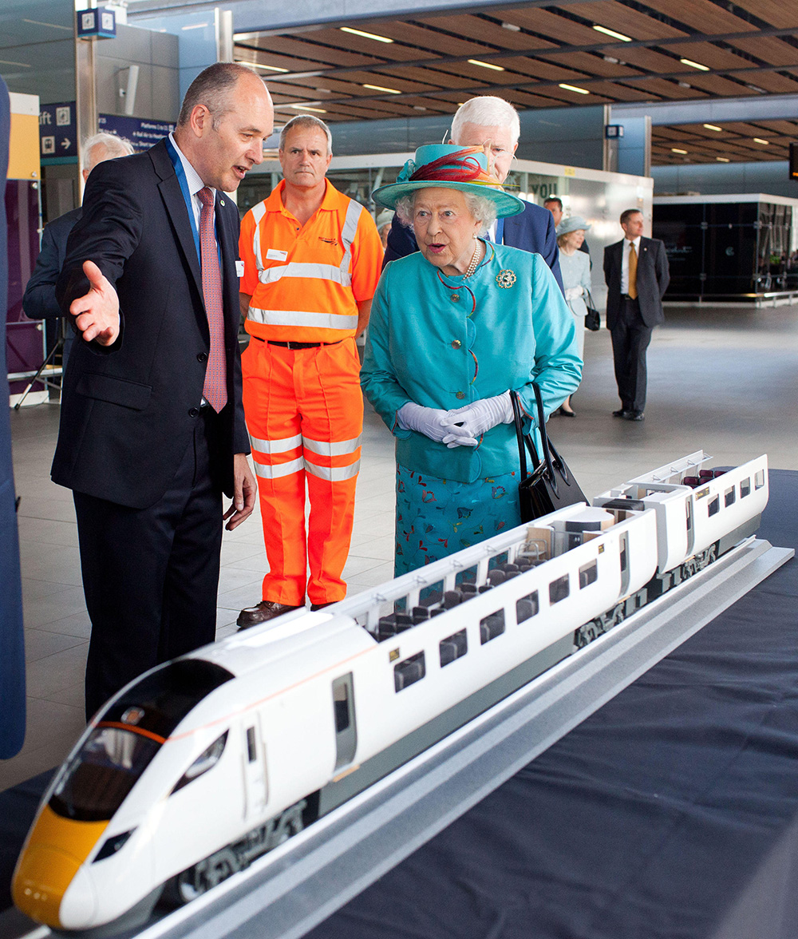
Notes:
The Queen was shown a scale model of a train during a visit to open the new station on 17 July 2014, after a £900 million redevelopment. © Alamy - G77PAR - 17 July 2014

Slide 72
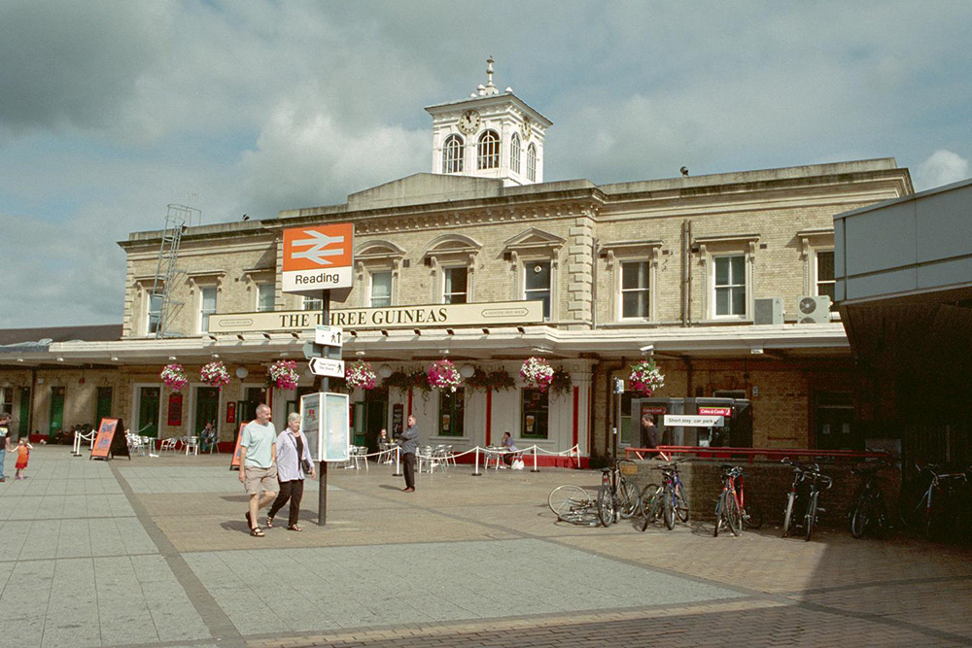
Notes:
A view of the classically styled stone built original Reading Station. © Ms Pamela Jackson. Source: Historic England Archive - IOE01/03950/23 - 1 Sep 2001

Slide 73
Banbury Town Hall
The Queen visited Banbury town hall on 27 November 2008 to unveil a plaque commemorating the 400th anniversary of the 1608 charter, which gave Banbury its first Mayor.
The Town Hall was opened in October 1854. It was designed in the Gothic style of architecture and a clock tower was added in 1860. Originally it was also the town’s police station and the cells remain to this day.
It was not the first town hall, the earliest documented one was built in around 1590. The town was awarded its Charter 1608 and a second timber town hall built in the Market Place in 1633. This was replaced by a third on the same site in around 1790.
Find out more on the National Heritage List.

Slide 74
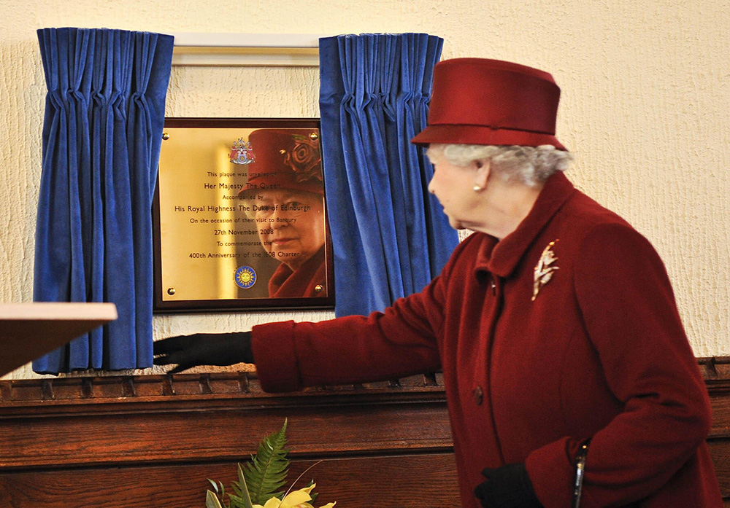
Notes:
The Queen visited Banbury town hall on 27 November 2008 to unveil a plaque commemorating the 400th anniversary of the 1608 charter, which gave Banbury its first Mayor. © Alamy – GBAGYB - 27 November 2008

Slide 75
Notes:
A view of the stone built, Gothic styled, Town Hall. © Mr Alistair F Nisbet. Source: Historic England Archive - IOE01/15276/24 - 12 Apr 2006

Slide 76
Notes:
A black and white image of the Town Hall in 1878 with people and horses and carts in the foreground. Source: Historic England Archive - CC66/00770 - 1878

Slide 77
RAF Halton
The Queen met children from the Pepper Club, which stages annual concerts to raise funding for Iain Rennie Hospice nurses, at RAF Halton near Aylesbury after she presented the base with a new colour on 31 October 1997.
The first recorded military aviation at Halton took place in 1913 when the then owner of the Halton estate, Alfred de Rothschild, invited No 3 Squadron of the Royal Flying Corps to conduct manoeuvres on his land. He also allowed the estate to be used by the British Army throughout the First World War.
In 1919 Halton House on the estate became an RAF Officer’s Mess. The Grade II* listed house was built in 1881-83 by W R Rogers of Cubitts for Alfred de Rothschild, son of Baron Lionel de Rothschild, head of the British branch of the Rothschild international banking dynasty.
Find out more on the National Heritage List.

Slide 78
Notes:
The Queen met children from the Pepper Club, which stages annual concerts to raise funding for Iain Rennie Hospice nurses, at RAF Halton near Aylesbury after she presented the base with a new colour on 31 October 1997. © Alamy - G49RPP - 31 October 1997

Slide 79
Notes:
A black and white aerial view of Halton House, with rows of military huts in the background in 1921. © Historic England Archive. Aerofilms Collection - EPW005575 – March 1921

Slide 80
Guildford Cathedral
The Queen went for a walk-about in Guildford High Street after distributing Maundy Money at Guildford Cathedral on 13 April 2006.
The cathedral was designed in 1932-3 by Edward Maufe and the foundation stone was laid in 1936. The eastern section was completed in 1939, the second stage begun in 1948, after the Second World War had delayed construction.
The nave was inaugurated by 1955, the cathedral was consecrated in 1961, and the whole building was completed in 1965.
Find out more on the National Heritage List.

Slide 81
Notes:
The Queen went for a walk-about in Guildford High Street after distributing Maundy Money at Guildford Cathedral on 13 April 2006. © Alamy - G999E0 - 13 April 2006

Slide 82
Notes:
A view across the rooftops of Guildford towards the massive red brick cathedral with its green copper roof. © Norman Wigg. Source: Historic England Archive - IOE01/05189/24 - 22 Sep 2001

Slide 83
Notes:
A black and white view of the part built cathedral church during its construction. © Historic England Archive - HKR01/04/122 - 1952 - 1960

Slide 84
Christs’ Hospital School, Horsham
The Queen and Prince Philip visited Christ’s Hospital School on 2 October 2003 to unveil a commemoration stone marking 450 years since Edward VI granted the school its Royal Charter.
The School was moved from London to this site in 1902. The new school buildings were designed by the architect Sir Aston Webb. It is interesting in that they incorporate parts of the original school buildings from Newgate Street, London.
These remains that were transported from London include a portico designed by Sir Christopher Wren from c1682 and archways designed by John Shaw in 1836.
Find out more on the National Heritage List.

Slide 85
Notes:
The Queen and Prince Philip visited Christ’s Hospital School on 2 October 2003 to unveil a commemoration stone marking 450 years since Edward VI granted the school its Royal Charter. © Alamy - 2GXBJ8W - 24 October 2003

Slide 86
Notes:
A view of the red brick school buildings as seen looking across the grass of the quadrangle. © Mr David Easton. Source: Historic England Archive - IOE01/13596/18 - 7 Jun 2005

Slide 87
Notes:
A black and white view of a classroom at Christ's Hospital School in 1937. There are rows of wooden desks and lots of maps can be seen as part of displays on the walls. Source: Historic England Archive - CC47/01676A - Jul 1937

Slide 88
Gatwick Airport
The Queen, escorted by British Airports Authority Chairman Sir Norman Payne, at Gatwick Airport to open the new North Terminal on 18 March 1988.
In the late 1920s land adjacent o Gatwick Racecourse was first used as an aerodrome and a farmhouse on the was converted into a clubhouse and terminal. In 1930 the Surrey Aero Club was founded there and in 1933 the Air Ministry approved commercial flights from Gatwick. The airport continued in use throughout most of the early 20th century.
It was closed from 1956-8 for a major £7.8 million renovation. The new concrete runway was 2.1km. The site continued to develop with new terminal and other buildings added. In 1998 the main runway was extended for a fourth time to 3.3km long. In 2014 Gatwick's main runway handled a record 906 movements, equating to an aircraft taking off or landing every 63 seconds!
Find out more about Gatwick Airport.

Slide 89
Notes:
The Queen, escorted by British Airports Authority Chairman Sir Norman Payne, at Gatwick Airport to open the new North Terminal on 18 March 1988. © Alamy - G668CR - 18 March 1988

Slide 90
Notes:
A black and white aerial view of what was Gatwick Racecourse and the farm that was the the first clubhouse and terminal for Gatwick Airport as they looked in 1929. © Historic England Archive Aerofilms Collection - EPW028582 – August 1929

Slide 91
Notes:
A black and white view of the North Terminal from the platform between the Mono-Rail line. © Crown Copyright. Historic England Archive - BB97/01367 - 10 Apr 1997

Slide 92
Notes:
A black and white view of the interior of the North Terminal air side baggage loading area. © Crown Copyright. Historic England Archive - BB97/01385 - 10 Apr 1997

Slide 93
Leeds Castle, Maidstone
The Queen meets a group of disabled people during a visit to Leeds Castle in Maidstone on 25 March 1981. A scheme inaugurated by the Queen allows disabled guests to visit the castle for free as guests of the Trustees.
The present castle was begun c 1119 by Robert de Crèvecoeur. It was ceded to Edward I in 1278 and remained a royal castle until 1552. In 1618 the castle was sold to Sir Richard Smythe, who built a Jacobean house on the main island.
In 1778 King George III and Queen Charlotte are entertained at the Castle. In 1821 Fiennes Wykeham Martin inherits the Castle and immediately begins construction work by demolishing the Jacobean House and building a ‘New Castle’ in a more fitting medieval style.
Find out more on the National Heritage List.

Slide 94
Notes:
The Queen meets a group of disabled people during a visit to Leeds Castle in Maidstone on 25 March 1981. © Alamy - G7EDPB - 25 March 1981

Slide 95
Notes:
A general view of the 'New Castle', built in a medieval style and surrounded by the lake. © Historic England Archive - DD003346 - 30 Apr 1990

Slide 96
Dover Watersports Centre
The Queen and the Principal of Dover Watersports Centre, John Hope, watch sailing in the channel on 20 July 2005. The Queen was in Dover to open two passenger ferry berths at the Dover Ferry Terminal.
Dover's first two drive-on drive-off ferry berths were opened in 1953. Before then all cars and even coaches had been craned on and off ferries! Since then the growth of the port of Dover continued with major expansions in the 1960s, 1970s and early 2000s.
These expansions are just a continuation of Dover’s importance as a cross channel port, which can be traced back to the Romans. Julius Caesar mentions it in his writing and the remains of a Roman lighthouse (The Pharos) built under Emperor Claudius still exist today!
Find out more on the National Heritage List.

Slide 97
Notes:
The Queen and the Principal of Dover Watersports Centre, John Hope, watch sailing in the channel on 20 July 2005. © Alamy - G8GD3A - 20 July 2005

Slide 98
Notes:
An aerial view of the Dover Watersports Centre on the beach at the port of Dover. © Historic England Archive - 33064_013 – 24 August 2016

Slide 99
Notes:
A view of the remains of the stone built Roman lighthouse, known as The Pharos, on the hill above the port of Dover. © Mr Steve Dallison. Source: Historic England Archive - IOE01/12172/01 - 16 Apr 2005

Slide 100
RNLI Margate Lifeboat Station
The Queen visited Margate RNLI lifeboat station where she met the coxswain, crew and families, as well as volunteers, during her visit to the town on 1 November 2011.
The first lifeboats, called Hannah and Angela, were given to the town in 1857 by a Miss Burdett Coutts. In 1898 the town opened a second lifeboat station. During its time the station has been awarded six medals, five Silver and one Bronze.
On 30 May 1940 the station sent a lifeboat to Dunkirk to help in the evacuation of the British Expeditionary Force, amazingly it helped save some 600 soldiers. The actions of many such ‘little ships’ rescued more than 336,00 trapped soldiers in the Second World War.
Find out more about Margate Lifeboat Station.

Slide 101
Notes:
The Queen visited Margate RNLI lifeboat station where she met the coxswain, crew and families, as well as volunteers, during her visit to the town on 1 November 2011. © Alamy - G4MX6P - 11 November 2011

Slide 102
Notes:
The Queen meeting the coxswain, crew and families, as well as volunteers, who are all involved with the Lifeboat Station. © Alamy - G4MX6X - 11 November 2011

Slide 103
Notes:
An aerial view showing the Lifeboat Station, which is dwarfed by the nearby Turner Contemporary art gallery, on the seafront. © Historic England Archive - 27508_009 – 9 August 2012

Slide 104
Brompton Barracks, Chatham
The Queen poses for a group photograph during a visit to the Corps of Royal Engineers at Brompton Barracks in Chatham on 13 October 2016, to celebrate their 300th anniversary.
Brompton Barracks themselves were built in 1804-6, by James Wyatt, Surveyor to the Office of Works. They are one of the largest and most impressive examples of military architecture in the country.
As such many of the buildings have been given listed status. As well as buildings for the soldiers there were also stables for 200 horses, which until after the First World War, were the army’s main form of transport.
Find out more on the National Heritage List.

Slide 105
Notes:
The Queen poses for a group photograph during a visit to the Corps of Royal Engineers at Brompton Barracks in Chatham on 13 October 2016, to celebrate their 300th anniversary. © Alamy - H47FR5 - 13 October 2016

Slide 106
Notes:
A black and white aerial view of Chatham in 1948, showing the Brompton Barracks clearly in the foreground. © Historic England Archive. Aerofilms Collection - EAW018565 – 9 September 1948

Slide 107
Canine Partners, Heyshott
The Queen smiles as she strokes a puppy being held by one of the staff at Canine Partners on 30 November 2017.
Canine Partners is a registered charity that was founded in 1990. It transforms the lives of people with physical disabilities by partnering them with assistance dogs. The dogs bring a greater independence and quality of life to their partners, offering security, companionship, and practical help with everyday household tasks.
They began to operate from this former polo yard and farm with its various outbuildings from 2003. They were able to continue training dogs whilst building a new, purpose built, centre on the site which was officially opened in 2005. They very rural setting of the centre makes it ideal for training so many dogs and providing a tranquil setting.
Find out more about Canine Partners.

Slide 108
Notes:
The Queen smiles as she strokes a puppy being held by one of the staff at Canine Partners on 30 November 2017. © Alamy - 2CHB7YM - 30 November 2017

Slide 109
Notes:
An aerial view showing the very rural setting of the Canine Partners Centre, in the far left top corner of the photo. © Historic England Archive - 29213_012 - 17 February 2015

Slide 110
Courtlands Hospital, Goring-by-Sea
A smiling Princess Elizabeth (later Queen) met Mrs’ Green and Harris with their babies, when she formally opened Courtlands Hospital on 19 May 1951. The two babies were both born on the same day as the Queen’s daughter, Princess Anne.
The hospital building dates from 1906 and was originally built as a house. During the Second World War it became the HQ of the Canadian 1st Army and in 1945 it was acquired by Worthing Hospital as a place for patients to recover after surgery.
The house was further converted and first used by the new NHS in 1948, after the Queen’s visit the house continued to be used as a hospital by the NHS until 1973. On 23 July 1974 the building was given permanent protection when it was Grade II listed.
Find out more on the National Heritage List.

Slide 111
Notes:
A smiling Princess Elizabeth (later Queen) met Mrs’ Green and Harris with their babies, when she formally opened Courtlands Hospital on 19 May 1951. The two babies were both born on the same day as the Queen’s daughter, Princess Anne. © Alamy - 2HX5A9J - 19 May 1951

Slide 112
Notes:
A view of the three storey, white plastered, classically styled house that became a hospital. © Mr Robin Earl. Source: Historic England Archive - IOE01/02869/14 - 23 Sep 2000

