Slide 1

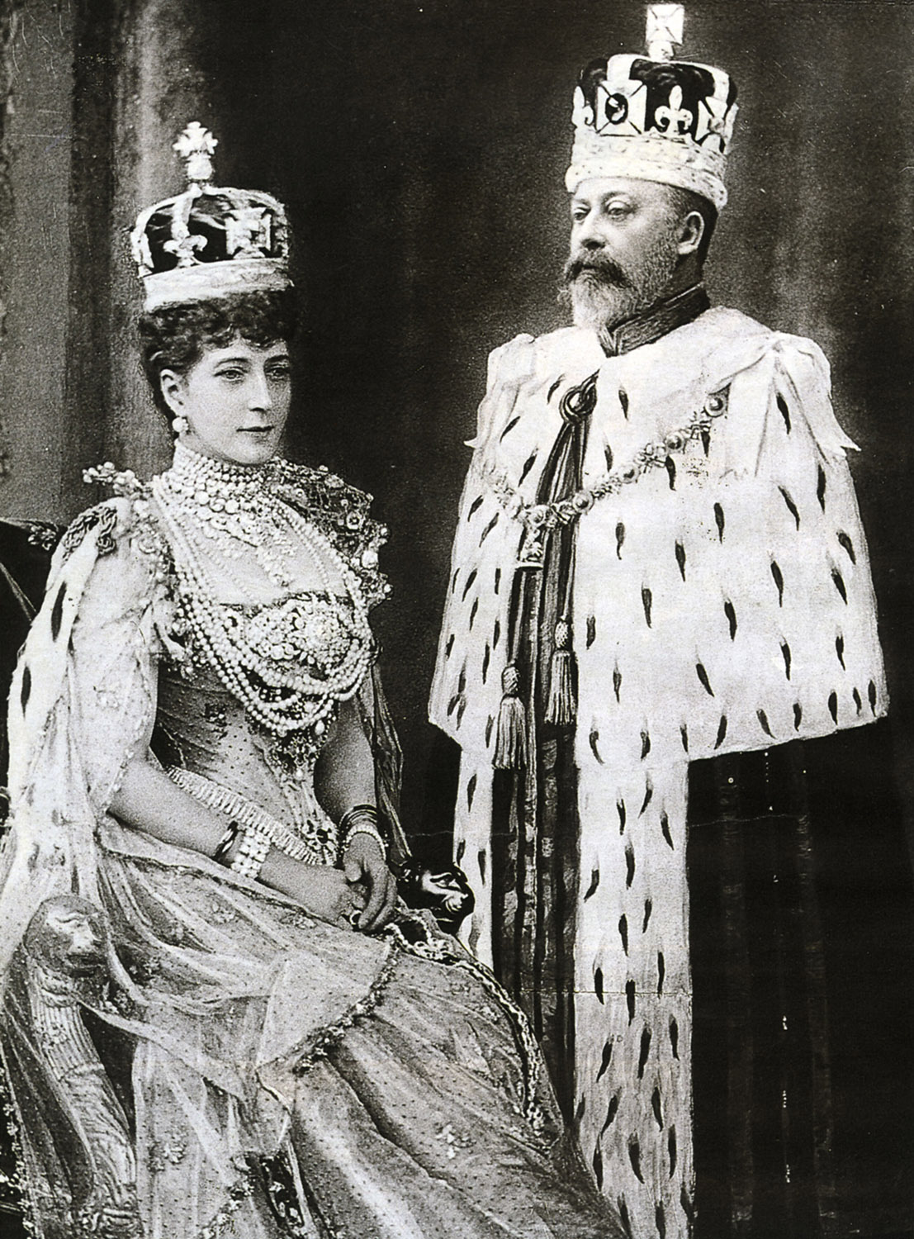
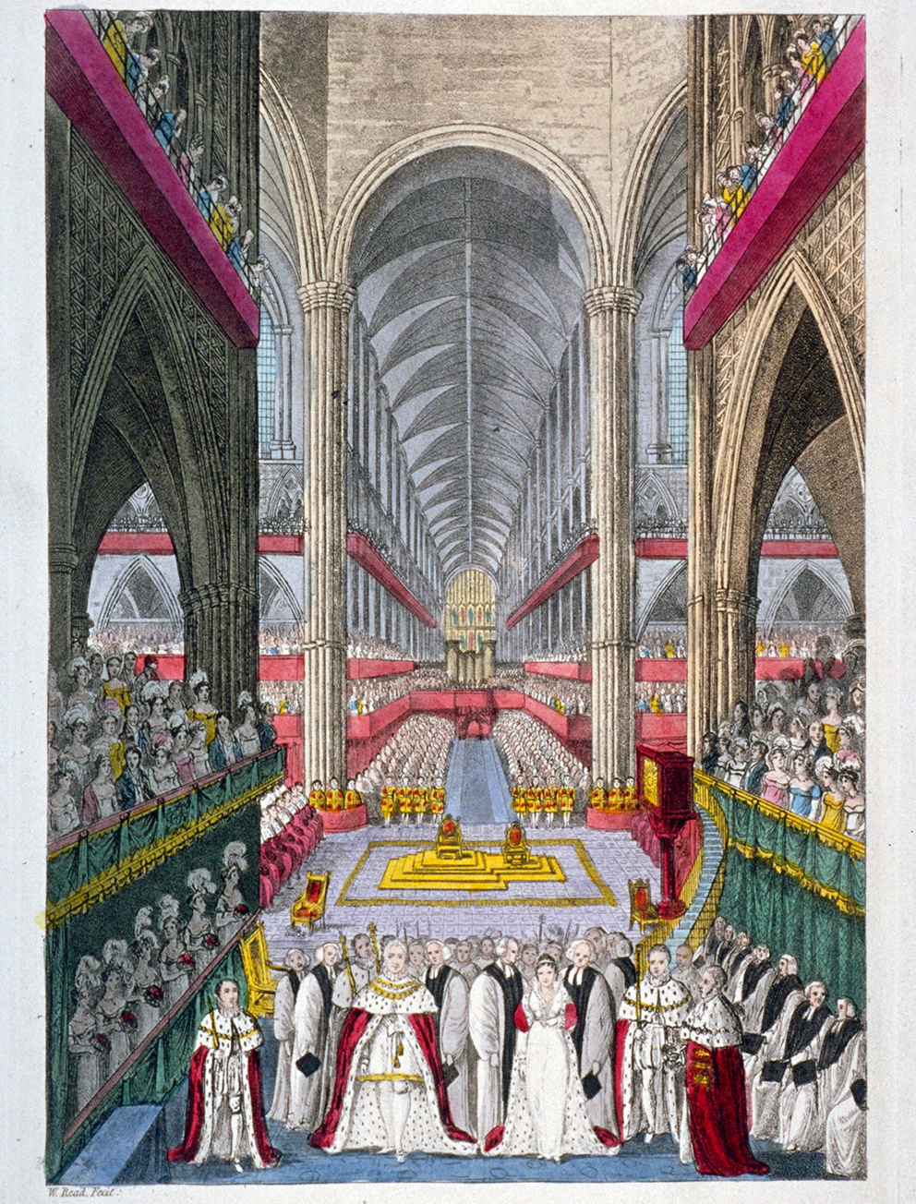
Teaching Activity on using photos and paintings
How do historians use photos and paintings as historical evidence?
Notes:
Image © Historic England Archive, Ref: DP059901, Date: 14 April 2008 - https://historicengland.org.uk/images-books/photos/item/DP059901
Photo Image: KING EDWARD VII AND QUEEN ALEXANDRA in their Coronation robes ©Alamy Ref: BRT92Y Date: 9 August 1902
Paninting Image: Coronation of William IV and Queen Adelaide's in Westminster Abbey, London, 1831. ©Alamy Ref: DDTK61 Date: 1831

Slide 2

How to use this PPT
Contents
What is historical evidence?
Types of historical evidence
Analysing historical evidence
Using Inference Grids to analyse historical evidence
Usefulness and reliability
How useful and reliable are paintings?
How useful and reliable are photos as historical evidence?
This PPT is designed to provide you, as the teacher, with enough information to teach your pupils about using photos and paintings as historical evidence.
The PPT contains useful information about using photos and paintings as historical evidence, as well as questions and activities to help your students to analyse these types of sources.

Slide 3
How do historians use photos and paintings as historical evidence?
History
To improve knowledge & understanding of different types of historical evidence​
To develop skills in analysing historical evidence
To consider the usefulness and reliability of different types of historical evidence
To recognise that all historical evidence can be useful, even if it is not always entirely reliable
This PPT is part of the Teaching Activity: How do historians use photos and paintings as historical evidence?

Slide 4



What is historical evidence
Historical evidence is anything that an historian uses to find out about an event, person or place in the past!
There are lots of different types of historical evidence, from artefacts and objects to books, letters, photographs or paintings.
Pieces of historical evidence are often described as sources.
Historical evidence, or sources, are often categorized into two main groups…..
Can you write a list of the different types of evidence a historian might use to find out about an event, person or place in the past?
Write

Slide 5

Types of historical evidence
Primary sources (sometimes just called sources): These are objects, or pieces of information (written or drawn for example) that were created at the time of the event that you are studying.
Secondary sources (sometimes called interpretations): These are objects, or pieces of information that were created after the time of the event you are studying.
Both may be influenced by the opinions of the people who produced them for example, or the situation they find themselves in.
Is a painting always a primary source, always a secondary source, or can it be either?
Is a photograph always a primary source, always a secondary source, or can it be either?
Think

Slide 6

Analysing historical evidence.
Historians need to examine historical evidence very carefully in order to get as much information from it as they can, about a person, place, event or thing.
They need to work out what the source tells them about a person, place, event or thing.
They need to spot any hidden or underlying messages or information.
They might also think about what the evidence doesn’t tell them that they still want to know, or any questions they might have.
This is sometimes called analysing the evidence.
Inference grids are useful for helping us to analyse historical evidence…..
Can you spot any ways in which being an historian is a bit like being a detective?

Slide 7

Using an Inference Grid to analyse evidence
Write down anything you still want to know or any questions you have about the source,
3. What questions do you have?
2. What can you infer?
Write down everything the source tells you about the person, place, event or thing.
1. What can you see?
Write down any hidden, or underlying messages or information you can uncover from the source. You might also write down what makes you think that.
Historical evidence goes here!

Slide 8
Blank inference grid
3. What questions do you have?
2.What can you infer?
1. What can you see?

Slide 9

Activities to help you analyse photos or paintings.
Look
What is the landscape like?
What is the weather like?
Are there people / animals in the image? How many?
What are they doing?
What are they holding / using?
What objects are in the background and the foreground?
Can you tell where the image was captured?
What can you see?
Divide the image into sections. Describe what you see in each section in as much detail as you can.
Start with the centre of the image and work your way out to the four corners. Describe what you see in every part of the image.
Look out for different things that the artist / photographer chose to capture in their image.
  The setting and the environment
  Buildings
  People
  Objects
Play “spot it” with the image or do a drag and drop activity on an interactive whiteboard
Play “eye spy” with the image.

Slide 10
Activities to help you analyse photos or paintings.
What can you infer?
What might the people in the image be saying? Draw speech bubbles and write in your ideas. Why do you think this?
Imagine what might have happened just before or just after the image was captured. Why do you think this?
How does the image make you feel and why? Do you think the person who made the image wanted you to feel this way?
Look
What emotions are people showing and why?
Why are certain objects included or given importance?
Why do you think this image was captured?

Slide 11
Questions to consider when analysing photos or paintings: Four W’s!
When?
Who?
When was the image taken or the painting painted?
Was the person who captured the image there at the time that the image was captured? Did they see / experience it?
Who captured the image or painted the painting (and do we know anything about them)?
Why?
What?
Why did they capture the image? (Did they choose to? Were they asked / made to? Were they paid?)
What message did the artist or photographer want to send to the people looking at the image?
What was happening (locally, regionally, nationally, globally) at the time that the image was captured?

Slide 12
Why are the four W’s important?
In order to answer the “W” questions, we need to find out about the context in which the image has been captured, or the painting has been painted. This is sometimes called the provenance of the source. We also need to use our own knowledge about the event or person shown in the image or painting, and / or do some extra research.
Finding out about the provenance of a source and using our own knowledge, helps us to decide how useful it is, as historical evidence, and how reliable it is…..

Slide 13

Usefulness and reliability
All historical evidence is useful in some ways
and not so useful in others.
Even a source that doesn’t tell us the whole truth about a person, place, event or thing can be useful to historians.
On the next slide are some questions to help you think about how useful and how reliable any particular source might be…..

Slide 14
Usefulness and reliability
Is the source reliable?
Is the source useful?
Can we trust the image?
Who’s opinions / ideas can we trust it to tell us about?
Does it tell us about everyone’s opinions / ideas?
Was it made to convince people to think / feel / act in a certain way?
What is the image useful for telling us about the subject?
What doesn’t it tell us?
Is the information it gives us accurate?
What else would we still like to know?
What other sources of evidence would we like in order to build up a complete picture of the event or time?

Slide 15
How useful are paintings as historical evidence?
Less useful because…
Useful because….
Paintings don’t tell us what had happened before or after the moment that they depict.
We can’t tell what people are saying or thinking, and we have to infer how they are feeling.
Sometimes we don’t know who painted the painting, where or when.
Sometimes they are painted from memory or imagination. They are not necessarily an accurate depiction of the event or person they are portraying.
Paintings depict a moment in time, a certain event, or a particular person.
They can tell us about things that are sometimes hard to explain in words – fashions or atmosphere for example.
They can trigger memories or emotions, which sometimes help to find out more about an event or time.
They can be particularly useful for telling us about things that happened before the invention of photography and film.

Slide 16
How reliable are paintings as historical evidence?
Do we know whether the artist was present at the time of the event and whether they saw the thing they painted?
Do we know how accurate the painting is to real life?
The artist may have taken great care to include certain things (and not include other things) in the painting.
Paintings are not necessarily based on real events or may portray an event, person, place or thing differently to the reality.
Sometimes artists choose, are paid, are pressured or even forced to present a person, event place or thing in a certain way.
It is important to think about who painted the painting, when, where and why.
The 4 W’s!

Slide 17
How useful are photographs as historical evidence?
Useful because….
Less useful because…
Photographs are a snapshot of a particular second in time, which will never again be repeated.
They can tell us about things that are sometimes hard to explain in words – fashions or atmosphere for example.
They can trigger memories or emotions, which sometimes help to find out more about an event or time.
They can be particularly useful for telling us about things that happened before the invention of film.
Photos don’t tell us what had happened before or after the photo was taken.
We can’t tell what people are saying and we have to infer how they are feeling.
Sometimes, especially if the photo was taken by a member of the public, or is from a personal collection, we don’t know who took the photo, where or when.

Slide 18
How reliable are photographs as historical evidence?
Photographs were taken by someone who saw and experienced the event happening.
The photographer may, however, have taken great care to include certain things (and not include other things) in the shot.
Photographs can be staged, cropped or manipulated after the event.
Sometimes photographers choose, are paid, are pressured or even forced to present a person, event place or thing in a certain way.
Sometimes only certain photographs are released to the public.
It is important to think about who took the photo, when, where and why.
The 4 W’s!

Slide 19
Example: What can we learn from this painting about coronations of kings and queens?

Slide 20
Inference grid with colour painting in the centre
3. What questions do you have?
2. What can you infer?
1. What can you see?

Slide 21
Inference grid with suggested ‘answers’ for what you can see
What can you see?
Lots of people watching the event. All dressed smartly.
Some of the men in the foreground are carrying gold "sticks“.
Men and woman at the front in white and red robes.
Men in black and white robes.
Stained glass window.
Men in red and yellow unforms standing very straight and tall.
The people in the foreground look serious.
Two thrones behind the main group of people. One is on a podium, slightly higher than the other.
Women in white dresses with feathers in their hats.
The man in the centre foreground is wearing a gold chain.
Men in red and white gowns sitting to either side of thrones.
Big, grand building.

Slide 22
Inference grid with suggested ‘answers’ for what you can infer
What can you infer?
The stained glass window makes me think that the building might be a church.
The fact that there are thrones in this painting, and that the people in the foreground are dressed in red, white and gold, suggests that this event might involve people from the royal family.
I infer that this is an important event because there are so many people attending. Everyone is dressed in formal looking clothes and the event is taking place in a grand building.
The people dressed in black and white might be people of the church as this is the colour often worn by the clergy.
I infer that the people at this event are rich because they are wearing expensive looking clothes.
The people seated either side of the throne and dressed in red and white might be members of the church choir

Slide 23
Inference grid with suggested ‘answers’ for what questions do you have
What questions do you have?
When did the event take place?
Who are the people in the painting?
When was the painting painted?
Who painted the painting? Was he at the event?
What is happening in the painting?
Why did the artist paint the painting? Were they paid to paint it? Did they hope to sell it?
Where is the event taking place?
Why are they looking so serious and standing so formally?

Slide 24
The provenance of this painting.
This is a painting of the Coronation of William IV and Queen Adelaide which happened in 1831 at Westminster Abbey in London
The king and queen are shown in the foreground with spectators filling the aisle and main body of the abbey.
The painting was created by an artist and engraver called William Read. He was alive at the time of the coronation but we don't know if he was at the ceremony.

Slide 25
How useful is this painting as historical evidence?
Less useful because…
Useful because….
This painting gives us an impression of the coronation as a grand, spectacular event, to which lots of people were invited.
The painting provides us with some information about what might have happened at the ceremony, for example:
  what the King and Queen, as well as others at the event, might have worn
  the sorts of people who might have been present at the event
We know from other sources that the Queen wore a white and gold dress. We can see this in the painting.
There are no photos of the coronation so paintings are our only visual evidence from the time
We don’t know how accurate the painting is. We know for example, from various historical accounts, that the King wore his naval uniform for his coronation. This is not shown in the painting.
The painting gives us the impression that the coronation was a very grand event. In fact, whilst the ceremony was almost definitely an elaborate affair, King William did not want to spend too much money on his coronation and it cost far less than others!
We don’t know about other aspects of the coronation, such as the details of the ceremony or the procession beforehand.

Slide 26
How reliable is this painting as historical evidence?
We don’t know if the painter was at the coronation ceremony. He might have based his painting on accounts of the event, entirely from his own imagination or a mixture of both! This means that it might contain inaccuracies.
Even if the painter was at the event the painting would probably have been completed after the event, perhaps from sketches and memory. It may not be entirely accurate.
We don’t know why the artist made the painting. He might have been paid by the royal family to make a record of the event, or he might have created the painting to sell to the public and make money. This might mean that he painted the event inaccurately for artistic effect.

Slide 27
Example: What can we learn from this photograph about coronations of kings and queens?

Slide 28
Inference grid with black and white photo in the centre
3. What questions do you have?
2. What can you infer?
1. What can you see?

Slide 29
Inference grid with suggested ‘answers’ for what you can see
What can you see?
Jewelled crowns
Robes
Jewellery
Standing / sitting formally
A man and a woman
Expensive looking clothes
Serious faces
The man has a beard and a moustache

Slide 30
Inference grid with suggested ‘answers’ for what you can infer
What can you infer?
The fact that they are wearing crowns suggests that they might be part of a royal family.
I can infer that they are rich because they are wearing expensive looking clothes and lots of jewels
They look serious and are sitting very straight and formally. This makes me think they are having their photo taken to mark a serious occasion.

Slide 31
Inference grid with suggested ‘answers’ for what questions do you have
What questions do you have?
When was the photo taken?
Where was the photograph taken?
Who are they?
Who took the photo?
Were they paid to take it?
Why are they having their photograph taken?
Did they choose to pose like this or were they made to stand/sit this way? If so, why?
Why are they looking so serious and sitting so formally?

Slide 32
The provenance of this photo.
This photograph shows King Edward VII and Queen Alexandra. He is wearing his coronation robes. She’s taken her robes off so you can see her dress. (You can also just see her robes on the back of her chair)
The photo was taken 9 August 1902, the day of the king's coronation.
The King and Queen posed for the photograph, after the coronation ceremony, at Buckingham Palace.
A photographer called James Edward Ellam took the photo. He worked for a company called Underwood & Underwood. They were one of the biggest photography publishers in the world at the time.

Slide 33
How useful is this photograph as historical evidence?
Useful because….
Less useful because…
It is a snapshot of the newly crowned King and Queen taken to mark a very important event in England’s history.
There is no film evidence of the coronation so photographs like this are the only first-hand, snap shots of the event.
We can learn about what the King and Queen wore for the coronation - their jewellery and their crowns.
We get a sense of the importance of the occasion and the seriousness of the event.
This photo doesn’t tell us about events at the coronation itself.
The King and Queen are showing very little emotion in the photo, so we don’t know how they are feeling on the day.
The photo is in black and white so we don't know what colour the clothing and jewels were for example.
The photo appears to be posed, so we don’t get any insight into the day of the coronation.

Slide 34
How reliable is this photograph as historical evidence?
We know that the person who took the photograph was there at the time. We don’t know, however, whether he also attended the coronation.
The photographer was almost definitely hired (& paid) by the royal family to make a formal photographic record of the event. We don’t know exactly how the photos were used (they might have been sold to the public or published in newspapers for example), but the photographers were probably told to capture the King and Queen looking formal and grand!

