Slide 1
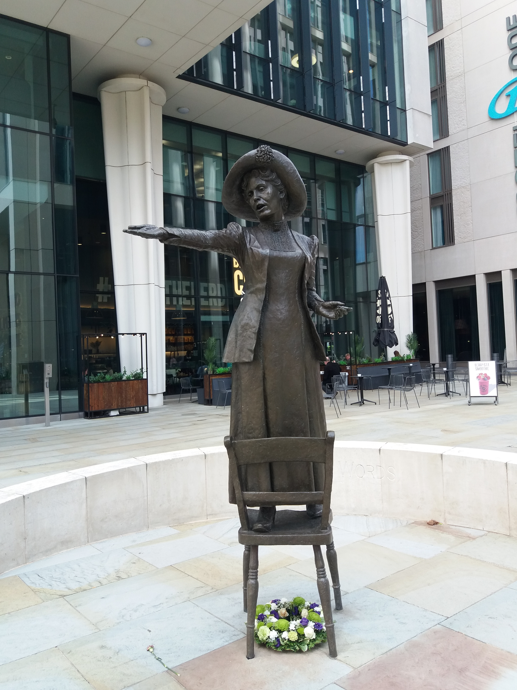
Introductory Slide the Manchester Young People’s Peace Trail
Manchester Peace Trail
Key Stage 2
How can we use buildings, statues and memorials to learn about peace, justice and equality?
Notes:
Image of Emmeline Pankhurst Statue © Historic England

Slide 2
How can we use buildings, statues and memorials to learn about peace, justice and equality?
History,
Key Stage 2: History, SMSC, British Values
To know more about the built environment of Manchester city centre and how it relates to the heritage and story of a place
To know more about Britain’s democratic parliamentary system and its central role in shaping our history and values, and in continuing to develop Britain
To know that people living in the past did not have the same rights and freedoms as people today and were not treated with equal respect because of wealth, faith, race, gender
To know about Manchester’s contribution to making laws fairer for all people
To know that people can help make the world a better place for everyone to live
Notes:
SMSC
knowledge of Britain’s democratic parliamentary system and its central role in shaping our history and values, and in continuing to develop Britain
interest in exploring, improving understanding of and showing respect for different faiths and cultural diversity and the extent to which they understand, accept and respect diversity. This is shown by their respect and attitudes towards different religious, ethnic and socio-economic groups in the local, national and global communities

Slide 3
How to use this PowerPoint
This PowerPoint complements the Manchester Young People's Peace Trail StoryMap. The trail includes 6 sites in Manchester's city centre that link to Manchester's contribution to peace and social justice in Britain. It would take approximately 1 hour to take pupils on the trail. A good starting point is Central Library.
The PowerPoint contains:
Information for teachers on all the sites on the trail.
Activity suggestions for pupils before and after doing the trail.
A bank of images for teachers to use in their own worksheets.
The online StoryMap - This contains all the information and images for the Young People's Peace trail. Use this to explore or revisit the sites on the trail, when you are in the classroom, or if it is not viable to physically take your pupils on this trail.
The How to Make a Peace Dove file - This includes step-by-step instructions for making card and paper doves.
The Peace Dove Template - This is for the dove's body. It is better to print this on A4 card. A piece of ordinary A4 paper can be used for the wings.

Slide 4
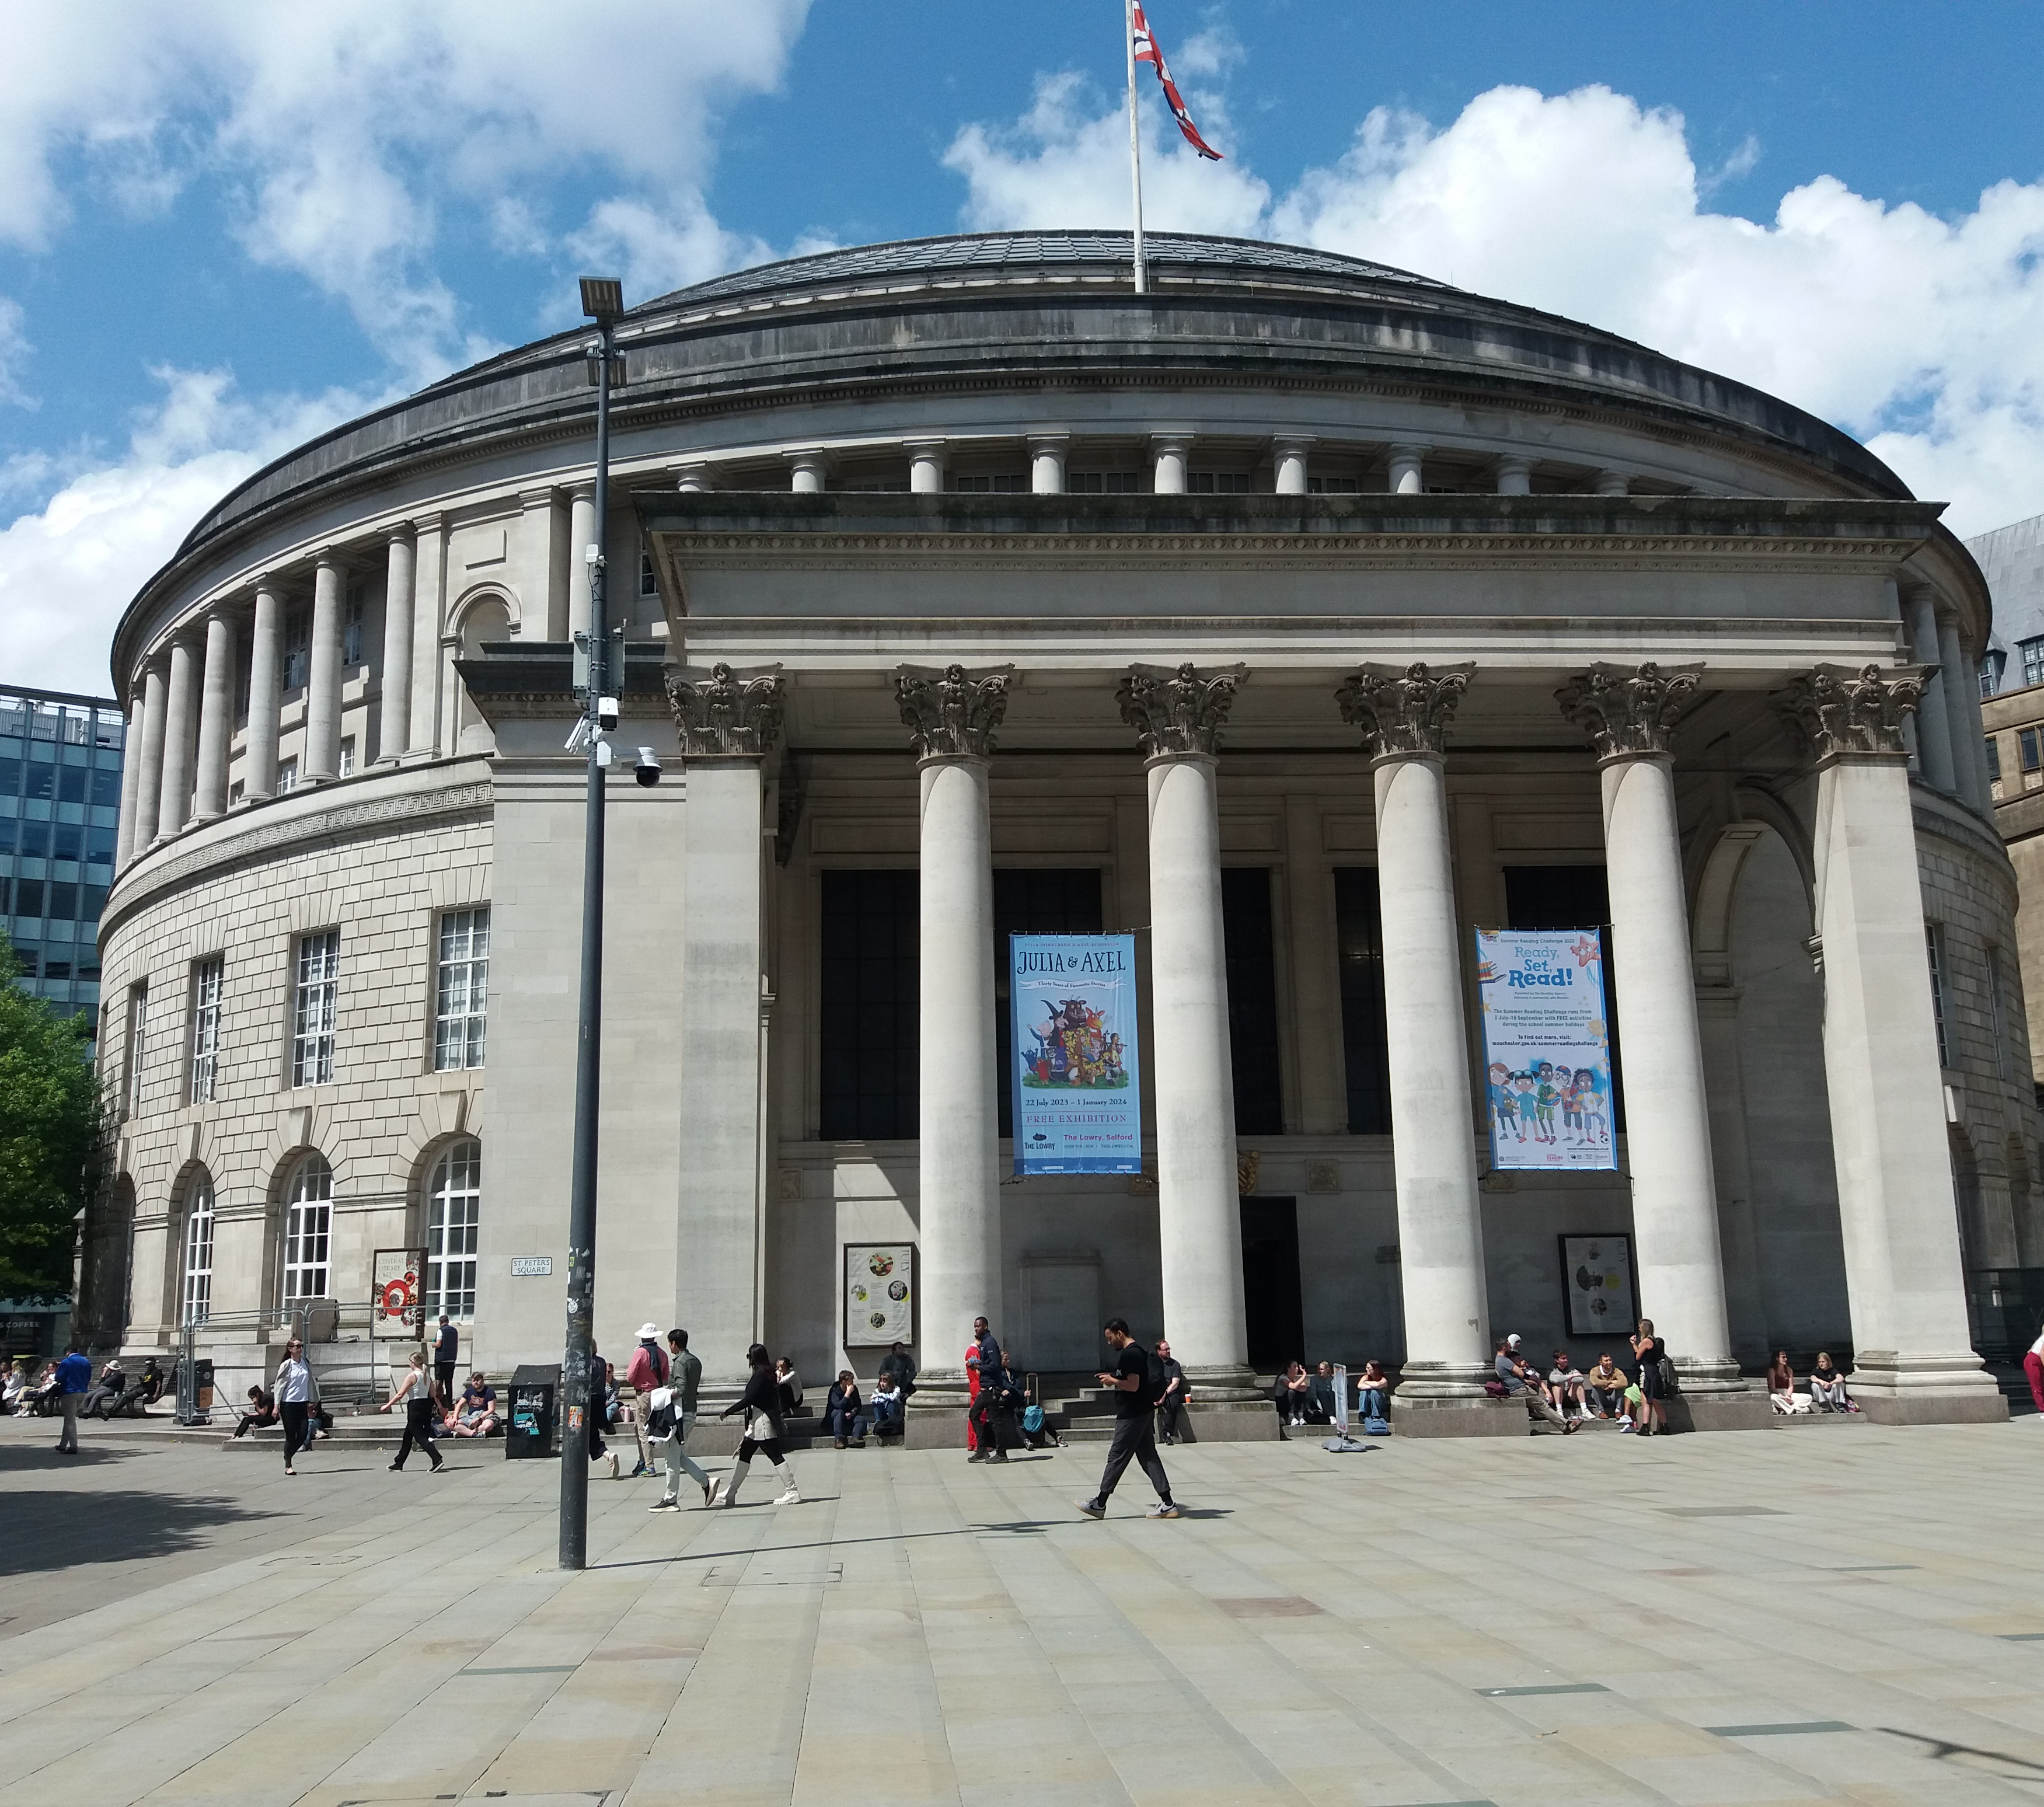
Manchester Central Library
Manchester Central Library opened in 1934. One reason for building it was to help provide people with work at a time when lots of people had no jobs. When it was first built, it was the largest public library in the country.
For many years, libraries have been important buildings where all people can learn, borrow books and find information without having to pay. Manchester opened the first lending library in Britain without subscription fees (now demolished). This helped people, who could not afford to buy books, read and learn, and provided fairer access to education.
The oldest public library in the English-speaking world, Chetham’s Library, is also in Manchester, next to Victoria Station, it was founded in 1852.
Manchester Central Library and Archives Centre
Notes:
Image of Central library © Historic England
List Entry: https://historicengland.org.uk/listing/the-list/list-entry/1270759?section=official-list-entry

Slide 5
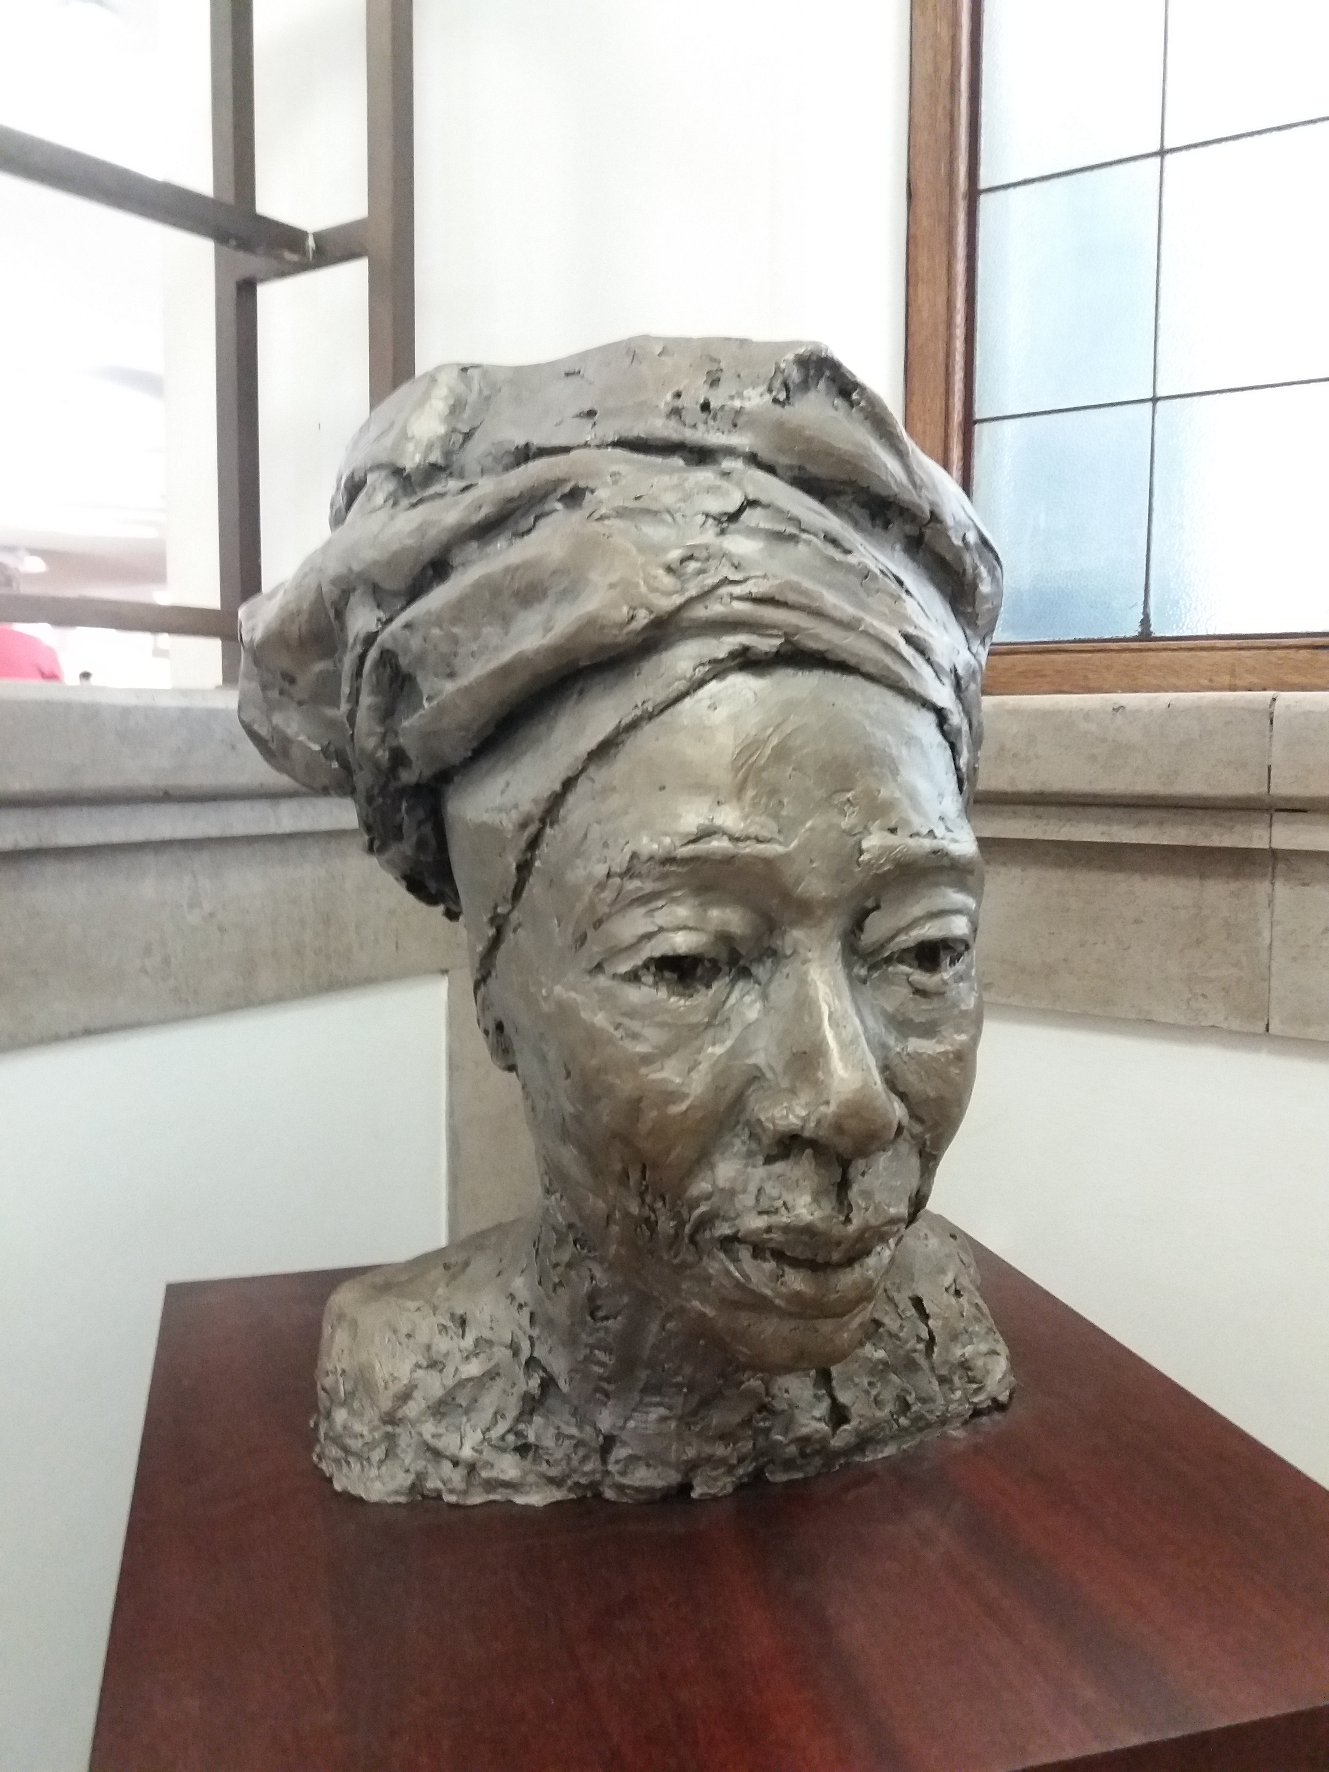
Erinma Bell – Peace Activist
Manchester Central Library was modernised in 2014 and has a combined Archive Centre and Local History information.
There are often peace-related exhibitions and displays at the library, and there is a bust of Erinma Bell, a local peace activist, displayed on the right-hand staircase to the lower floor. The bust was created to recognise Erinma Bell’s work tackling gun crime. It is made from melted guns, seized by or surrendered to the police.
Bust of Erinma Bell
Notes:
Image of Erinma Bell Bust © Historic England

Slide 6
Emmeline Pankhurst Statue
Over 100 years ago not all adults in Britain had the right to vote for their government. This included all women and some men. This was very unfair and lots of people campaigned to have the law changed. Emmeline Pankhurst led a group of campaigners who were called Suffragettes. They took part in lots of demonstrations to protest against these unfair laws and to get the attention of Members of Parliament. Sometimes, they even damaged things like buildings and paintings to get in the news. Another group of campaigners for voting rights were known as the Suffragists. They wanted the right to vote too, but they protested peacefully.
It was 1918 before the law was changed, allowing all men over the age of 21 and women over the age of 30 to vote. The statue of Emmeline Pankhurst was unveiled in 2018 to commemorate the 100-year anniversary of this change in the voting laws. The ledge surrounding the statue is engraved with the words ‘Deeds not Words’, which was the motto of the Suffragettes. This was because they believed their actions would have more impact on the government, to bring changes to the voting system, than speeches or letters.
Statue of Emmeline Pankhurst
Notes:
Image of Emmeline Pankhurst statue © Historic England

Slide 7
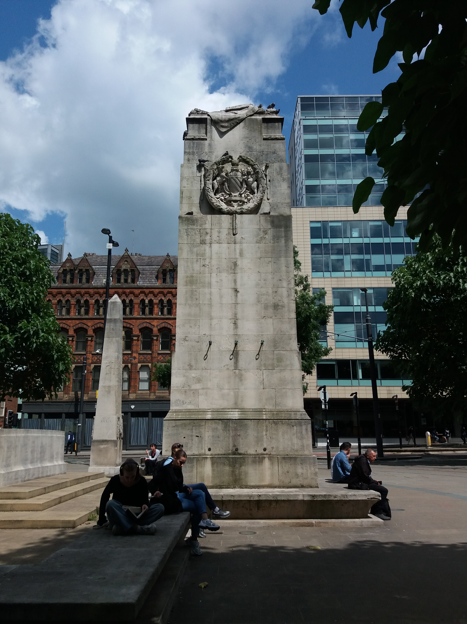
The Cenotaph
War memorials are a way to help us think about the impact of war and to remember those in the armed forces and all other people who have died because of wars. Wars can start when people disagree about the way countries are run, their beliefs 0r religion. Sometimes wars are fought about the way some people are treated in a country and the laws they have, especially if they are very unfair and cruel. They can also start because leaders of countries want to take over another country or a piece of land. Wars are often very violent, and people get killed and buildings are destroyed, but sometimes people feel they have no choice, but to fight for what they think is right.
The cenotaph was unveiled in 1924, six years after the end of the First World War. A cenotaph is a memorial to people who died away from their home ground, and many were built after the First World War because most soldiers were killed overseas and were buried in other countries.
The area around the cenotaph has memorials to other wars and conflicts, and a public memorial event is held around it every year, in November, on Remembrance Sunday.
The Cenotaph
Notes:
Manchester War Memorial
Image © Historic England
List Entry;
https://historicengland.org.uk/listing/the-list/list-entry/1293302?section=official-list-entry

Slide 8
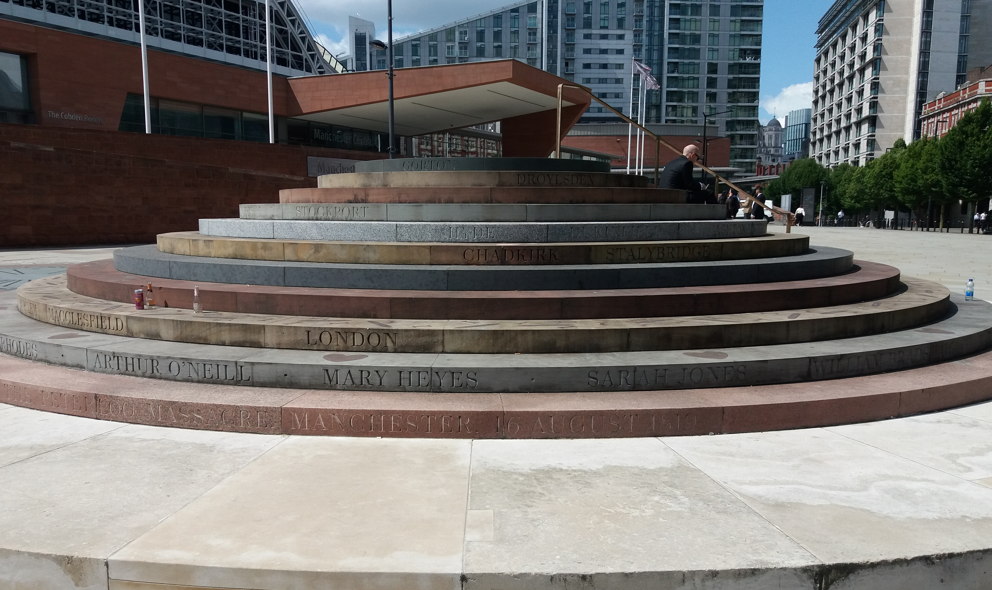
The Peterloo Memorial
Over 200 years ago Manchester did not have any Members of Parliament and only a few rich men in Britain had the right to vote. People didn’t think this was fair, and, on August 16th, 1819, about 60,000 men, women and children from around the region walked peacefully to St. Peter’s Field, in the centre of Manchester, to listen to speeches on the right to vote and choose the government. However, the meeting was interrupted by soldiers on horseback, who rode at the people swinging their swords. They had been sent by magistrates, in charge of Manchester, to stop the meeting. Fifteen people died that day, including one child. This terrible event became known as the Peterloo Massacre.
The meeting at St Peter’s Field was part of a long campaign for a fairer voting system. It wasn’t until 1832 that more MPs were provided for new industrial towns like Manchester and not until 1928 that all men and women were able to vote for their MP.
The Peterloo memorial was unveiled in 2019 to commemorate the 200-year anniversary of the massacre. The names of the people who were killed, the places the crowds travelled from, and symbols of peace and justice are engraved in the steps of the memorial.
Watch this animation of the events that took place on 16th August, 1819, at a peaceful gathering that became known as the Peterloo Massacre.
The Peterloo Memorial
Notes:
Peterloo Memorial © Historic England

Slide 9
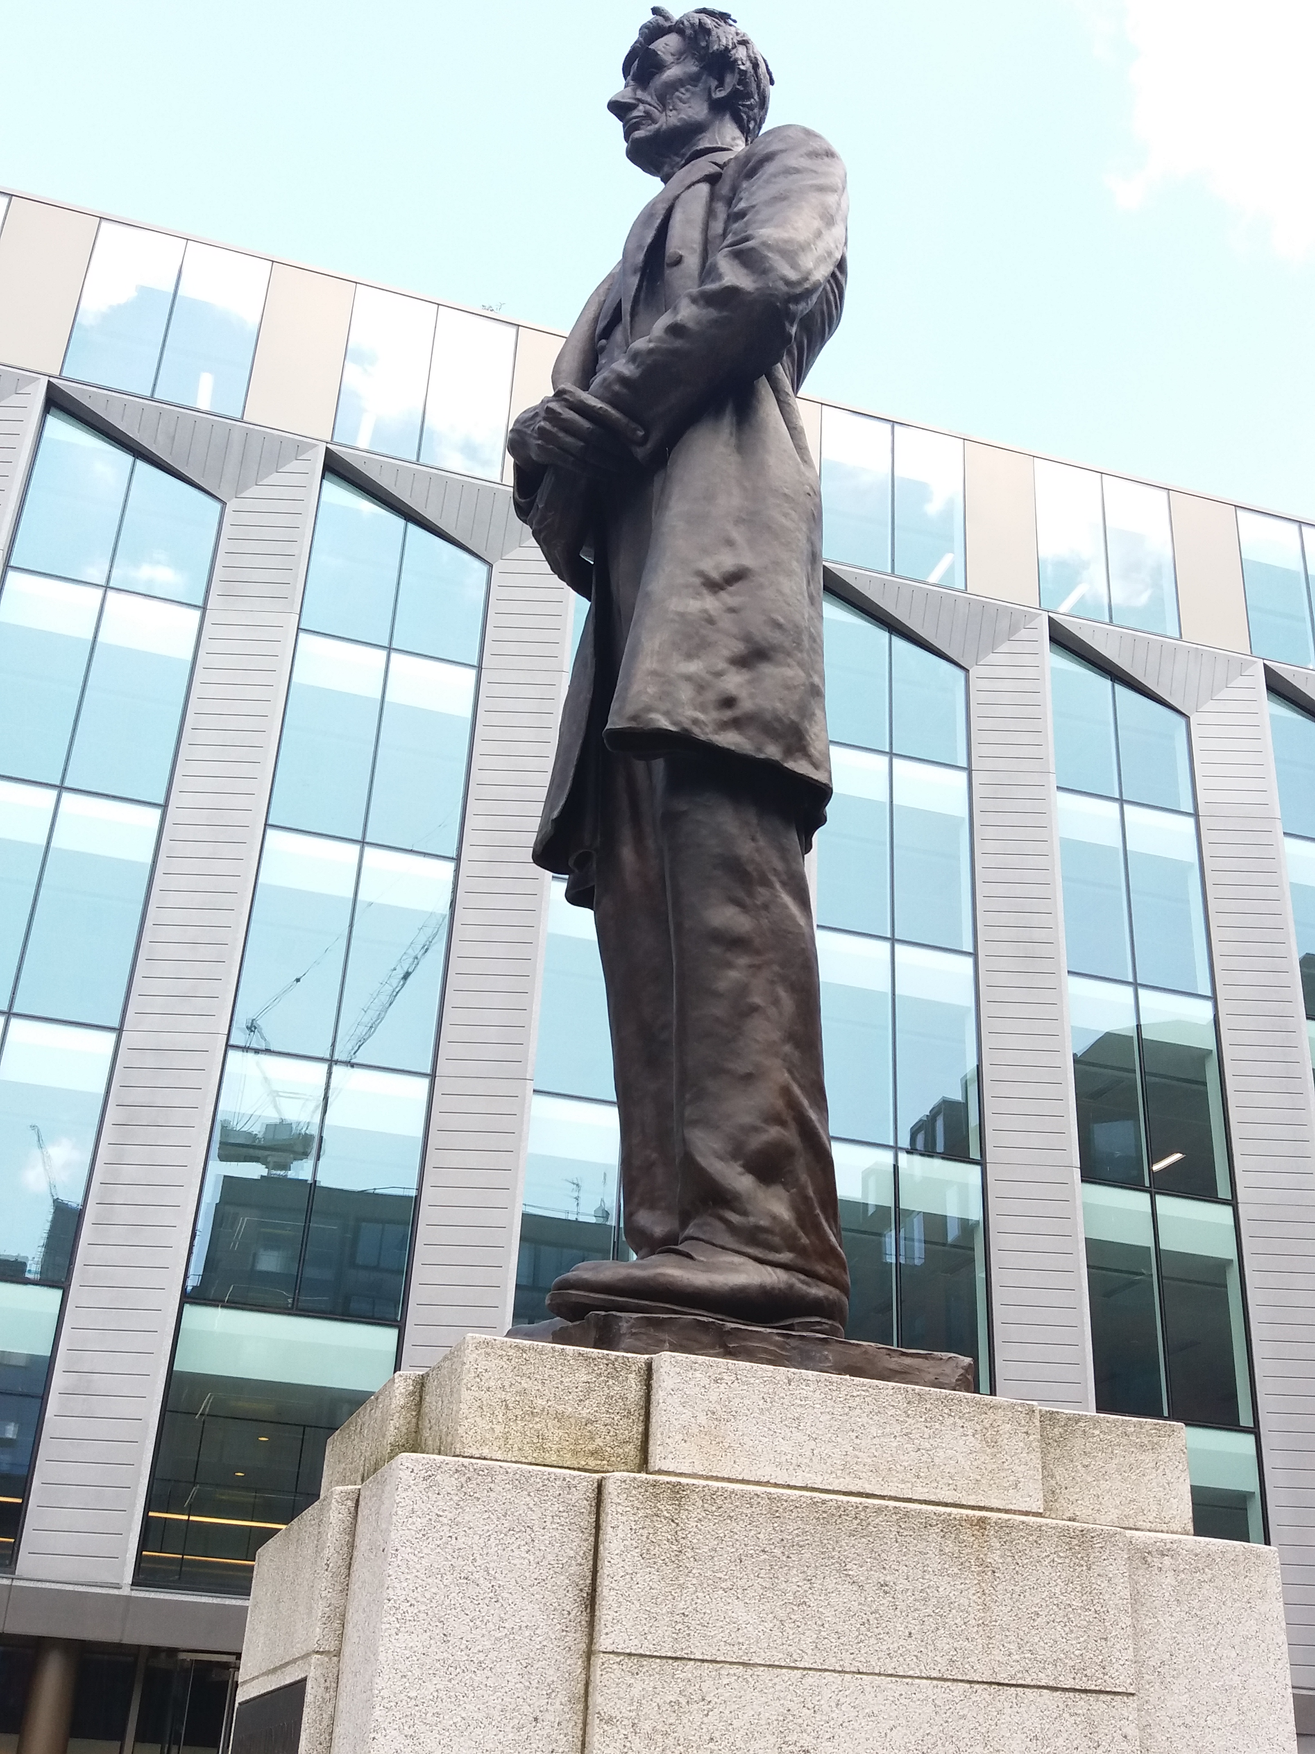
The Peace Garden - Abraham Lincoln Statue
The statue of the former American president, Abraham Lincoln, in the Peace Garden, commemorates the abolition of slavery in the United States, after the American Civil War of the 1860s. A Civil War is when people living the same country disagree about something and fight each other. Some people in America disagreed with the president, who wanted to abolish slavery.
President Lincoln was grateful for the support he got from the cotton mill workers of Manchester and Lancashire, who refused to take cotton that was grown and picked by enslaved people. This meant the workers had no work or wages, and it was a very difficult time for them. Abraham Lincoln sent a letter to the people to thank them for their support.
Statue of Abraham Lincoln
Notes:
Statue of Abraham Lincoln © Historic England
List Entry
https://historicengland.org.uk/listing/the-list/list-entry/1293302?section=official-list-entry

Slide 10
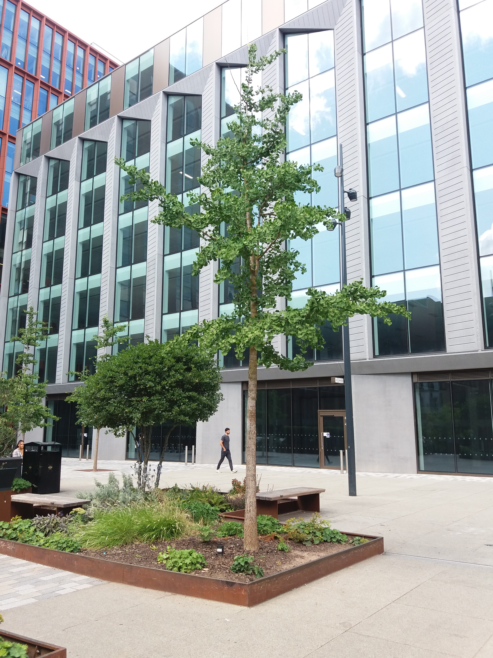
The Peace Garden – The Gingko tree
The Peace Garden includes other memorials, and Gingko trees are also planted there. These are trees that come from saplings of a tree in Hiroshima in Japan, that was damaged by the atomic bombing of the city at the end of the Second World War, in 1945.
The atomic bomb killed thousands of people, destroyed buildings and burnt land covering over 4 square miles. Miraculously, a Gingko tree regrew the following spring and it is now a symbol of peace.
A Gingko Tree
Notes:
Image of the Peace Garden © Historic England

Slide 11
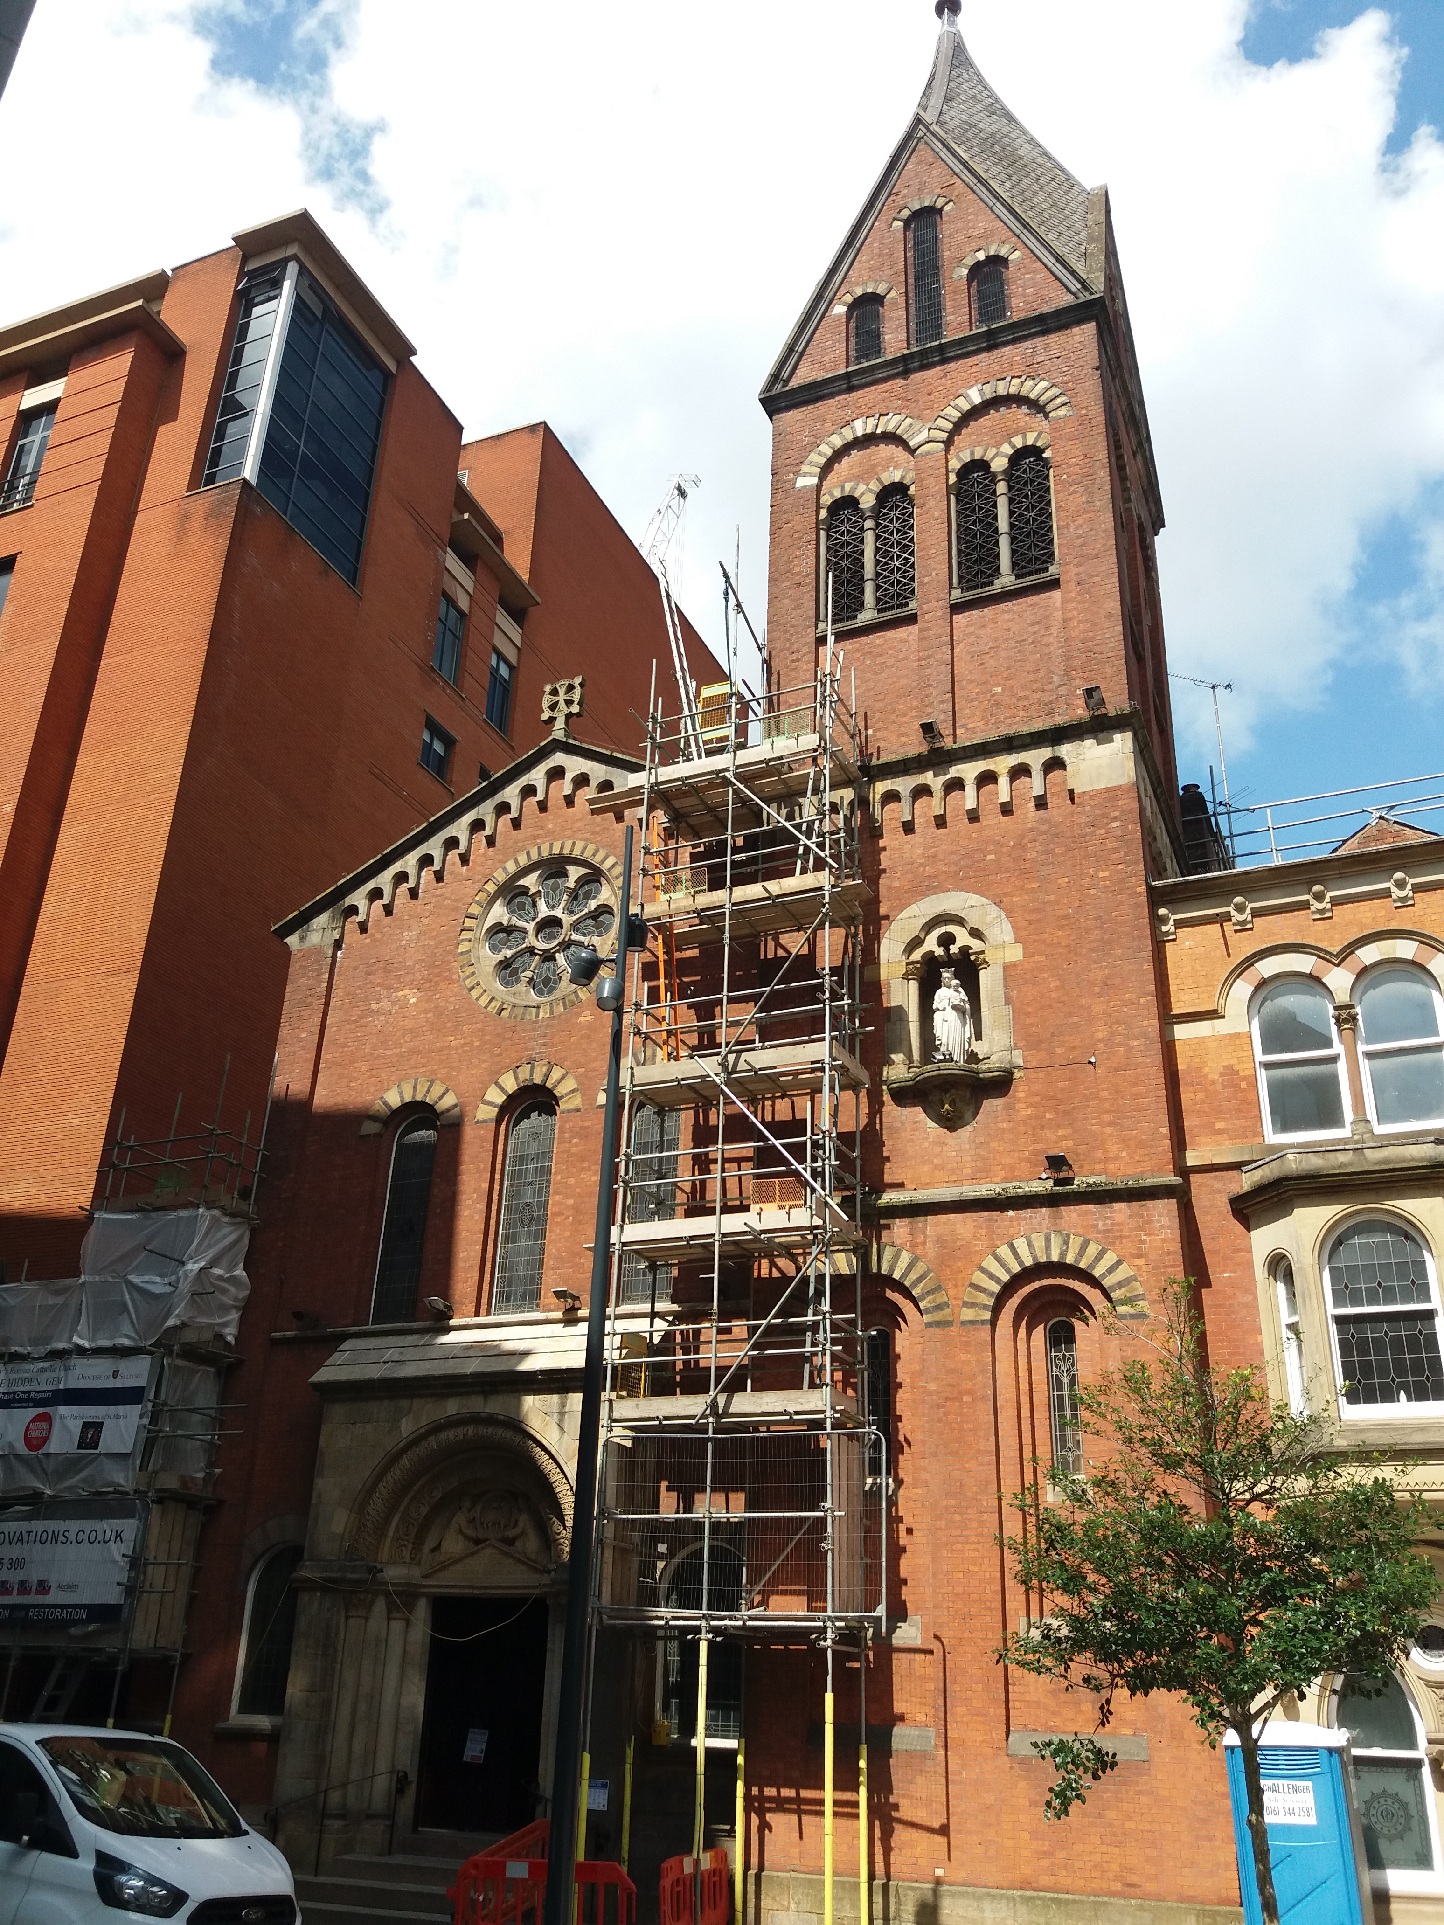
The Hidden Gem – St Mary’s Roman Catholic Church
Around 500 years ago King Henry VIII declared himself the head of the Church of England and banned people from worshipping in Roman Catholic Churches because he. He did this because he wanted to divorce his first wife and remarry, and the Catholic faith does not allow this. He ordered the destruction of many Catholic churches and monasteries, and people who were Catholics had to meet in secret to worship together.
In 1791, around 300 years later, the laws changed, and St Mary’s church was one of the first Catholic churches to be built in Manchester. It is known as the Hidden Gem because it is tucked away, and many people don’t know it is there. The church is a reminder of the need for acceptance of different faiths and beliefs.
Nowadays, there are many different faith buildings across Manchester, including Muslim mosques, Jewish synagogues, Sikh gurdwaras, Jain temples and Buddhist centres. People who want to worship are free to do so where and how they choose.
The Hidden Gem
Notes:
Image of St Mary’s Church – Creative Commons

Slide 12
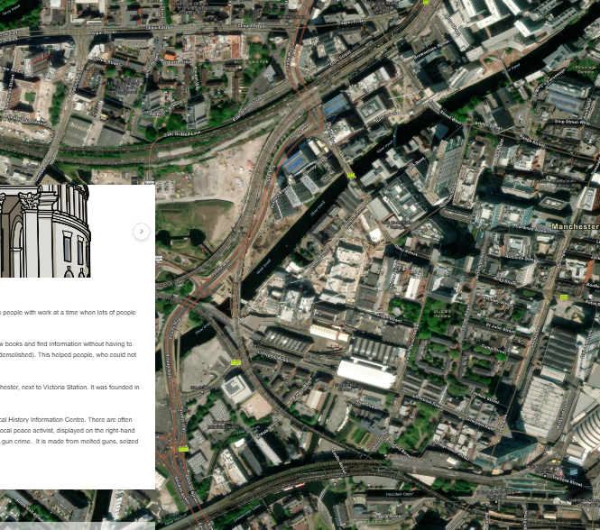
Activity suggestions before doing the Peace Trail
Explore the Story Map. You could do this as a whole-class activity, on the interactive whiteboard, or pupils could do this in pairs, using tablets.
The following activities could then be carried out in preparation for the Peace Trail.
Story Map screenshot
Notes:
Screen shot of Story Map on Historic England website © Historic England

Slide 13


Class or Group Discussion
How do each of the sites on the trail remind us about peace, equality and living in a fairer world?
Library – free access to books for all
Emmeline Pankhurst – equal rights for women and men
Peterloo Memorial – fair voting system,
freedom of speech
Peace Garden – equality, freedom and peace
Hidden Gem – acceptance of different faiths
and beliefs
Cenotaph – remembrance and understanding
after the destruction of war
Why do you think peace, equality and fairness are important in our world?

Slide 14





Hold a Class Vote
Vote for my idea!
Read again about the Peterloo Memorial
Hold a vote on a choice of classroom activities e.g. a class story, a class game to play etc.
Nominate children to run campaigns for the different stories, games or other ideas to vote for (make posters, deliver speeches etc).
Consider how it would feel if some children were not allowed to vote? e.g. everyone wearing blue or children whose first name begins with a vowel.
Children could cast their votes on ballot paper and post them in a ballot box.
A group of children could be appointed to count the votes and announce the results.
I need to listen to all the ideas first
My vote is my business
Why is important to have a secret ballot?
Notes:
Holding a class vote will help the children understand more about the voting process and why it is important that everybody has the right to vote. It will help them appreciate the injustice of the voting system in Britain in the past and why people protested and campaigned for equal rights to vote.

Slide 15


Activity suggestions after doing the Peace Trail
Find out more about the sites on the trail
Visit Central Library and explore the exhibitions, displays and the children’s library with your family
Visit the Pankhurst Centre at the weekend
Watch the animation about the Peterloo Massacre
Look at a map of the local area and see how many different faith buildings you can find
Find your nearest war memorial using the War Memorials Trust location search
Investigate
Research

Slide 16
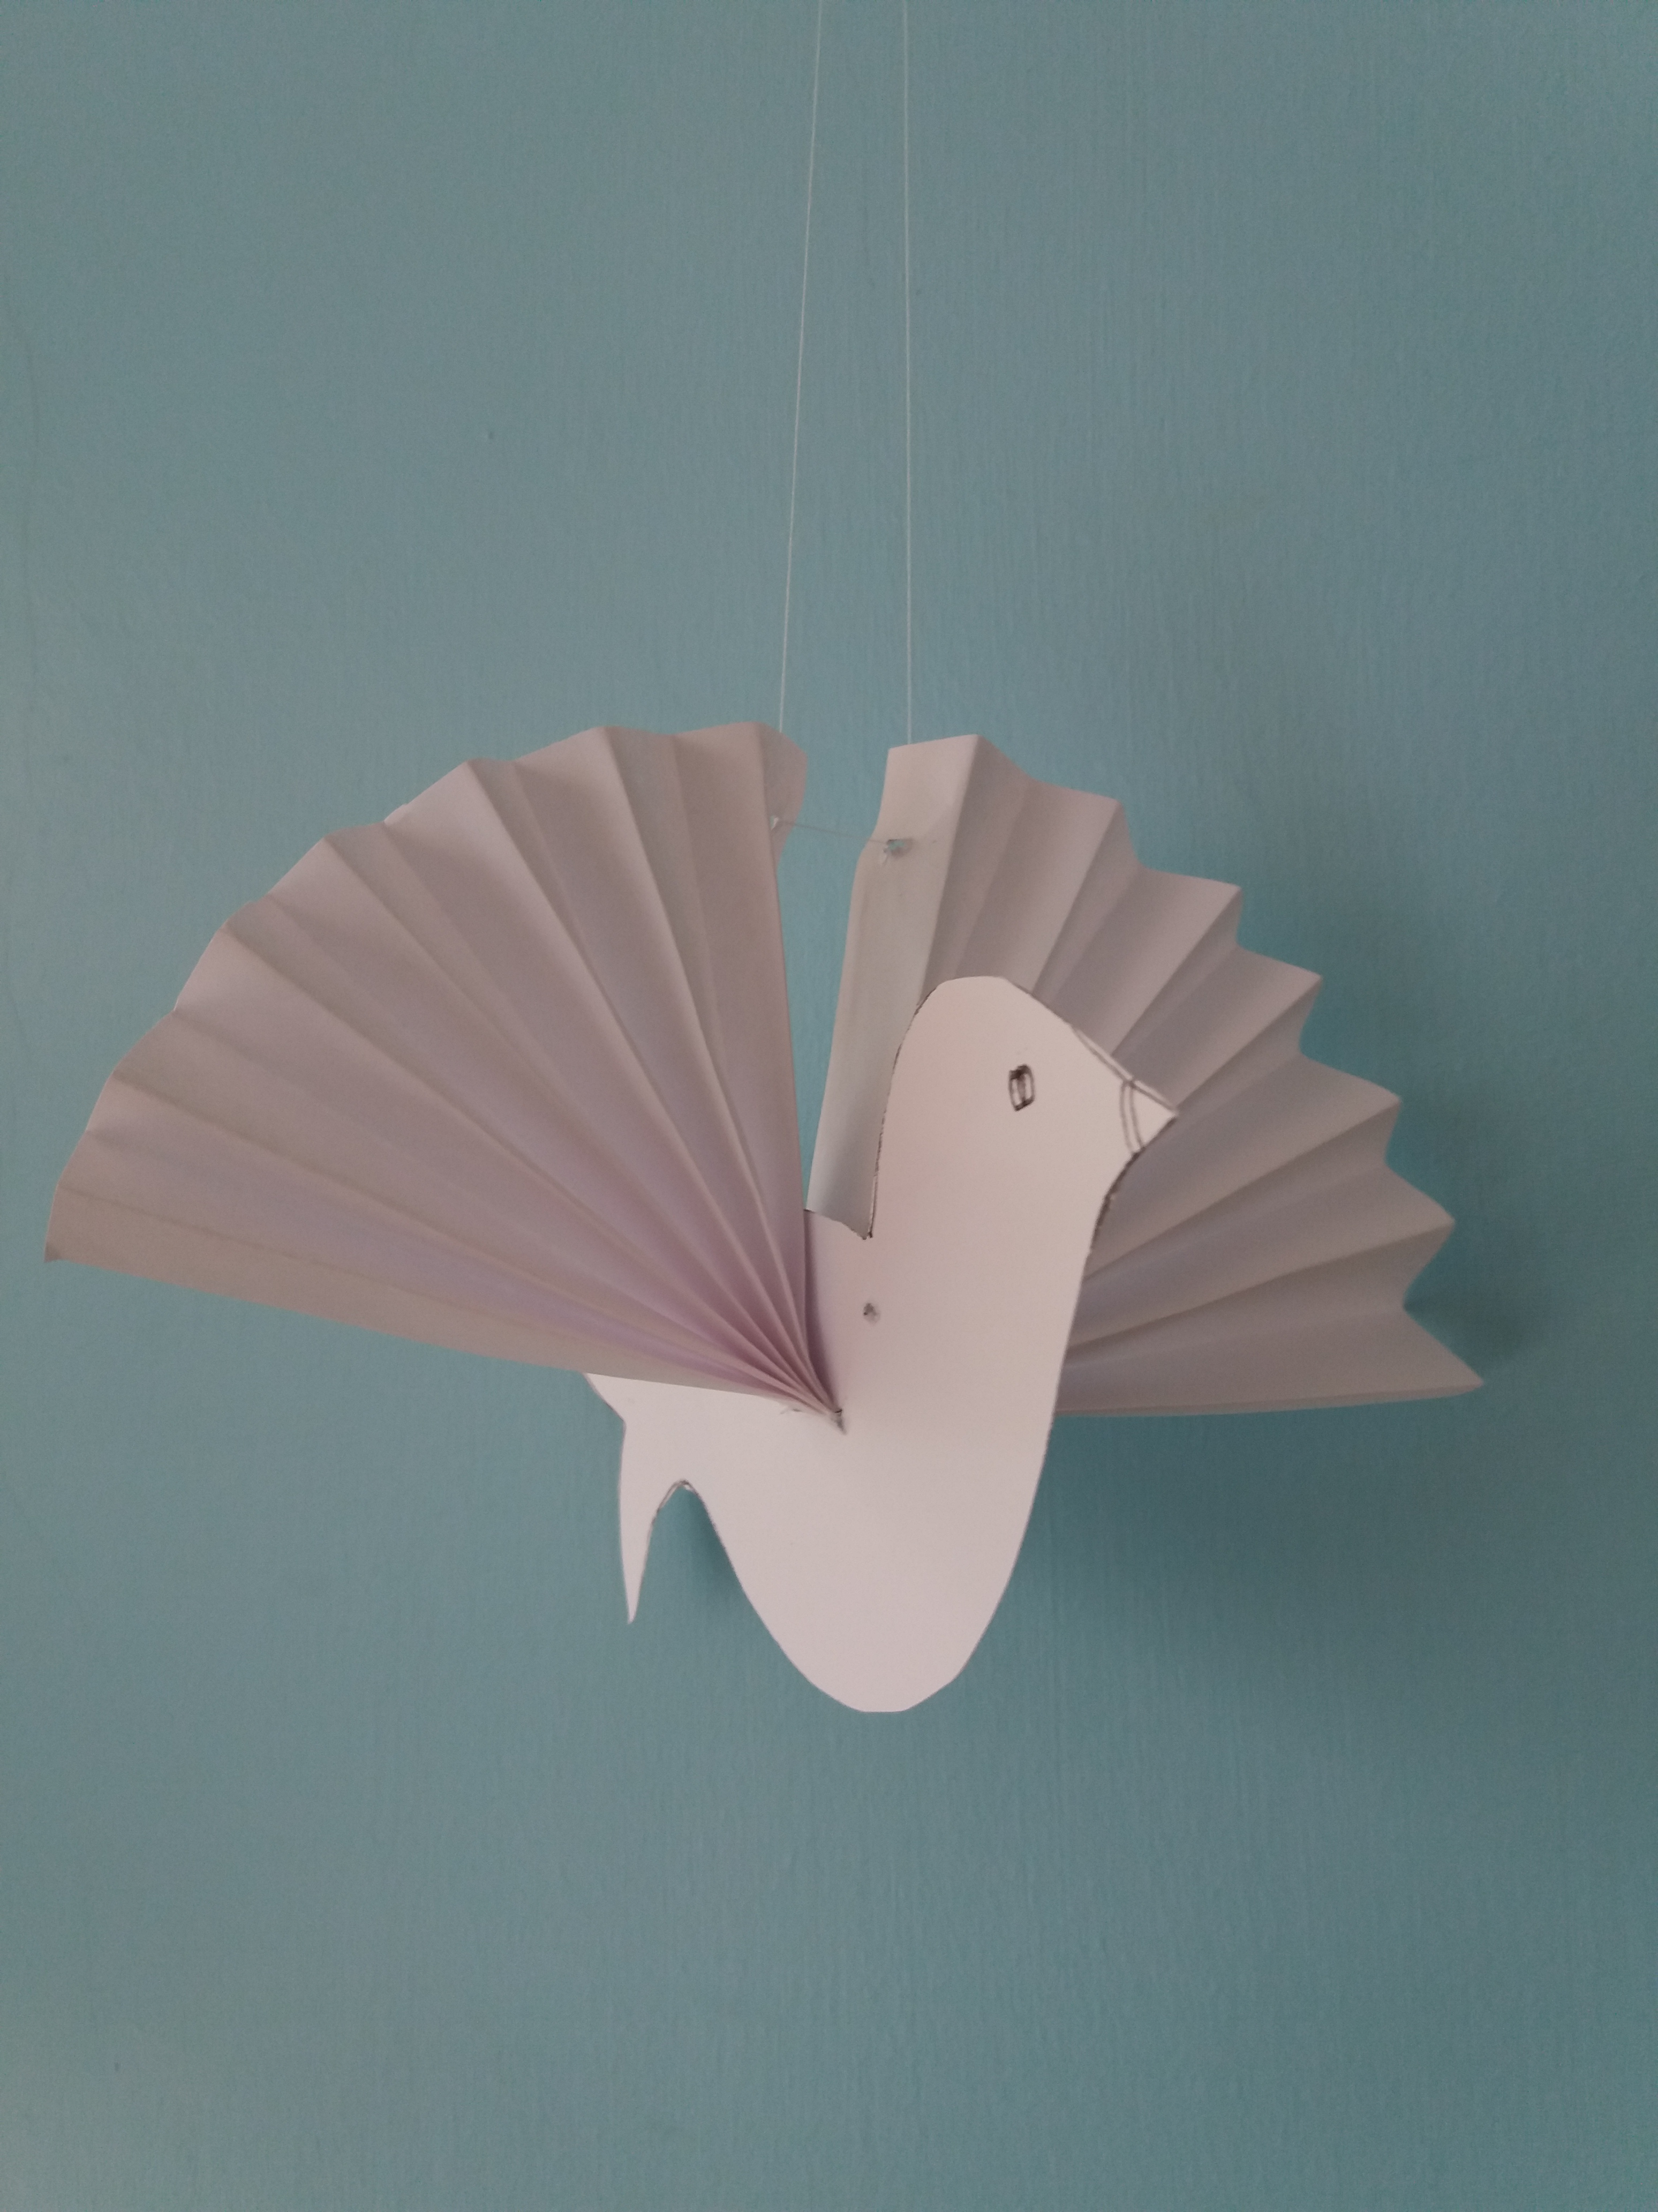
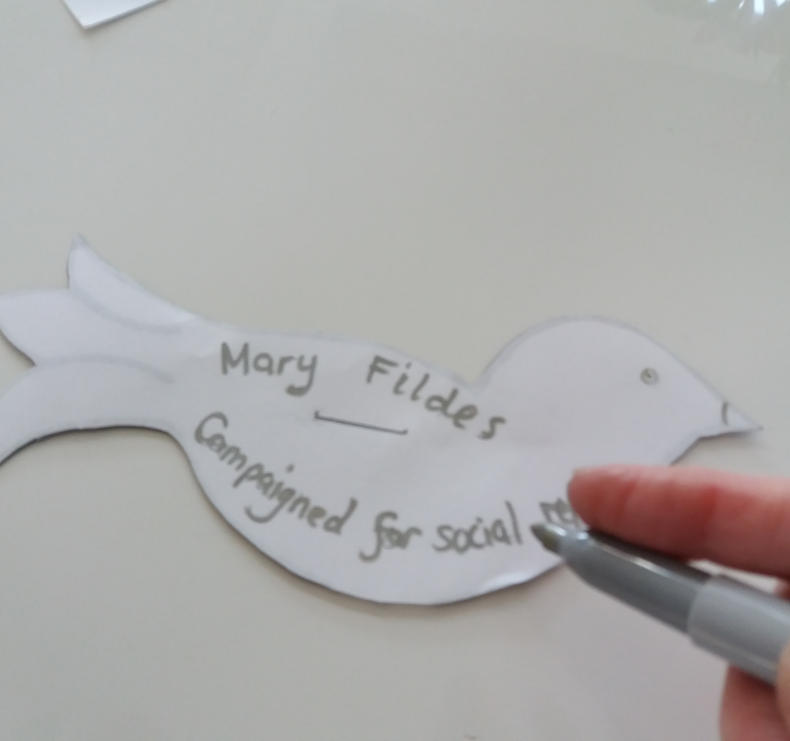
Make a Peace Dove Display
Make Peace Doves and write messages of peace on the sides of the doves. Suggestions include:
Using the Peace Trail for inspiration
Using names of people who have campaigned for peace and equality
Using the names of soldiers who died fighting for peace and a fairer world
Download the instructions on How to Make Peace Dove
Download the Peace Dove Template
Create a classroom display
Write your message of peace
Notes:
See the How to Make a Peace Dove Activity Sheet for more instructions.
Doves became a symbol of piece in the story of Noah’s Ark. After the flood, Noah sent a dove out from the ark and it returned with an olive branch in its mouth, showing that it had found dry land.

Slide 17
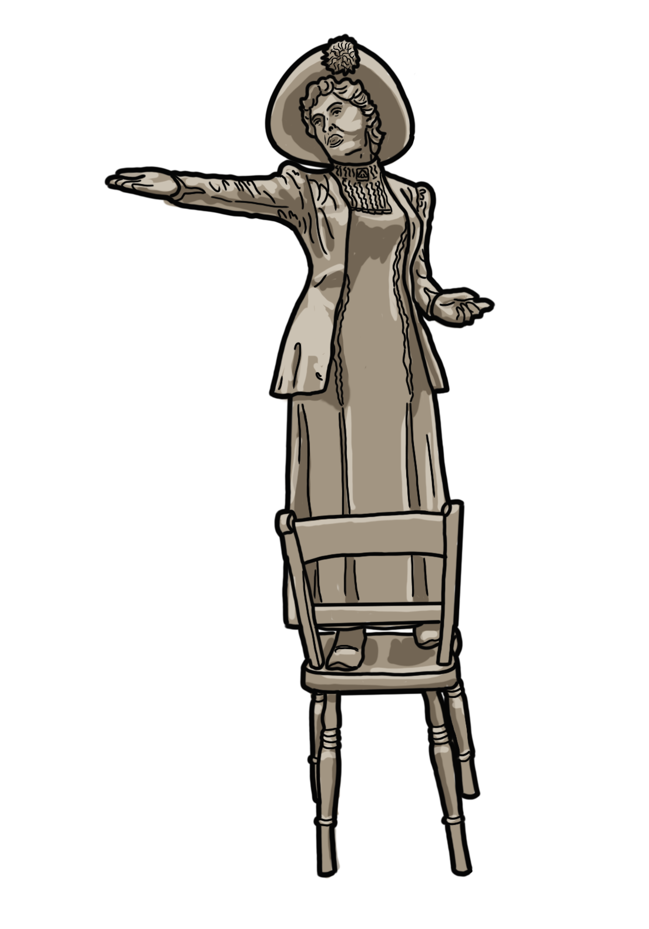

Write a speech for Emmeline Pankhurst
Write
Votes for women!
Notes:
Drawing of Emmeline Pankhurst by Bearsgetcrafty

Slide 18
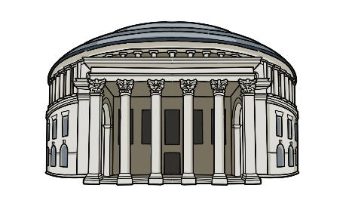
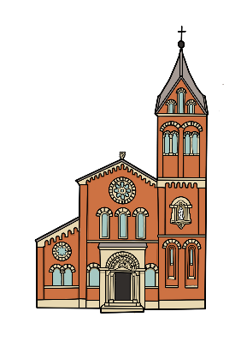
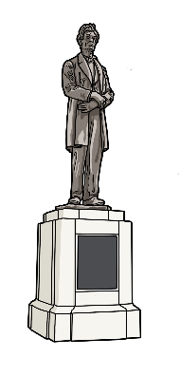
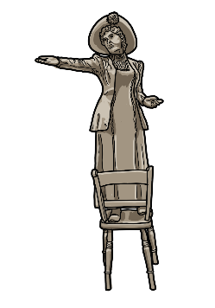
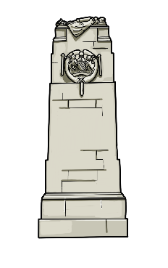
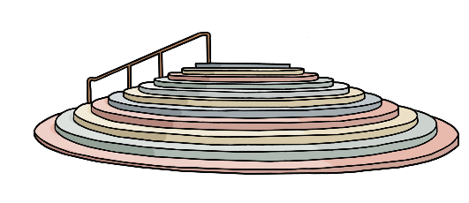
Arrange the images from the Peace Trail in a timeline
Cenotaph built 1924
Peterloo Massacre 1819
Hidden Gem built 1791
Central Library opened 1934
Slavery abolished in USA 1865
Some women get the vote 1918
Notes:
All drawing by Bearsgetcrafty

Slide 19
Image Bank
The drawings below can all be copied and pasted and used in worksheets and activities.
They can be enlarged to A4 size for classroom display

Slide 20
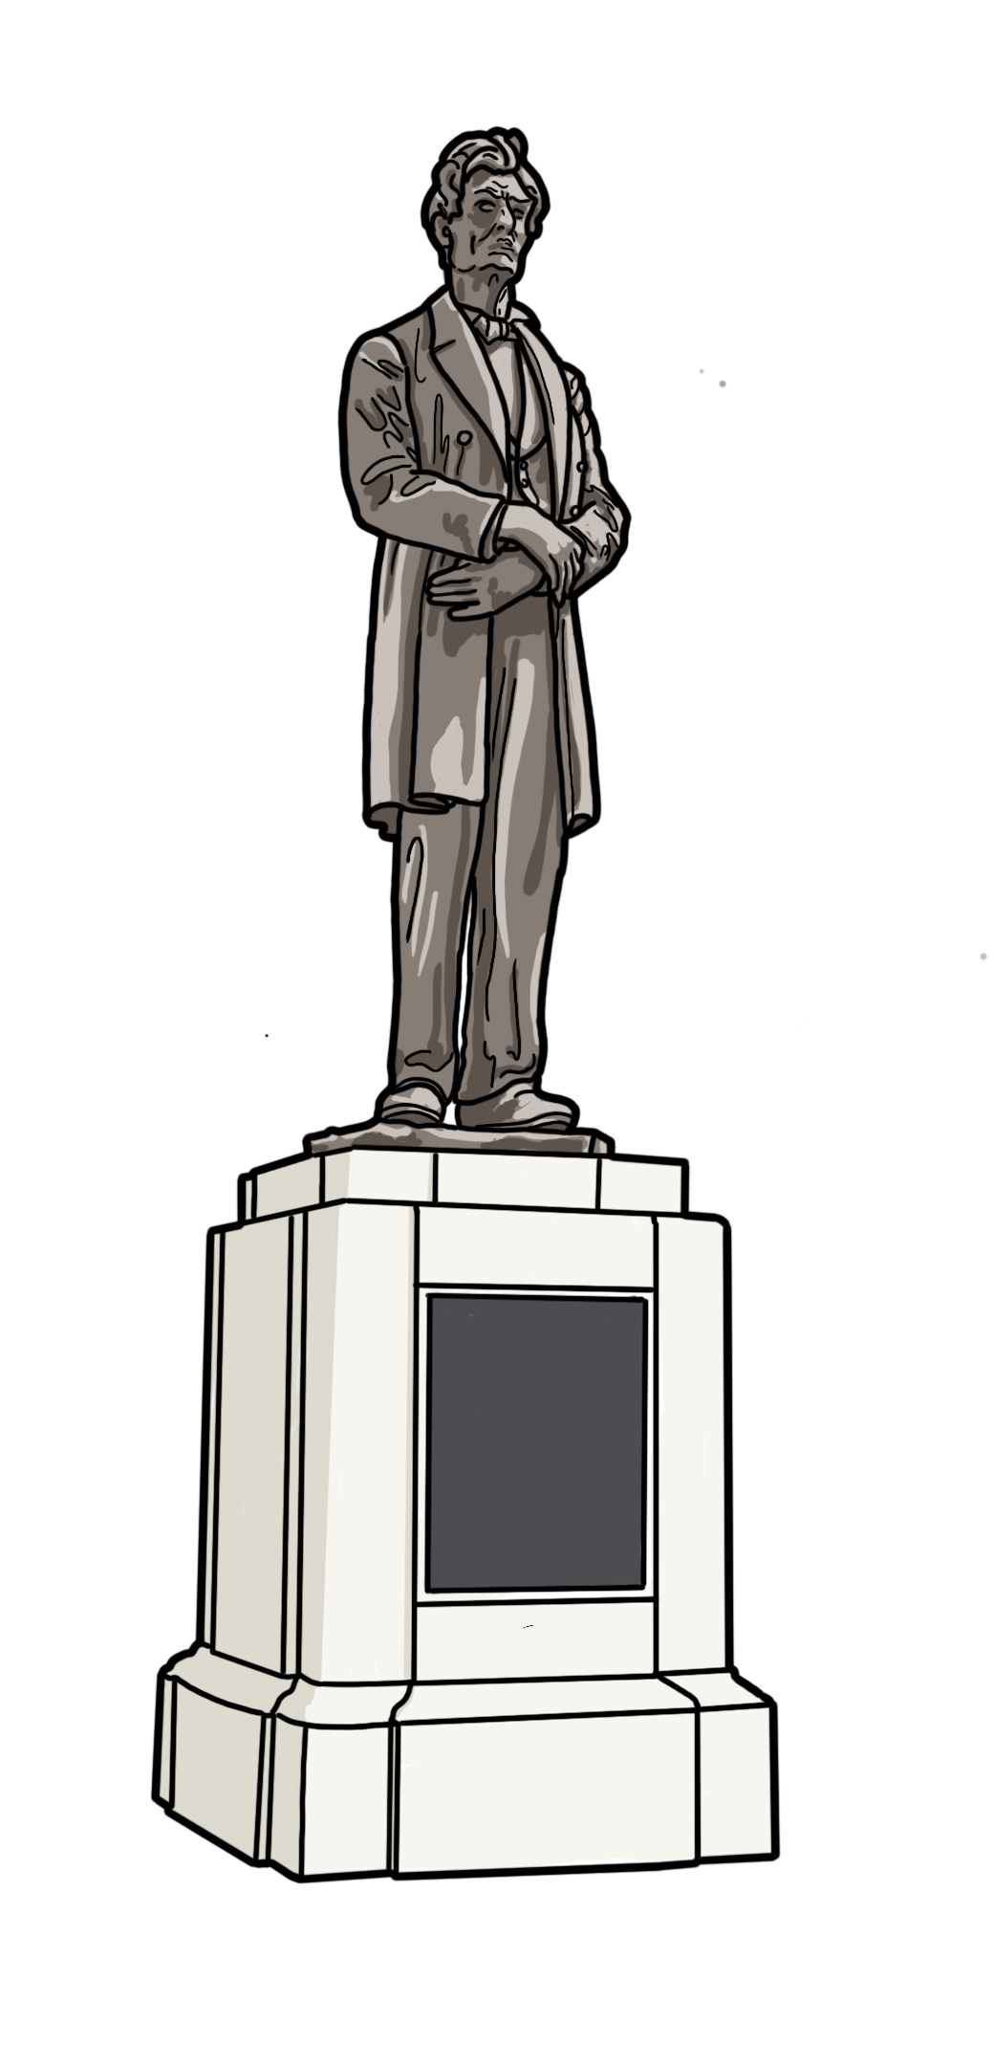
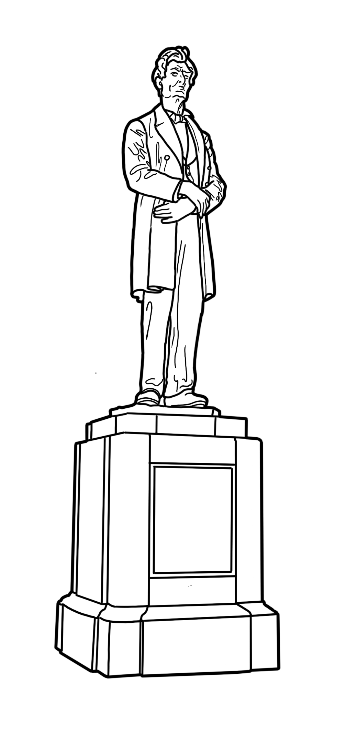
Abraham Lincoln Statue
Notes:
Drawings by Bearsgetcrafty

Slide 21
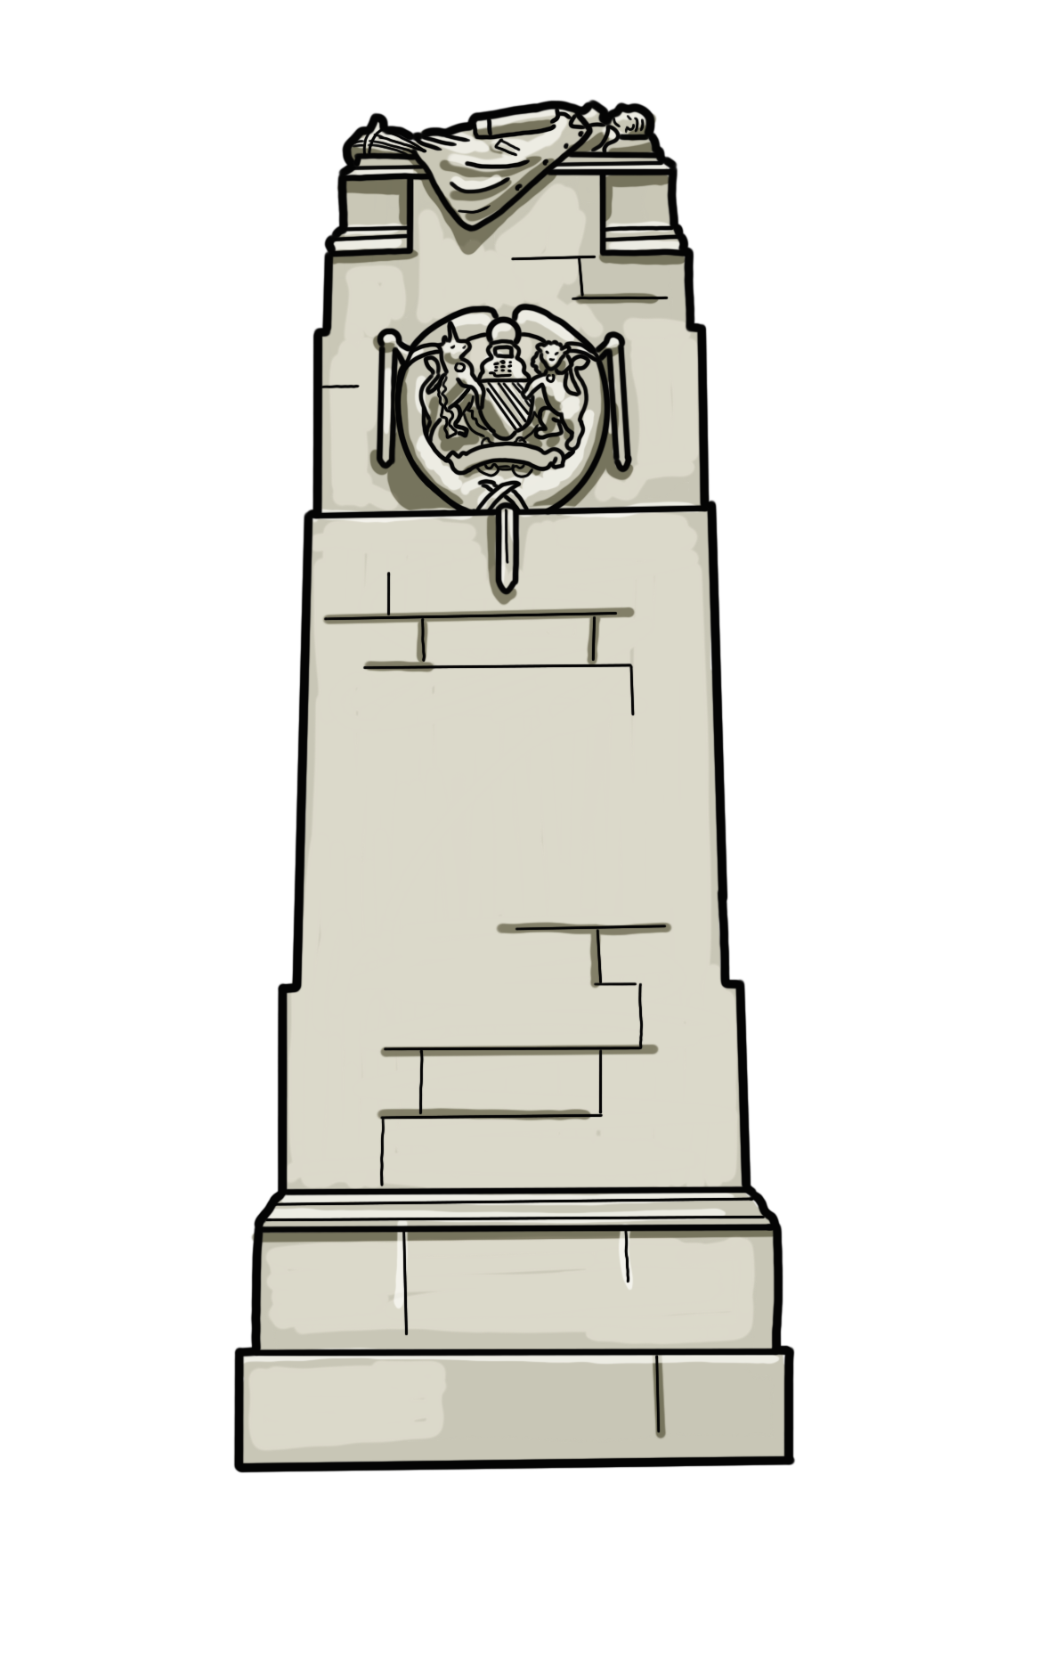
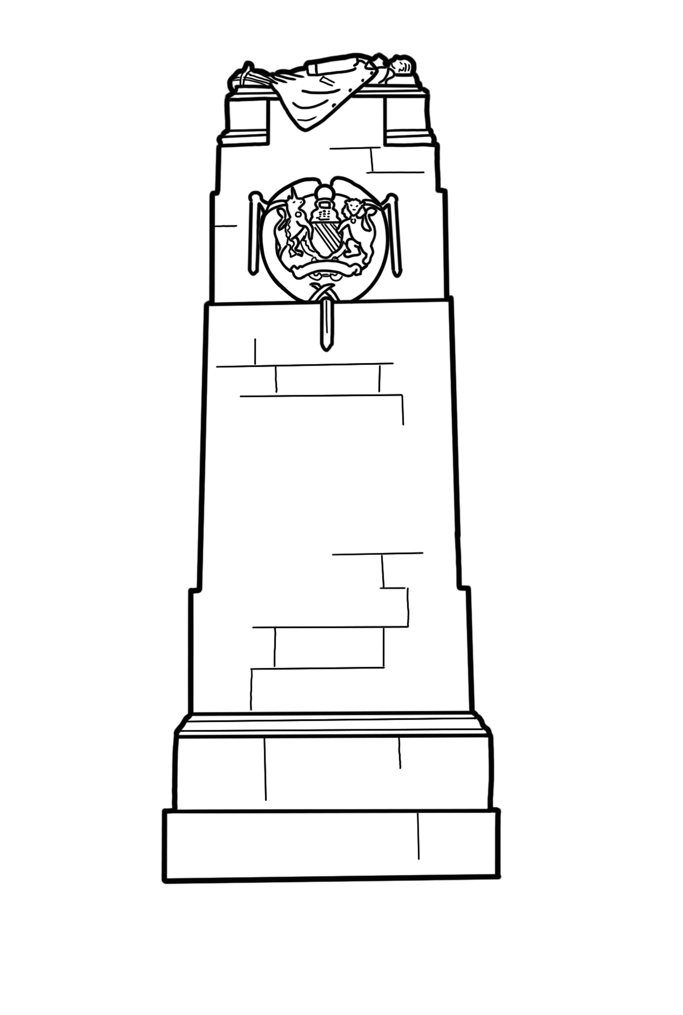
Cenotaph
Notes:
Drawings by Bearsgetcrafty

Slide 22
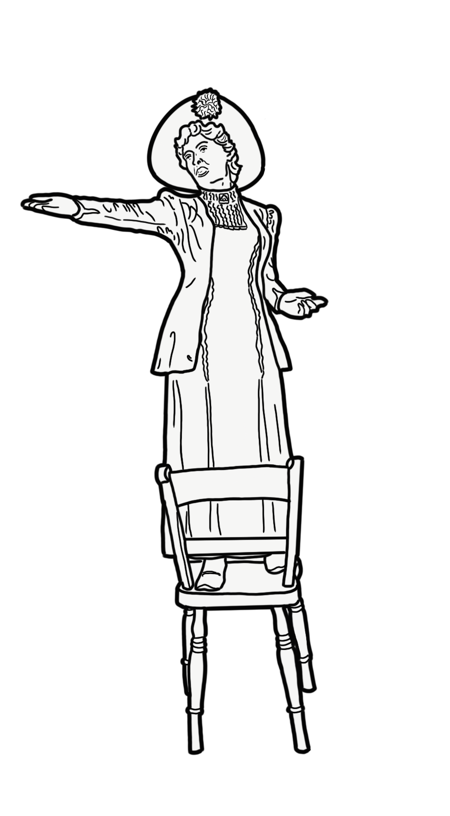
Emmeline Pankhurst statue
Notes:
Drawings by Bearsgetcrafty

Slide 23
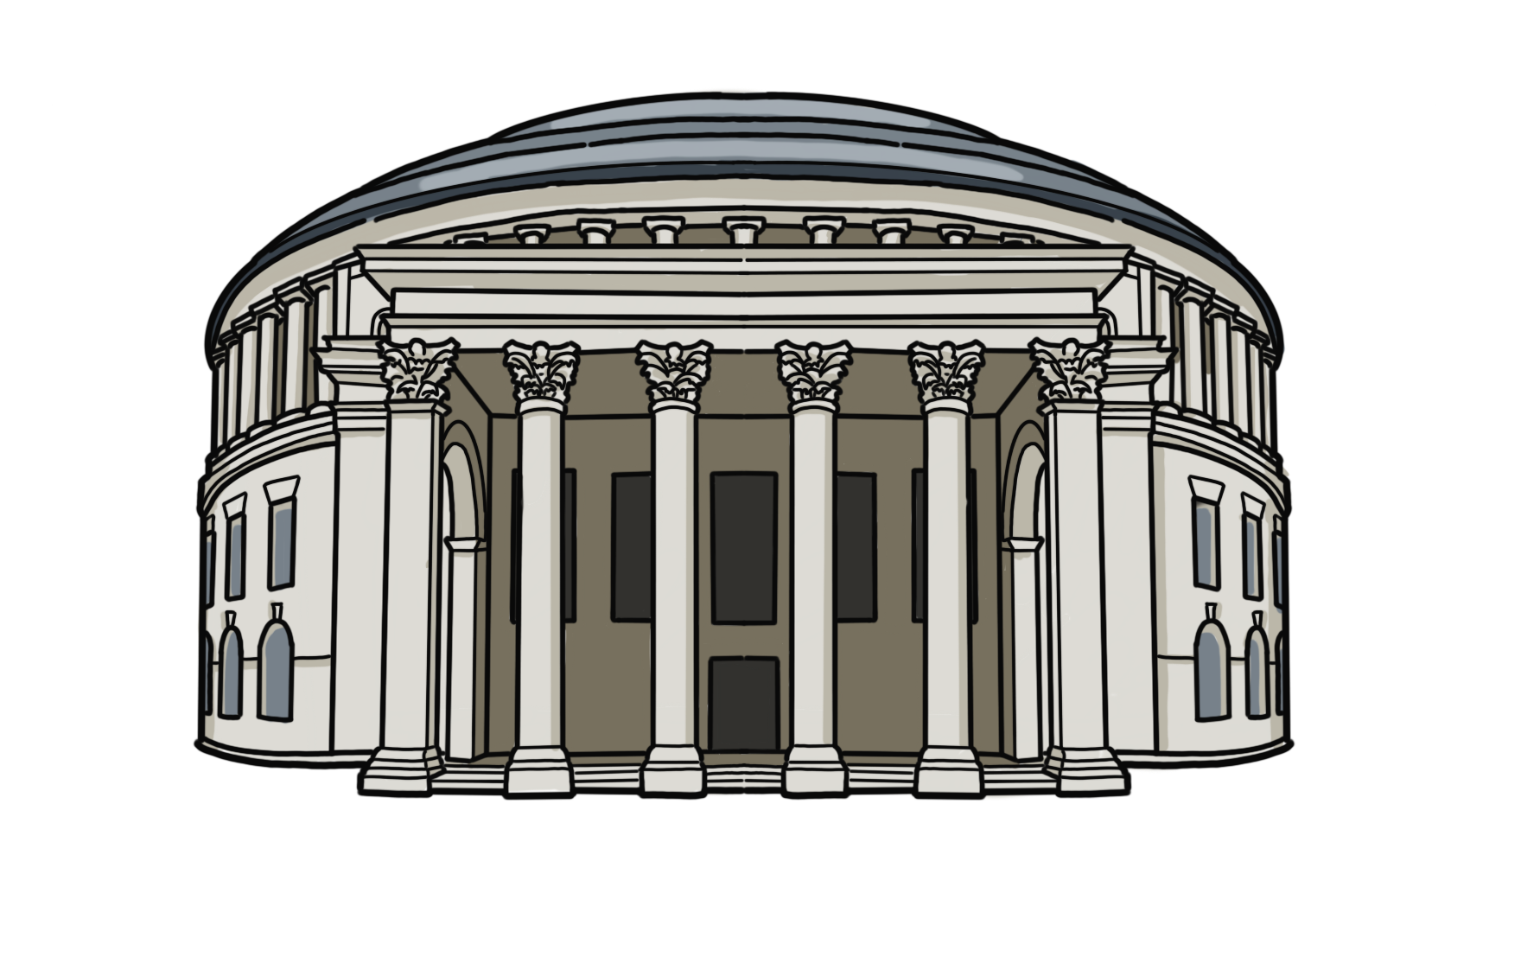
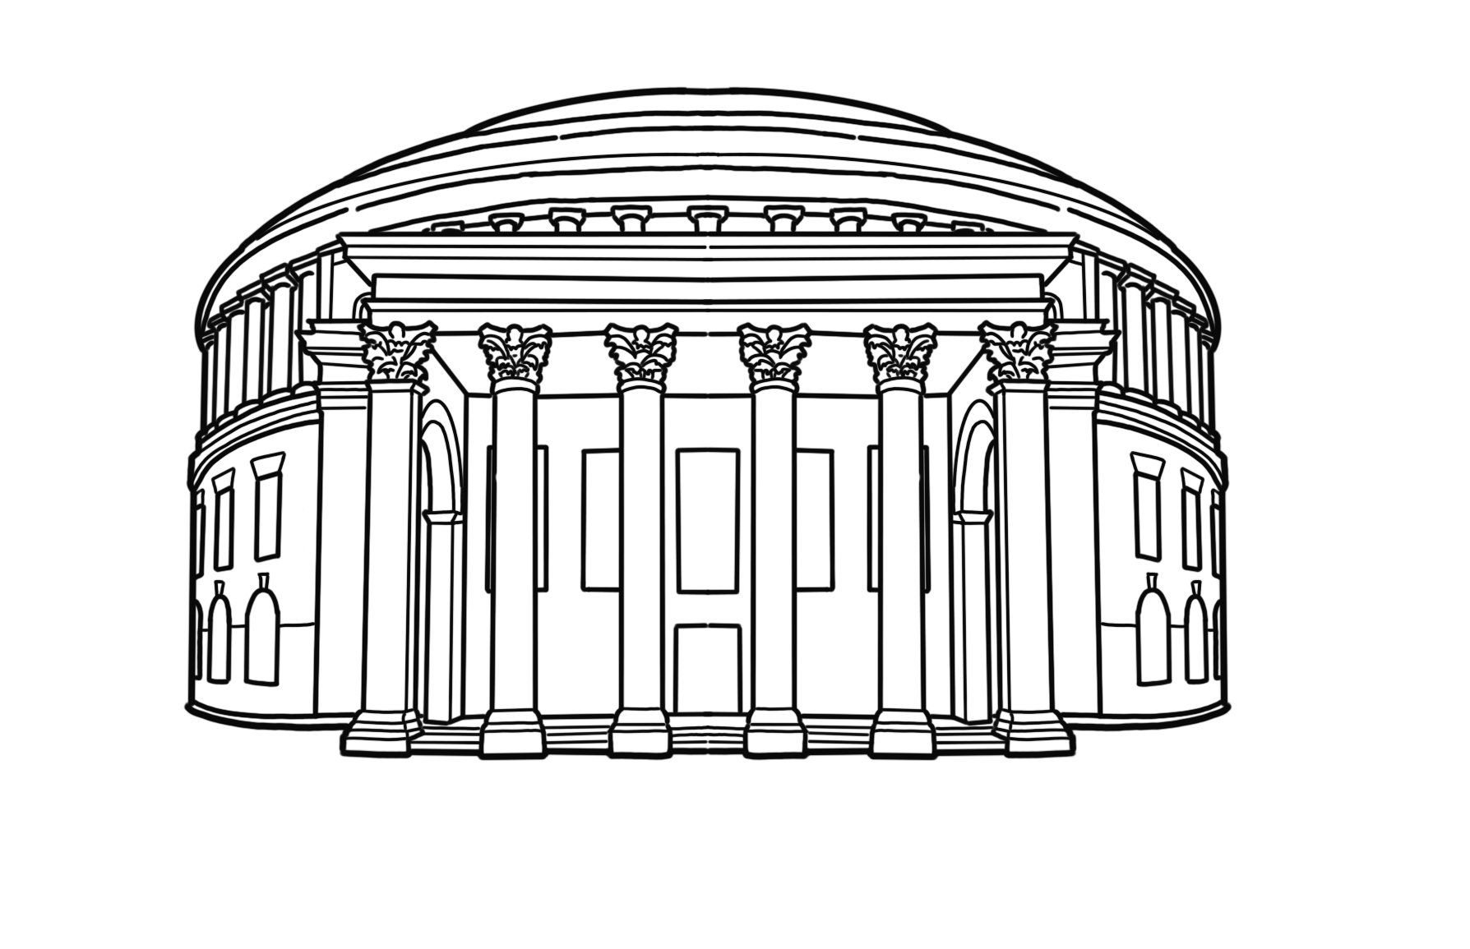
Central Library
Notes:
Drawings by Bearsgetcrafty

Slide 24
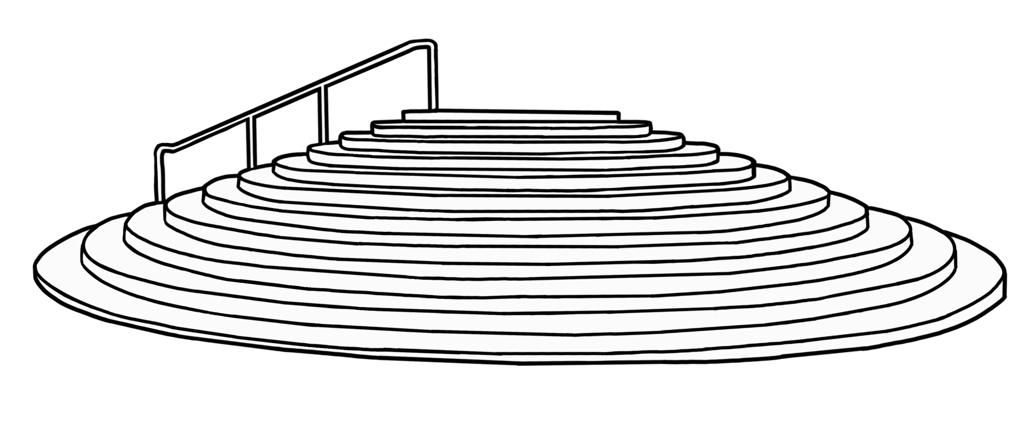
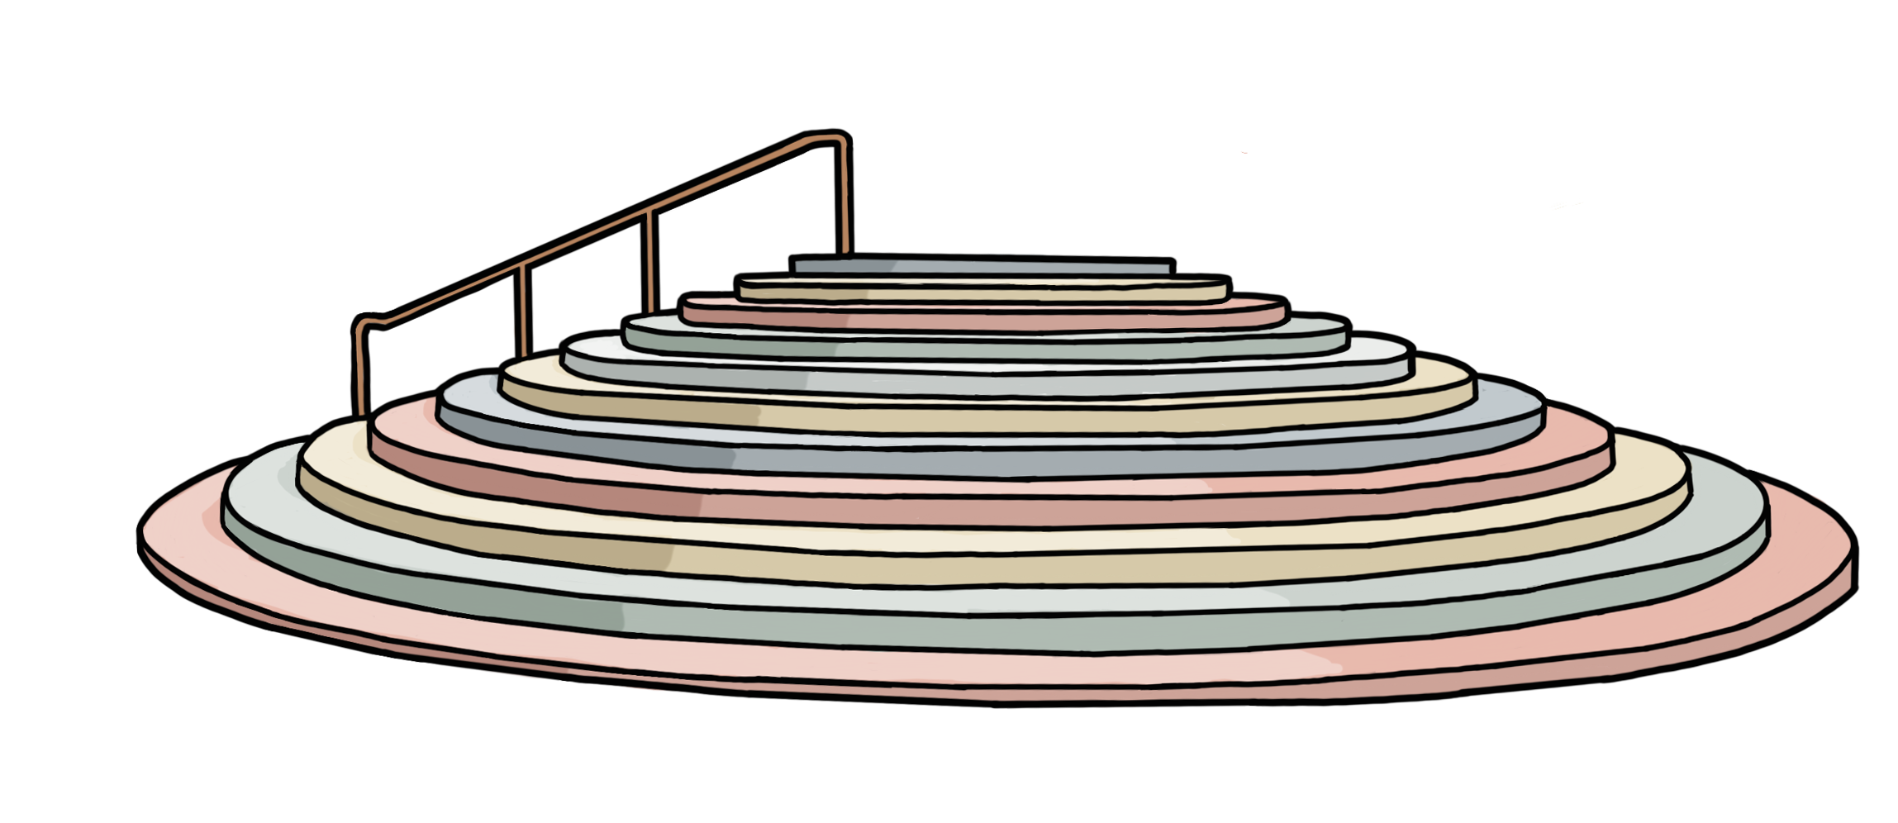
Peterloo Memorial

Slide 25
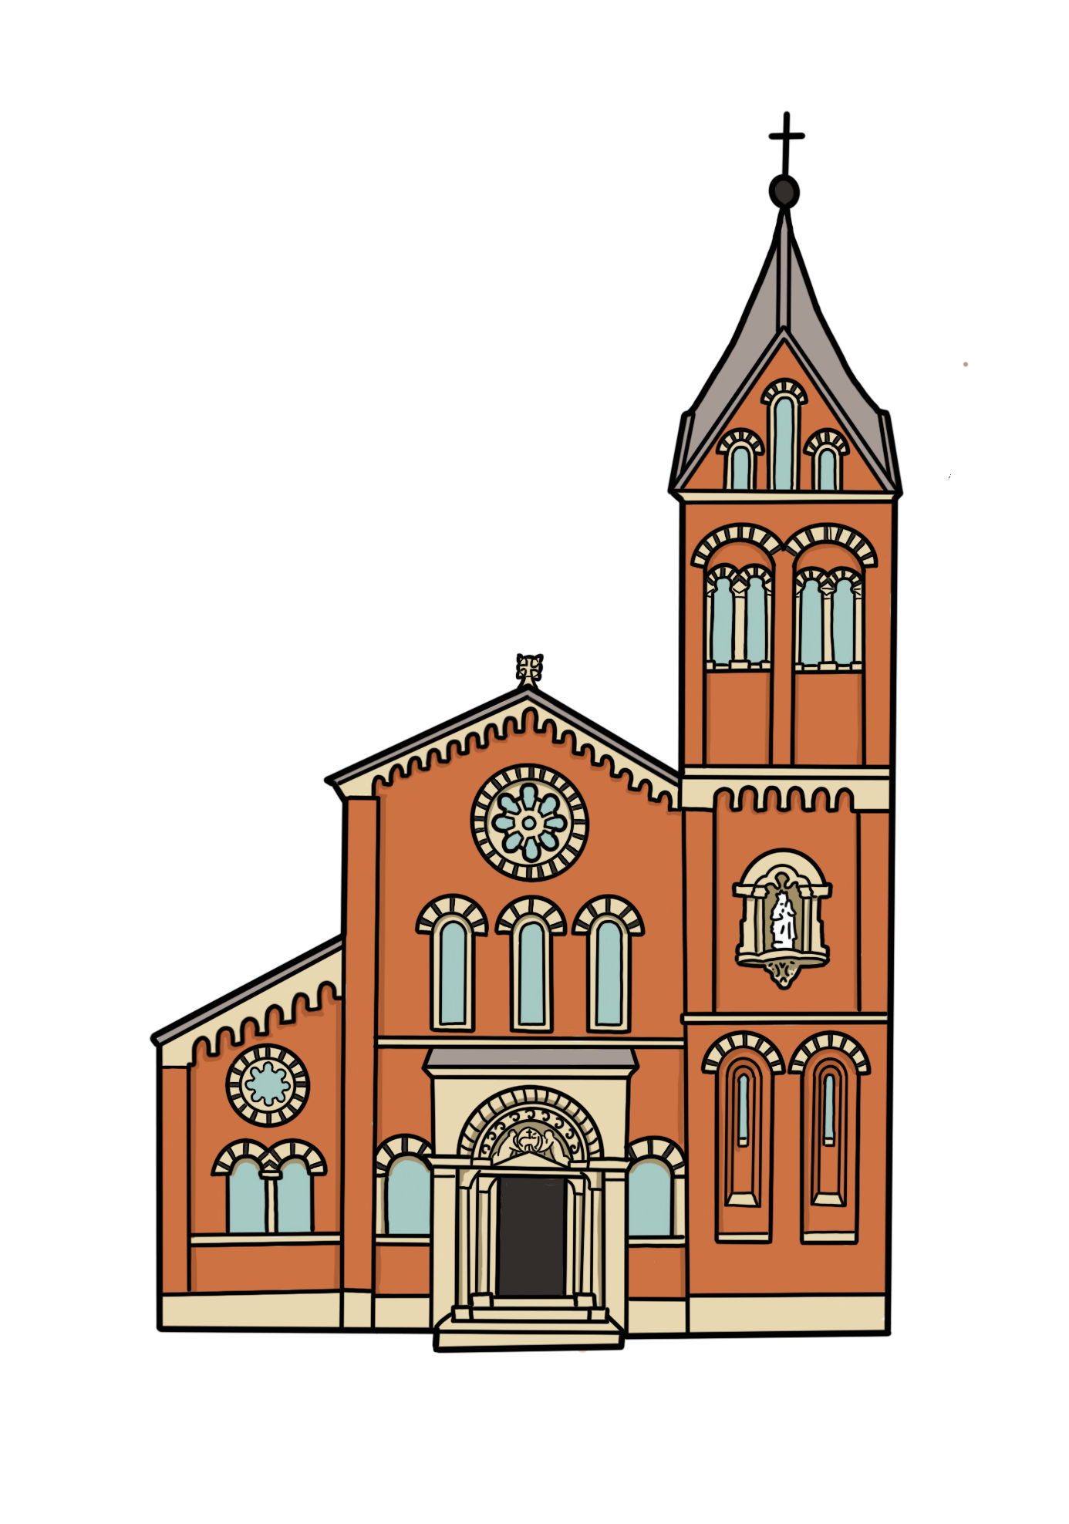
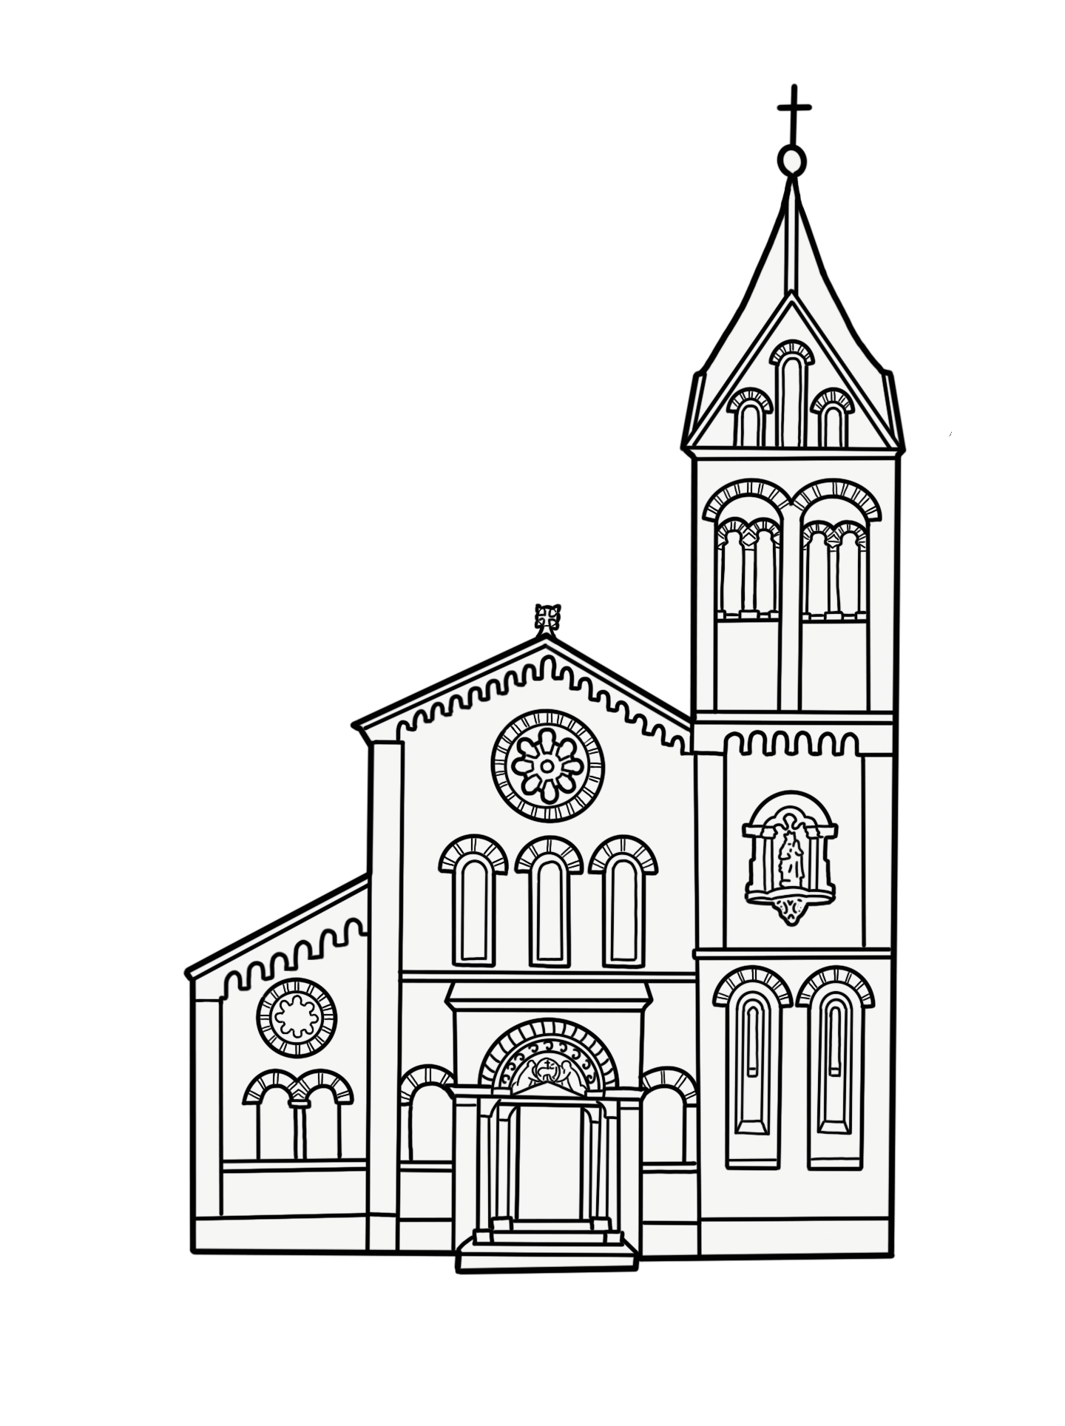
The Hidden Gem – St Mary’s RC Church
Notes:
Drawings by Bearsgetcrafty

